Slide 1

WELCOME
welcome

Slide 2
TEACHERS IDENTITY
Mst. Kohinoor Akter Banu.
Assistant Head Master
Alampur Secondary Girls School
Kushtia Sadar, Kushtia
Mobile no- 01716494605

Slide 3
Class: 9/10
Subject: English 2nd Paper
Lesson: Tag Question
Time: 50 minutes

Slide 4

Let’s see some Examples
A tag question
Isn’t she?
She is a student,
What is this?

Slide 5
Our Today’s lesson is
Tag questions
Notes:
Lesson declaration.

Slide 6
After the end of the lesson, students will be able to-
Learning outcome
1
Define Tag Question
1
Identify Tag Operator
Define tag questions
2
Define tag questions
3
Apply Tag

Slide 7
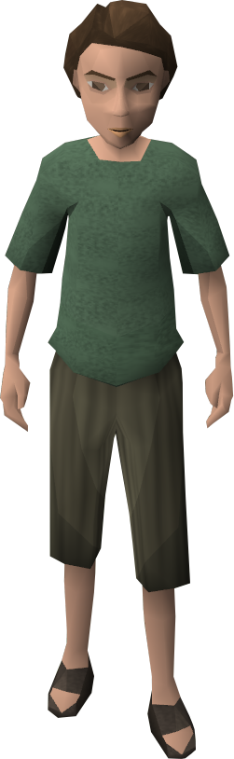
You are Jisan, aren’t you?
Tag
Adding something with other
A tag question is a question that is used at the end of a statement to get the support from the listener.
Notes:
Definition of tag question.

Slide 8

A computer operator.
Am, is, are ,was, were, shall, should, will , would, can, could, may, might, have, has, had, must, ought, dare, need.
Tag question operators
Do, does & did (Used in action verbs)
Notes:
This slide is to teach the operators of tag questions to the students.

Slide 9
Tag question basic/contraction form of the operators.
Am not = aren’t/ain’t
Is not = isn’t
Are not = aren’t
Was not = wasn’t
Were not = weren’t
Will not = won’t
Shall not = shan’t
Can not = can’t
Could not = couldn’t
May not = mayn’t
Might not = mightn’t
Must not = mustn’t
Has not = hasn’t
Have not = haven’t
Had not = hadn’t
Do not = don’t
Does not = doesn’t
Did not = didn’t
Ought not = oughtn’t
Dare not = daren’t
Need not = needn’t
Notes:
Tag or contraction forms of the operators.

Slide 10
Mahbuba was our good friend,
wasn’t she?
Notes:
First teacher may show the picture and sentence to ask tag to the students then he can show the answer to check.

Slide 11
How to form a tag question
01.
  Structure in positive statement
  Hv.+neg+sub.?
example
  Hasan is a truthful boy, isn’t he?
  Shima has nine dolls, hasn’t she?
02.
  Structure in negative statement
  Hv.+sub.?
02.
  She is not my sister, is she?
  They are not playing, are they?

Slide 12
Add tag to the following
1. Rubina was a brilliant student, __________?
wasn’t she
2. You were not a player,__________?
were you
3. They are our guests,_____________?
aren’t they
4. We cannot do this now,_________?
can we
5. He may come tomorrow,__________?
mayn’t he
6. We should not disobey our parents,___________?
should we
7. You could do it easily,_____________?
couldn’t you
8. They must not play bad,__________?
must they
9. I have a pen, _______?
don’t I
10. You had better go,_____________?
hadn’t you
Notes:
Teacher may ask orally or written to get answers from the learners as class activities.

Slide 13
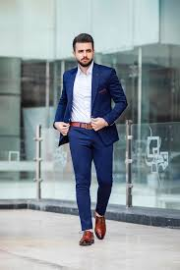
Talib is a smart boy,
isn’t he?
Notes:
Teacher may show the picture and sentence to ask tag to the students then he can show the answer to check.

Slide 14
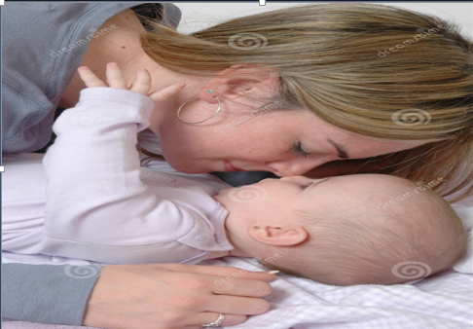
Every mother loves her child,
don’t they?
Notes:
Exceptional use f tag begins from here.

Slide 15

Nobody believes a liar,
do they?
Notes:
Exceptional use of tag question.

Slide 16
Exceptions
If you find ‘s/es after everybody, everyone, nobody, no one, somebody, some one, one, none, the above rules will not be effective. In that place you have to add ‘don’t they/do they’
Everyone respects him,
don’t they?
Nobody likes a man of bad temper,
do they?
Notes:
The rules of exceptional use of tag question are shown here. Teacher may explain it if necessary.

Slide 17
never, rarely, seldom, hardly, barely and scarcely are--
treated as negative though they appear to be positive. | Positive tag
He never came again, | did he?
She can rarely come these days, | can she?
You hardly ever came late, | did you?
I barely know you, | do I?
You would scarcely expect her to come, | would you?
Notice carefully
Notes:
There are some words which seem to be affirmative but in tag question they are treated negatives. Teacher may explain it clearly.

Slide 18
More exceptions
I have a few money,
don’t I/haven’t I ?
a few, a little = Affirmative
few, little = Negative
I have few money,
do I/ have I?
There is a little water in the jar,
isn’t there?
There is little water in the jar,
is there?
Notes:
Difference between a few, few, a little, little and something like this are shown in this slide.

Slide 19
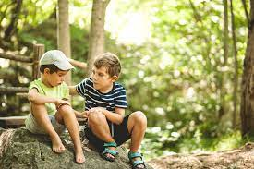
Action /do verb
don’t/doesn’t +?
I need your help,
don’t I?
She needs a pen,
doesn’t she?
But
You need not worry,
need you?
I need not go there,
need I?
Modal verb
need + Sub(pronoun) +?
Notes:
‘Need’ is used as action verb but ‘need not’ is used as modal verb.

Slide 20
If I had any scope, I’d visit London,
wouldn’t I?
Subordinate clause
Principal clause
Follow
I’d visit = I would+ v₁
I’d visited = I had+ v₃
Last year I’d visited London,
hadn’t I?
Notes:
If there is a complex sentence, students will have to follow the verb of principal clause. Teacher may make it clear to the students with the example above.

Slide 21
Tag question in imperative sentence
will you?
Follow me,
Don’t stop,
will you?
Go on,
will you?
Please help me,
will you?
Kindly do me a favour,
will you?
Notes:
While adding tag with an imperative sentence, it indicates simple future . So ‘will you/won’t you’ is suggested to use.

Slide 22
Let me say something,
will you?
Let him go,
will you?
Let them enjoy the game,
will you?
Exception in one place
Let us settle the matter,
shall we?
Let’s go out for a walk,
shall we?
Notes:
The differences between let me, let him, let them and let us are shown here. Teacher may explain it if necessary.

Slide 23
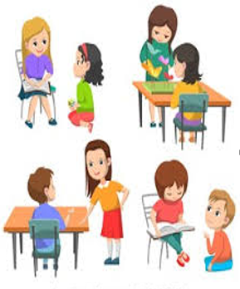
Pair Work
Add tag in every sentence of the following passage.
Mahim is a good boy. He goes to school regularly. Everybody loves him. Once he went to visit cox’s bazar. As he became ill, he could not visit Saint Martin. He told his friends, Let’s go back to Dhaka.
Notes:
Teacher may make some pairs to conduct this session .

Slide 24
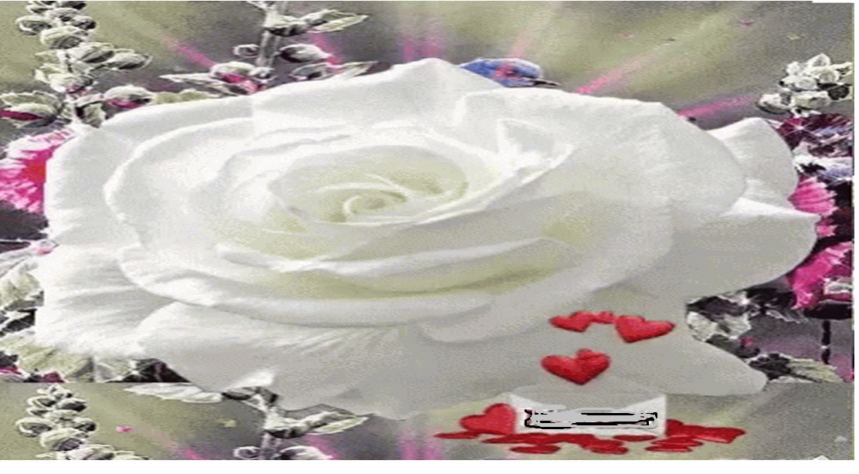
That’s all for today
Thankew

