Slide 1

বিসমিল্লাহির রহমানির রাহিম

Slide 2

Welcome everyone

Slide 3
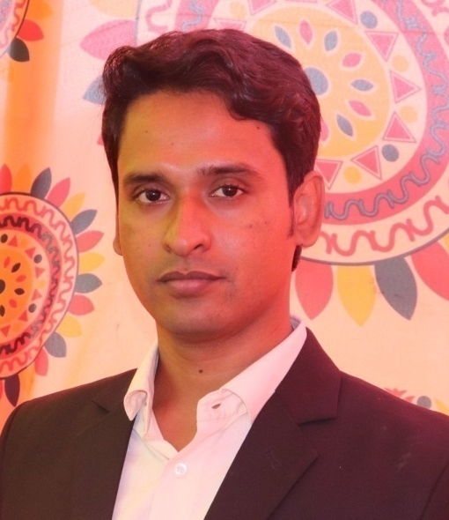
Teacher’s Introduction:
Md. Ataur Rahman
Assistant Teacher
Mohanpur Govt. Primary School,
Titas, Cumilla.

Slide 4
Introduction of the lesson
Class: Four
Sub:English
Unit:3
Lesson:2
Lesson title:Family
Today’s lesson:B ( Read)
Time:40 Minute

Slide 5
Learning outcomes
Reading:
1.5.1 read words, phrases and sentences in the text with proper pronunciation, stress and intonation.
1.7.1 read short paragraphs, dialogues and simple letters.
5.1.1 read silently with understanding paragraphs, stories and other texts.
Speaking:
6.2.1 talk about people, objects, events, etc.

Slide 6
Today we will read
Family

Slide 7
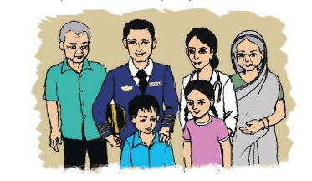
Are you see a Picture?
It is a joint family. There are father, mother, sister, brother, grandmother, grandfather.

Slide 8
I have mother, two brothers and two sister in my family
Say, about your family
I have …………………………….. in my family

Slide 9
New words :
TAKE CARE PATIENTS
AIRLINES JOB
PILOT TRAVEL

Slide 10
New words :
TAKE CARE – সেবা করা PATIENTS - রোগী
AIRLINES - বিমান সংস্থা JOB - চাকুরী
PILOT – বিমান চালক TRAVEL – ভ্রমন করা।

Slide 11
Activity: B

Slide 12
Let’s find out the answer from the text
1. How old is Farzana?
2. What is Rehana Parvin?
3. What is Aziz Ahmed?
Notes:
Pre- reading

Slide 13
Let’s match with your answer
1. How old is Farzana?
Farzana is nine years old.
2. What is Rehana Parvin?
Rehana Parvin is a doctor.
3. What is Aziz Ahmed?
Aziz Ahmed is a pilot.
Notes:
Pre- reading

Slide 14
Home work
Reading Activity: B

Slide 15

Thanks to all!!!

