Slide 1
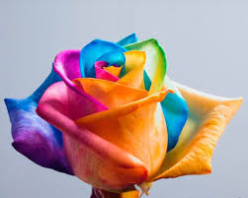
WELCOME

Slide 2
TEACHER’S IDENTITY
S.M.Lutful Haider
Assistant Teacher
Lutfunnesa balika Biddanekaton, Pagla, Gafargoan.
Mobile No: 01719527980

Slide 3
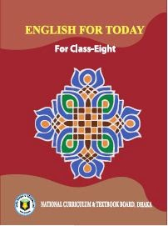
Lesson’s Identity
Subject: English 1st part
class : Eight
Unit :One
Lesson :One
Time :45 minutes

Slide 4
Let’s watch a video.....

Slide 5
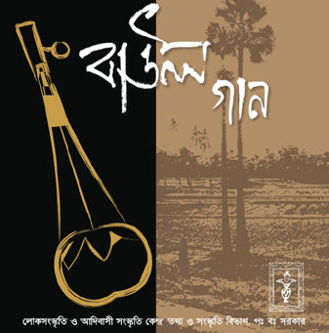
Today’s topic is ……………
Our Folk Songs

Slide 6
Outcomes of the lesson...
At the end of the lesson students will be able to...
tell about the our folk songs
answer the questions
infer meaning from context
Write a paragraph

Slide 7
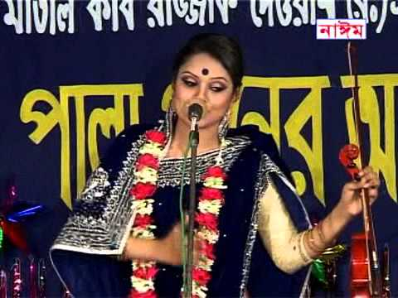
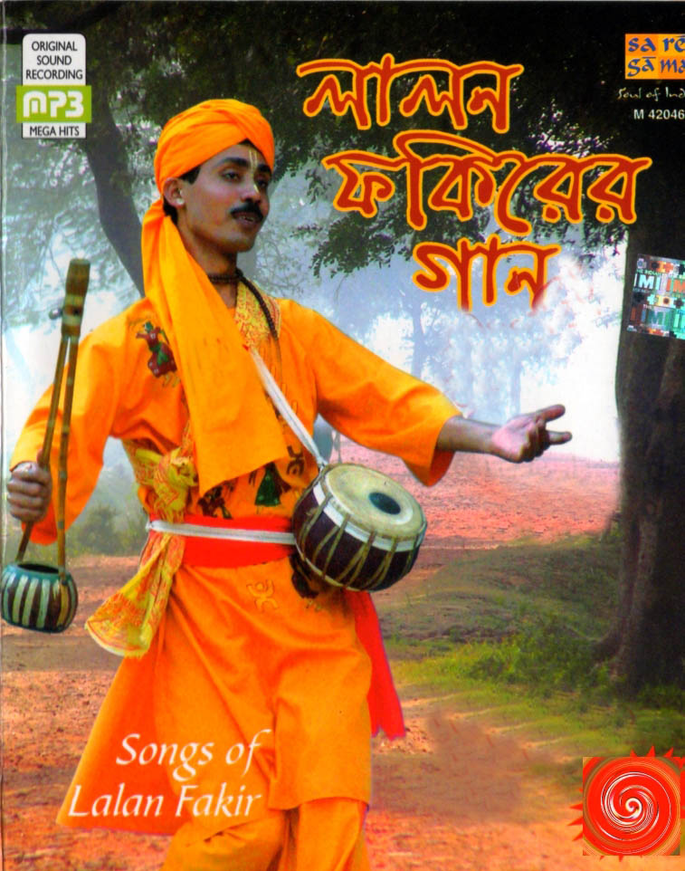
Folk=
The great proportion of the members of a people that determines the group character and that tends to preserve its characteristic form of civilization and its customs, arts and crafts, legends, traditions, and superstitions from generation to generation.

Slide 8
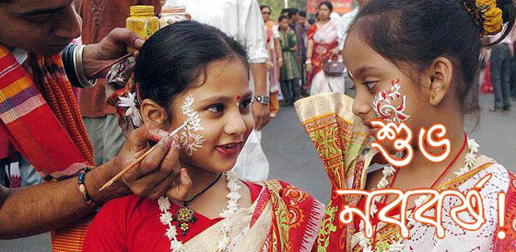
Traditional=
A tradition is belief or behaviour passed down within a group or society with symbolic meaning or special significance with origins in past

Slide 9
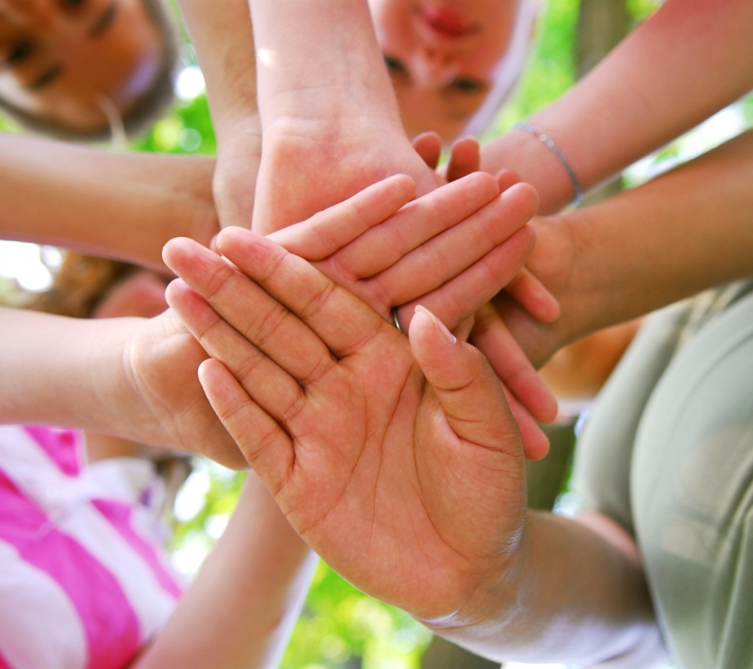
Community=
A social, religious, occupational, or other group sharing common characteristics or interests and perceived or perceiving itself as distinct in some respect from the larger society within which it exists (usually preceded by the): the business community; the community of scholars.

Slide 10
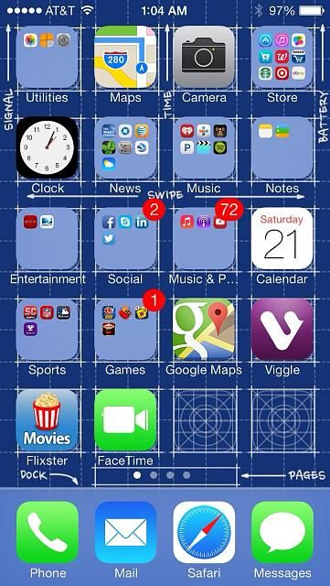
Collection =
Something that is collected; a group of objects or an amount of material accumulated in one location, especially for some purpose or as a result of some process: a stamp collection; a collection of unclaimed hats in the checkroom; a collection of books on Churchill.

Slide 11
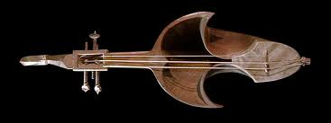
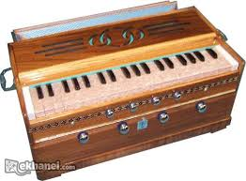
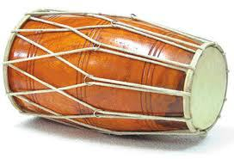
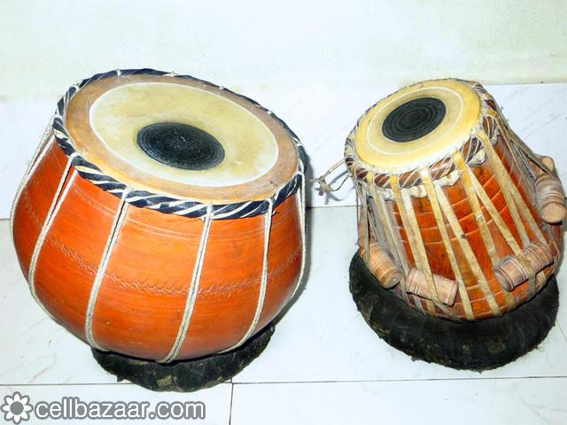
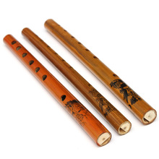
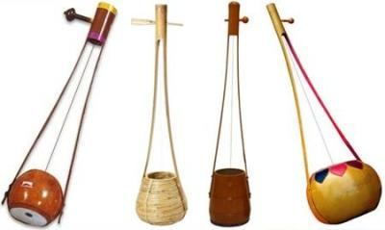
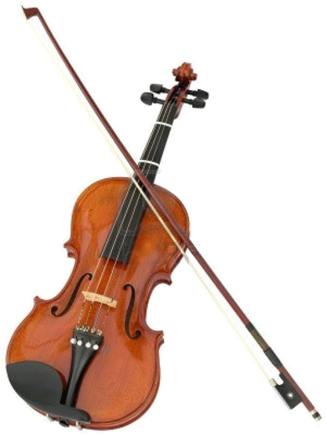
Tell the names of the below instruments.
sarinda
harmonium
dotara
dhol
tabla
bamboo flute
Ek-tara
violin
Notes:
Showing the pictures ,the teacher may ask the learners to name the instruments. After that he/ she may tell them to check their answers with his/hers.

Slide 12
Answer the questions
1.Who usually likes our folk songs?
2.Can you name some well known folk singers?
Who is your favourite folk singer?

Slide 13
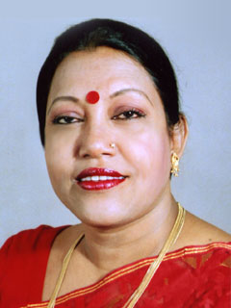
Solution the above questions:
1.The common people like folk songs.
2.Abdul Alim,Abbas Uddin,Farida parvin,Nina Hamid,Momotaz Begum,Kiron Chandra Roy etc.
3.Farida parvin(This answer will be varied from student to student.)

Slide 14
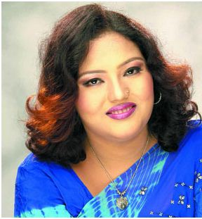
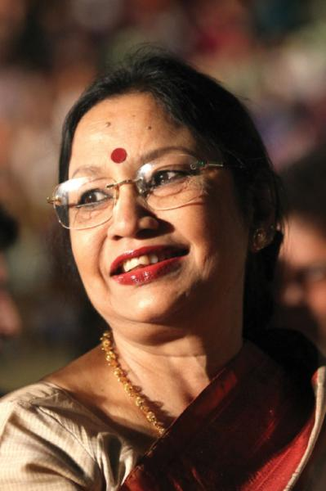
Discuss in groups and write a paragraph on:
Do you want more or less programs on folk songs
on your TV channels ? Why ?
Notes:
If time does not allow, no need to give it as a group work , It can be given as home work.

Slide 15
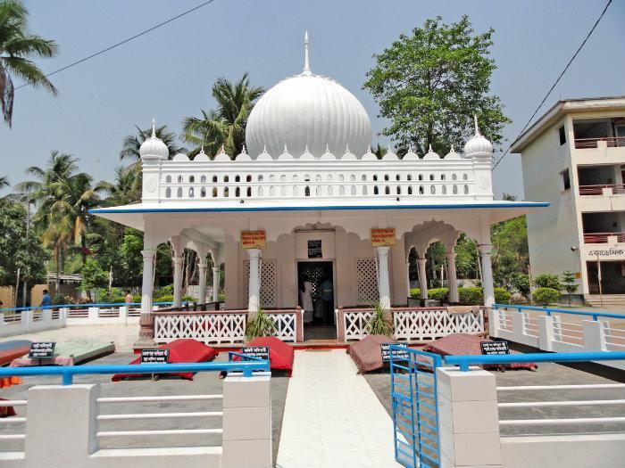
Evaluation
In which district this majar situated?

Slide 16
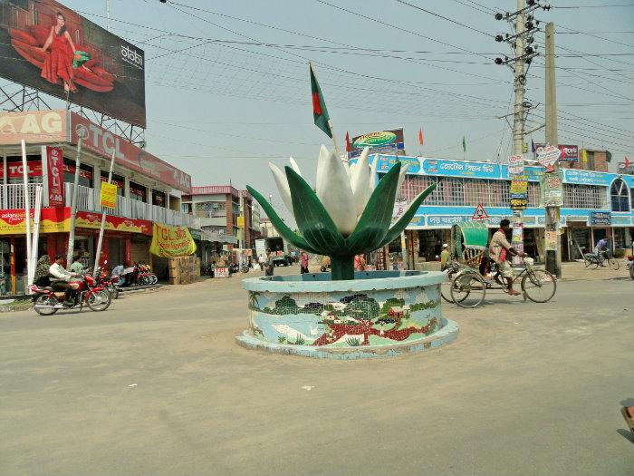
Answer:
Kustia

Slide 17
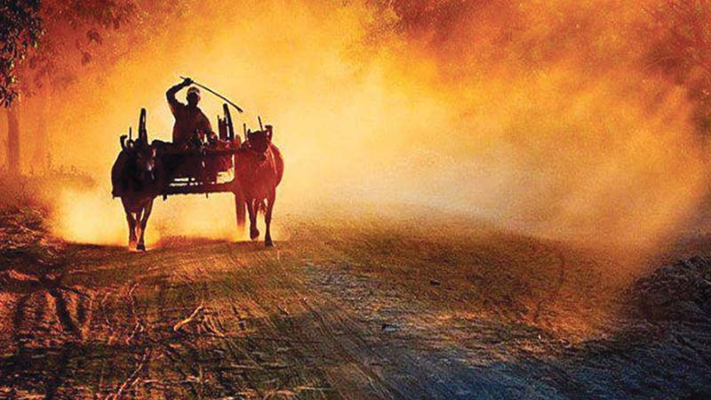
Home work
In which area bhawaiyas are sung?

Slide 18
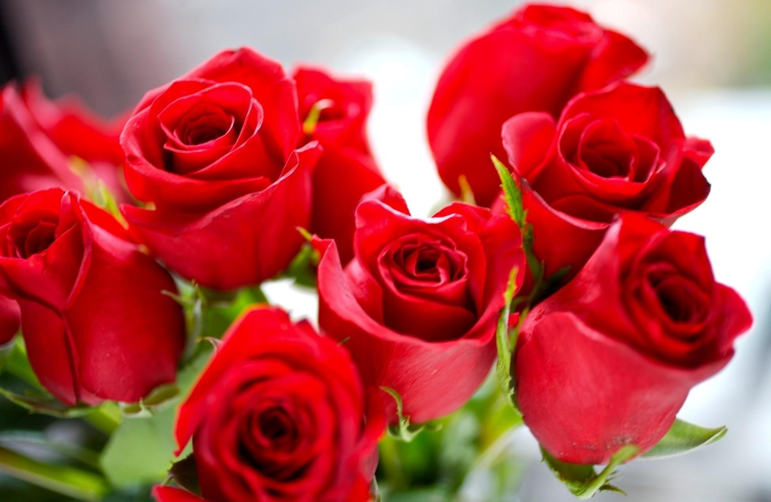
Thank you so much

