Slide 1
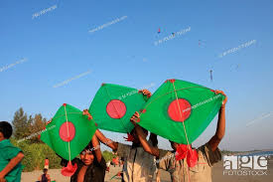
Welcome to my class

Slide 2
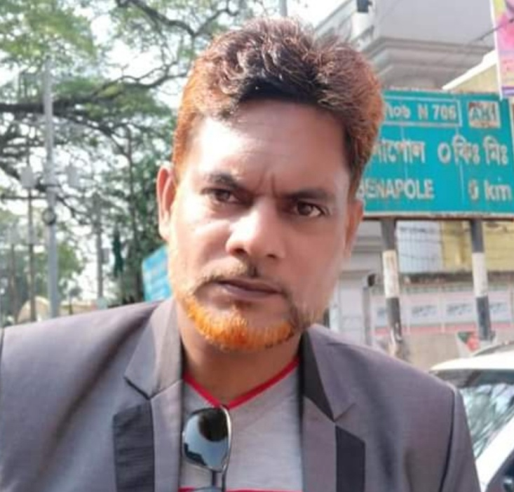
Introduction
Md. Shahneoaz
Assistant Teacher (English)
Jalalabad B/L High School
shahneoazmd@yahoo.com
Cell: 01631712091
English 1st Paper
Class: Nine
Unit: 02, Lesson: 3 (A)

Slide 3
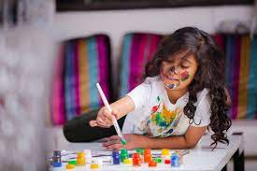
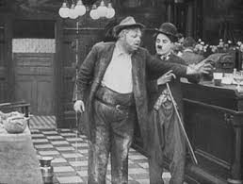
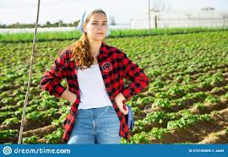
Look at the pictures bellow
What can you see in the pictures?
How do you want to describe the works?

Slide 5
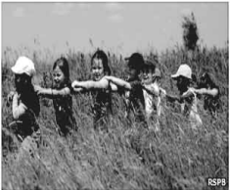
Today’s Topic
Change in Pastime
Unit 2, Lesson 3 (A)

Slide 6
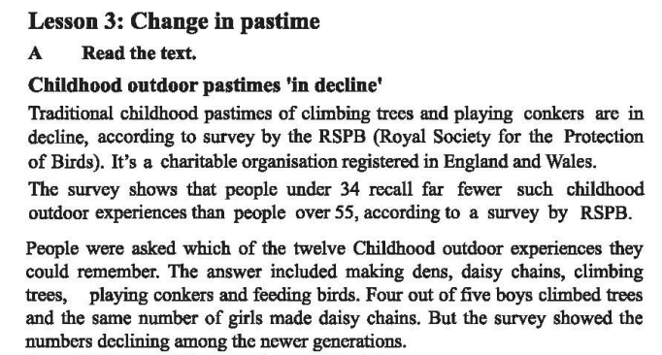
Silent Reading

Slide 7
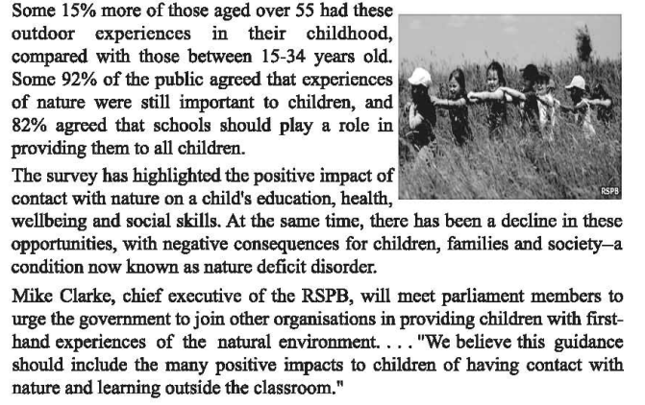
Silent Reading

Slide 8
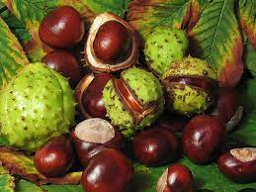
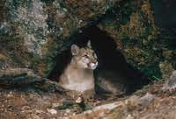
Let’s be introduced with some new words
The hard, shiny dark brown nut of a horse chestnut tree
Conkers
Hole/ tunnel/ cave/ dugout/ hollow/ covert/ shelter/ hiding place/ hideout/ hidey-hole
Den

Slide 9
Let’s be introduced with some new words
Decrease/ reduce/ get smaller/ grow smaller/ lessen/ get less/ diminish
Decline
high point/ high spot/ best part/ climax/ culmination/ peak
Highlight

Slide 10
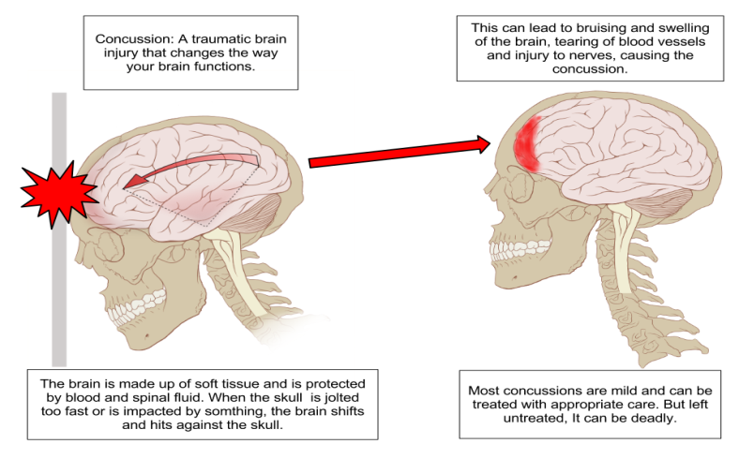
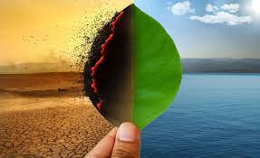
Let’s be introduced with some new words
Effect/ influence/ impression/ footprint/ results/ aftermath
Impact
Result/ upshot/ outcome/ out-turn/ sequel/ effect/ reaction
Consequence

Slide 11
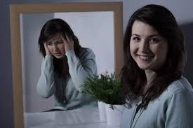
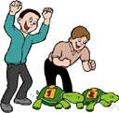
Let’s be introduced with some new words
Untidiness/ disorderliness/ mess/ disarray/ disorganization/ chaos
Disorder
Try earnestly or persistently to persuade (someone) to do something
Urge

Slide 12
Pair Work
Choose the best answer from the alternatives:
Having contact with nature leaves a _________ impact on children’s mind.
harmful ii) drastic iii) positive iv) negative
b) The text focuses on children’s having contact with________.
technology ii) nature iii) modern world iv) knowledge
c) “Survey” in the second line could be replaced by __________.
summary ii) findings iii) result iv) fund
d) ‘First hand experience’ mentioned in the passage means_________.
instant experience ii) prompt experience iii) bitter experience iv) practical experience
e) What kind of organization is RSPB?
Profitable ii) Benevolent iii) Commercial iv) Financial
f) Climbing tree is a __________pastime activity.
modern ii) conventional iii) dead iv) unconventional
g) Mike Clarke_________ providing children with first-hand experience of natural environment.
i) forbids ii) prohibits iii) alarms iv) suggests

Slide 13
Group Work
Write the following questions:
What is nature’s impact on children’s learning?
Ans. Nature influences children’s learning by developing their education, health, well-being and social skills.
2. Why are schools important?
Ans. Schools are important as they may provide children with the opportunity of learning outside the classroom.
3. What kind of organization is RSPB?
Ans. RSPB is a charitable organization.

Slide 14
Evaluation
1. What does the text deal with?
2. What is the scenario of the traditional childhood pastimes?
3. What are your childhood pastime activities?

Slide 15
Write the summary with the one third number of the words of the passage.

