Slide 1
Good morning

Slide 2
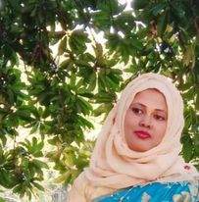
Teacher’s Introduction
Mst.Sharmin Akter
Assistant teacher
Matain Govt. Primary School
Hajiganj, Chandpur
E-mail:
mstsharminakter1985@gmail.com

Slide 3
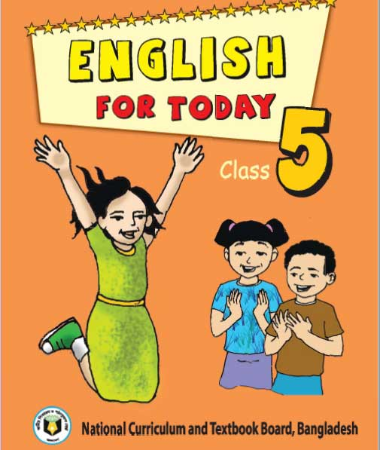
Lesson Identity
Class : Five
Subject : English
Lesson :1-2
Unit:4
Activity : A(So…..
Hojja.)
Time : 40 min
A
e
r
G

Slide 4
Learning Outcomes
Student’s will be able to-
Listening:1.3.1-recognize which words in a sentence are stressed.
Speaking:1.1.1-say words and phrases and sentences with proper sounds and stress.
Reading:1.5.1-read words , phrases and sentences with proper pronunciation , stress and intonation.
Writing:5.1.3-read silently with understanding dialogue.

Slide 5
We can see here 4 persons are talking.
What can you see in the picture ?

Slide 6
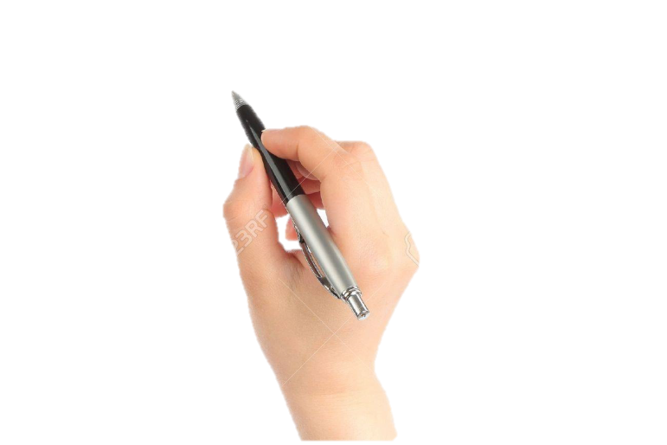
Lesson declaration
Our todays lesson is Leisure time

Slide 7
New word
fit
painting
funny
cricket
swimming

Slide 8
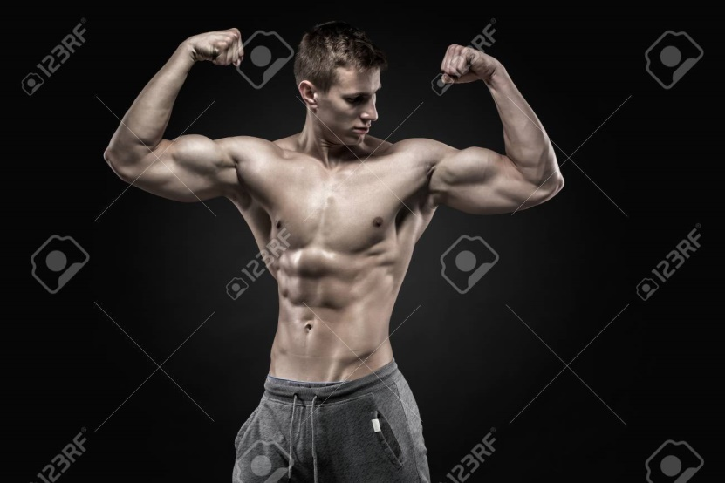
fit
active
It keeps me fit .

Slide 9
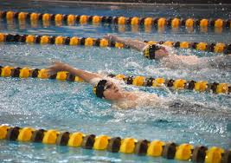
swimming
One kind of sport
I love swimming

Slide 10
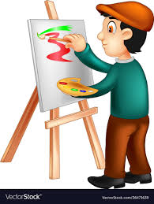
painting
drawing
I like painting.

Slide 11
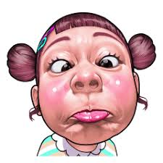
funny
joky
I like to read funny stories.

Slide 12
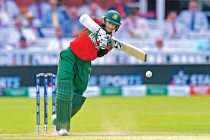
cricket
One kind of sport
I like to play cricket

Slide 13
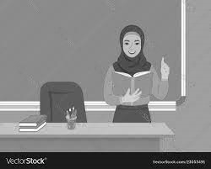
Teacher’s Reading

Slide 15
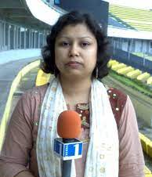
Nasreen: So talking on the internet keeps you connected.
Sima: That’s right.

Slide 16
Tamal: ( to Biju ) Hello ! Can I ask you
the same questions ?
Biju : my name’s Biju and I’m in class 5, too.
I love swimming. It keeps me fit.
I also like painting . I’m not very
good but painting makes me happy.

Slide 17
Tamal:What about reading?
Do either of you like reading ?
Biju :I do. I often read magazine in my free time . I like
magazine about sports , especially football and cricket .

Slide 18
Sima: Oh , I like to read, too. I love reading funny
stories, especially stories of Nasiruddin Hojja.

Slide 19
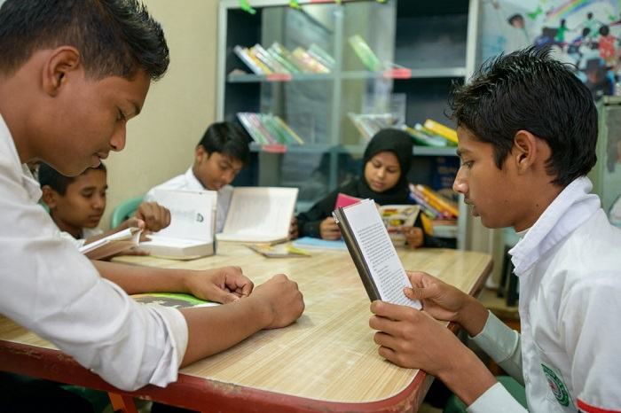
Group reading

Slide 20
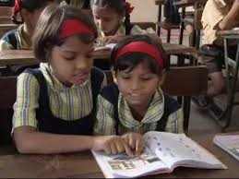
Read in pair

Slide 21
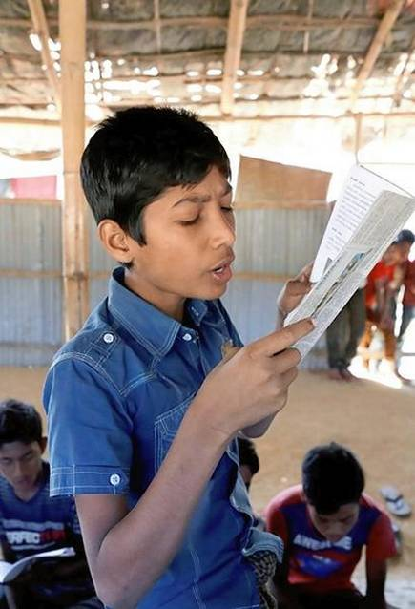
IW
Student’s reading

Slide 22
Practise the conversation with your partner.

Slide 23
Questions:
1Who likes to walk in the park?
2.In which class does Biju read in?
3.Who likes to painting?
4. What kind of books does Sima like to read?
gw

Slide 24
Answers:
1.Sima likes to walk in the park.
2.Biju reads in class 5.
3.Biju likes to painting.
4.Sima likes to read funny stories.
gw

Slide 25
Bingo game
leisure
swimming
magazine
cricket
connected
internet
painting
especially
question
either

Slide 26
One day one word
magazine-পত্রিকা

Slide 27
Goodbye

