Slide 1
WELCOME MY DEAR ALL STUDENTS

Slide 2
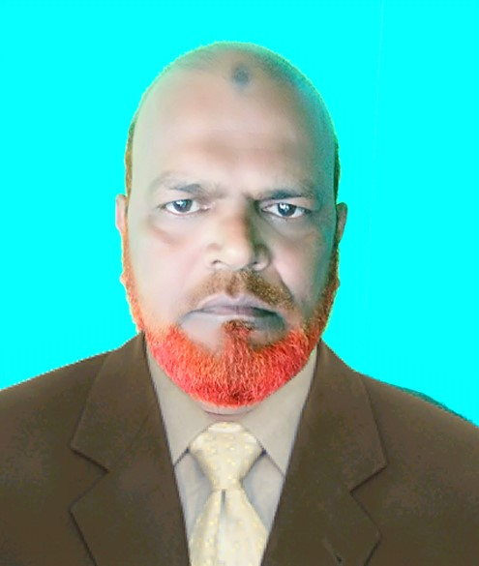
INTRODUCTION
MD.KHALILUR RAHMAN
ASSISTANT TEACHER
ATGHARIA HIGH SCHOOL
HARIPUR, THAKURGAON.
SUBJECT:-ENGLISH 2nd PAPER
CLASS:-VI,VII,VIII and IX
TOPIC:-NUMBER

Slide 3
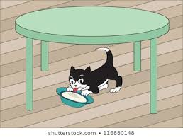
What do see you in the picture ?
1
2
How many books are on the table?
How many cats is under the table?

Slide 4
Todays lesson
Number and its r Classification

Slide 5
Number
The word number denotes to noun or pronoun and states whether the noun/ pronoun is one or more than one.
Types of Number:
Generally, the number is of two types:
1. Singular Number
2. Plural Number

Slide 6
Number
1. Singular Number:
Singular Number denotes to such noun/pronoun which is one in number.
Example: Pen, Lion, Eye, etc.
2. Plural Number:
Plural Number denotes to such noun/pronoun which is more than one in number.
Example: Pens, Lions, Eyes etc.

Slide 7
Number
(Rules to convert singular number to plural number)
Rule 1:
Generally, an “s” is added to the end of the singular number word to change it into a plural number.
Example:
Singular Plural
Tiger Tigers
Book Books
Pen Pens

Slide 8
Number
Rule 2:
If the singular number word has s, ss, sh, x or z at its end and the pronunciation of the “ch” situated at the end is like “ch”, then es is added to the end of the singular number to change it into a plural number.
Example:
Singular Plural
Glass Glasses
Bus Buses
Bush Bushes
Tax Taxes
Topaz Topazes
Branch Branches

Slide 9
Number
2. Exception :
If the pronunciation of the “ch” situated at the end of the singular number word is like “K”, then only an s is added to the end of the singular number to change it into a plural number.
Singular Plural
Monarch Monarchs
Stomach Stomachs
Patriarch Patriarchs

Slide 10
Number
Rule 3: If the singular noun has the letter “O” at its end and a consonant before the letter “O”, then es is added at its end to make it plural.
Singular Plural
Cargo Cargoes
Hero Heroes
Volcano Volcanoes
Exception
But there are some singular nouns which have “O” at their end and the letter before “O” are consonant still, only an “s” is added at their end to make them plural.
Singular Plural
Piano Pianos
Solo Solos
Photo Photos

Slide 11
Number
Rule 4:
If the singular noun has an “O” at its end and a vowel before the “O”, only an “s’ is added at its end to make it plural.
Singular Plural
Stereo Stereos
Studio Studios
Radio Radios

Slide 12
Number
Rule 5: If the singular noun has “y” at its end and the letter before “y” is a consonant, ies is added instead of “y” to change it into the plural.
Singular Plural
Hobby Hobbies
Army Armies
City Cities
Exception :
But if the letter before “y” is a vowel, only an s is added to make it plural.
Singular Plural
Toy Toys
Day Days
Key Keys

Slide 13
Number
Rule 6:
If the singular number word has ef, fe, and f, at its end, ves is added in the place of ef, fe and f to change it into the plural number.
Singular Plural
Thief Thieves
Life Lives
Leaf Leaves

Slide 14
Number
Rule 6:
Exception :
There are some words which have eef, fe, ff, ief, ife, if, oof and rf at their end and only “s” is added at their end to make them plural.
Singular Plural
Reef Reefs
Safe Safes
Cliff Cliffs
Belief Beliefs
Roof Roofs
Proof Proofs
Dwarf Dwarfs

Slide 15
Number
Rule 7:
Some singular noun’s one or more than one vowel and consonant situated in their middle are changed to make them plural.
Singular Plural
Foot Feet
Tooth Teeth
Man Men
Woman Women
Mouse Mice

Slide 16
Number
Rule 8:
There are some singular nouns which are made plural by adding en or ren at their end.
Singular Plural
Brother Brethren
Ox Oxen
Child Children

Slide 17
Number
Rule 9:
Either an s is added to the end of the compound noun’s main noun or vowels situated in the middle are changed to make it plural.
Singular Plural
Sister-in-law Sisters-in-law
Father-in-law Fathers-in-law
Passer-by Passers-by
Washer-man Washer-men
Maid-servant Maid-servants
Step-daughter Step-daughters

Slide 18
Number
Rule 10:
The compound nouns which don’t have hyphens (-) are made plural by adding an s at their end.
Singular Plural
Spoonful Spoonfuls
Armchair Armchairs
Bookcase Bookcases
Handful Handfuls

Slide 19
Number
Rule 11:
In case of some compound nouns “s” is added to nouns situated both sides of the hyphen (-) or vowels situated in the middle are changed to make it plural.
Singular Plural
Woman-servant Women-servants
Man-servant Men-servants
Lord-justice Lords-justices

Slide 20
Number
Rule 12:
Some singular nouns are same in their plural form.
Singular Plural
Dozen Dozen
Deer Deer
Sheep Sheep
Gross Gross
Pair Pair

Slide 21
Number
Rule 13:
Some collective nouns look like singular noun but are used as a plural. Such as mankind, public, people, cattle, poultry, vermin, gentry, majority.
Rule 14:
Some common nouns look like singular noun but are used as a plural. Such as the pious, the poor, the virtuous, the rich, etc.
Example:
The pious know how to be patient.
The rich are generally money minded.

Slide 22
Number
Rule 15:
Some nouns look like plural noun but are used as a singular. Such as politics, mathematics, statistics, physics, news, economics, wages, etc.
Example:
Physics is an interesting subject.
This news is really good.
Rule 16:
Some nouns are always used as singular numbers. Such as money, business, alphabet, information, hair, etc.
Example:
Your business is really profitable.
Her hair is curly.

Slide 23
Number
Rule 17:
Some nouns are always used as plural numbers. Such as Billiards, Draughts , Mumps , trousers , ‍scissors , spectacles etc.
Example:
His spectacles are broken.
Karim’s trousers are black.
Rule 18:
Apostrophe (‘) and s are used to make the plural of letters, numbers, and abbreviations.
Example:
MBA’s will definitely attend this program.
There are five 2’s in this picture.

Slide 24
Number
Rule 19:
Some nouns express different meanings as singular and plural.
Singular Plural
Force (শক্তি) Forces (সৈন্যবাহিনী)
Good (ভালো) Goods (মালপত্র)
Wood (কাঠ) Woods (বন)
Sand (বালু) Sands (মরুভূমি)
Advice (উপদেশ) Advices (সংবাদ)
Physic (চিকিৎসা বিজ্ঞান) Physics (পদার্থবিদ্যা

Slide 25
Number
Rule 20:
Different singular pronouns have different pronoun forms. They are stated below:
Subjective pronoun forms:
Singular Plural
I We
You You
She/he They
It It
This These
That Those
Possessive pronoun forms:
Singular Plural
My Our
Your Your
Mine Mine
His/her Their
Its Their
Objective pronoun forms:
Singular Plural
Me Us
You You
Her/him Them

Slide 26
Number
Rule 22: Abstract nouns don’t have a plural form. Such as honesty, charity, hope, kindness, love, etc.
Rule 23: Some mentionable words’ (which are derived from foreign language) plural form:
Singular Plural
Radius Radii
Oasis Oases
Genus Genera
Forum Forums
Focus Focuses
Singular Plural
Crisis Crises
Medium Media
Agendum Agenda
Singular Plural
Analysis Analyses
Axis Axes
Basis Bases
Curriculum Curricula
Formula Formulas

Slide 27
Thanks to all

