Slide 1
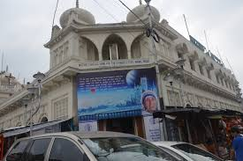
Welcome to English Class

Slide 2
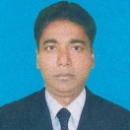
Identity
School
Azimnagor Com. K. School & B. College.
Azimnagor , Tarash, Sirajgonj.
Teacher
Md, Monirul Islam
Assitant Teacher
Email-monir19077@gmail.com
Mob: 01761714820
Subject
English For Today
Class –Ten
Time -45 mins

Slide 3
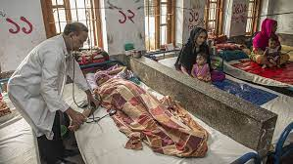
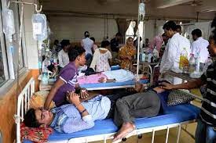
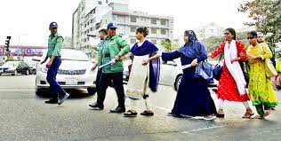
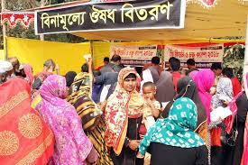
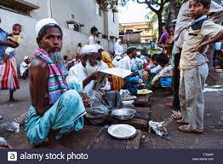
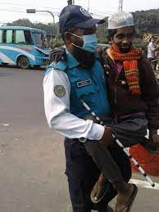
Look at these pictures.
What can you see in these pictures ?

Slide 4
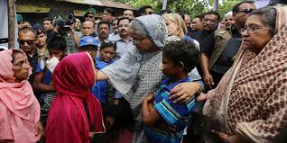
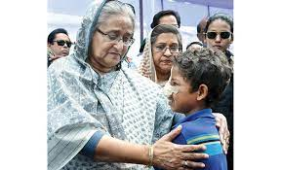
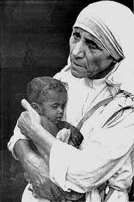
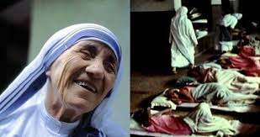
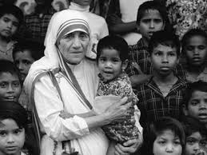
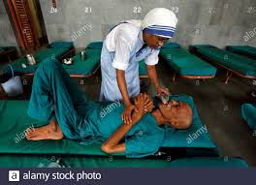
Love For Humanity

Slide 5
Our today’s lesson is -
Love For Humanity
Unit-7, Lesson -6

Slide 6
Learning Outcomes
After studied this lesson, students will be able to---
ask and answer questions ;
read and understand through silent reading ;
Write a short composition about Mother Teresa.

Slide 7
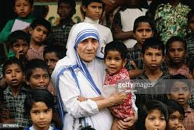
Look at the picture and talk about it in pairs.
Can you guess who that woman is in the picture ?

Slide 8
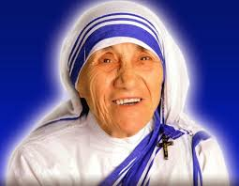
Main character of “Love for humanity” is -
Mother Teresa

Slide 9
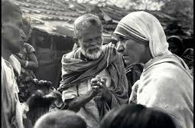
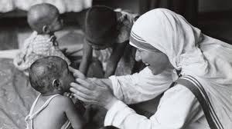
Mother Teresa was moved by the sight of the sick and dying on the streets of Kalkata.

Slide 10
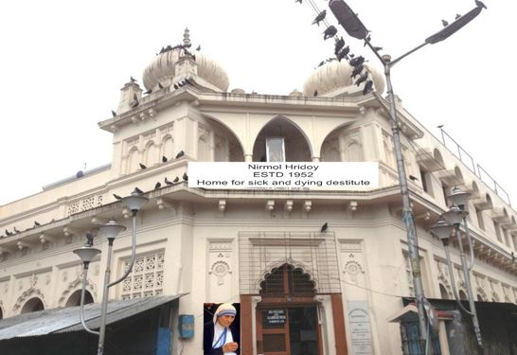
He found a home for the dying destitute and named it “Nirmal Hriday’ meaning ‘Pure Heart’.

Slide 11
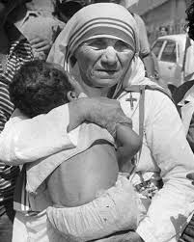
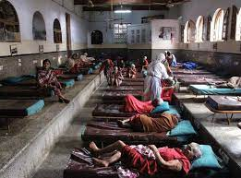
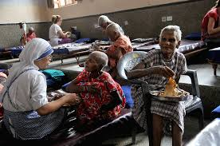
She and her fellow nuns brought the dying people off the streets of Kolkata to this home.

Slide 12
Mother Teresa’s work has been recognized throughout the world and she received a number of awards.

Slide 13
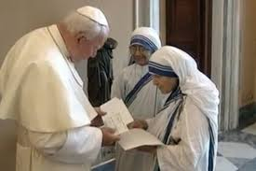
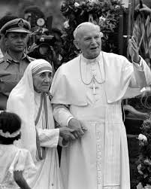
The pope john XXIII Peace prize ( 1971)

Slide 14
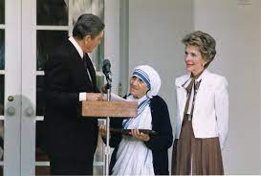
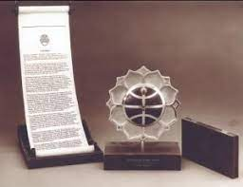
The Nehru Prize for promotion of International Peace & Understanding (1972)

Slide 15
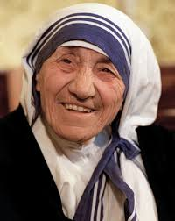
The balzan Prize (1978)

Slide 16
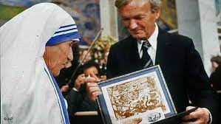
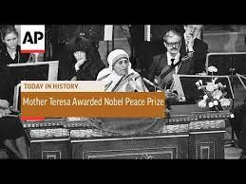
The Nobel Peace Prize (1979)

Slide 17
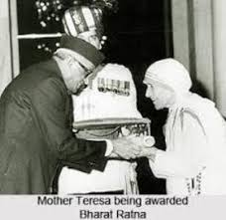
The Bharat Ratna (1980)

Slide 18
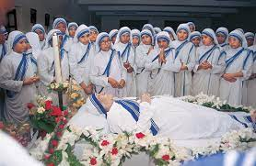
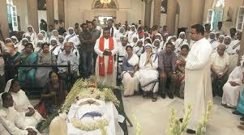
Mother Teresa died at the age of 87, on 5 September 1997.

Slide 19
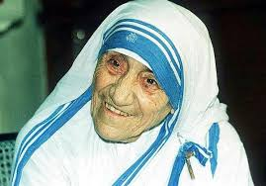
Picture of Mother Teresa.
Draped in a white and blue-bordered sari.
Ever soft eye
Saintly smile.
Wrinkled face.
Mother Teresa lives on in our mind.

Slide 20
Dear students, read the text silently.
If you don’t understand anything, let me know.

Slide 21
Individual Work
D Read the text in B again and write the answer to the following questions in your exercise book.
1 Why do you think Mother Teresa won so many awards?
2 What does ‘Nirmol Hridoy’ stand for?
3 Why do you think the home is named ‘Nirmol Hridoy’?
4 Why did Mother Teresa want the dying people to feel that they deserve care and love too?
5 What are things that we have learnt from Mother Teresa?

Slide 22
Pair work
C. Now say whether the following statements are true or false. If false, give the correct information.
1 Mother Teresa was moved to see the diseases that spread in the streets of Kolkata.
2 She opened a home for the orphans.
3 She and her group brought in the dying people from the streets of Kolkata.
4 ‘Nirmol Hridoy’ was founded so that the poor people who are dying can get love and care before death.
5 Mother Teresa said that humanity passes through charitable organization.
6 We have learnt how to come forward to help only those who belong to a special caste.

Slide 23
Evaluation
Read the text B. again and complete the chart given below.
Dates | Events
1971
1972
1978
1979
1980
1997
The pope john XXIII Peace prize .
The Nehru Prize for promotion of International Peace & Understanding .
The balzan Prize .
The Nobel Peace Prize .
The Bharat Ratna .
Mother Teresa died at the age of 87.

Slide 24
Home work
Who is Mother Teresa ?
What has she taught us ?
Why did she found “Nirmal Hridoy”?

Slide 25
The End
Thanks to all.
Allah Hafez.

