Slide 1
WELCOME
Good Morning
Md.Khalilur Rahman Assistant Teacher Atgharia High School
Haripur,Thakurgaon.

Slide 2
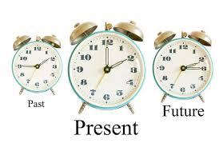
What do you see in the picture?

Slide 3
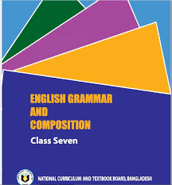

Slide 4
Learning Outcomes:
After the lesson students will be able to :
understand the tense of verb.
Identify the present tense of
verb of sentences.
Use right form of verb by using structure of present tense.

Slide 5
Tense
Present
Future
Past

Slide 6
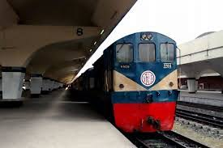
Present Tense
Use the present tense for the following cases:
To express repeated or regular actions in the present period.
Ex:
I take the train to the office.
She loves to read.

Slide 7
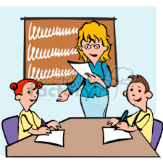
Present Tense
Use the present tense for the following cases :
We use present tense to express facts.
Ex :
They write for the magazine.
There are 7 days in a week.

Slide 8
Present Tense
Use the present tense for the following cases :
We use present tense for describing habits.
Ex:
I get up early every day.
I go for a walk daily.

Slide 9
Present Tense
Use the present tense for the following cases :
We use present tense for things that are generally true.
Ex :
It rains a lot in rainy season.
The sun sets in the west.

Slide 10
Types of Present Tense
Indefinite
continuous
Perfect
Perfect Continuous

Slide 11
Present Indefinite Tense
We use present indefinite tense to describe facts and habits.
Ex :
The moon gets its light from sun.
The stars shine at night.

Slide 12
Present Indefinite Tense
We use present indefinite tense to describe scheduled events in the future.
Ex :
The train leaves at 5 o’clock.
My class starts at 10 a.m.

Slide 13
Present Indefinite Tense
Structure :
Subject + v1+s/es+ object.
I ,We ,You They. | Use (s / es ) She ,He , It, Rana , Sima, Runa.
Walk Visit Work Go Write | Walks Visits Works Goes Writes
Ex :
You write a letter.
Sima writes a letter.
They write a letter.
She writes a letter.

Slide 14
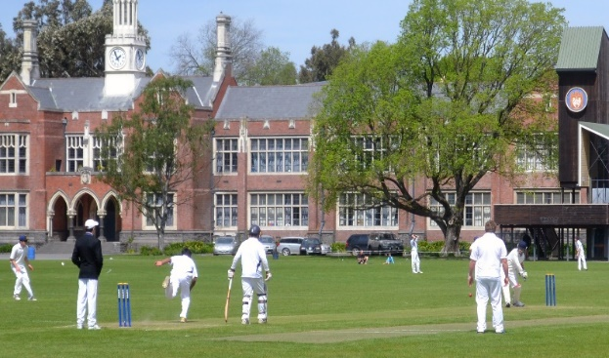
Present Continuous Tense
Present Continuous tense is used for an on-going action in the present.
EX:
I am going to Madrasah.
He is looking for the last train.
.
Here the action of going,looking,playing are still in continuing.
They are playing cricket.

Slide 15
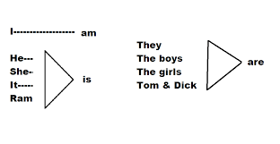
Present Continuous Tense
Structure :
Subject +am/is/are+ verb( ing )+object.
I am writing a letter.
He is writing a letter.
Rahim is writing a letter.
They are writing a letter.
The boys are writing a letter.
Use of am/is are

Slide 16
Present Perfect Tense
Present perfect tense is used to describe action that began in the past and continuous into the present or has just been completed.
I have watched the movie.
The person started watching the movie in the past
which is finished just by the time of speaking the sentence.
The people started writing the letters in the past
which are finished just by the time of speaking the sentence.
They have written two letters already.

Slide 17
Present perfect Tense
Structure :
Subject + have/has+ v3 +object.
Ex:
I have written a letter.
They have written a letter.
Sima has written a letter.
He/she has written a letter.
I ,We ,You They. | She ,He , It, Rana , Sima, Runa.
Have | Has

Slide 18
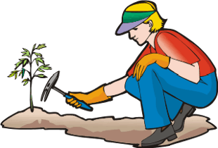
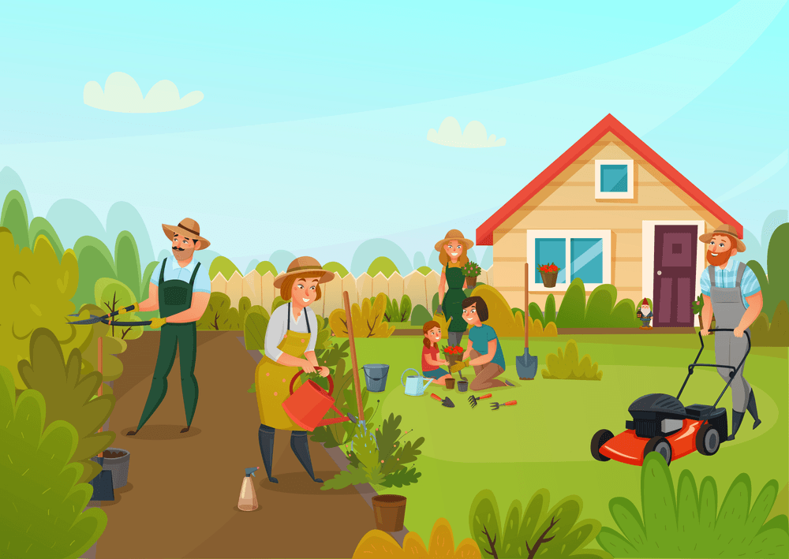
Present Perfect Continues Tense
This tense is used to describe an experience or an action that started in the past and is still continuing till the present moment.
Here the boy has started working in the morning and is still continuing to do that.
Ex :
The boy has been working in the garden since morning.
Here they have started doing their work for 3 hours and is still continuing to do that.
They have been doing the work for three hours now.

Slide 19
Present Perfect Continues Tense
Structure :
Subject + have/has + been + verb(ing) + object + Extension .
Raju has been playing cricket
for two hours.
Raju and Jony have been
playing cricket for two hours.

Slide 20
Evaluation:
What do you understand by tense?
How many kinds of tense are there?
Tell me the types of present tense?
What is the Structure of present continuous tense?
What is the auxiliary verb of present perfect tense?
Which tense do not take any auxiliary verb?

Slide 21
Home Work
Use the correct form of verbs.
He (read) the book.
I am (read )the book.
He is (go) to madrasah.
Please open your book. Have you (open) it?
I have (do) my homework.
I (get )up early in the morning.

