Slide 1
WELCOME

Slide 2
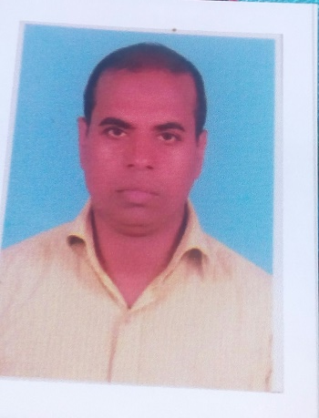
IDENTITY
Mohammad Shafiqul Islam
Lecturer in English
Sreechail Mohammad pur Islamia Alim Madrasha
Daudkandi,Cumilla
Sub-English Grammar and Composition
Class-Alim/Ten

Slide 3
WARMING UP
Read the following sentences-
*He said , “Karim,come here.”
*He told karim to go there
Which kind of grammatical item do the above sentences indicate?

Slide 4
So, today’s topic name-
Narration-part four

Slide 5
LEARNING OUTCOME
In this lesson the students will be able-
To say the rules of using ‘Reporting verb’ for Narration change
To say the rules of using ‘That’ in reported speechfor Narration change
To write the rules of using ‘Reporting verb’ for Narration change
To write the rules of using ‘That’ in reported speechfor Narration
change

Slide 6
In indirect speech, ‘said,told and ask’ are mostly used as reporting verb. The uses of these are
shown below-
1. ‘Ask’ is used in ‘ Interrogative sentence’
Such as-He asked me where I had gone
2. ‘Told ‘ is used with object.
He told me that he had done the sum.
3.Generally if no object,said is used.
Such as-He said that he was going to open a school.
Besides, the following verbs may be used-
Accuse,admit,advise,allege,agree,apologize,beg,boast,complain,deny,explain,imply,invite,offer,order,promise,reply,suggest, think etc.

Slide 7
Use of ‘ That’ in reported speech-
‘That’ is often used in reported speech.
Such as-I told him that I was eating rice.
But,the use of ‘That’ is optional.
For example, the above sentence may be in this way-
I told him Iwas eating rice.
NB: ‘That’ is never used in question. ‘If/where’ is used instead of ‘That’.
Such as-He asked me if I would come.

Slide 8
EVALUATION
*Say the rules of using ‘Reporting verb’ for narration change.
*Say the rules of using ‘That’for narration change.

Slide 9
HOME WORK
1.Write the rules of using ‘Reporting verb’ for narration change.
2.Write the rules of ‘using ‘That’ for narration change

Slide 10
THANK YOU ALL

