Slide 1
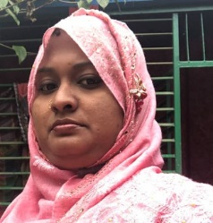
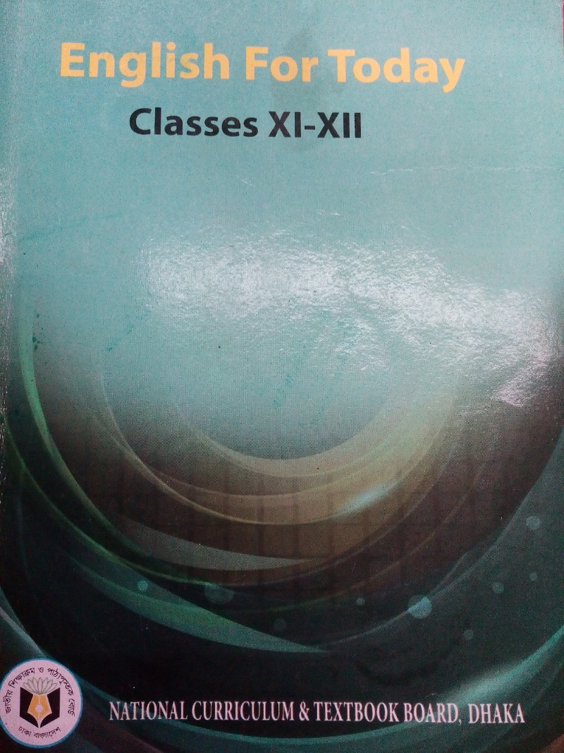
Teachers information
Mazada Akter
Lecturer (English)
Barabor alim Madrasha
Class : 1x
Subject : English 1st paper

Slide 2
English 1st Paper
Class: xi
Unit: Nine (Myths and Literature)
Lesson: 4 Time:45 minutes
24/06/2021

Slide 3
Announcement of the Lesson
HERCULES

Slide 4
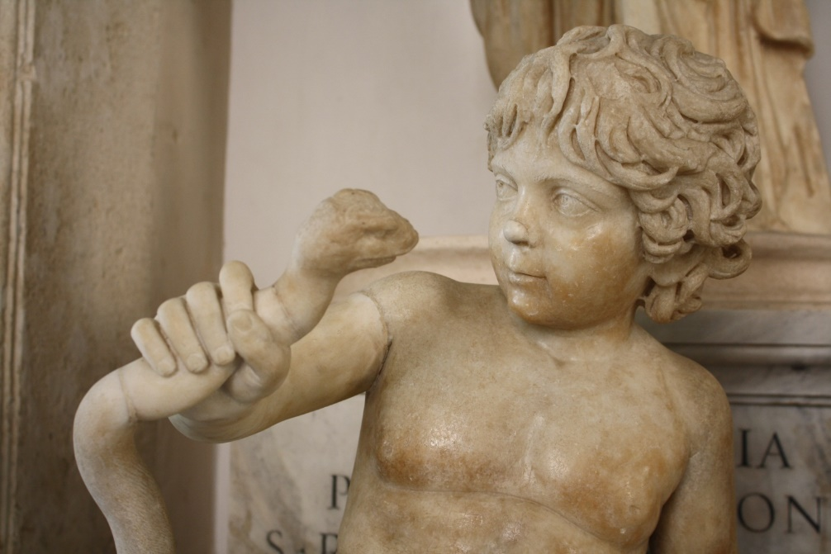
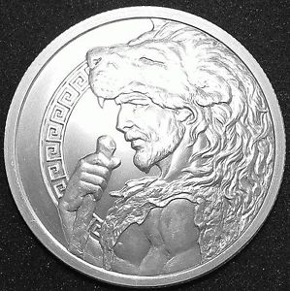
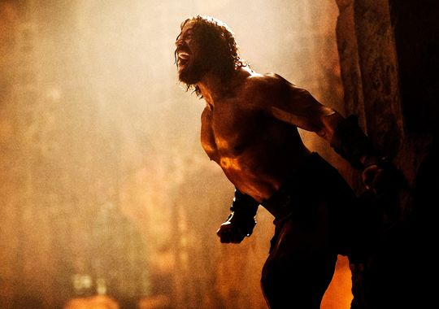
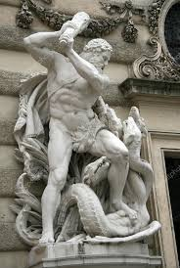
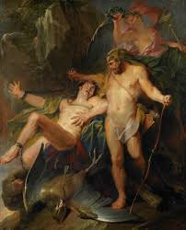
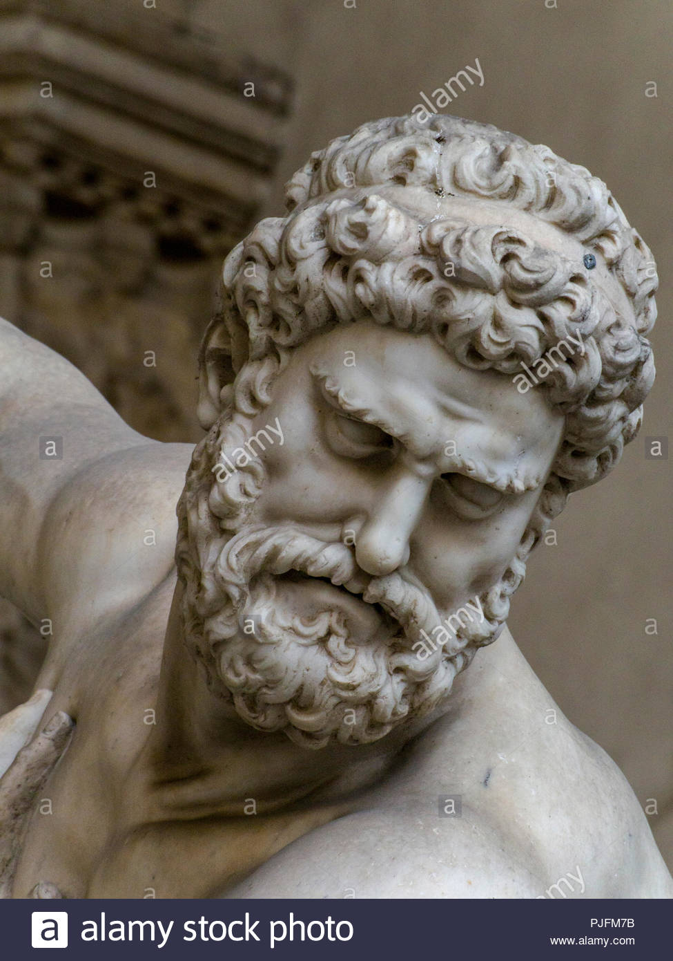
Let us watch some pictures

Slide 5
Learning outcomes
Students will be able to…….
# Tell the meaning of some words.
# Describe the” second labour” of the hero.
# Describe the reasons for calling Hercules a hero.

Slide 6
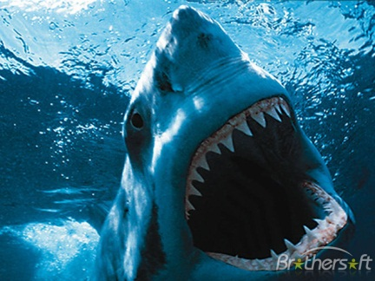
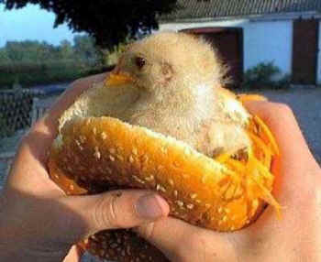
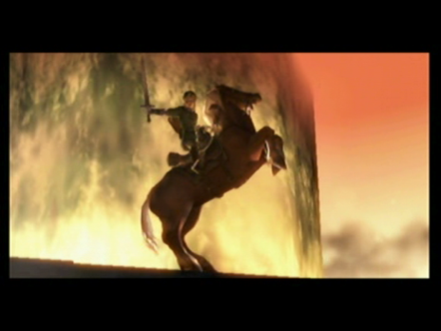
Word meaning
Terrible
Dreadful
Slay
kill
Victorious
Winner

Slide 7
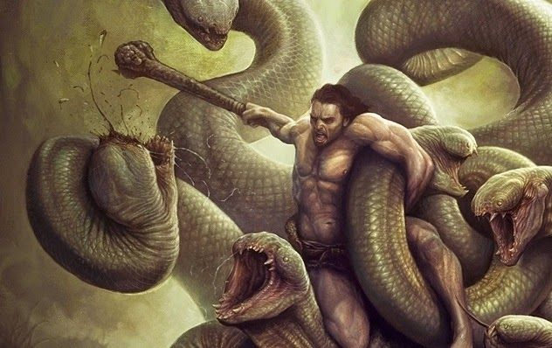
His next task was to slay a monster called Hydra that was ravaging the country of Argos.

Slide 8
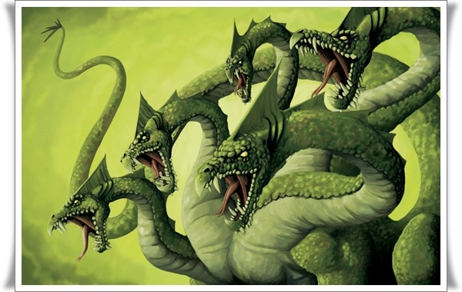
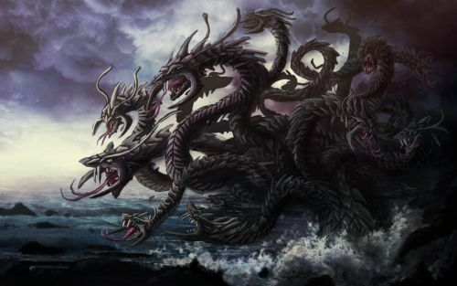
The Hydra had nine heads.
Among them the middle one was said to be immortal.

Slide 9
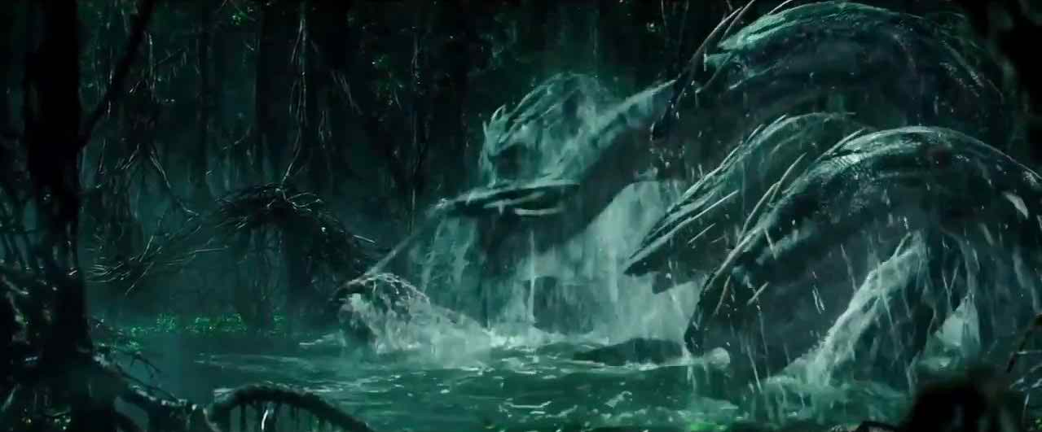
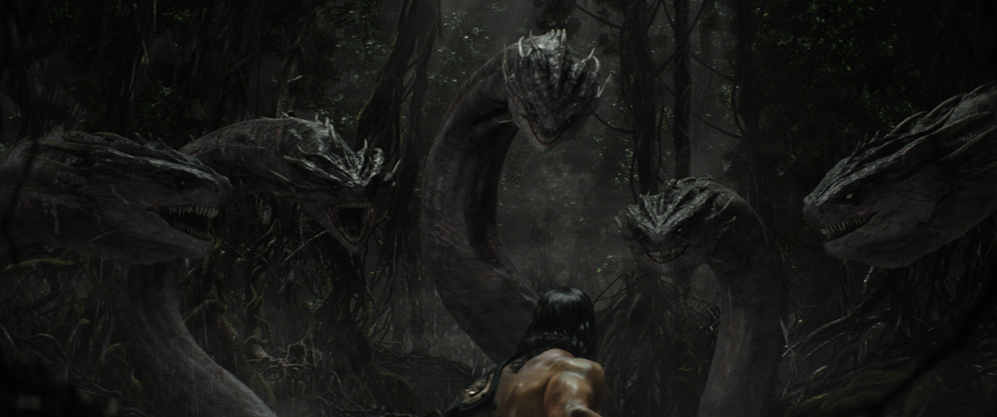
Our hero struck off its heads with his club, but whenever he knocked off a head ,two new ones erupted in its place.

Slide 10
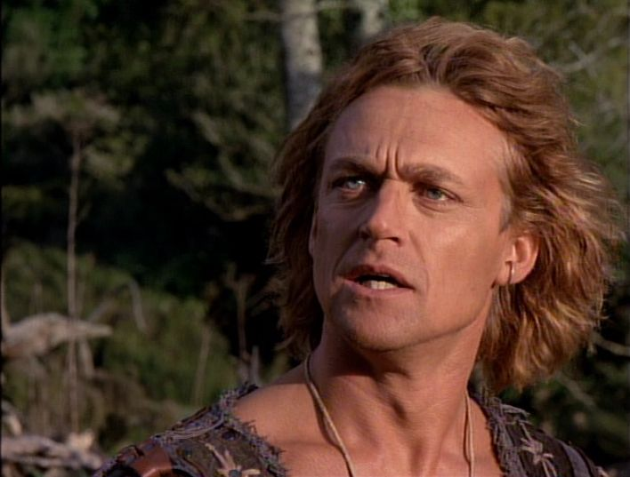
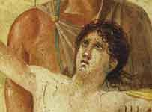
Micheal Hurst as Iolaus
Iolaus
Eventually with the help of his devoted servant Iolaus, Hercules succeeded in burning all the heads if the Hydra except the ninth or immoral one, which he decided to bury under a huge rock.

Slide 11
Single work
1.Who gave Hercules all the labours?
2.What was the second labour of Hercules?
3. How did he kill the hydra?

Slide 12
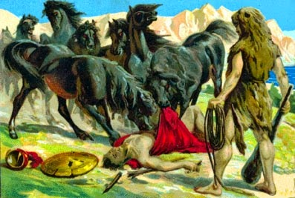
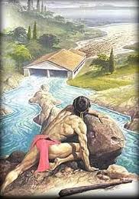
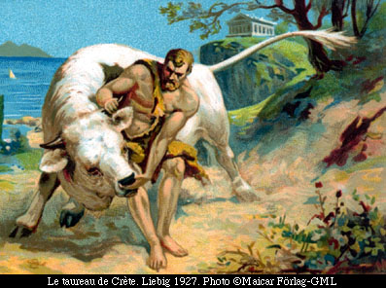
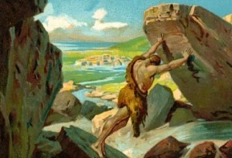
The stable
The Horses
The Boar
The Bull
Hercules triumphed again and again, as he would every time he was given an impossible task by Eurystheus

Slide 13
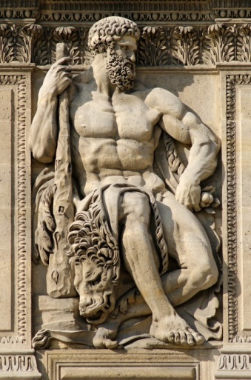
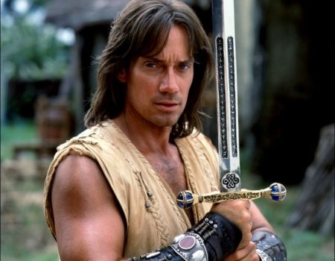
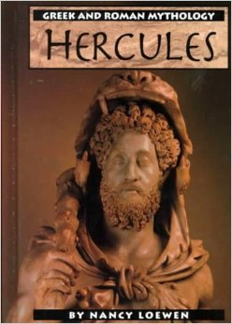
Kevin as Hercules
Because of twelve labours Hercules began to acquire reputation of a hero possessing immense strength throughout the world.

Slide 14
Pair work
Discuss Hercules’s second labour?
2. What did he do with Hydra’s immortal head?

Slide 15
Write a paragraph on Hercules’ SECOND LABOUR

Slide 16
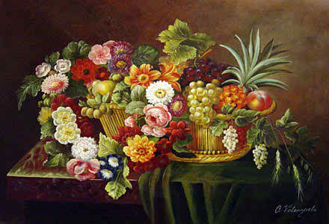
Thanks a lot

