Slide 1
Welcome
MS English Online Class

Slide 2
Madhu
Sudan Das.
BA (H), English,
MA (Double),
ELL & ELT; M.Ed.
Bakalia Adarsha Girls’
High School.
Introduction
Candidates
and
Nine-Ten

Slide 3
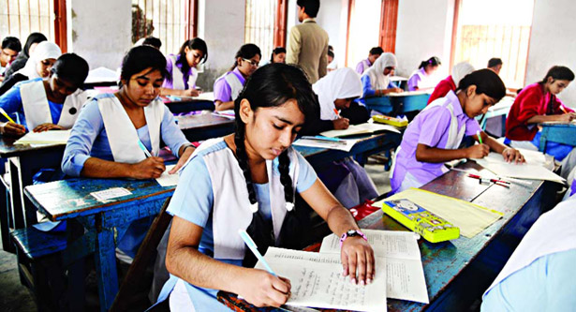
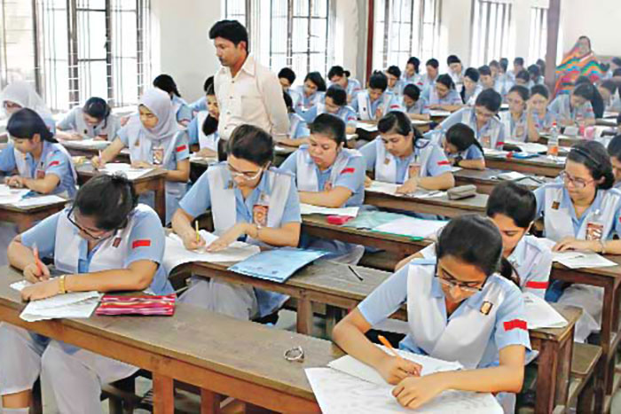
What are they doing?
What are they doing?
They are also appearing at SSC Exam.
They are appearing at SSC Exam.

Slide 4
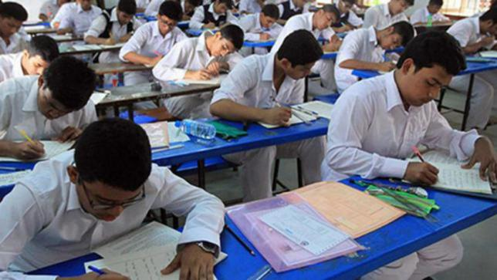
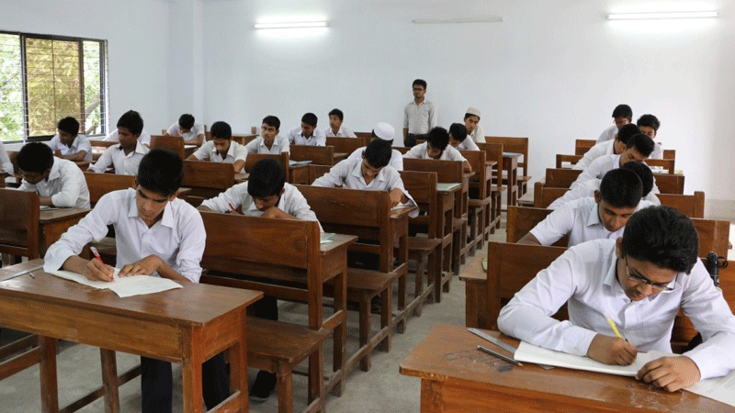
Today our topic is Questions items of SSC 2021

Slide 5
Learning outcomes:
After completing the lesson we will be able to:
Make Tag questions
Use right form of verbs
Make sentences using parts
Fill the blanks without words
Use Capitals and Punctuation Marks
Fill the blanks with suitable words
Speak about pictures and events
Fill the blanks with words from the box

Slide 6
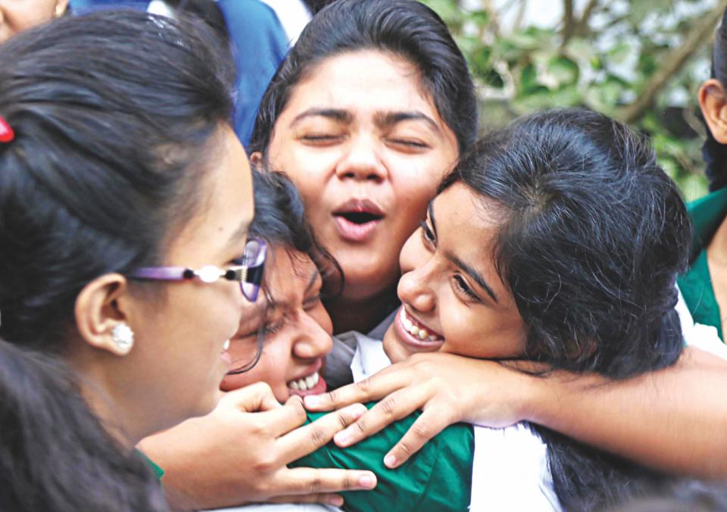
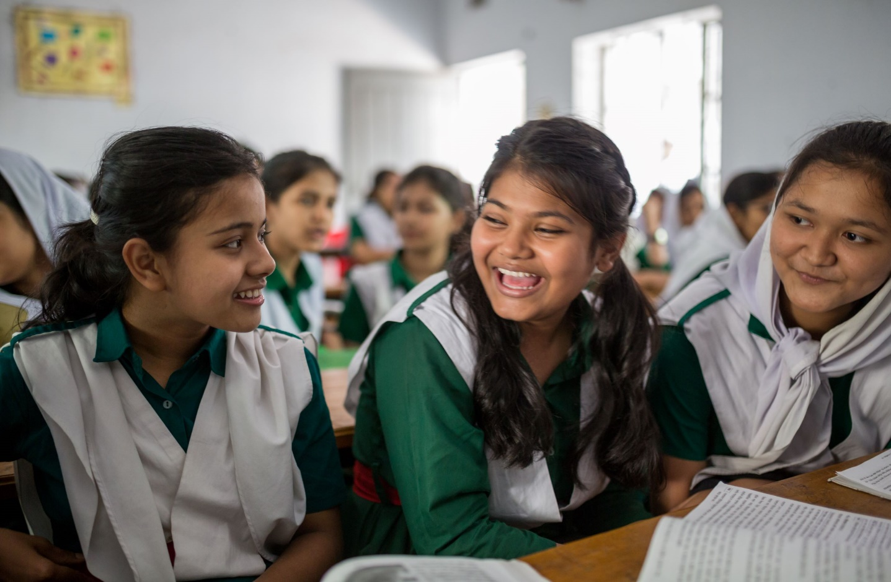
Are they happy?
Do you think them happy?
Is the man happy?
Yes, I think them happy..
Yes, the man seems to be happy.
Yes, they look too happy.

Slide 7
1. Fill in the blanks with the words from the box. You may need to change the forms of some words. You may need to use one word more than once.
0.5×10=5
expect
meaningful
The
be
and
happy
common
an
to
are
What you don’t (a)________for yourself don’t do others. For a (b) _____ and (c) __________ life we have to have some virtues.(d) ___ rulers would set up (e) __ example so that the (f) _______ people would be kind (g) __ each other. There are five ways to (h) __ happy. These five qualities (i) __ honesty and righteousness, virtue and decency, generosity and humanity, knowledge and education, (j) ___ fidelity and loyalty. Each of these five qualities is very important for all of us to be happy.

Slide 8
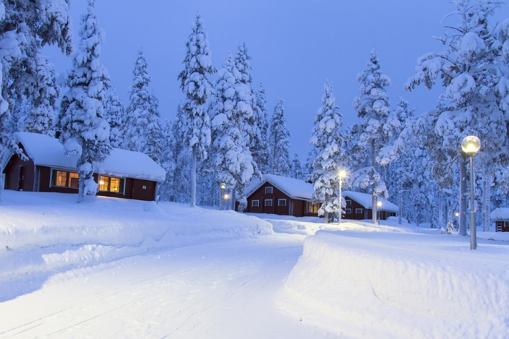
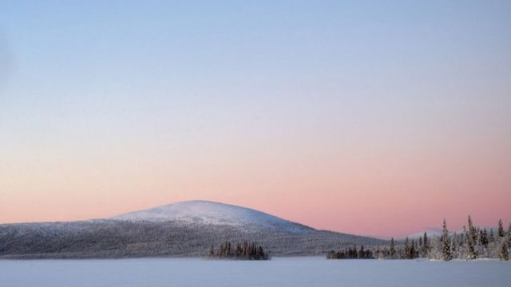
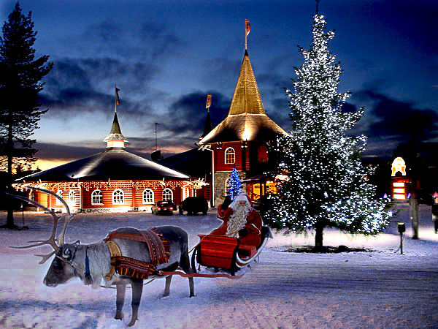
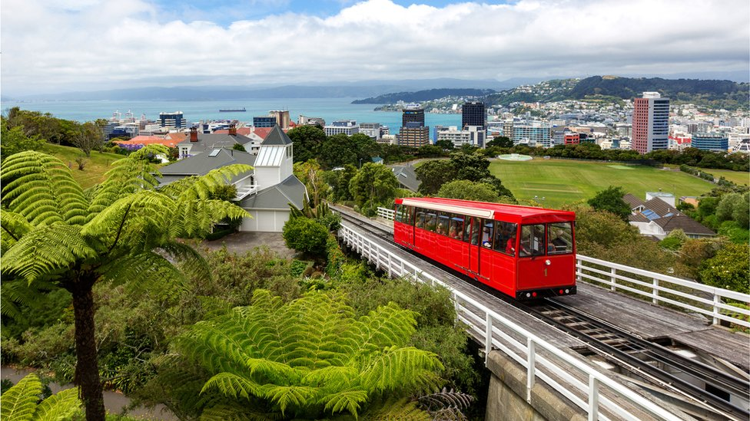
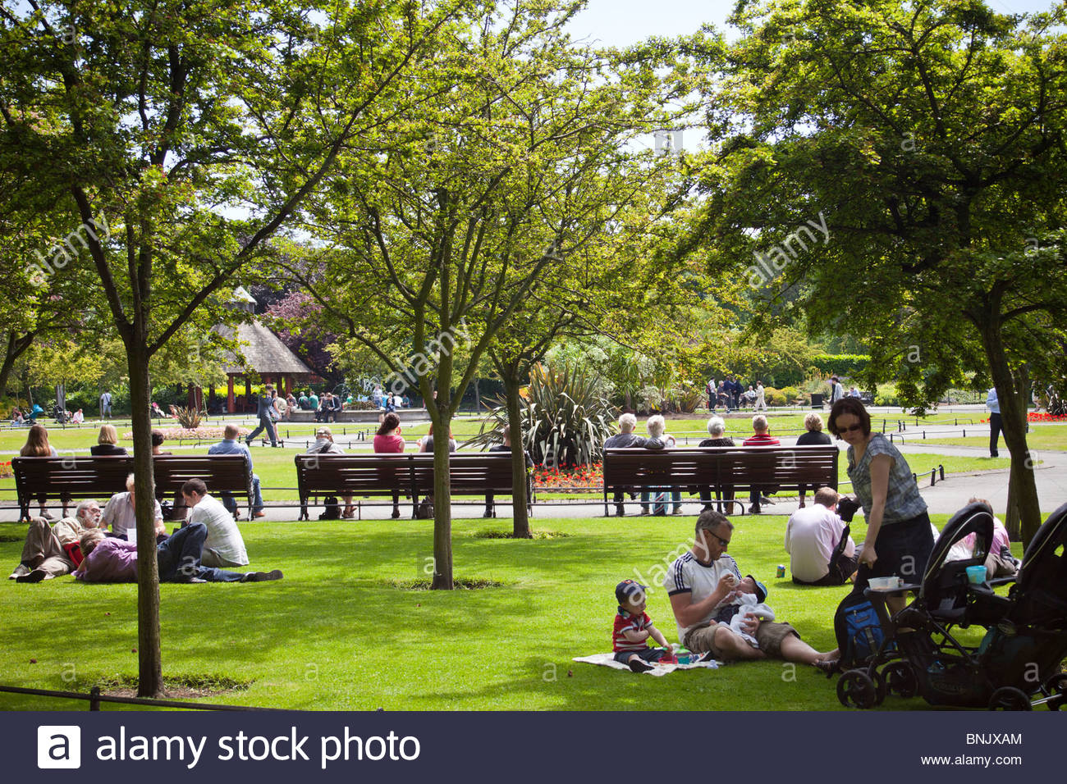
Look a beautiful country and its happy population.
It is Finland.
It is Finland

Slide 9
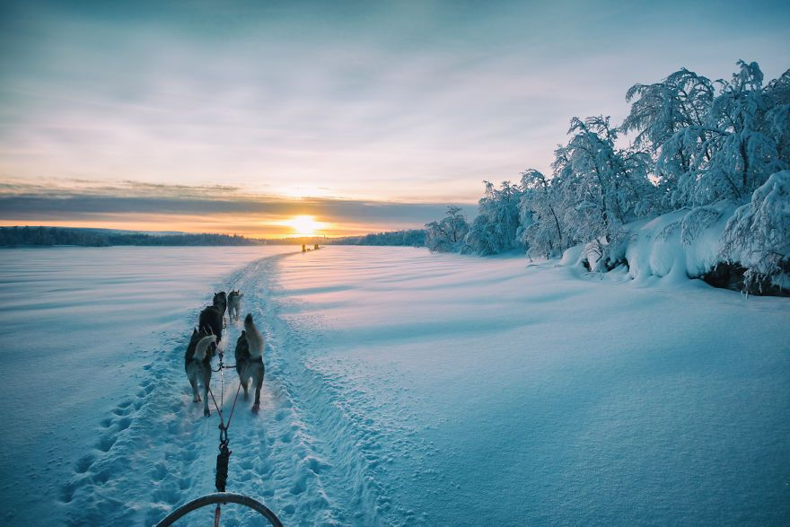
Pair work
2. Fill in the blanks with suitable words
1×5=5
Finland is said (a)― the happiest country in (b) ― world. Finland, a country (c) ― is very attractive to everyone because (d) ― its improved quality of life. It is the (e) ― country in the world (f) ― the highest score in terms of quality of life, freedom, gender (g) ― compared other countries in the world. Corruption, crime (h) ―pollution are negligible in the country. It has the second highest elderly population (i) ― Japan. Finland now needs active migrants. They are hopeful that they will be able to attract talented people from Asian in future to overcome the (j) ― manpower crisis.
Madhu Sudan Das. BA (Hon’s), English; MA (Double); ELL & ELT, M.Ed.
Answers:
a. to
b. the
c. that
d. of
e. happiest
f. with
g. equality
h. and
i. after
j. working

Slide 10
3.Make six sentences using parts of sentences from each column of the table.
1×6=6
This world
want it with a lot of good
students just dream of completing their education.
of competition most of the
social and family pressures.
They
is due to
should be good person first of all.
The main
demand of the students
academic excellence and professional success.
It
are blindly pursuing only
and advice of parents and teachers.
also should follow the orders
results and have a successful professional life.
Answer:
a. This world of competition most of the students Just dream of completing their education.
b. They want it with a lot of good results and have a successful professional life.
c. They are blindly pursuing only academic excellence and professional success.
d. It is due to social and family pressures.
e. The main demand of the students should be good person first of all.
f. They also should follow the orders and advice of parents and teachers.

Slide 11
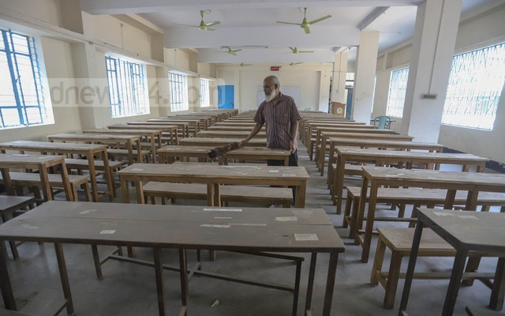
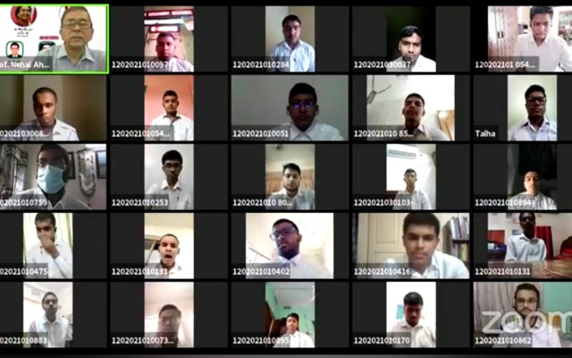
Look at the picture
School is closed for Corona Virus.
Online class.

Slide 12
4. Use right form of verbs
1×10=10
collapse
agree
lock
continue
be
run
agree
use
make
suppose
The educational institution has been (a) --- for almost a year and half. Shortly after the start of the lockdown, the online education program was (b) --- to be active, but within a few days, the system (c)--- . Many blame the inadequacy of information technology for this. However, I am not completely (d) --- with this. If students can (e) --- Facebook, (f) --- active on social media, where is the problem in (g) --- online learning activities? During the lockdown in America, all kinds of educational activities were (h) --- online and now (i) --- fully operational. They are going to take public exam (j) --- their online capabilities.
Madhu Sudan Das. BA (Hon’s), English; MA (Double); ELL & ELT, M.Ed.
a. locked
b. supposed
c. collapsed
d. agree
e. run
f. be
g. continuing
h. made
i. is
j. using

Slide 13
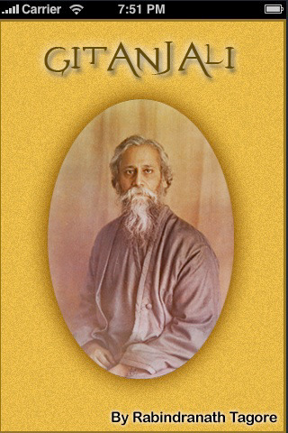
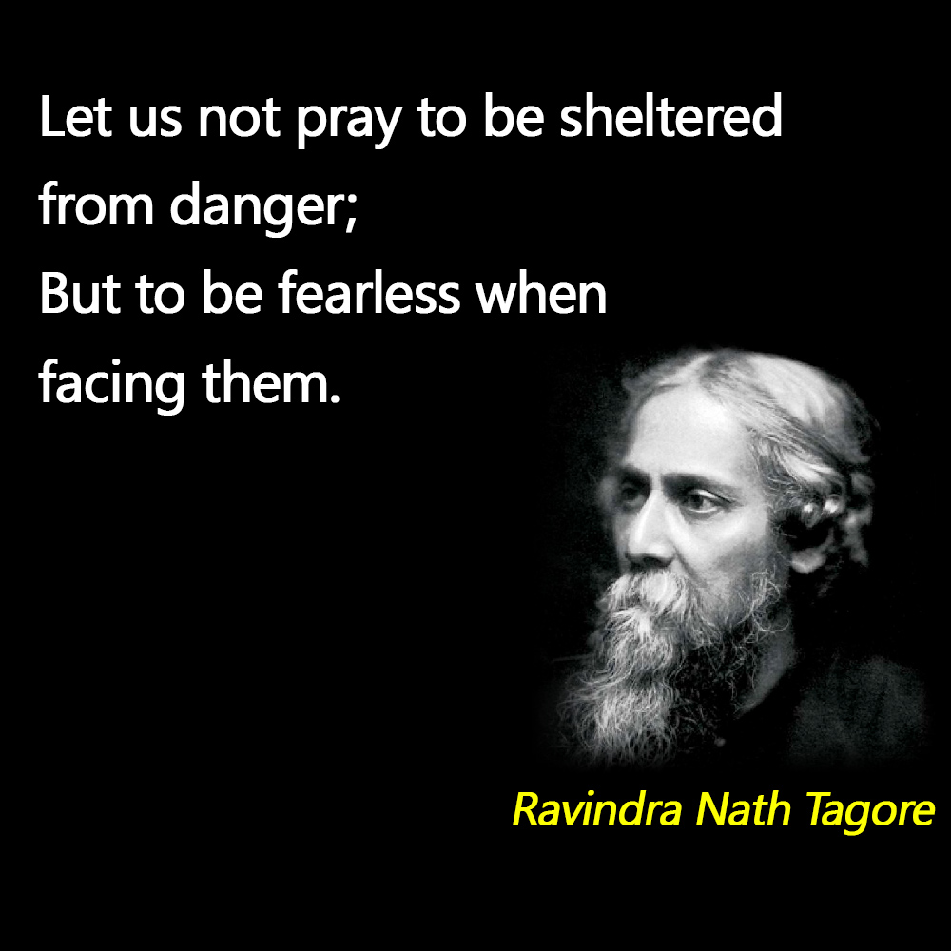
Look at the pictures

Slide 14
5. Change the sentences as directed
1×10 = 10
a.Tagore is one of the most famous poets. (Positive)
A. Very few poets are as famous as Tagore.
b. Everybody has heard of Tagore. (Negative)
A: There is nobody but has heard of Tagore.
c. Nobody dislikes Tagore’s poems. (Affirmative)
A. Everybody likes Tagore’s poem.
d. People know that his writings interest all. (Passive)
A: It is known that all are interested in his writings
e. The Gitanjali is the most famous book of Tagore. (Comparative)
A: The Gitanjali is more famous than any other book of Tagore.
Madhu Sudan Das. BA (Hon’s), English; MA (Double); ELL & ELT, M.Ed.

Slide 15
f. I am not disinterested in the novels of Tagore. (Affirmative)
A: I am interested I the novels of Tagore.
g. Shesher Kabita pleases even the average readers. (Passive)
A: Even the average readers are pleased with Shesher Kabita.
h. The diction of Tagore’s poetry is very simple. (Exclamatory)
A: How simple the diction of Tagore’s poetry is!.
i. He was not a domestic talent. (Affirmative)
A: He was a universal talent. (Affirmative)
j. No other writer is as popular as Tagore. (Superlative)
A: Tagore is the most popular writer.
Madhu Sudan Das. BA (Hon’s), English; MA (Double); ELL & ELT, M.Ed.

Slide 16
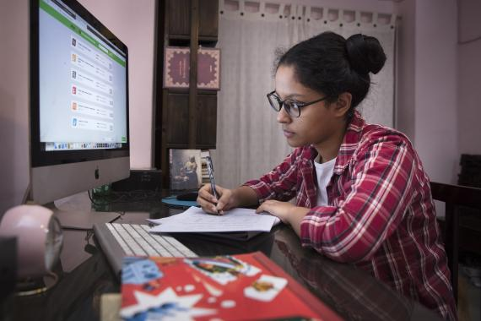
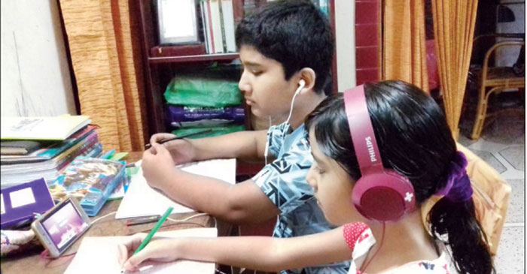
Do they have online opportunities?
Do they have online opportunities?
Does she have online opportunities?
Yes, I think she has all kinds of opportunities.
I think, they don’t have

Slide 17
6. Use suffix or prefix or both:
Individual work
Loans can be (a) — (give) for the (b) — (chase) of distance learning equipment such as computers, laptops, especially mobile phones by (c) — (arrange) loans at low or nominal (d) — (rest) . A large number of students in the United States graduate with a loan from a bank or state (e) — (govern) for (f) — (high) education. When she/he (g) — (come) to work, he pays the government or the bank in installments. We can at least arrange this loan on (h) — (education) materials. Although the bank say that there is an (i) — (educate) loan system in Bangladesh, we do not see much of its real (j) — (allot). It is time to (k) — (date) these (l) — (communicate) tools and keep educational (m) — (activity) in line with the outside world. (n) — (wise), the country could become the land of diamond king.
0.5×14=7
Read the text
a. given
b. purchase
c. arranging
d. interest
e. government
f. higher
g. comes
h. educational
i. education
j. allocation
k. update
l. communication
m. activities
n. otherwise
Madhu Sudan Das. BA (Hon’s), English; MA (Double); ELL & ELT, M.Ed.

Slide 18
7. Make Question tag
1×7=7
1. He is a pronoun, ________ ?
isn’t it
2. The animal rose in them, ________?
didn’t it
3. The girl in her pleased us all, ______?
didn’t it
4. Those who are honest hardly suffer, _______ ?
do they
5. Happy birthday, ______ ?
don’t I
6. Many a girl was present, ___________ ?
weren’t they
7. He let us enter the house, _________?
didn’t he
Madhu Sudan Das. BA (Hon’s), English; MA (Double); ELL & ELT, M.Ed.

Slide 19
8. Use capitals and punctuation marks:
0.5×10=10
who are you what do you want
we are replied one of the friends strangers we shall go a long way we want shelter for the night
where will you go said an old man
to the hills replied another friend
to the hills shouted the old man why will you go to the dangerous hills
“Who are you? What do you want?”
“We are”
replied one of the friends,
“Strangers we shall go a long way. We
want shelter for the night.”
“Where will you go?” said an old man.
“To the hills,” replied another friend.
“To the hills!” shouted the old man, “Why will you go to the dangerous hills?”

