Slide 1
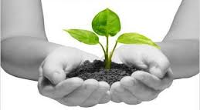
Welcome
To English 2nd Paper class.

Slide 2
Identity.
Conduct by
Md. Monirul Islam
Assistant Teacher
Email- monir19077@gmail.com
Mob: 01761714820
Azimnagor Com. K.School & B. College.
Subject Identity
CLASS- 9-10
*SUB- ENGLISH 2nd part.
(paragraph/composition)
*TIME- 50 MINUTES

Slide 3
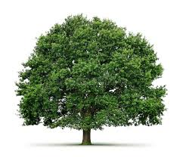
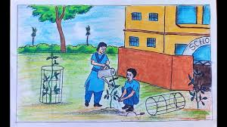
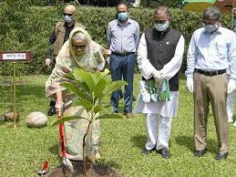
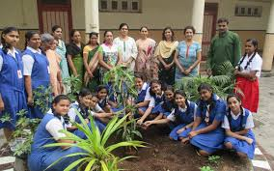
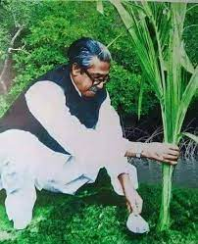
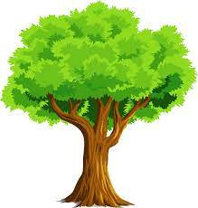
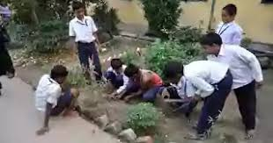
Tree Plantation.
Look at these pictures .
Look at some more pictures .
What can you see ?
Trees .

Slide 4
So Today we will read and share about-
Subject- English 2nd part.
(Paragraph/composition)
Tree Plantation.

Slide 5
Learning outcomes .
At the end of the lesson, we will be able to –
define about tree plantation ;
write a composition ;
ask and answer question .

Slide 6
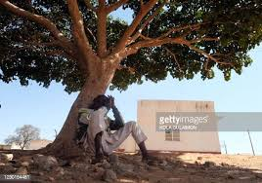
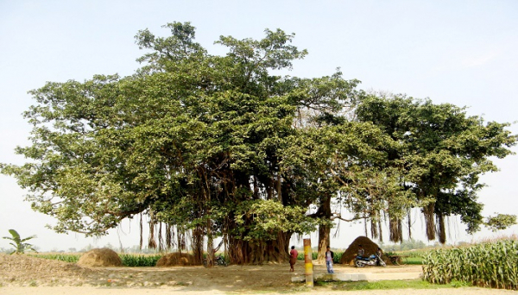
Trees are gift of nature. They give us cool shade with their spreading branches.

Slide 7
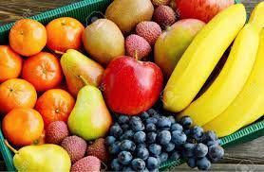
Trees give us many kind of fruits and flowers.

Slide 8
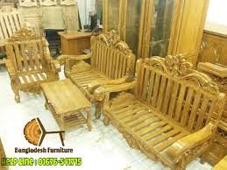
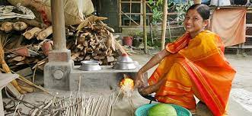
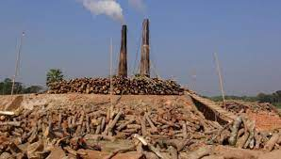
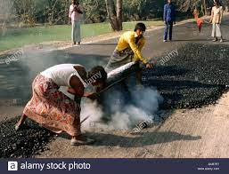
We get wood from trees for our-
Furniture
Cooking food
Burning brick
Melting pitch

Slide 9
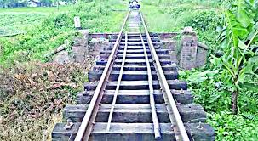
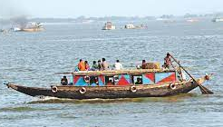
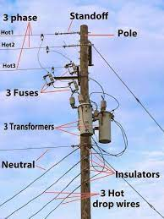
We also get wood from trees for our-
Railway slippers
boats
electric poles

Slide 10
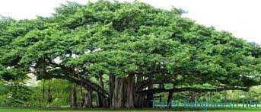
Trees produce oxygen which we inhale and absorb carbon dioxide.
oxygen
Carbon dioxide

Slide 11
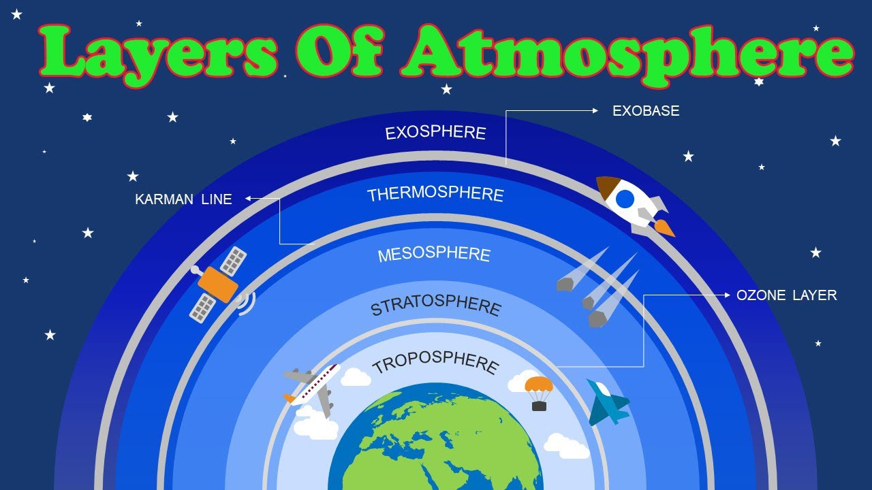
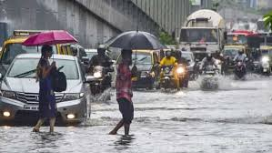
Trees keep the atmosphere cool and help rainfall.

Slide 12
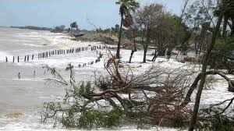
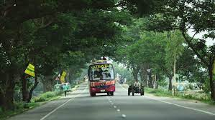
Trees among the roadside and costal areas prevent erosion of the soil with their spreading roots.

Slide 13
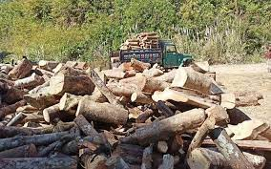
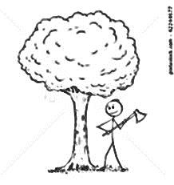
We should check the unwise chopping
down of trees.

Slide 14
We should plant trees to preserve a green world for our future generation .

Slide 15
Evaluation.
1 . What are trees for us ?
2. What do we get from trees?
3. What purposes wood use d for ?
4. What role does tree play on atmosphere ?
5. Why should we plant tree ?

Slide 16
Home work
Write a composition about “Tree plantation” in your own word.

