Slide 2
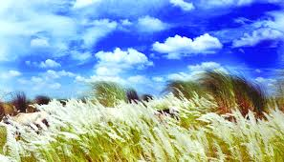
Welcome to all

Slide 4
Lesson information
Class :Five
Subject : English
Unit :14
Lesson :1
Title: Story: The hare and the tortoise
Today’s Lesson: A

Slide 5
Let’s enjoy a video

Slide 6
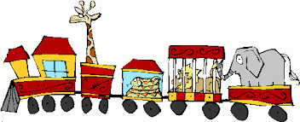
LEARNING OUTCOMES
Students will be able to
Listening
4.2.1 Understand and enjoy simple stories.
Speaking
1.1.1 Say words, phrases and sentences with proper sounds and stress.
Reading
1.7.1 Read paragraphs, dialogues ,stories ,letters and other texts .

Slide 7
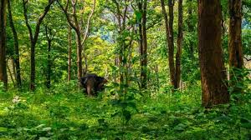
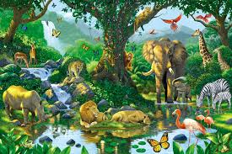
What are you see in those picture?
There are some animals in that picture

Slide 8
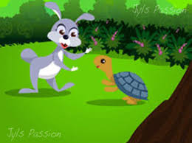
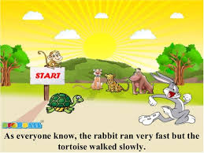
Dear learners what are you see in above pictures?
The hare and the tortoise and also some other animals.

Slide 9
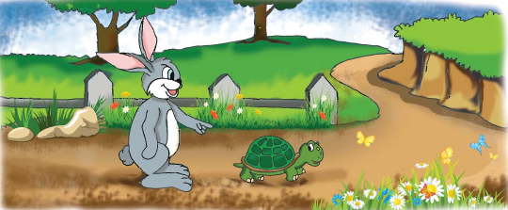
Today’s Lesson
Unit :14, Lesson:1, Page :54
Story: the hare and the tortoise

Slide 10
Fast
Slow
Angry
Finish
Start
New words

Slide 11
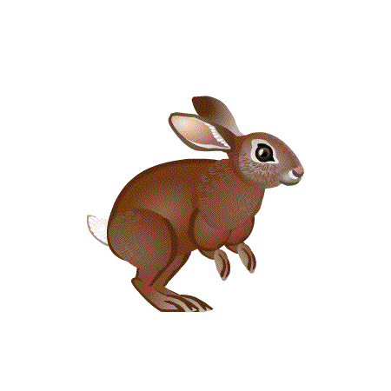
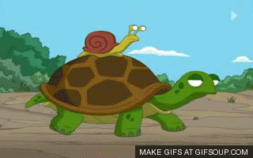
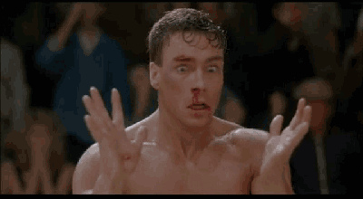
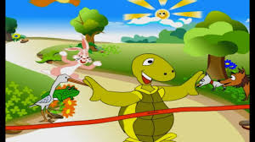
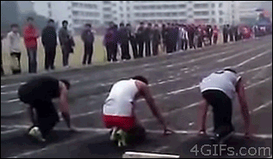
New words
Fast
Quick
The hare is a fastest animal.
Slow
Late
The tortoise is a slowest animal.
Angry
Crazy
He felt angry.
Finish
End
The tortoise crossed the finish line.
Start
Begain
Let’s start the race.

Slide 12
One day, a hare was walking in the forest when he saw a tortoise. The hare was the fastest animal in the forest.

Slide 13
The hare was the fastest animal in the forest.The tortoise was the slowest animal in the forest.

Slide 14
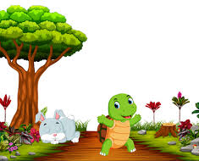
The hare called out to the tortoise,Harry up!You are so slow! Can’t you walk faster? Can’t you run?”

Slide 15
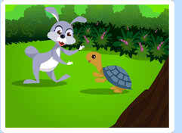
The tortoise felt angry and said to the hare, Why don’t we have a race?Maybe I can win!’’

Slide 16
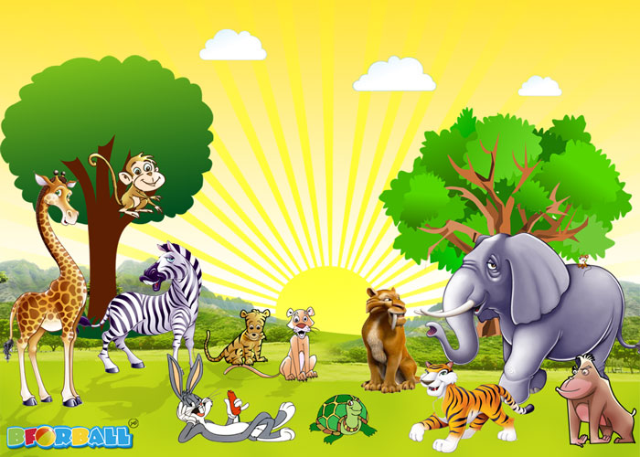
They agreed to start next to a big tree and finish to the river. Then they called their friends to watch.

Slide 17
The hare stood beside the tortoise and the race began.

Slide 18
Slow but steady wins the race!”

Slide 19
The story on a smart art.
Story:the hare and the tortoise
The hare was the fastest animal.
The tortoise was the slowest animal.
Then they call their friends to watch.
The race began.

Slide 20
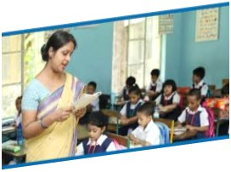
Teacher’s Loud reading

Slide 21
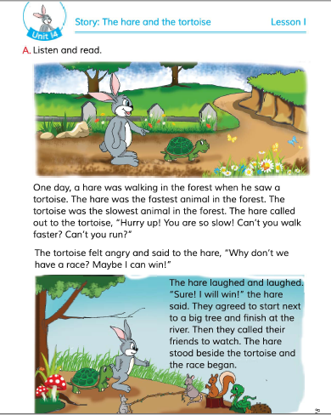
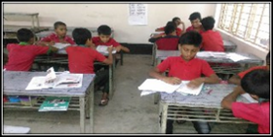
STUDENT’s {silent reading}

Slide 22
GROUP WORK
Group - ROSE | Read the passage with correct pronunciation stress and intonation.
Group - BELLY | Read the passage with correct pronunciation stress and intonation.
Group –JUI | Read the passage with correct pronunciation stress and intonation.
Group –JABA | Read the passage with correct pronunciation stress and intonation.
Group -CHAPA | Read the passage with correct pronunciation stress and intonation.

Slide 23
Match the picture with their words
Fast
Slow
Angry
Finish
Start

Slide 24
Answer the following questions
1. Where was the hare walking ?
Ans: The hare was walking in the forest.
2.Who was the fastest animal in the forest ?
Ans:The hare was the fastest animal in the forest.
3.Who was the slowest animal in the forest ?
Ans: The tortoise was the slowest animal in the forest.

Slide 25
HOME WORK
Write five sentences about the hare and tortoise .

Slide 26
One day one word
FINISH
end
সমাপ্ত

