Slide 1
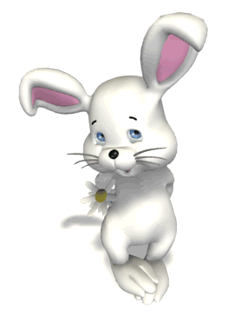
Welcome to my class

Slide 2
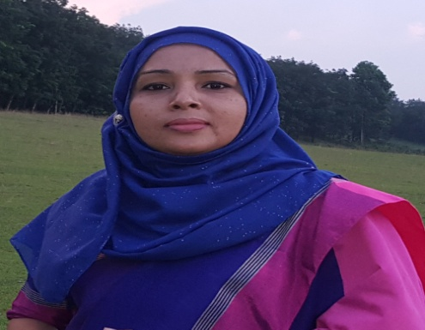
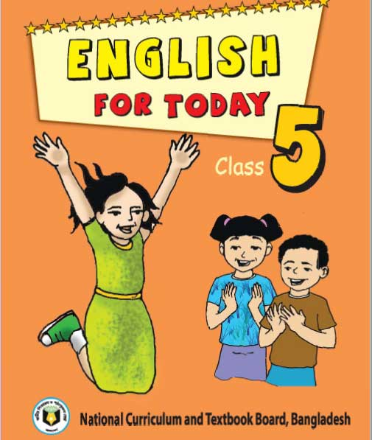
Identity
Achia Begum
Head teacher
Uttarsur K.C Govt. Primary school
Sreemangal, Moulvibazar.

Slide 3
Learning outcomes
Listening
1.4.1 recognize and use intonation patterns for Yes/No and Wh questions.
1.1.1 say words, phrases and sentences with proper sounds and stress.
1.1.2 say sentences with proper intonation.
3.1.1 ask and answer Wh questions.
Speaking
1.6.1 recognize and read statements, commands, greetings, questions and answers.
5.1.1 read silently with understanding paragraph.
Reading

Slide 4
Pre knowledge test …….
Mr.
What title do we use to address a man?
Mrs.
What title do we use to address a married woman?
Ms.
What title we use to address both married and unmarried women?
Ms.
How will you address me?

Slide 5
Let’s enjoy a video…..

Slide 6
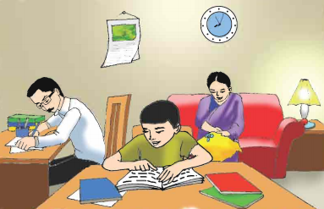
Look at the picture
Think in pair and say what are they doing?
The man is writing.
The woman is sitting on the sofa.
The woman is sewing.
The boy is reading.

Slide 7
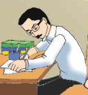
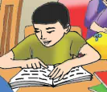
Their identity…….
Mr.Rashidul Islam,banker
Mrs.Monwara Islam,housewife
Saikat Islam,student

Slide 8
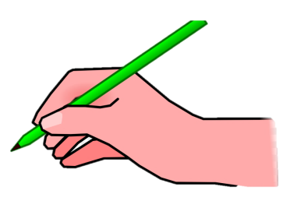
Our today’s topic is …….
Saikat’s family
Unit:3
Lessons: 1-2(A,B,C)
Pg: 10

Slide 9
Listen to me carefully….
Saikat Islam lives with his parents in a flat in Bogra.

Slide 10
His father Mr.Rashidul Islam is a banker.But in his free time Mr.Islam writes stories and listens to music.

Slide 11
Saikat’s mother is Mrs.Monwara Islam.She is a housewife. In her free time she enjoys sewing.She makes dresses.She often gets orders from her friends and neighbours.

Slide 12
Saikat is in class 5.He is a good student.

Slide 13
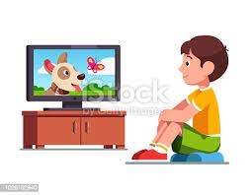
He wants to improve his English,so he watches cartoons on TV everyday.

Slide 14
He also reads English books.He likes books about animals, especially tigers and lions.

Slide 15
Key words
parents
Father and mother
banker
who works in a bank
improve
To do better

Slide 16
a woman who performs the household works.
housewife
to make dresses by using a needle and thread.
sew
to wish to get something.
want

Slide 17
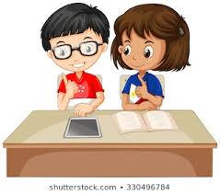
Pair work
Read in pair. One student will read
by turn and others will listen. Help him/
her .Do it in turn.

Slide 18
Answer the questions…..
1.What is Saikat’s parents occupation?
Saikat’s father is a banker and mother is a housewife.
2. What is saikat’s father’s name?
Saikat’s father’s name is Mr. Rashidul Islam.

Slide 19
3.What do his parents do in their free time?
In their free time his father writes stories and his mother enjoys sewing.
4. What does Saikat do in his free time?
In his free time Saikat watches cartoons on TV and reads English books.

Slide 20
5. What kind of books does Saikat like?
Saikat likes books about animals, especially tigers and lions .

Slide 21
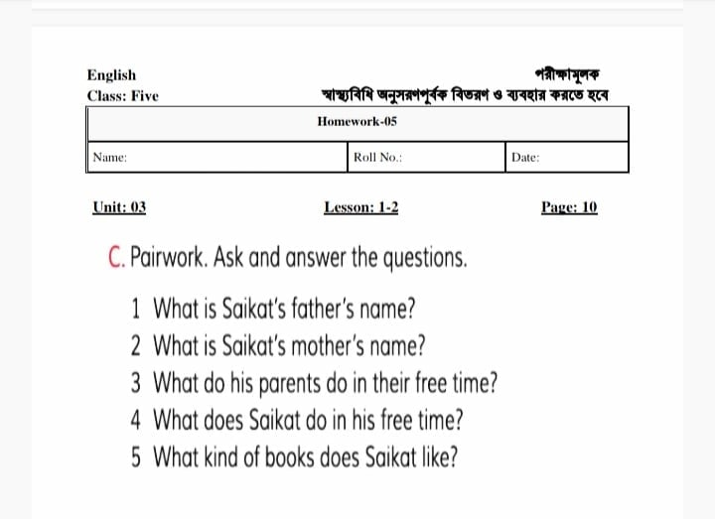
Read and write C at home.

