Slide 1
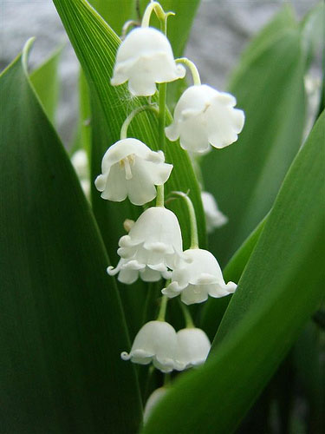
Congratulation
You are welcome

Slide 2
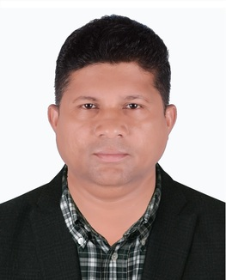
Presented by:
Dulal Halder
Assistant Teacher
Kumna Government Primary School
Chhatak,Sunamgonj.

Slide 3
Lesson Introduce
Class:One
Subject:
English For Today

Slide 4
Heading: Alphabet Unit-16 Lessons(4-6)
Part of lesson: A. Look,listen and say. Trace in the air.

Slide 5
Learning outcome:
At the end of the lesson,students will be able to-
1.2.1- recognize and read the alphabet both small and capital.
1.2.1- write non-cursive capital and small letters.

Slide 6
Let us enjoy a greeting song.

Slide 7
Look at this letters.
Do you know this letters?
Please say this letters after me.
a
b
c
d
e
f
g
h
i
j
k
l

Slide 8
Now say a word to me with each letter.
a-ant
b- ball
c- cat
d-dog
e- egg
f- fish
g- goat
h- hen
i- insects
j- jar
k- kite
l- lamp

Slide 9
Do you like game? We want to play a interesting game. Ok. It’s a matching game.
ant
ball
cat
dog
egg
fish
a
b
c
d
e
f
goat
hen
insects
jar
kite
lamp
g
h
i
j
k
l

Slide 10
What’s this?
moon

Slide 11
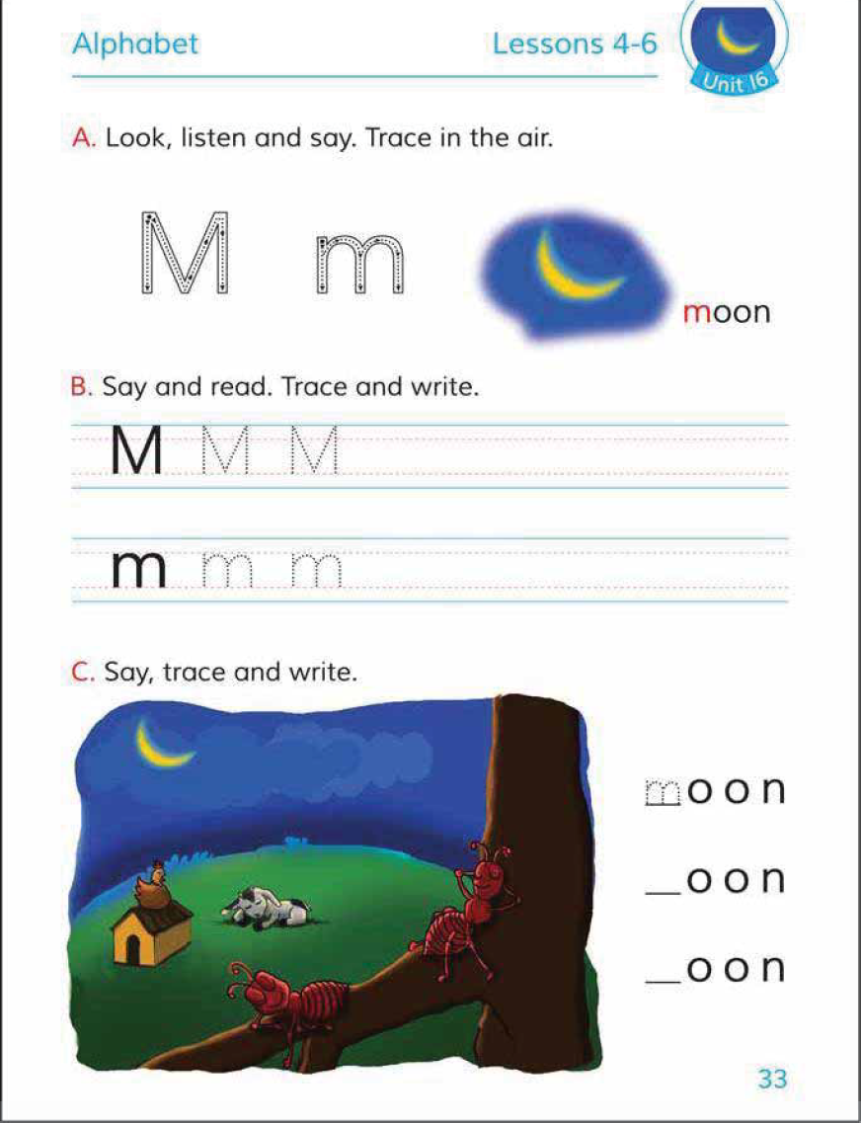
Now open at page 33. See the Activity A.

Slide 12
Now say after me the name of this letter and its pronounciation.
M
m

Slide 13
What is the pronounciation of first letter?
moon
M m

Slide 14
Look attentively how to write the capital M and small m.

Slide 15
Now students look attentively and trace in the air. Try again and again.

Slide 16
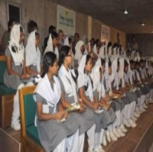
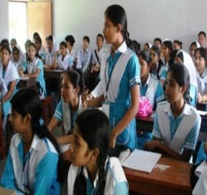
EVALUATION
Moon
What is the pronounciation of the first letter?

Slide 17
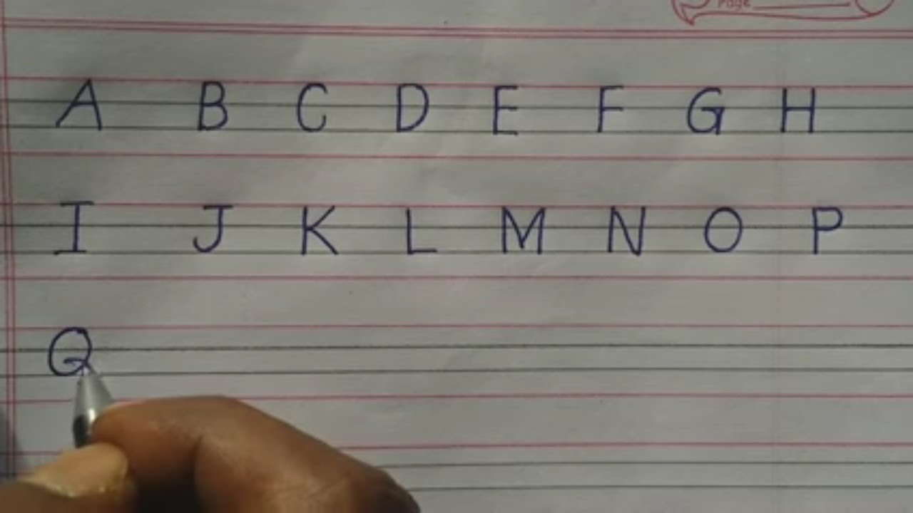
Look at these capital letters and follow them.

Slide 18
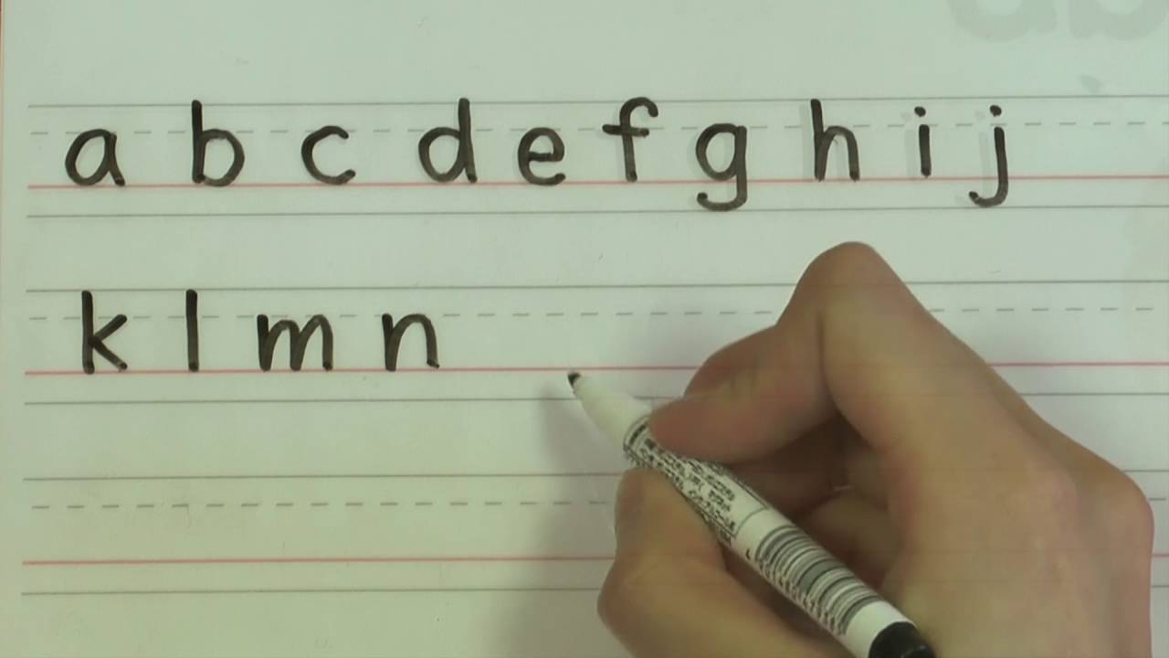
Look at these small letters and follow them.

Slide 19
HOME WORK
You will write capital M and small m 10 times in your notebook.

Slide 20
Wish you a goodluck for today and good

Slide 21
See again tomorrow--
“Thanks to all”

