Slide 1
WELCOME

Slide 2
Lesson Identity
Subject : English
Class : Five
Unit : 1
Lesson : 4-5 (Hello!)
Part of the lesson : E&F (Sima and Tamal are in the Town …………… Come with me.)
Time : 40 minutes.
Date : 26.05.2021

Slide 4
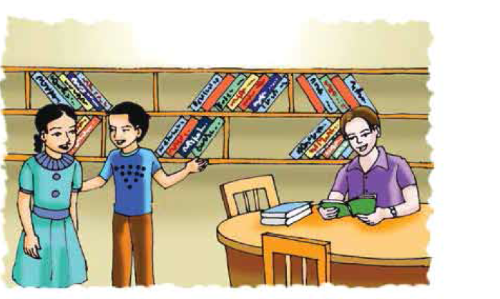
Let’s see the picture

Slide 5
Today’s Lesson
Hello!

Slide 6
New words
Bookshop
বইয়ের দোকান
Bookstore
Chat
গল্প করা
Talk
Club
সংঘ
Society
Thinking
Idea
ধারণা
Tongue
Language
ভাষা

Slide 7
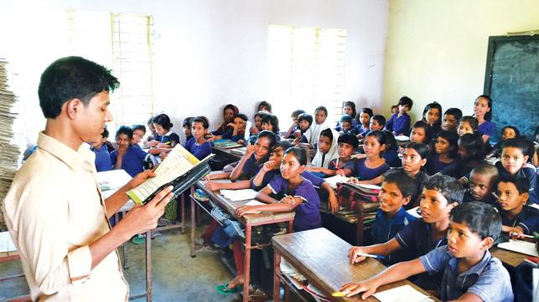
Teacher’s reading

Slide 8
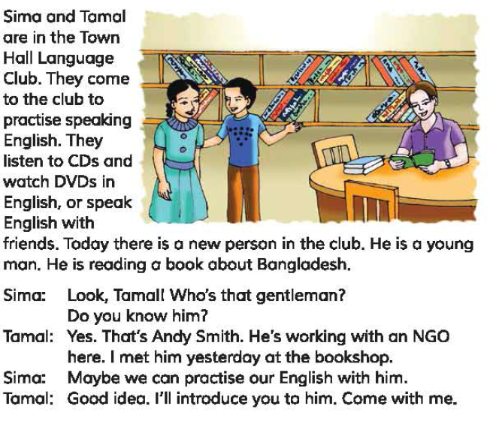

Slide 9
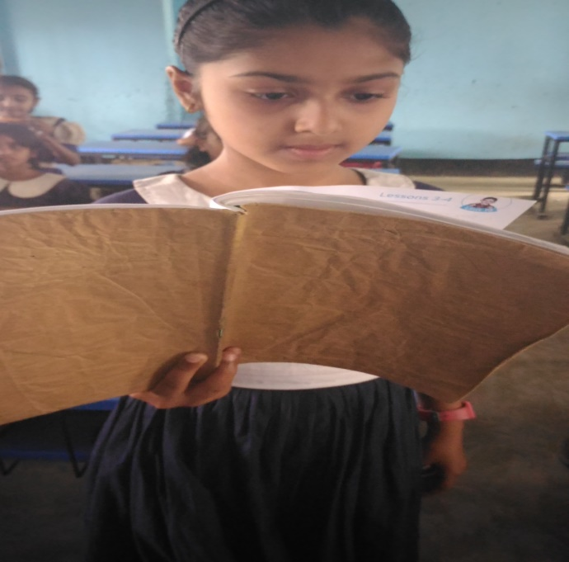
Student’s Reading
Let’s read by change role.

Slide 10
Pair work
Answer the following questions:
a. Where are Sima and Tamal?
b. Who is the new person there?
c. Why do they go there?
d. What is Andy reading?
e. Where did Tamal meet the new person?
f. Why does Sima want to meet the new person?

Slide 11
Group work
Group: Rose
Write True for correct statement and False for incorrect statement:
a.Tamal and Sima know each other.
b.Andy was reading a book about Bangladesh.
c.Sima wants to speak with Andy.
Group: Lily
Fill in the blanks using the right words:
a.Andy Smith is a -------------.
b.Sima and Tamal want to
-------------- their English
Sima to Andy.
c.The club ------------- listen to CD’s in English.
foreigner
True
improve
True
members
True

Slide 12
Evaluation
Make Wh questions from the underlined words
a.Jessica is going to Chattogram.
b.She is from the UK.
c.He is reading a book about Bangladesh.
d.Tamal met Andy Smith yesterday.
e.They come to the club to practise speaking English.

Slide 13
One day one word
Gentleman
অর্থ
ভদ্রলোক
Asif is a gentleman.

Slide 14
Home work
Write five sentences about ‘How to improve English’.

Slide 15
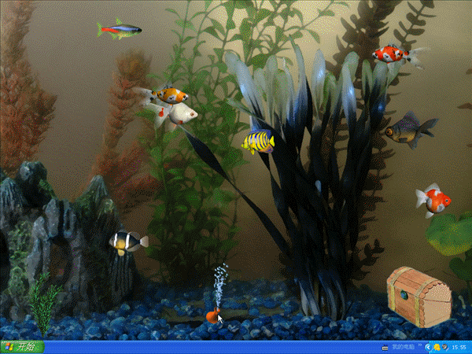
Thanks everybody

