Slide 1
WELCOME TO OUR ENGLISH CLASS

Slide 2
INTRODUCTION
TEACHER
LESSON
SHAHRINA TAHIR NISHU
LECTURER
SUBJECT:ENGLISH
KUP COLLEGE,KALIGANJ, LALMONIRHAT
VOICE CHANGE (PART 1)

Slide 3
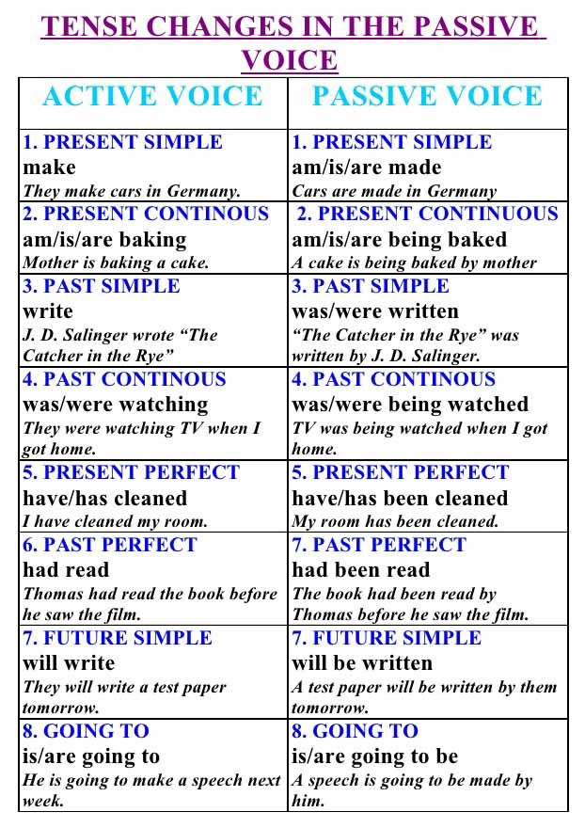

Slide 5
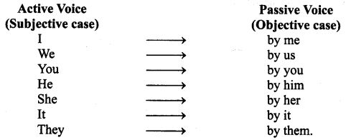
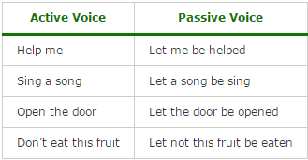

Slide 6
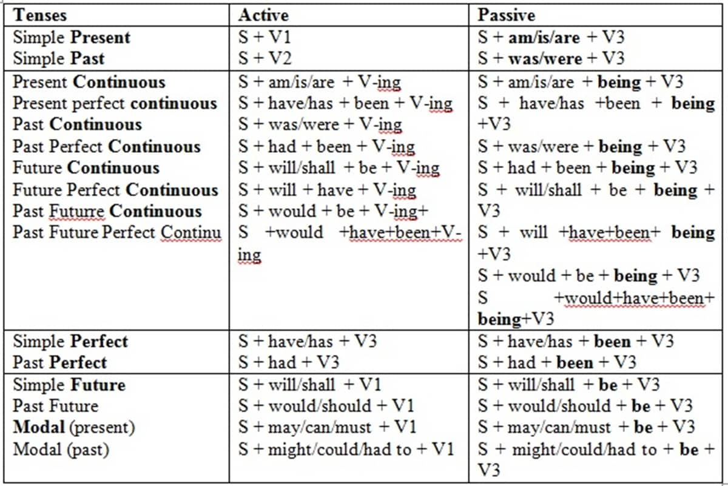

Slide 8
LETS FOLLOW THE RULES

Slide 9
NOW DISCUSS AND PRACTICE

Slide 10
HOME WORK

Slide 11
SEE YOU SOON
THANK YOU AND
GOOD BYE

