Slide 2
INTRODUCTION
MD. AFSAR ALI
Assistant Teacher in English
MAJHIRA MODEL HIGH SCHOOL
SHAJAHANPUR, BOGURA
ENGLISH FOR TODAY
CLASS: NINE

Slide 3
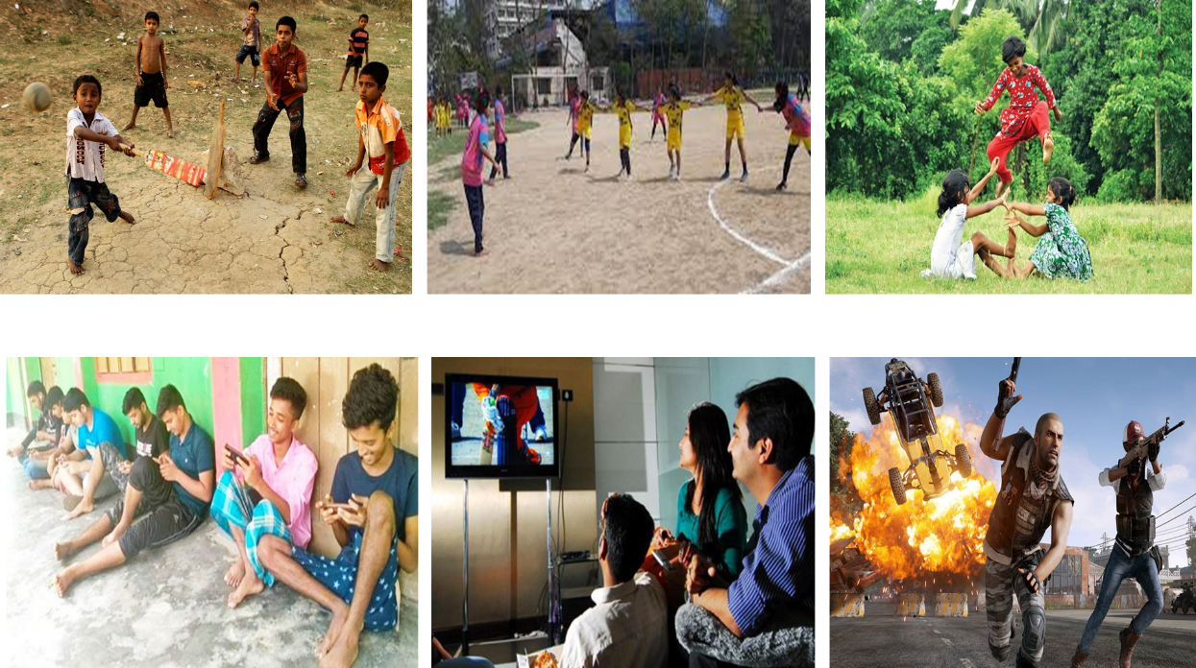
What is the difference between the pictures?
Look at the picture carefully. What can you see in the pictures.
What is your observation on hobbies in the past and present?

Slide 4
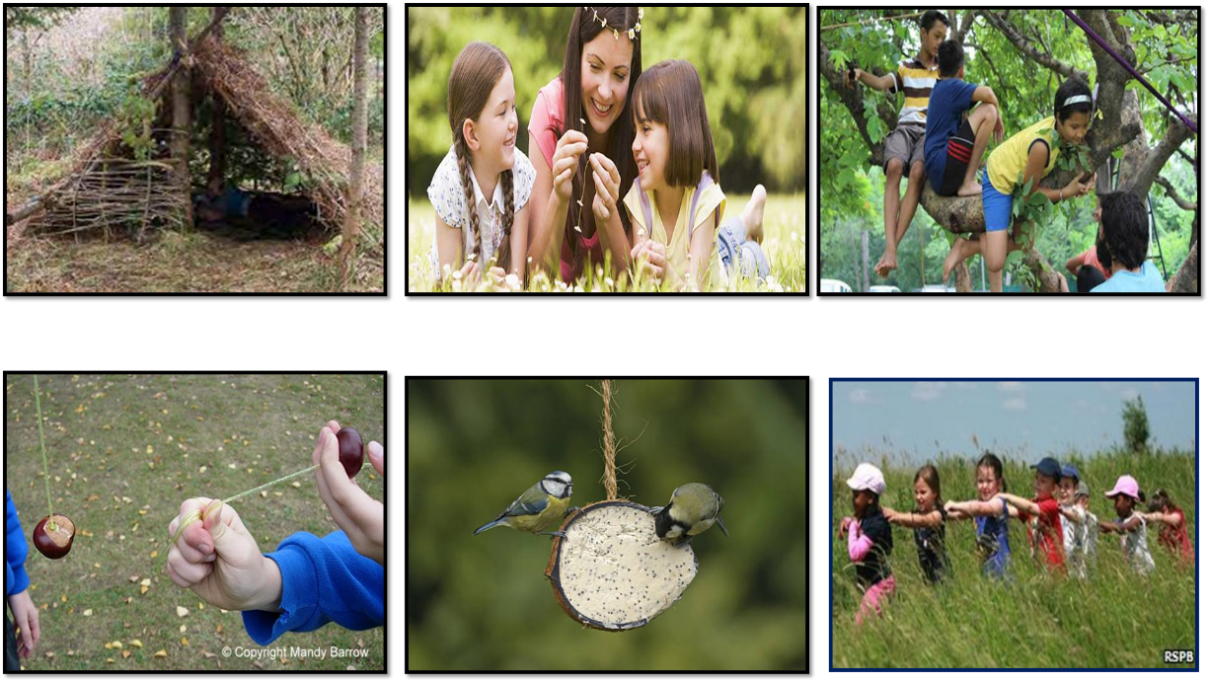
Look at the picture carefully and try to tell what our today’s lesson is

Slide 6
Learning outcomes
After this lesson the students will be able to-
read and understand the text
ask and answer the questions
choose the best answer
fill in the blanks

Slide 7
Let's introduce with some key words
Synonym
Word
Conventional
Traditional
customary
ceremonial
classical
Sentence: It was a very traditional ceremony.
Meaning: Belonging to the customs

Slide 8
Let's introduce with some key words
Synonym
Word
Hobby
Pastime
Leisure
Entertainment
Amusement
Meaning: An activity that someone does regularly for enjoyment rather than work; hobby.
Sentence: Gardening is a very rewarding pastime.

Slide 9
Let's introduce with some key words
Synonym
Word
Move up
Climb
ascend
Mount
go up
Meaning: Go or come up (a slope, incline, or staircase), especially by using the feet and sometimes the hands; ascend.
Sentence: The boy is climbing a tree.

Slide 10
Let's introduce with some key words
Synonym
Word
shortfall
Deficit
Deficiency
Scarcity
Discrepancy
Meaning: The amount by which something, especially a sum of money, is too small.
Sentence: He made up the deficit with a loan.

Slide 11
A. Read the text.
Traditional childhood pastimes of climbing trees and playing Conkers are in decline according to survey by the RSPB (Royal Society for the protection of Birds). It’s a charitable organization registered in England and Wales.
The survey shows that people under 34 recall far fewer such childhood outdoor experiences than their counterparts over 55, according to a survey by RSPB.
People were asked which of 12 outdoor experiences they could remember during their childhood.

Slide 12
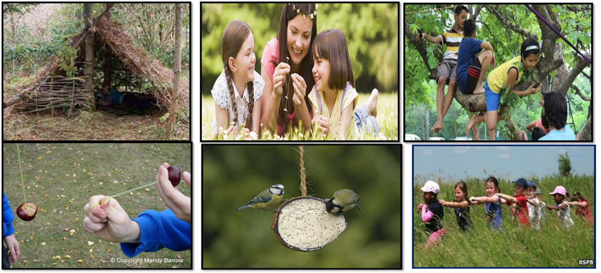
The answer included making dens, daisy chains, climbing trees, playing conkers and feeding birds. Four out of five boys climbed trees and the same numbers of girls made daisy chains.
Some 15% more of those aged over 55 had these outdoor experiences in their childhood, compared with those between 15-34 years old.
But the survey showed the numbers declining among the newer generations.

Slide 13
Some 92% of the public agreed that experiences of nature were still important to children, and 82% agreed that schools should play a role in providing them to all children.
At the same time, there has been a decline in these opportunities, with negative consequences for children, families and society - a condition now known as nature deficit disorder.
The survey has highlighted the positive impact of contact with nature on a child's education, health, wellbeing and social skills.

Slide 14
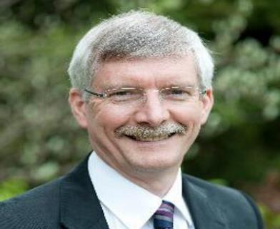
Mike Clarke, chief executive of the RSPB, will meet parliament members on Tuesday to urge the government to join other organizations in providing children with first-hand experiences of the natural environment... “We believe this guidance should include the many positive impacts to children of having contact with nature and learning outside the classroom”.

Slide 15
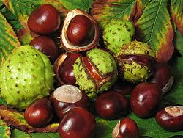
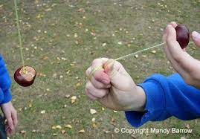
B. Read the following words and write their meanings as you understand them from the context. If you don’t understand, check the words from a dictionary.
Conkers: Conkers is a traditional children's game in Great Britain and Ireland played using the seeds of horse chestnut trees—the name 'conker' is also applied to the seed and to the tree itself. The game is played by two players, each with a conker threaded onto a piece of string: they take turns striking each other's conker until one breaks.

Slide 16
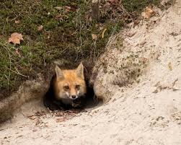
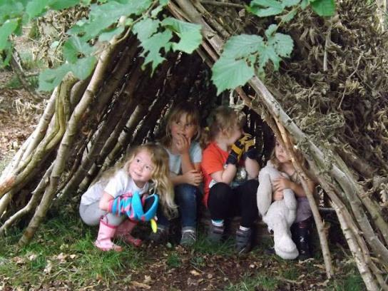
Dens: The hidden home of wild animals.
Dens: A small structure built by children as a place to play.

Slide 17
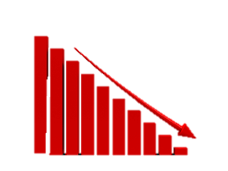
Decline: A gradual or continuous loss of numbers or value.

Slide 18
Emphasize
Highlight: Highlight refers to the action or process of making an object stand out from the rest of the objects on the display screen. The highlighted objects could be a selected block of text, menu options or command buttons. The objects are usually highlighted when they are selected by a combination of mouse clicks or keyboard buttons. The highlighted objects appear more prominent than the rest of the objects.

Slide 19
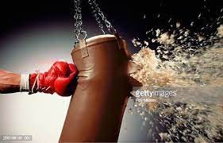
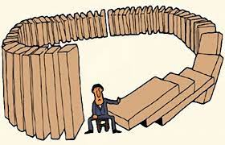
Impact: Impression of one thing on another.
Consequence: A result of effect, typically one that is unwelcome or unpleasant

Slide 20
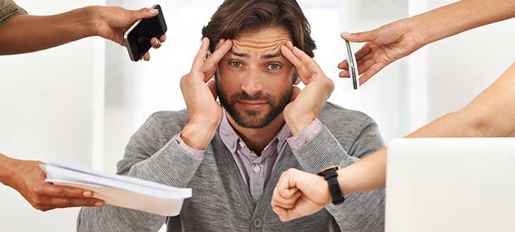
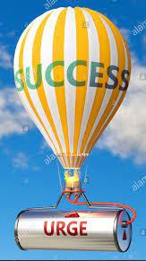
Disorder: A physical or mental condition that is not normal or healthy.
Urge: To demand, request.

Slide 21
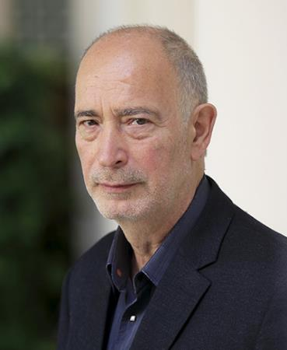
C. Read the following statement from the text in A and say what the subject of comparison in. Find out the other comparison in the text above.
Ans: Here the change of pastimes has been compared. The other comparison is that some 15% more of those aged over 55 had these outdoor experiences in their childhood, compared with those between 15-34 years old.
People under 34 recall fewer such childhood out door experiences than people over 55, according to the survey by Ipsos Mori for RSPB.

Slide 22
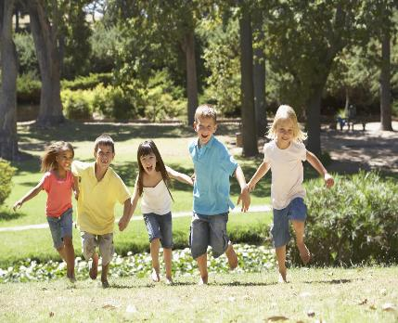
D. Do you agree that if children have more contacts with nature, they may have a positive impact on them? Make a list of the benefits or harms they may have if taken to nature frequently.
Ans: Nature is the best healer. Children can be benefitted if they are taken to nature frequently, Some of them are listed below:
Nature broadens one’s mind.
It teaches one to be votary of knowledge.
It is the best place to contemplate.
It has positive impact on a child’s education, health, wellbeing and social skills, etc.
I don’t have any big problem if children are taken to nature frequently. But some small problems may rise. Such as:
For some weaker children, it may be waste of time.
Wild animals or insects may bit the children.
Running in open nature, they may sometimes hurt themselves.

Slide 23
Choose the best answer
1. The word ‘in decline’ means __.
(i) rising (ii) spoiling (iii) decaying (iv) weakening
2. The word ‘providing’ stands for __.
(i) supplying (ii) bringing (iii) buying (iv) making
3. The word ‘charitable’ refers to __.
(i) educational (ii) recreational (iii) commercial (iv) philanthropic
4. Traditional childhood pastimes are __?
(i) becoming popular (ii) gaining appeal (iii) disappearing (iv) reappearing

Slide 24
5. The word ‘recall’ refers to __.
recast (ii) recap
(iii) discuss (iv) remember
6. What is the closest meaning of the word ‘wellbeing’?
Goodness (ii) Development
(iii) Welfare (iv) Flourishment
7. The word ‘highlight’ means?
To light a lamp (ii) Mention
(iii) Focus (iv) To put the light at a higher place

Slide 25
Fill in the blanks with suitable words
decline
Traditional childhood pastimes are on the (a) .................. The older generation (b) ................... their childhood outdoor (c).....................more than that of the younger (d) ..................... In the past, people like to (e)......................their free time in the midst of (f) ...................... They would (g) ................... dens, daisy chains, climb trees, play conkers and feed birds. In the past almost all the children had close (h) ....................with nature. Nature played a (i) ................... role in their life. They had much outdoor experiences because of having relation with nature. Nature had positive impact on them. But today children have less connection with nature and they are deprived of natural (j) ................... of the citizens.
recollects
experience
generation
spend
nature
make
connection
vital
experience

Slide 26
Answer the following questions
(i) What is pastime?
Answer: Pastime is the activity that we enjoy by doing in our leisure period.
(ii) Can you tell some names of work that one does in pastime?
Answer: Gardening/singing/dancing/story writing/reading books/playing games/internet browsing etc.
(iii) Among the mentioned pastime works which one is yours?
Answer: Gardening/singing/dancing/story writing/reading books/playing games/internet browsing etc.

