Slide 1
Welcome
to this
class

Slide 2
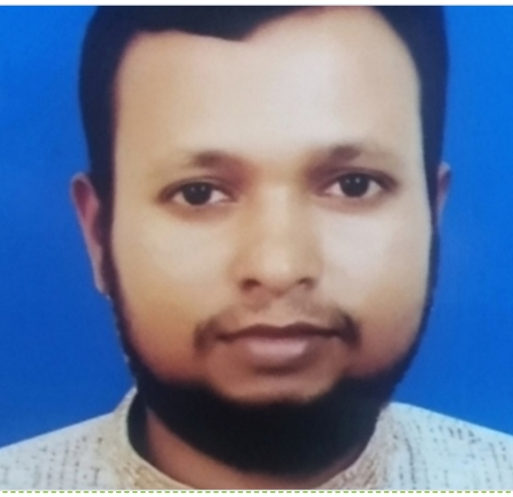
INTRODUCTION
MD. Habibur Rahman
Assistant teacher
Tilsindur Dakhil Madrasah
Barhatta-Netrakona
Class: Eight
Sub:English
First-paper

Slide 3
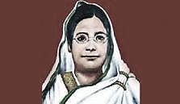
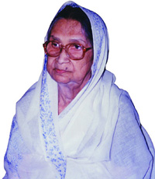
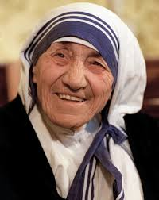
Their names frequently come in our mind, when we talk about women empowerment.
Because they are regarded as the pioneer of women empowerment.

Slide 4
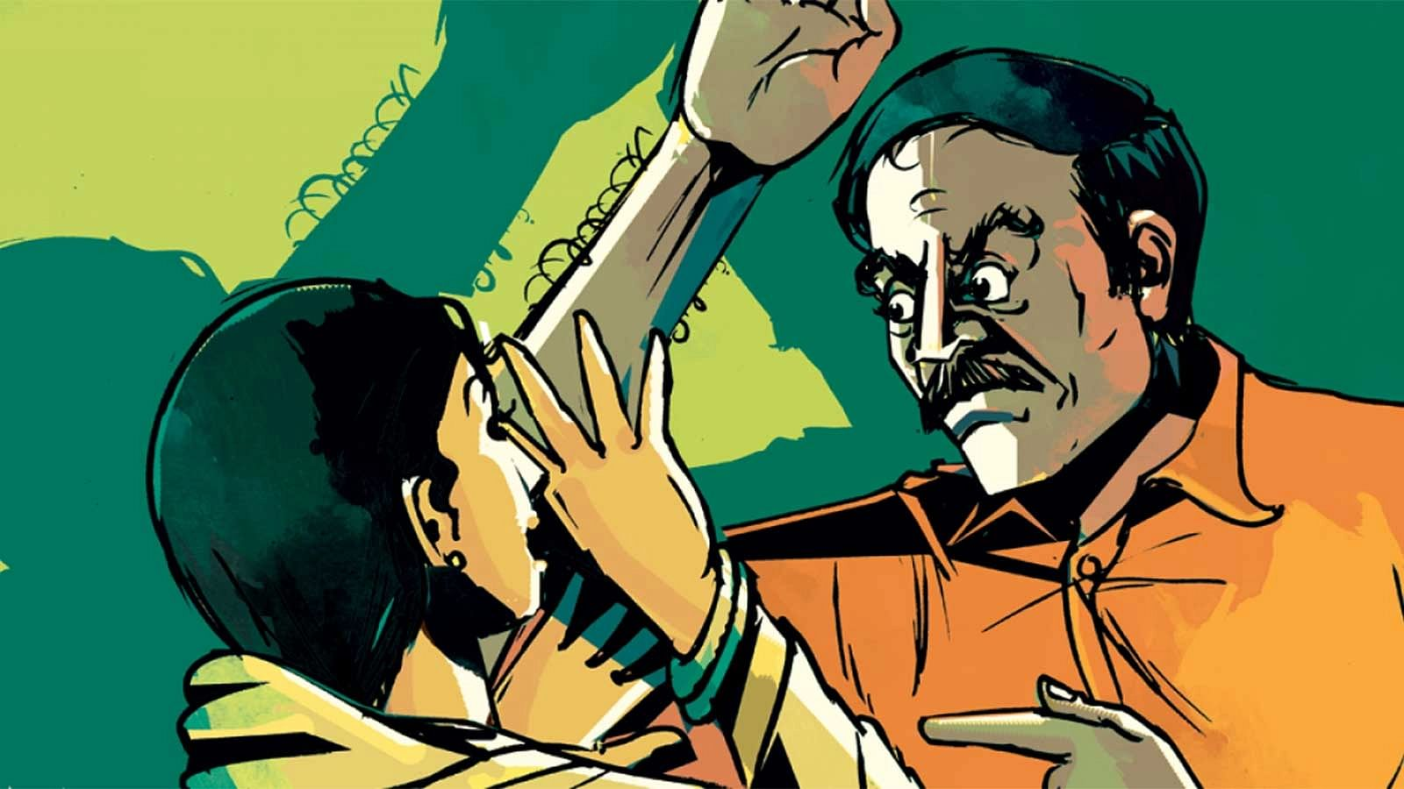
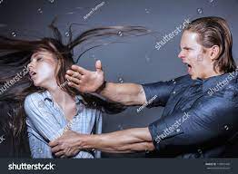
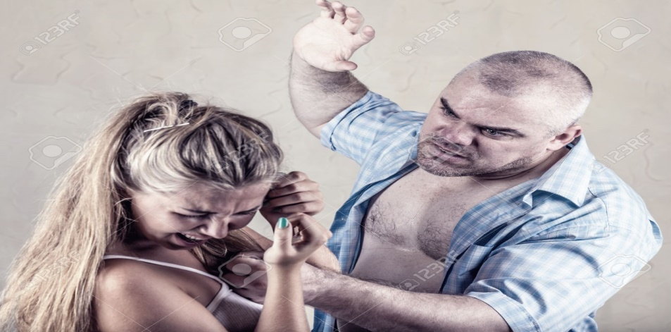
LOOK AT THE PICTURES

Slide 5
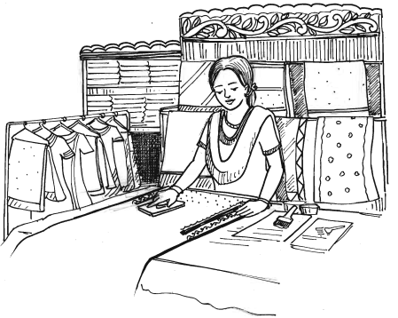
Today’s topic is
Ever Beautiful Shamima
Unit-5
Lesson-3

Slide 6
Learning Outcomes
After this lesson the students will be able to-
read and understand text through silent reading
find out the true/false sentences and correct them.
choose the best answers from the alternatives.
practice fill in the gaps with suitable words
ask and answer questions.

Slide 7
Let’s read the text.
Open Your book and read the passage silently for 10 minutes........

Slide 8
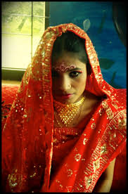
Shamima’s misery started the day she was married. Her husband was a greedy person and he used to abuse her verbally and physically. Within a few months into her marriage she had to leave her husband Kamal Uddin Joarder.

Slide 9
Now Shamima vows to work with women, who are ill-fated like her. She has 43 female members in her organisation working for her. She herself trains the members and then provides them with work. She designs fabrics, makes block-print, brush-paint and hand-embroidered saris.

Slide 10
She also makes three-piece dresses for women, and fatuas for men. She sells these products in her shop and supplies them outside. Shamima has a dream now, a dream to do something for the helpless people. She wants them to feel useful. They can live with self-respect and dignity. With this in view, she goes out looking for such people.

Slide 11
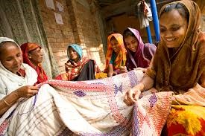
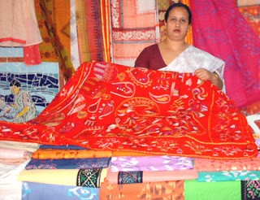
Shamima finished her story with a smile. Shamima has no complaints, no regrets, no grudges. All she wants to do is to bring a smile on the faces of those women who are unfortunate. Shamima wants to become a famous designer.

Slide 12
Choose the best answer from the alternatives
1. What is the similar meaning of abuse ____.
1. use for a bad purpose
ii. use something effectively
iii. treat with cruelty and or violence
iv. dweller
2. The word ‘grudge’ stands for ____.
1. anger
ii. objection
iii. complaint
iv. hatred

Slide 13
3. The adjective form of the word ‘misery’ is ____.
1. miserably
ii. miserly
iii. mishap
iv. miserable
4. Shamima’s husband ____ her.
1. revered
ii. rebuked
iii. adorned
iv. malign

Slide 14
5. Shamima is a ____ woman.
1. fanciful
ii. shy
iii. pious
iv. spirited
6. What is the closest meaning of the word ‘leave’?
1. divorce
ii. depart
iii. abandon
iv. demolish

Slide 15
7. The word ‘dignity’ refers to ____.
1. domination
ii. power
iii. esteem
iv. mirth
8. Shamima’s husband was devoid of ____.
1. humanity
ii. cruelty
iii. atrocity
iv. violence

Slide 16
9. Shamima has a dream ____ do something for the helpless people.
1. with a view to
ii. look forward to
iii. in
iv. to
10. What is the similar meaning of the word ‘respect’?
1. dishonour
ii. homage
iii. ridicule
iv. insignificant

Slide 17
True/false. If false give the correct information.
1. Shamima’s husband destroyed her.
2. Shamima promised to stand beside the helpless women.
3. She has some trainers to train the women of her organisation.
4. Shamima wants to become a wealthy person to help others.

Slide 18
১.True
2.True
3.False- Correct: She trains herself the women of her organization.
4.False- Correct: Shamima wants to become a famous designer.

Slide 19
Fill in the blanks with suitable words.
Shamima has a dream now, a dream to do something for the (a) ______ people. She wants them to feel (b) _____. They can live with self respect and (c) ______. With this in view, she goes out looking for such people. Shamima finished her (d) _____ with a smile. Shamima has no (e) _________, no regrets, no grudges.
a. helpless
b. useful
c. dignity
d. Story
e. complaints

Slide 20
Answer the following questions.
1. Who did Shamima work with?
2. What is Shamima’s present dream?
3. Why did she leave her husband?
4. What did she do after leaving her husband?
5. How has she become an entrepreneur?
6. Why is Shamima working for the helpless people?
7. What type of organization does Shamima run?

Slide 21
Home Work
Write a paragraph to Shamima,s dreams

Slide 22
Thanks all

