Slide 1
Welcome to my MMC

Slide 2
MD. ARIFUL ISLAM
B.A. (Hon’s), M.A. (English)
LECTURER (English)
SHAISTAGONJ KAMIL MADRASAH,
SHAISTAGONJ, HABIGANJ.
E-mail: arif046980@gmail.com

Slide 3
IDENTITY
MD. ARIFUL ISLAM
LECTURER IN ENGLISH
SHAISTAGANJ KAMIL MADRASAH
SHAISTAGONJ, HABIGANJ
Lesson
ENGLISH GRAMMAR.
Class : Eleven & Twelve
Unit : ten, Lesson - 1.

Slide 4
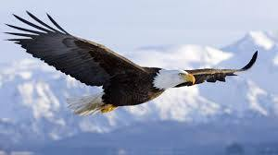
Look at the flying bird.
T : Do you know, here flying what kinds of verb ?
S : Sir, here flying is present participle

Slide 5
Lesson Declaration
So today we shall discuss about
Participle

Slide 6
LESSON OUTCONES
By the end of the lesson students will have
learnt what participle means.
learnt the uses of different participles.
learnt finding out different participles.
learnt filling the gaps using participles.
Join the pairs of sentences by using participles.

Slide 7
Definition of Participle
A participle is a form of verb working as both an adjective and a verb in the sentence.
Kinds of Participle
There are three kinds of Participle.
1. Present Participle
Eating , doing, going etc.
2. Past Participle
Ate, did, went etc.
3. Perfect Participle
Having eaten, having done

Slide 8
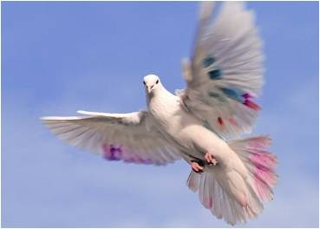
Definition of Present Participle.
A Present Participle expresses an action going on. It is formed by adding ‘ing’ to verb in the sentence. When a participle works as an Adjective, it qualifies the noun.
Examples :
A rolling stone gathers no moss.
( rolling qualifies stone).
The hunter looked at the flying bird
(flying qualifies bird).
Give me some writing paper
(writing qualifies paper)

Slide 9
Definition of Past Participle :
It is the past participle form of a verb. It works both as a verb and an adjective.
Examples :
A burnt child dreads the fire.
The Minister came to visit the
eroded riverbanks.
There is a broken chair in the room.
They will not receive the rejected goods.
Anwar has built a house.

Slide 10
Perfect Participle :
Perfect Participle is formed by using having before the past participle. It also works as a verb and an adjective.
Example :
Having reached home, he went straight to his mother.
Having read the, he gave it to me.
Having seen the film, we shed tears.
Having eaten rice, he went to bed.

Slide 11
Pair Works
Fill in the following passage using right participles from the box
reaching | closed | waiting | Coming | ringing
Before reaching the school, Saad heard the final bell (a) …………………………… (b) …………………………. School, he found the gate (c) ………………………. . So he could not enter the class (d) …………………. by the class teacher. He was (e)…………………………. outside.
Ans : a) ringing, b) reaching, c) closed, d) plying, e) standing.

Slide 12
Group Works
Join the following pairs of sentences by using participles
I saw the old man. He was walking.
(I saw the old man was walking).
I put some tea dust in the water. The water was boiling then
( I put some tea dust in the boiling water).
We visited the area. The area was affected by flood.
( we visited the flood affected area).
He closed the door. Then he went out for a walk.
( Having closed the door he went out for a walk ).
Give me some paper. I want to write.
( give me some writing paper ).

Slide 13
HOME WORK
Complete the sentences:
I saw a man …..
He is ……..
He is working…….
The man being poor…….
The pen is smooth in ……….

