Slide 2
TEACHER’S IDENTITY
CHARADHARY GOVT PRIMARY SCHOOL
ASSISTANT TEACHER
BRAHMANPARA, CUMILLA.
EMAIL- tanzina121996@gmail.com.
TANZINA AKTER

Slide 3
LESSON’S INTRODUCTION
Subject: English
Class: Four
Student’s: 35
Lesson name: the hen and her chicks
Unit: 25
Page: 50
Date : 06/06/2021

Slide 4
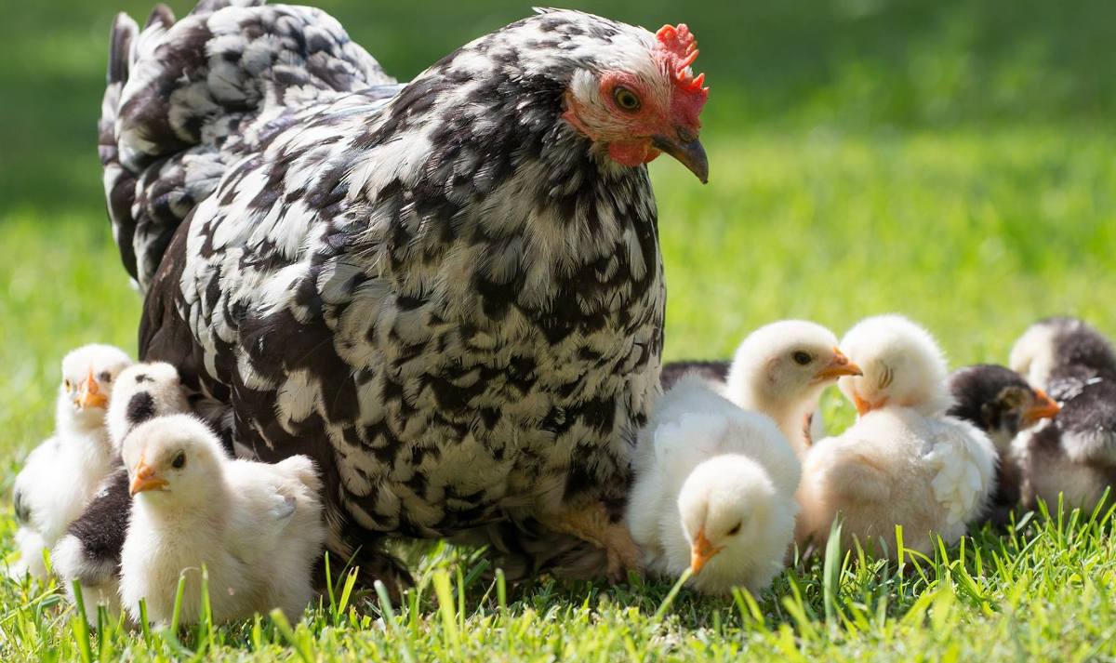
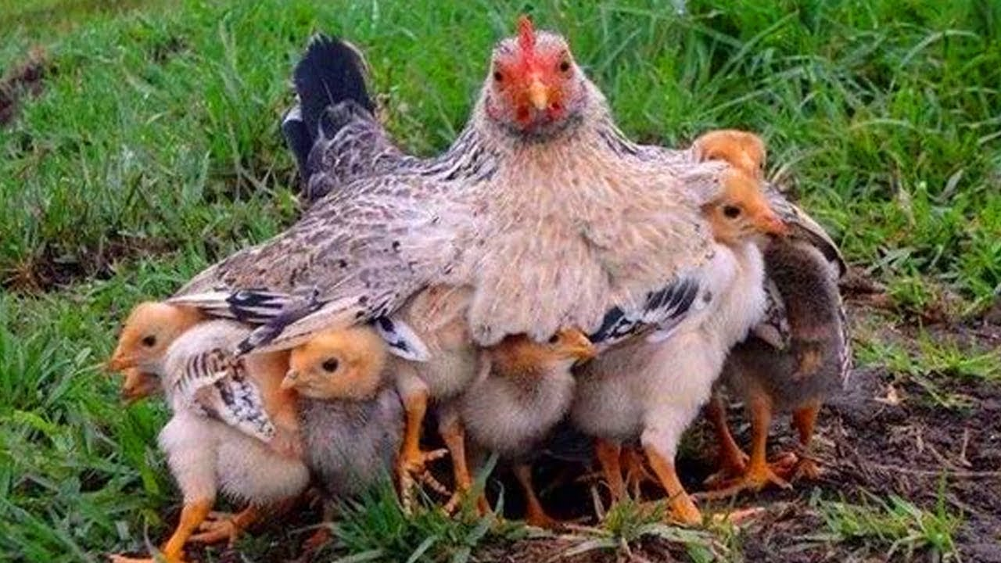
What can you see in the picture?

Slide 6
LEARNING OUTCOME’S
Students will be able to………
a. Read the story properly.
b. Write about importance of work.
c. Learn some new word meaning.
d. Find out the full stop, question marks and exclamation marks.
e. Learn proper use of punctuation and intonation.

Slide 7
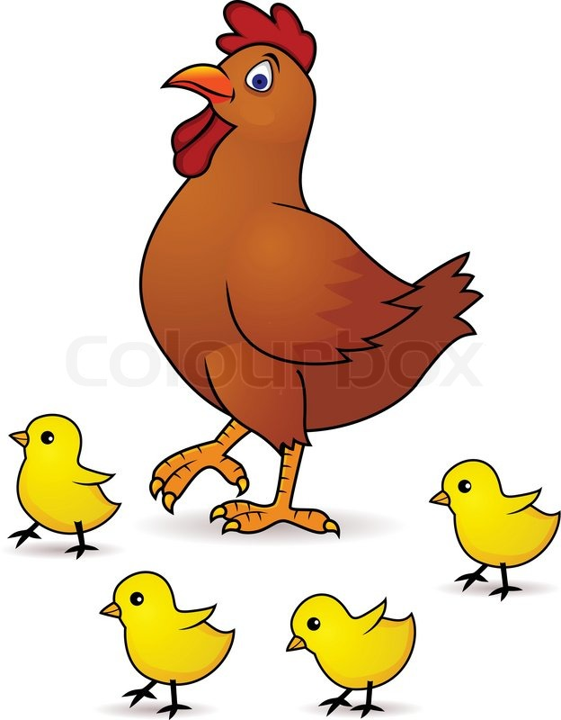
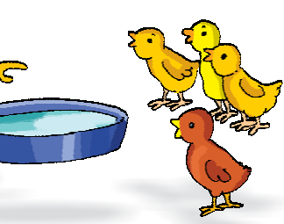
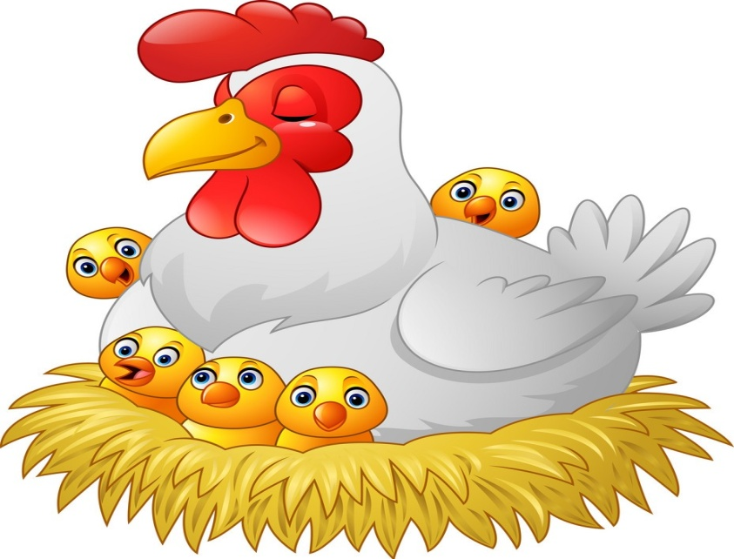
CREAT EMOTION

Slide 8
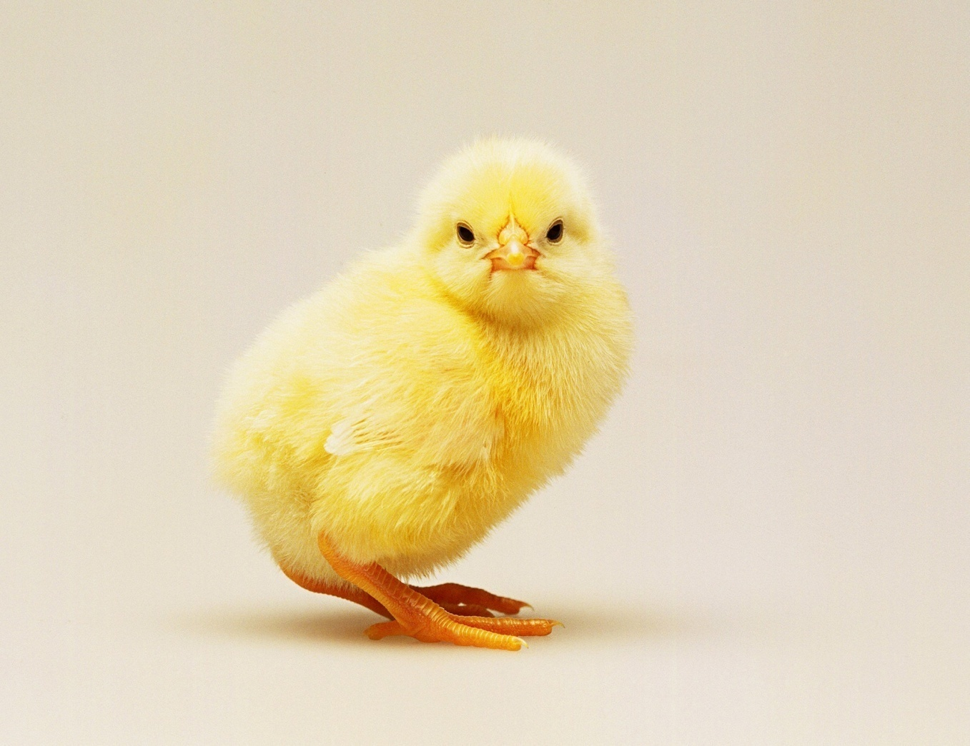
This work is hard! It’s hot in the sun!
“Chick 1”

Slide 9
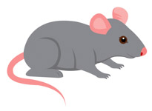
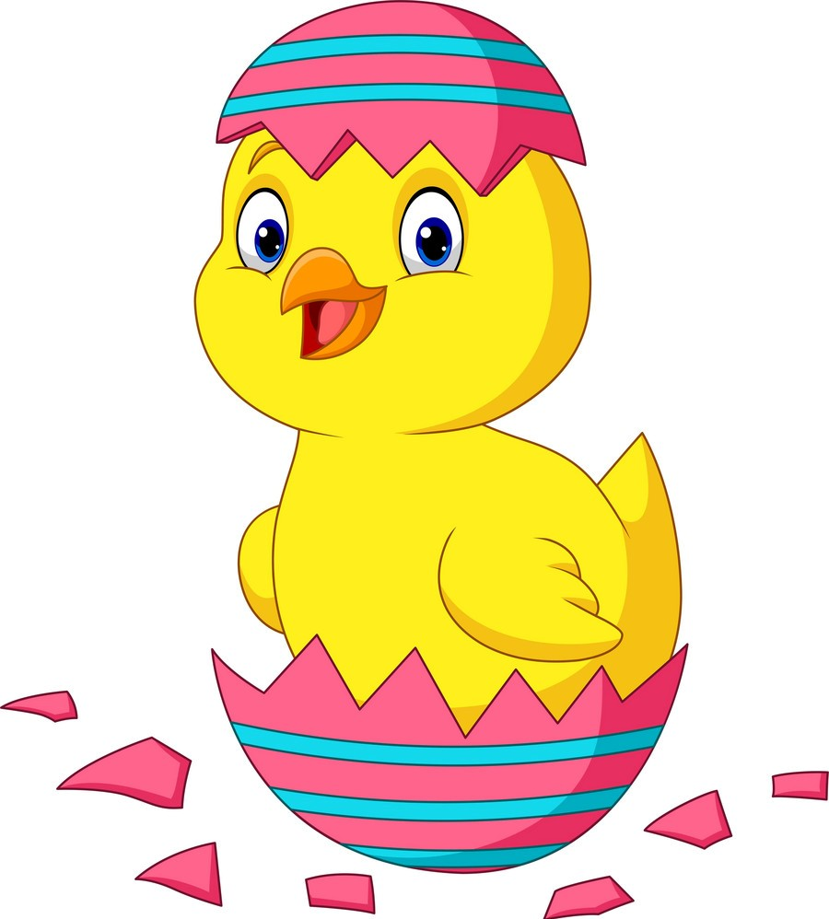
Mouse , Duck and Dog are having fun!
“Chick 2”

Slide 10
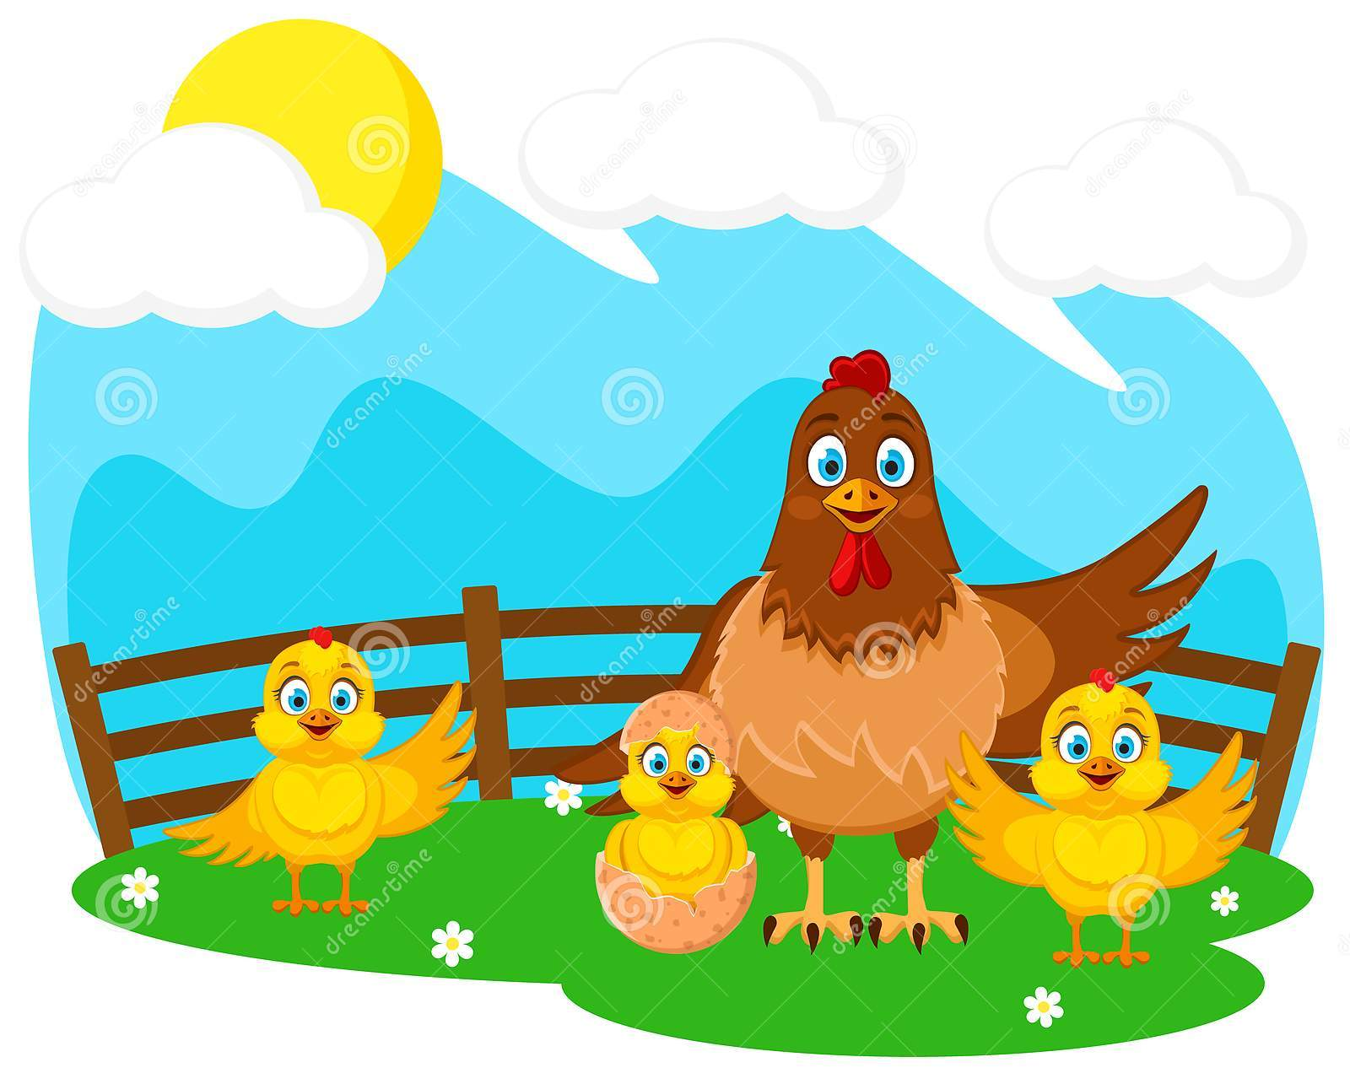
“Chick 3”
Why can’t we laugh and play and run?

Slide 11
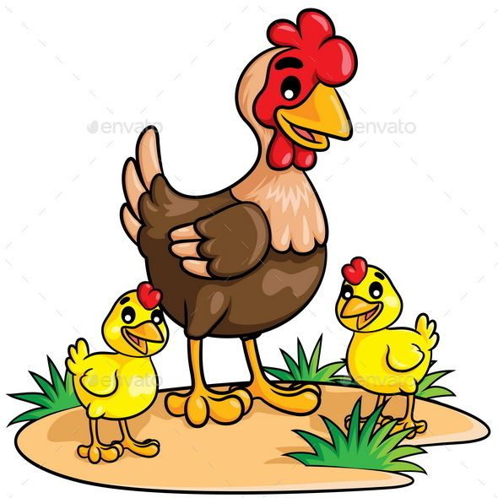
Hen : You will know when the work is done.

Slide 12
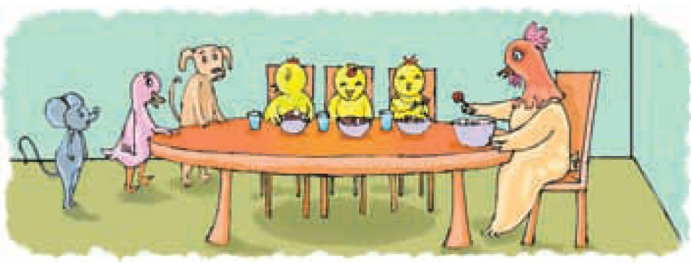
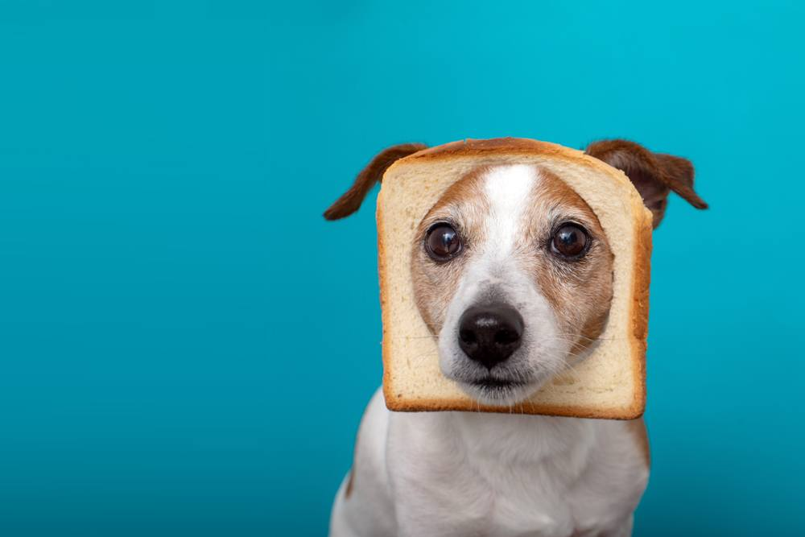
?
Dog
Is that bread? It smells so fine!

Slide 13
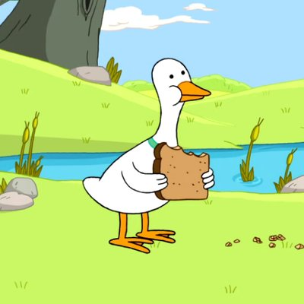
Mouse
I want some bread! What part is mine?
Duck
I want some ,too! When do we dine?

Slide 14
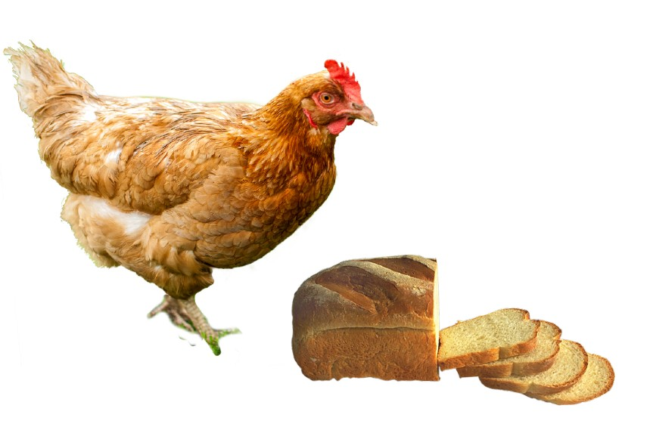
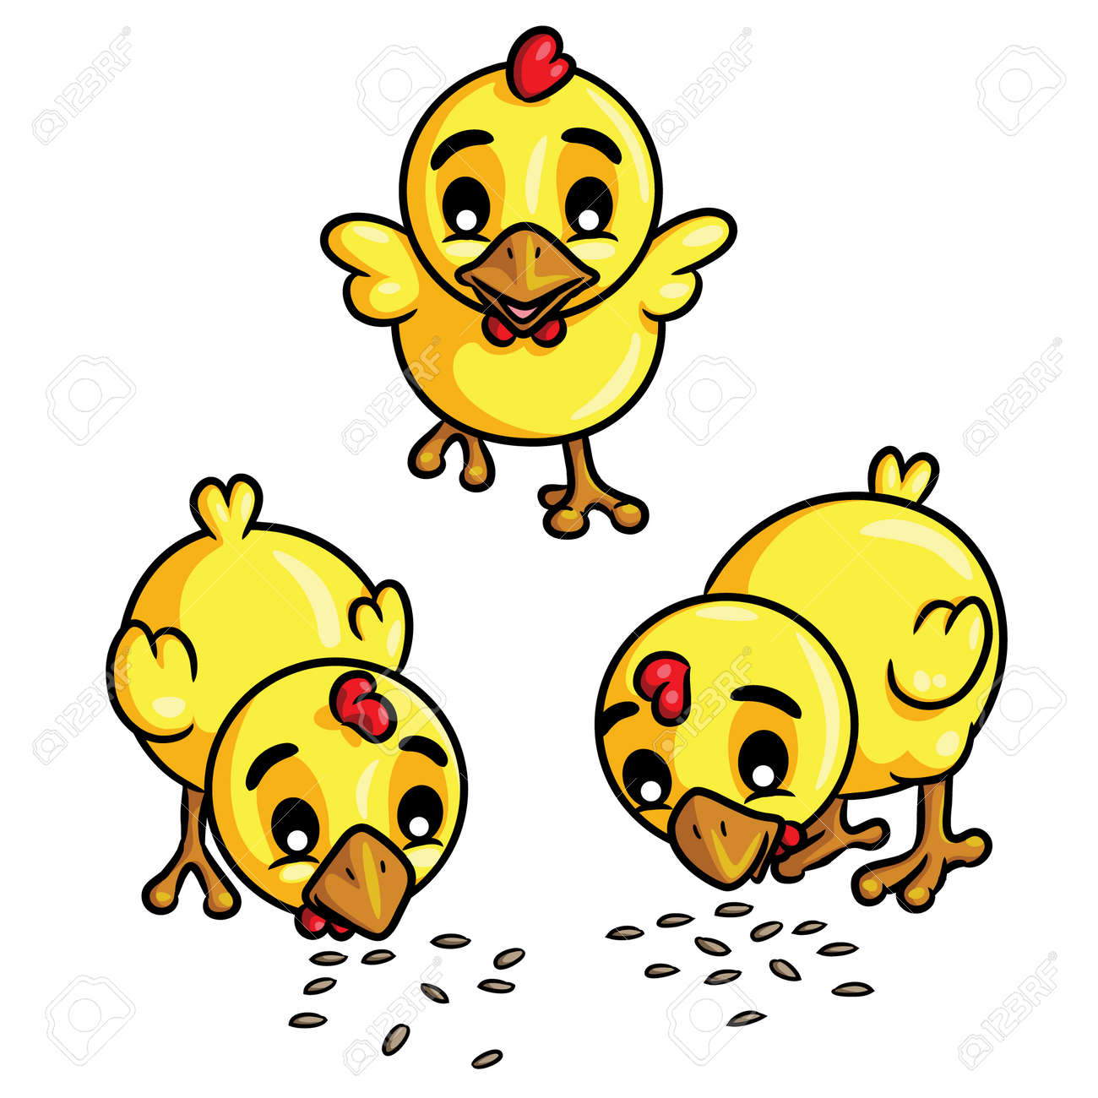
Hen
You didn’t plant or work or cook.
Chicks
So you can’t eat! You can stand and look!

Slide 15
GROUP WORK
What is the moral of the story?
1. It’s fun to play and laugh.
2. Everyone can have good things.
3. Good things come to people who work.

Slide 16
EVALUATION
Read the story again. Underline the punctuation. Complete the sentences.
a. There are ----------- full stops in the story.
b. There are -------- question marks in the story.
c. There are ----------- exclamation marks in the story.
d. There are ----------- capital letters in the story.

Slide 17
Follow your textbook ,Write the story in your own language.

