Slide 2
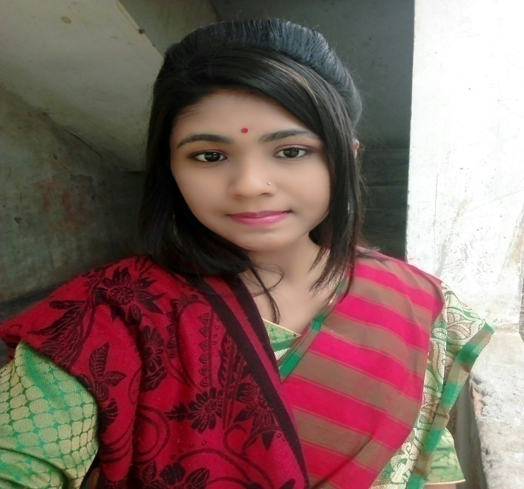
TEACHER’S IDENTITY
CHARADHARY GOVT PRIMARY SCHOOL
ASSISTANT TEACHER
BRAHMANPARA, CUMILLA.
EMAIL- tanzina121996@gmail.com.
TANZINA AKTER

Slide 3
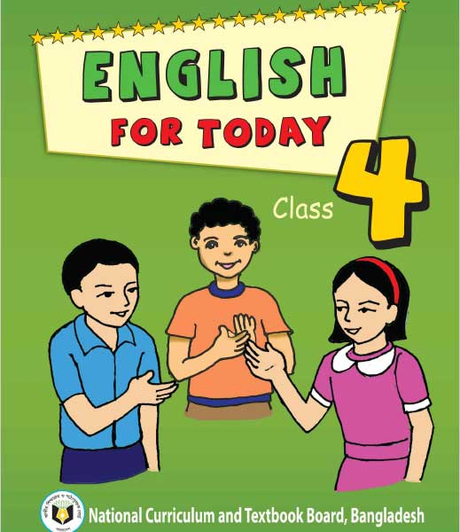
LESSON’S INTRODUCTION
Subject: English
Class: Four
Student’s: thirty five
Lesson name: Mita;s Day.
Unit: fourteen
Page: 28
Date : 06/06/2021

Slide 5
LEARNING OUTCOME’S
By read this passage student’s will be able to……….
a. Read the passage throughly.
b. Learn some new word meaning.
c. Learn about daily routine.
d. Describe about their daily life.
e. Learn proper use of punctuation , intonation and stress.

Slide 6
CREAT EMOTION
Teacher will sing a song to creat emotion.

Slide 7
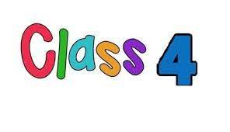
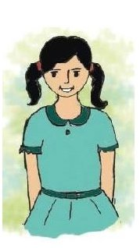
Listen and say. Read .
Mita is in class 4.

Slide 8
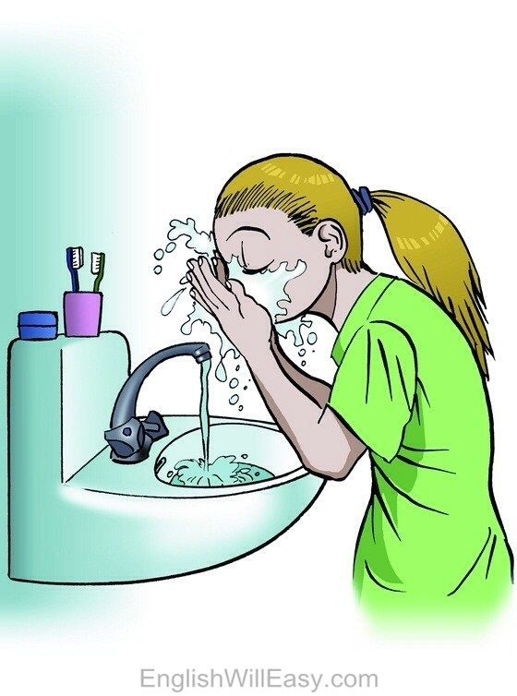
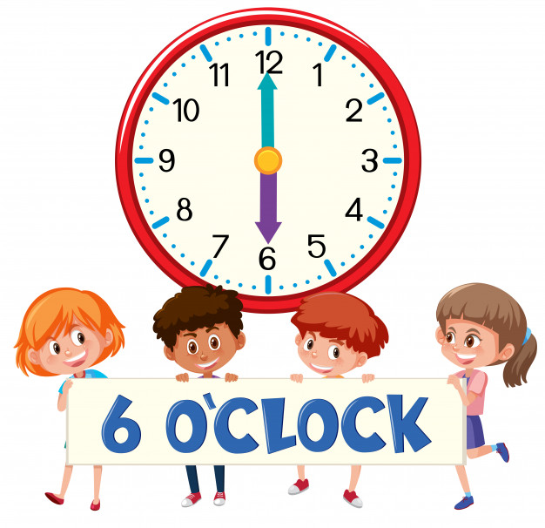
She gets up at six o’clock. She washes her face.

Slide 9
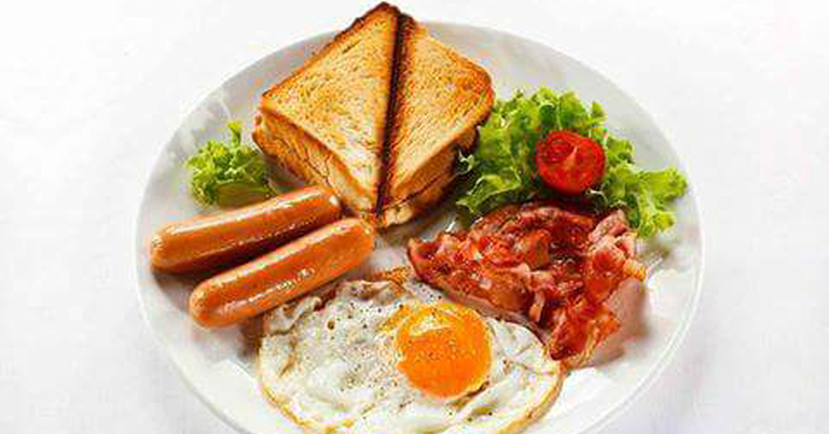
She has breakfast at seven o’clock.

Slide 10
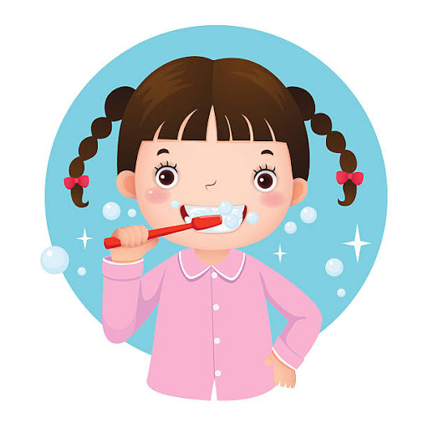
Then , she brushes her teeth.

Slide 11
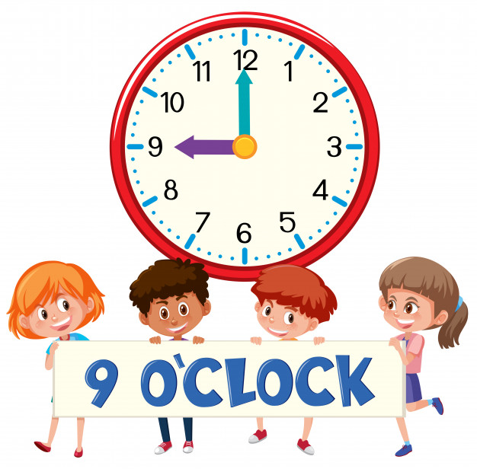
She goes to school at nine o’clock.
She walks to her school.

Slide 12
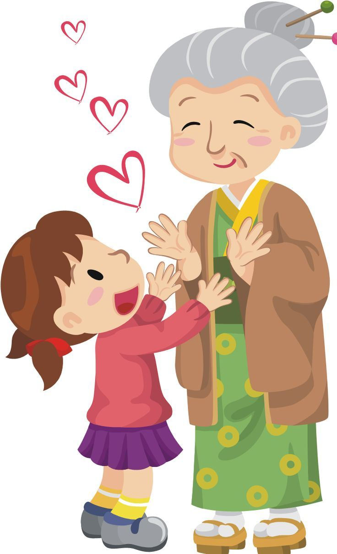
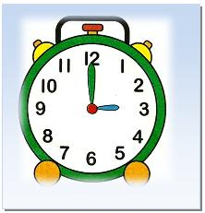
She visits her grandmother at three o’clock.

Slide 13
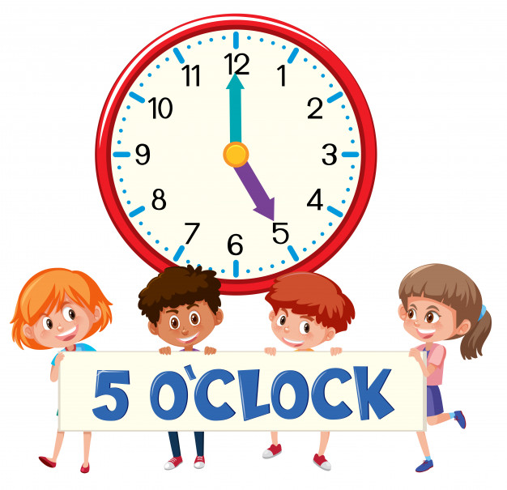
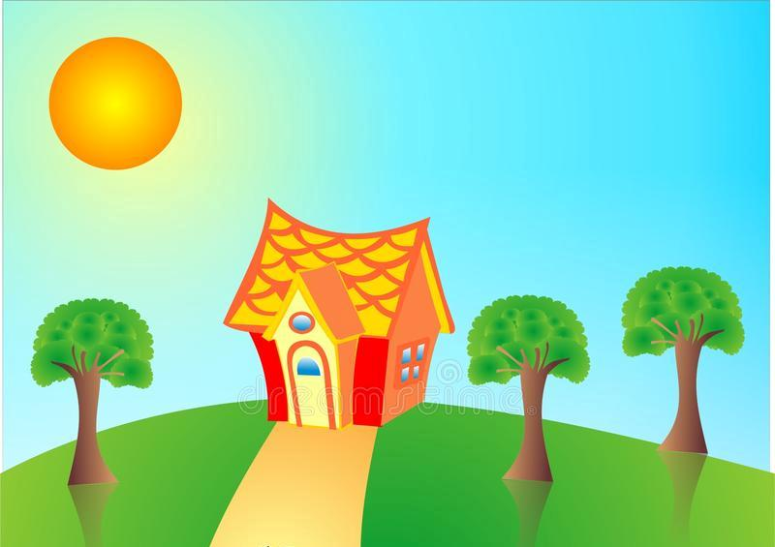
Then , Mita returns home at five o’clock.

Slide 14
GROUP WORK
Complete the sentences with the time in numbers.
1. Mita gets up at -------------.
2. She has breakfast at ---------------.
3. She goes to school at--------------.
4. She visits her grandmother at ------------.
5. She returns home at --------------.

Slide 15
New word
Let’s learn some new word-
Washes
Walk
Face
Visit
Brushes
Return

Slide 16
ASSESSMENT
Answer the following question-
a. What time Mita get up?
b. When do Mita have her breakfast?
c. What time Mita go to school?
d. When do Mita return home?
e. What time Mita visit her grandmother?

Slide 17
Write a short composition about your daily routine.

Slide 18
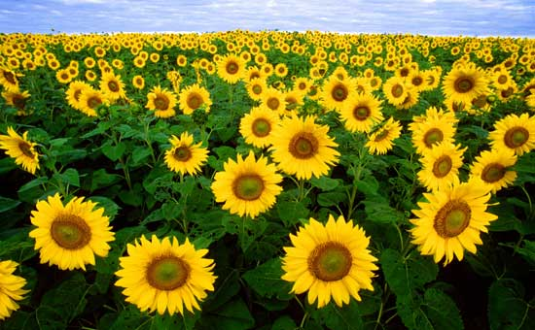
GOOD-BYE EVERYBODY

