Slide 1
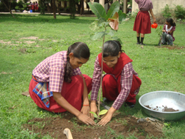
Welcome to everybody

Slide 2
Introduction
Class: Nine- Ten
English Second Paper
Gias Uddin
Assistant Teacher
Lakshmipur B/L High School
Kuliarchar High School
Mobile: 01719068890
giasuddin31121980@gmail.com

Slide 3
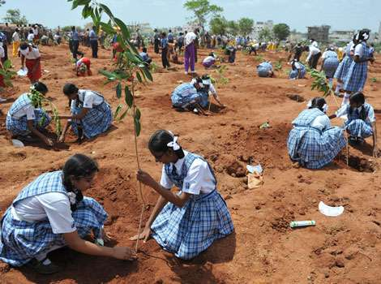

Slide 4
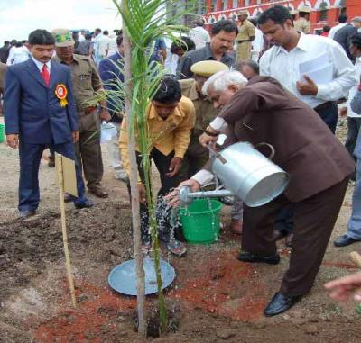
Today our topic is writing a paragraph on
“Tree Plantation’’

Slide 5
Learning outcomes
After studied this lesson, students will be able to—
tell what tree plantation is
describe the importance of tree plantation
tell about the effect of deforestation
write a paragraph

Slide 6
What is tree plantation?

Slide 7
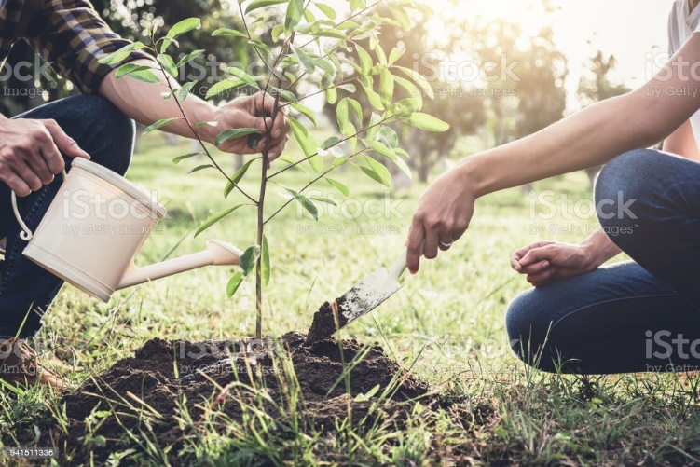
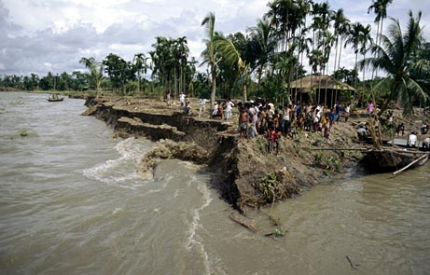
Tree plantation is planting trees for getting food,wood,fuel and to save our environment from natural disasters.
Tree plantation is planting trees for getting food,wood,fuel and to save our environment from natural disaster.

Slide 8
Why tree plantation is so important for us?

Slide 9
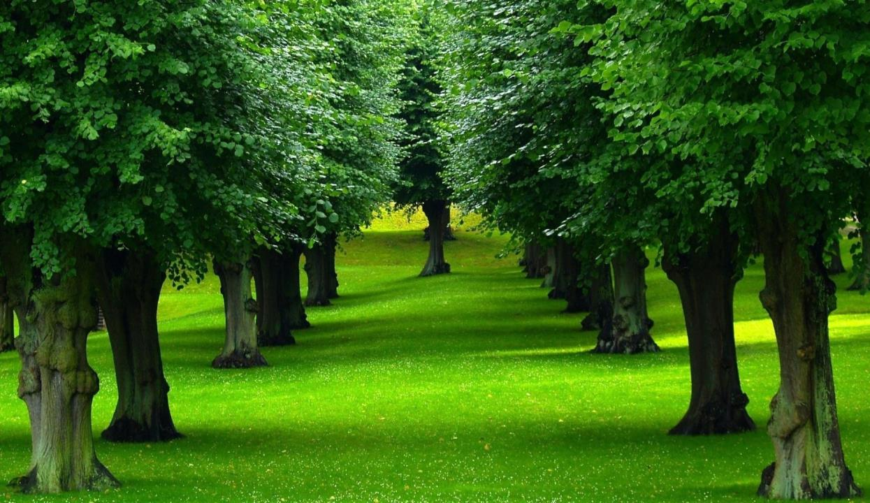
Trees are the most important element
of nature and environment.

Slide 10
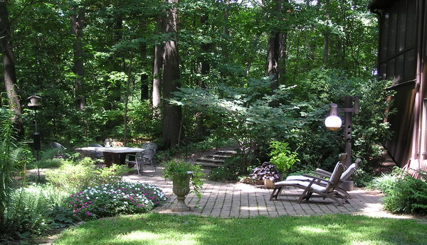
We cannot think a healthy environment without tree.

Slide 11
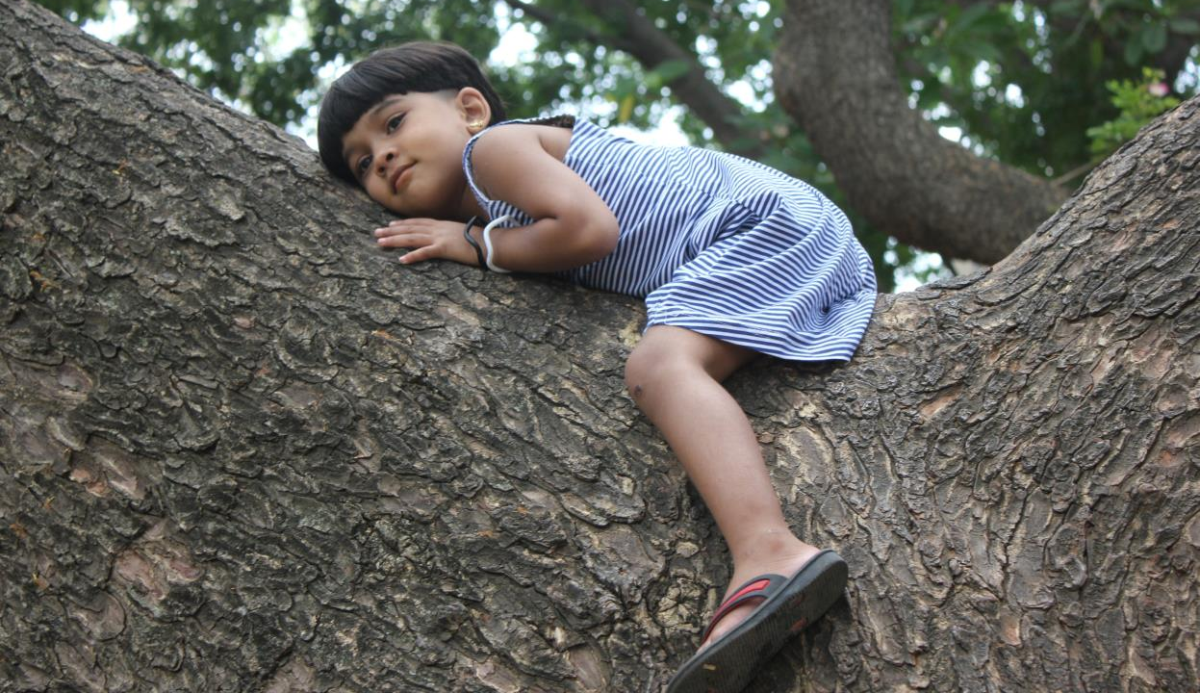
Trees are our most intimate friends.

Slide 12
They provide us with shed, food, medicine and furniture.

Slide 13
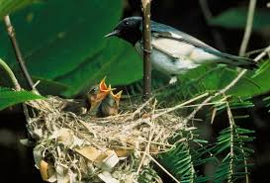
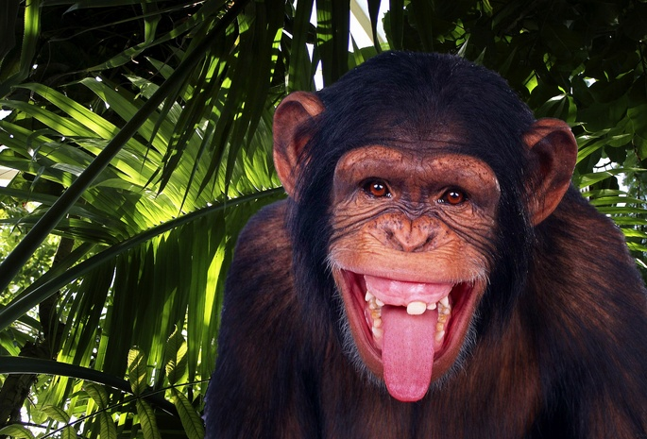
They give shelter to the birds and wild animals.

Slide 14
They receive carbon dioxides from the atmosphere and relies oxygen. No animal can live without oxygen

Slide 15
What is deforestation?

Slide 16
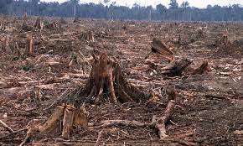
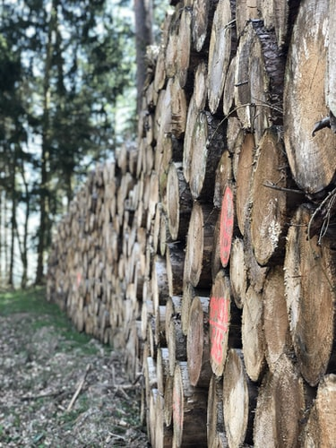
Deforestation means cutting down trees randomly without any consideration.

Slide 17
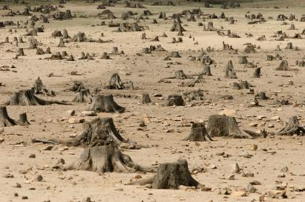
Because of deforestation we are losing our forest area. Birds and wild animals are losing their living place and many will animals are being vanished.

Slide 18
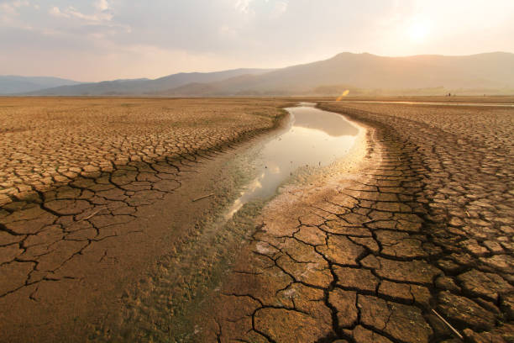
If there is no tree one day our country will turn into a desert. We will lose our ecological balance

Slide 19
What should be our duty now?
That’s why we should plant trees more and more in any blank space like open and unused place, by the side of the house, roads, high ways, by the side of schools, colleges and offices to ensure a happy ,healthy and fresh environment.

Slide 20
Home work
Write a paragraph about tree plantation.

Slide 21
Dear learners good bye. See you again.

