Slide 1
WELCOME

Slide 2
Teachers Identity
Name: Mushfika Ferdausee
Asst.Head Teacher
Patgudam High School,Sadar,Mymensingh

Slide 3
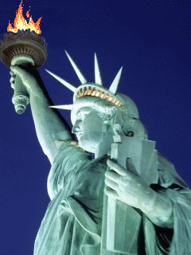
Todays Lesson
English 1st Paper
Class: X
Unit- 08, Lesson- 03
“The Statue Of Liberty”

Slide 4
LEARNING OUTCOMES
After we have studied this unit,we will be able to
Listen for specific information
Read and understand texts through silent reading
Ask and answer questions
Describe a place

Slide 6
Thank You All

