Slide 1
Welcome
To English Class.

Slide 2
Introduction
English For Today
Class –IX-X
Time - 45 mins.
Md. Monirul Islam
Assistant Teacher (English)
Azimnagor Com.K.School & college.
monir19077@gmail.com
01761714820

Slide 3
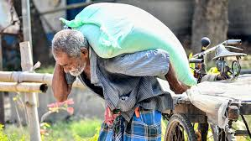
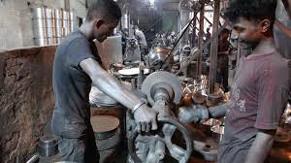
Look at these pictures.
What do you see in above pictures ?

Slide 4
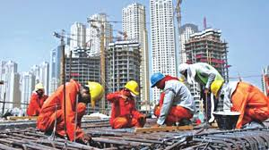
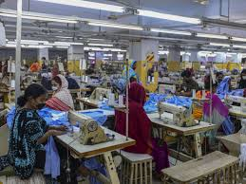
Look at some another pictures.
Can you relate any historical event to these picture?

Slide 5
Dear students ,
Let’s enjoy a video.

Slide 6
So today we’ll read about-
May Day
Unit No-3 , Lesson No-2

Slide 7
Learning Outcomes.
At the end of the lesson, we will be able to-
describe the workers’ historic struggle;
ask and answer questions;
Infer meaning from the context;
Write a short paragraph.

Slide 8
Dear learners, let us learn the meaning of the important words of this story and try to know more about
“ May Day” .

Slide 9
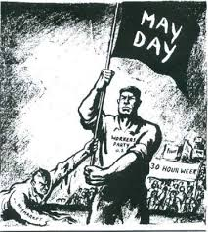
Establish
Set up , settle firmly
May day or International Worker’s day is observed on May 1 al over the world today to commemorate the historical struggle and sacrifices of the working people to establish an eight-hour workday.

Slide 10
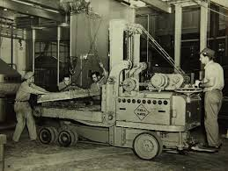
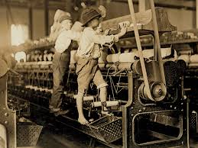
Revolution
a sudden, radical, or complete change
Since the Industrial Revolution (1) in the 18th and 19th centuries in Europe and the US, the workers in mills and factories had been working a long shift,fourteen or even more hour a day.

Slide 11
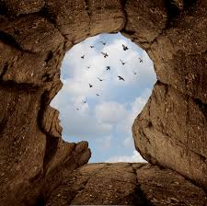
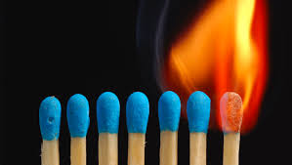
Inspired
Stimulate , instinct invigorated
On May 1st in 1886, inspired by the trade union 2 , half of the workers at the McCormick Harvesting Company in Chicago went on a strike demanding an eight-hour workday.

Slide 12
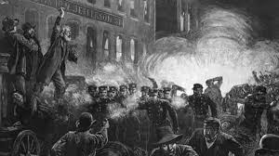
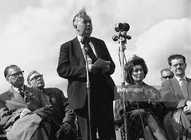
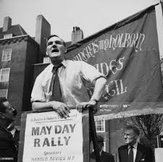
Address
Speech , lecture, discourse,oration
The rally was addressed by the labour leaders.

Slide 13
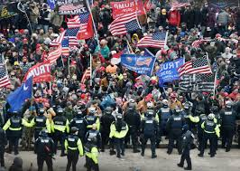
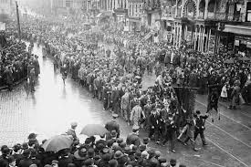
Attack
Invasion, onslaught, foray,offensive
200 policemen attacked the strikers with clubs and revolvers

Slide 14
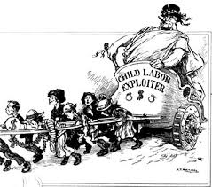
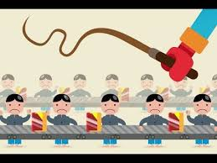
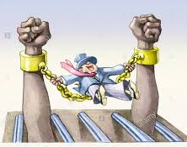
Exploited
Occlusion , bleed absorb ,imbibe
The workers will continue to be exploited until they stand up and speak out to gain better workingconditions, better pay and better lives

Slide 15
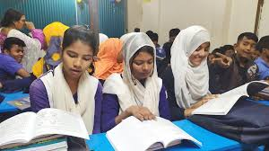
Dear learners,
Read the text silently to know the rest about “May Day”.
Unit 3. lesson -2

Slide 16
Pair work
Fill in the gap with suitable word from the box.
Chicago
out
protest
day
working
even
until
struggle
continue
refers
May day ------------------- to the historical----------------------------- and sacrifices of the
----------------------people of a large factory of -------------------------. The workers raised
-------------------- against fourteen or ------------------- more hours a -----------------. May Day is a reminder that workers will ------------------------ to be exploited------------------- they stand up and speak ----------------------- unitedly.

Slide 17
Group work
What does May Day refer to ?
What do you learn from the events of May Day ?

Slide 18
Evaluation
Choose the best answer from the alternatives.
The closest meaning of the word ‘inspired’ is-----
discouraged (ii) satisfied (iii) encouraged (iv) frustrated
What is the synonym of commemorate ?
Forget (ii) ignore (iii) celebrate (iv) neglect
Suddenly almost ---------- charged the strikers.
20 policemen (ii) 100 policemen (iii) 200 policemen (iv) 2000 policemen
The rally was addressed by the -----
(i) Labourers (ii) labour leaders (iii) political leaders (iv) religious leaders

Slide 19
Home
work.
What do you learn from the events of May 1, 1886 ?
Why is May Day observed today ?

Slide 20
Allah Hafez.

