Slide 1

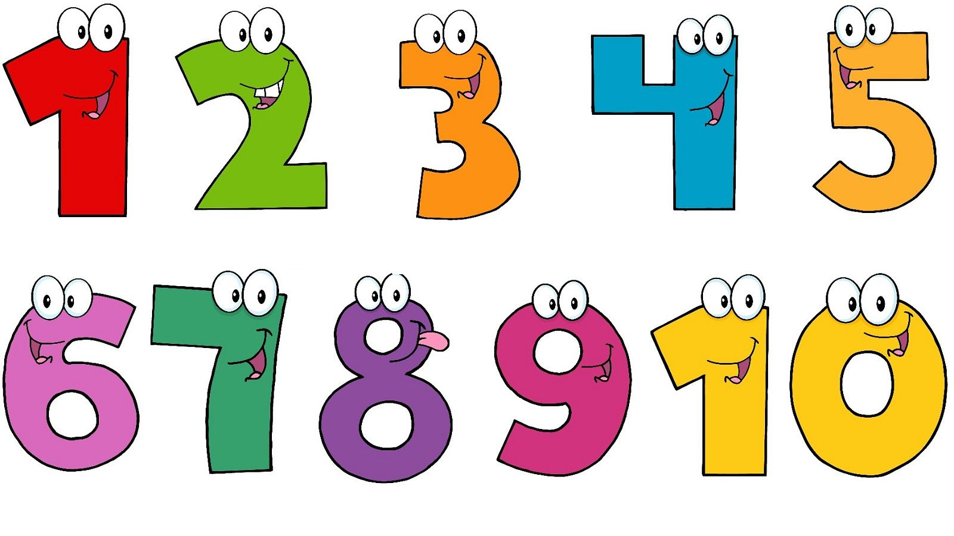


Slide 2
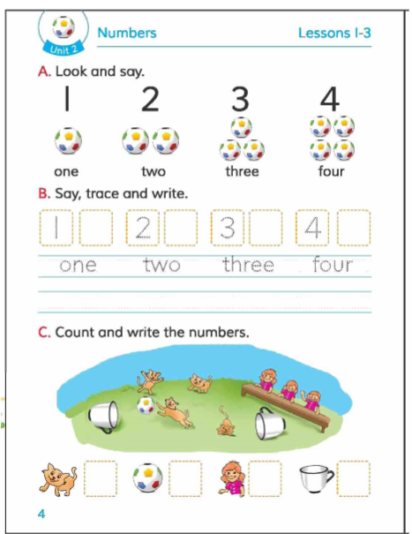
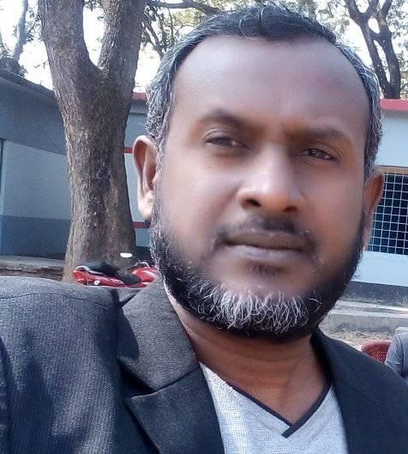
Teacher’s identity
MD. MOTIUR RAHAMAN
(Assistant Teacher)
8 No Gopalpur govt. Primary School
Kaligonj, Jhenaidah
motiur.gps@gmail.com
Page-1

Slide 3
Class : Two
Subject : English
Lessons : 1-3
Lesson unit : 2 (Numbers - 1, 2, 3, 4)
Learning outcomes
By the end of the lesson students will be able to—
1.recognize the numbers
2.say about the numbers.
Page-2
Page-3

Slide 4
Creat Emotion
https://youtu.be/4sHOH_zsRl4
Page-4
Page-5

Slide 5
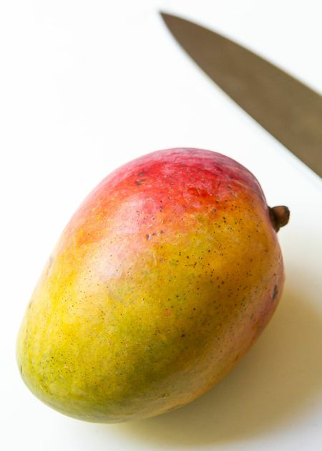
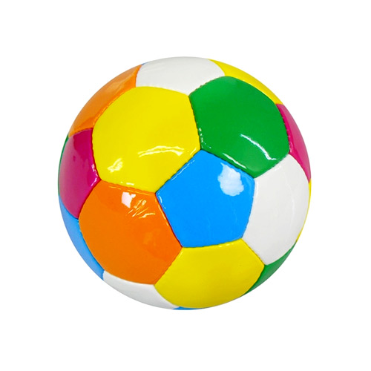

How many ball?
1
2
How many mangos?
What can you see in the picture
Two
One ball
Page-6
Page-7

Slide 6


How many bottles?
How many flowers?
3
4
Four
What can you see in the picture
Three
Page-8
Page-9

Slide 7

EVALUATION
1
One
4
Four
2
Two
3
Three
Page-10
Page-11

Slide 8
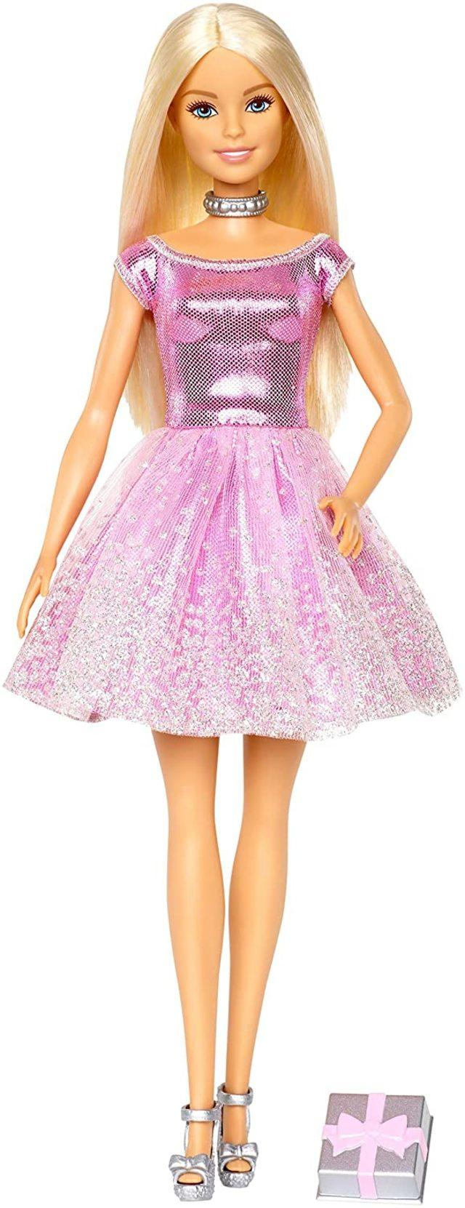

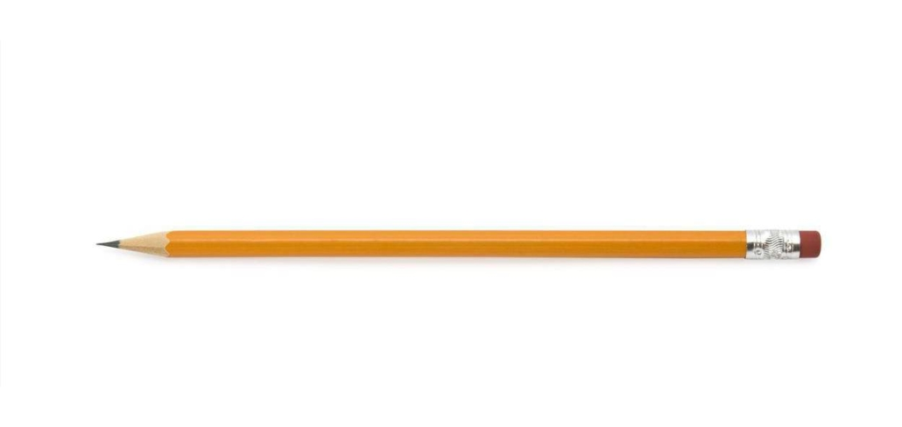
COUNTING
1
4
One
Four
2
Two
3
Three
Page-12
Page-13

Slide 9

No more today
Good bye
See you again
Page-14
Page-15

