Slide 1
WELCOME TO MY PRESENTATION

Slide 2
INTRODUCING
1
Class: xi
Subj: English
Topic: Articles
Time : 40 min
Date : 09-01-2021
Badal Chandra Borman
Assistant Teacher
Patuabhanga High School
Pakundia, Kishoregonj
E-mail:pritybadalpakundia@gmail.com

Slide 3
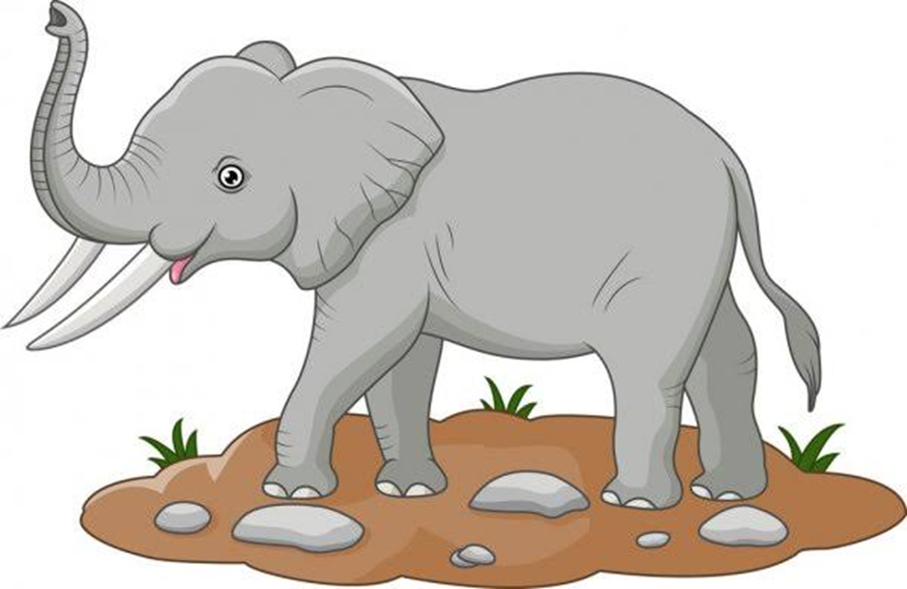
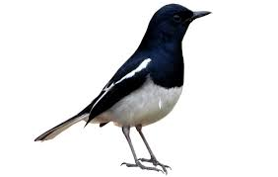
a bird
a ball
an elephant

Slide 4
ARTICLES

Slide 5
After we have studied the topic,we will be able to
What is definition of articles?
What is an example of an articles?
What are types of articles and there definitions?
Use of articles.

Slide 6
Article
An articles is a word use before a noun that indicates where or not the reference is to a specific entity or unspecific one

Slide 8
Indefinite articles
Definite article
Articles
Indefinite
definite
A
an
the

Slide 9
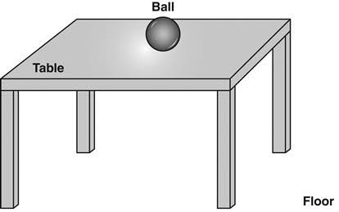
The
It is use to speak above a noun that is already known heand or identified
The ball is on the table

Slide 10
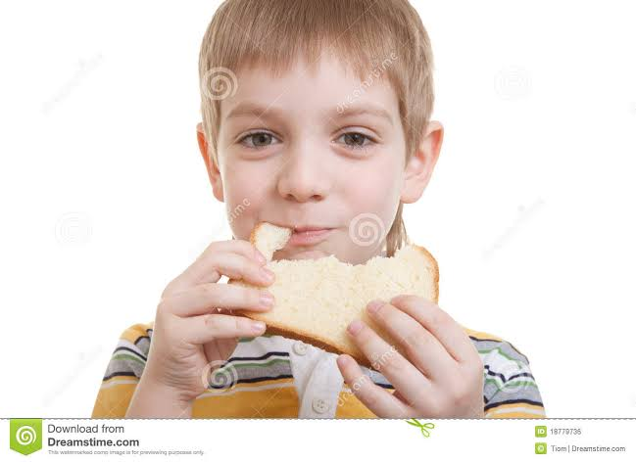
a
A” is use before all words starting with a consonat
She eats a loaf

Slide 11
An” articles
Exmp: see an elephant
An” is used before all wonds starting with a vowel

Slide 12
Individual work
Write three sentence using(a) particular articles

Slide 13
Group work
Discuss articles in groups and indentify different kinds of articles

Slide 14
Home work
Home Work
Write at least five sentence from each kinds of article

