Slide 2
Welcome to English class

Slide 3
Md . Saifuddin Khan
Lecturer in English
Hajee Goyes Uddin Mohila Fajil Madrasah
Bhangura , Pabna .
E-mail : skhan84bd@gmail.com.
Mobile Number :01710449379
English For Today
Class :xi & xii .
Time : 45 minutes

Slide 4
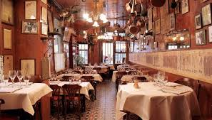
Dear students, here an image is for you.
It
is
an
Image
of
Restaurant
Why do people come here?

Slide 5
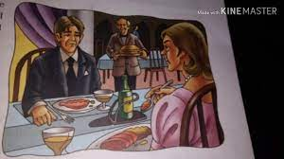
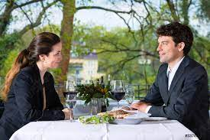
Dear ss,here some more images are for you. Think about them for sometimes .
What are people doing here?

Slide 6
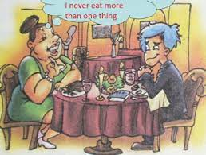
Today our topic is
Unit five: Food Adulteration
Lession two :Eating Habit and Hazards
The Luncheon
William Somerset Maugham

Slide 7
Learning outcomes
After reading the text ss will be able to
1.Tell the meaning of some new words.
2.Write about William Somerset Maugham.
3. Write the name of some tasty foods.
4.Tell about the story of a flatterer woman.

Slide 8
Dear s s ,here some new word meanings are for you .
Key word | Meaning
Lucid | Explicit
Profound | Intense
Expensive | Costly
Humour | Comedy
Interval | Break
Recognize | Identify
Overlook | Have a view
Cemetery | Graveyeard
Impose | Inflict
talkative | Chatty

Slide 9
Key word | Meaning
Anticipate | Visualize
Hospitable | Welcoming
Effusive | Emotional
Amicable | Friendly
Airy | Aerial
Gesture | Flounce
Horrible | Fearsome
Vindictive | Revengeful
Tickle | Allure
Gay | Frisky

Slide 10
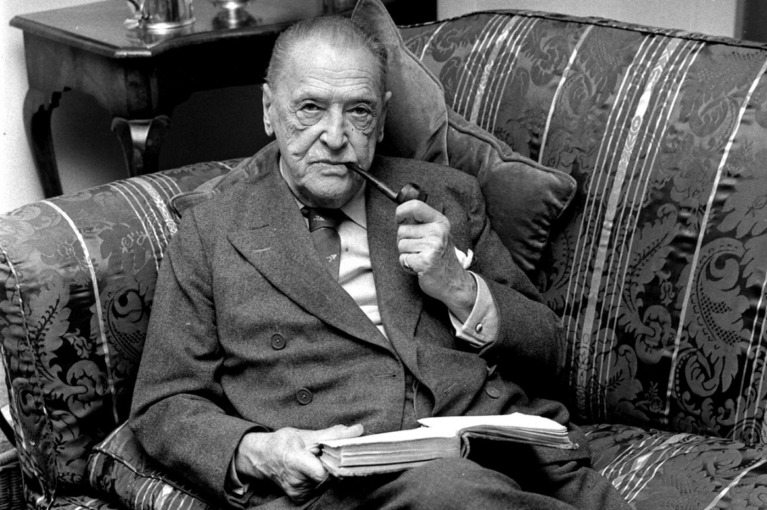
William Somerset Maugham(1874 -1965) is a British playwright, novelist and short-story writer. His work is characterized by a clear, lucid style, profound understanding of human nature.

Slide 11
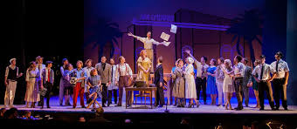
Theatre
I caught sight of her at the play, and in answer to her beckoning, I went over during the interval and sat down beside her .

Slide 12
Single work
1.What is the meaning of ‘interval’ in the passage ?
(a)Distance (b)separation (c) break (d) wait .
2.It was twenty years ago and I was living in ……….
(a) Paris (b) London (c) newyork (d) dubai .
3.My doctor won’t let me drink anythink but ………..
(a)Water (b) champagne(c) red wine (d) fresh water .
4. The writer had a ……. apartment in the Latin quarter .
(a)Big (b)large (c)tiny (d) luxurious.
5.The lady was ……..
(a) Chatty (b)quiet (c) silent (d) reserved .

Slide 13
Letter
She had read a book of mine and had written to me about.

Slide 14
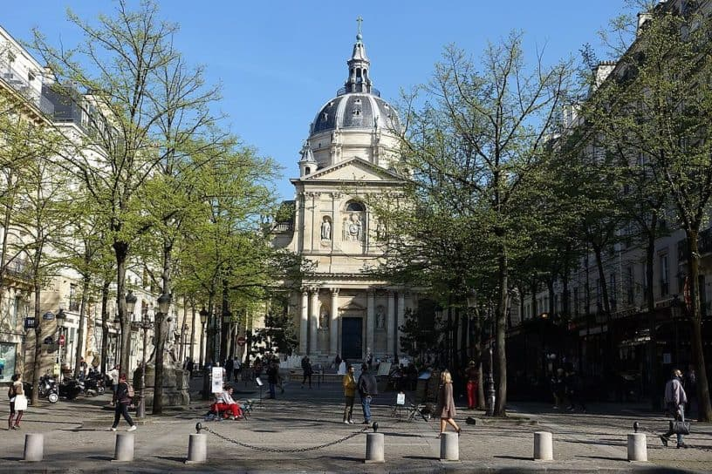
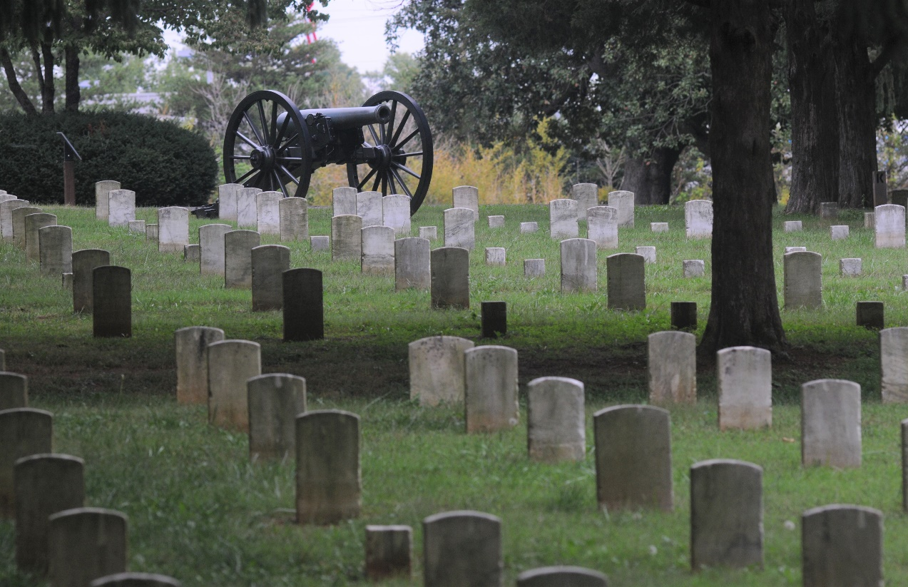
Latin quarter
Cemetery
It was twenty years ago and I was living in Paris. I had a tiny apartment in the Latin quarter overlooking a cemetery.

Slide 15
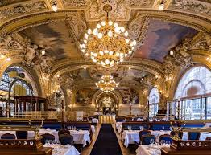
The Foyot’s Restaurant
Foyot’s is a restaurant at which the French senators eat, and it was so far beyond my means that I had never even thought of going there.

Slide 16
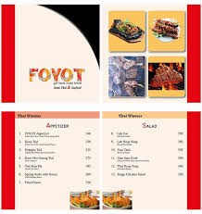
Pair work
What do you know about Foyot’s?

Slide 17
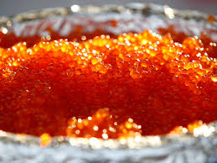
Caviare
“I never eat more than onething unless you have a little Caviare.

Slide 18
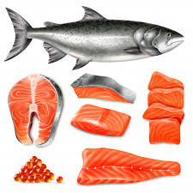
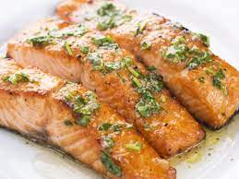
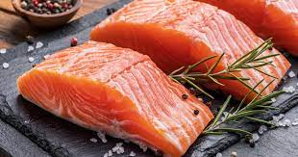
Salmon fish
“I never eat more than one thing. I think people eat far too much nowadays. A little fish, perhaps. I wonder if they have any salmon.”

Slide 19
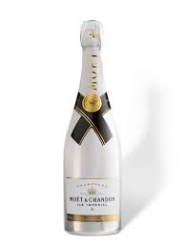
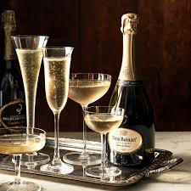
White wine
“My doctor won’t me let drink anything but champagne.”

Slide 20
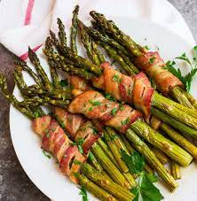
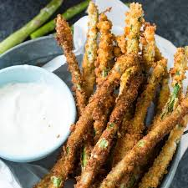
Asparagus
I couldn’t possibly eat anything more unless they had some of those gaint asparagus. I should be sorry to leave paris without having some of them.

Slide 21
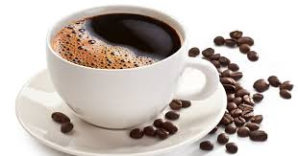
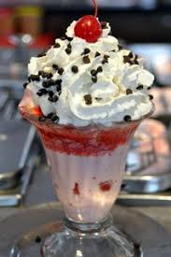
Coffee
Ice cream
“coffee” I said.
“Yes, just an ice cream and coffee,”
she answered.

Slide 22
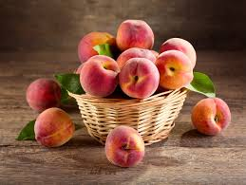
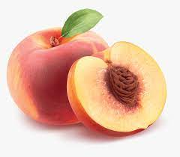
Peaches

Slide 23
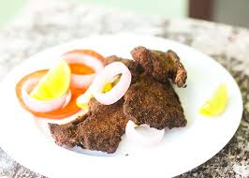
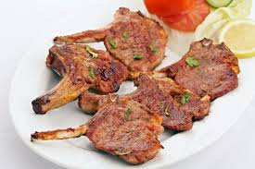
Mutton chop
When my mutton chop arrived she took me seriously to task.

Slide 24
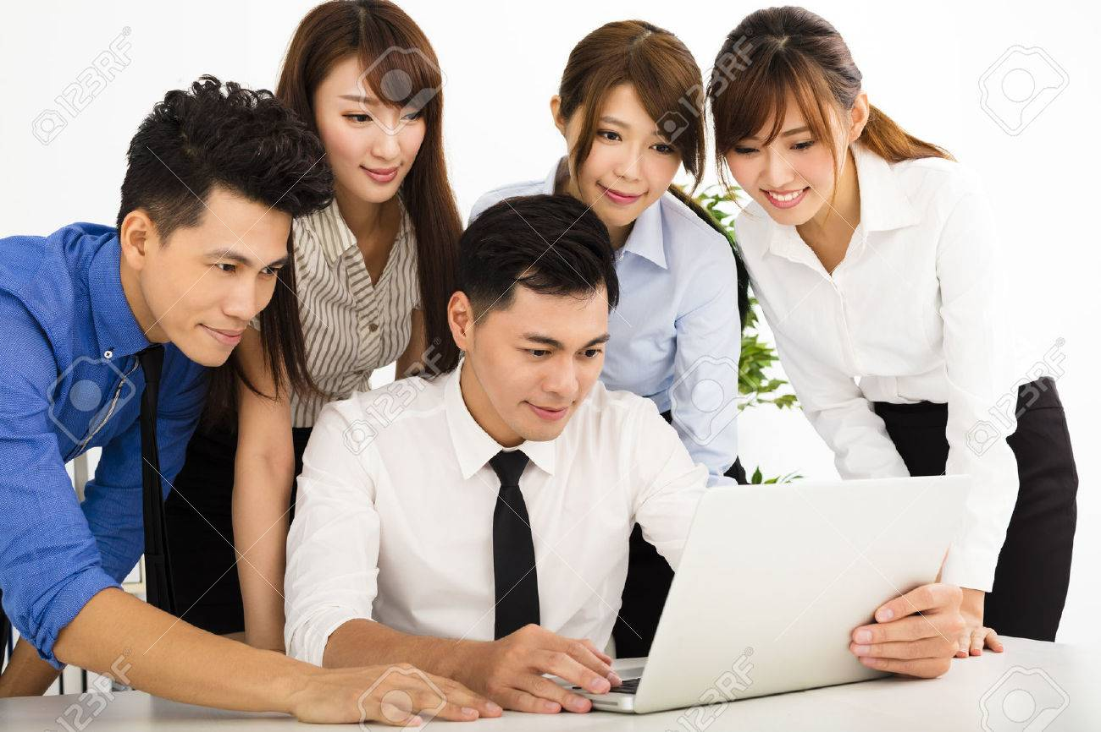
Group work
Write the number and name of foods that the lady guest ate at Foyot’s during luncheon.

Slide 25
Evaluation
Answer the following short questions.
1. What was the condition of the writer twenty years ago .
2. Why did the writer become an attentive listener?
3. How was the appearance of the lady?
4. What happened when the bill of fare was brought?
5.What did the lady guest suggest to follow the author?

Slide 26
Home Task
Write a summary of the passage.

Slide 27
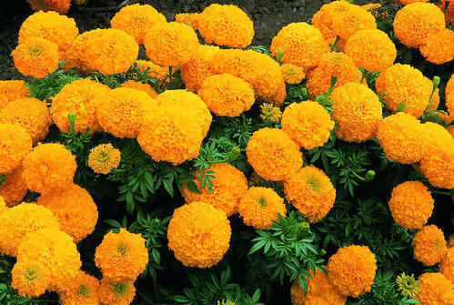
Thanks to all

