Slide 1
WELCOME

Slide 2
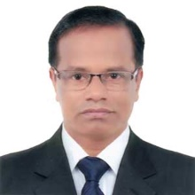
IDENTITY
GOLAM HOSSAIN
Senior Teacher (English)
Govt. Science School & College,
Tejgaon, Dhaka
E-mail: hossainsalim2001@gmail.com
Phone : 01913138642
Class - Eight
Subject – English
Second Paper
Topic – Degrees of Adjective
Date : 12.05.2021

Slide 3
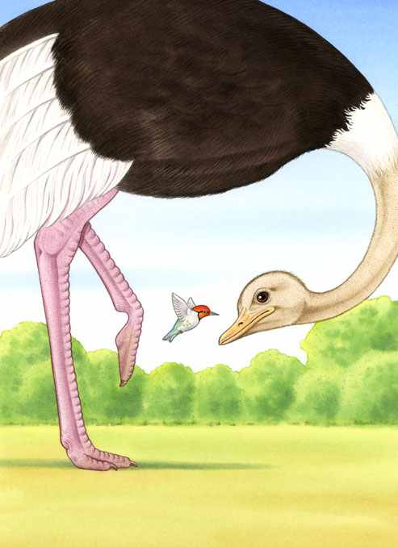
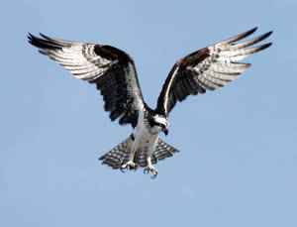
Look at the pictures carefully & try to compare among themselves:-
Taller
Biggest
Tall
smallest
small
Bigger
smaller
Big
Taller
Tallest
Tall
Tall

Slide 4
Let’s watch a video.

Slide 5
Our Today’s Lesson is…

Slide 6
Learning outcomes
By the end of the lesson the
students will be able to…
tell the definition of degrees of adjective
tell the kinds of degrees of adjective
describe some rules of changing degrees of adjective
change the degrees of adjective

Slide 7
Definition of degrees of comparison

Slide 8
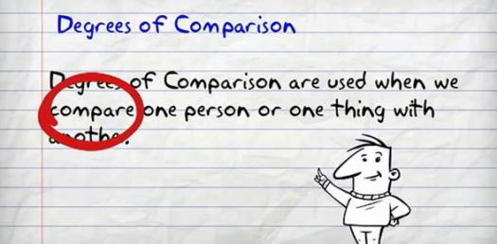

Slide 10
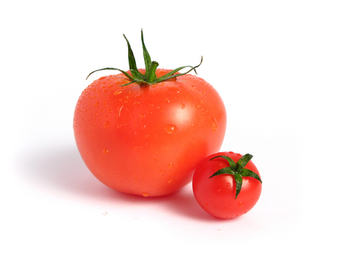
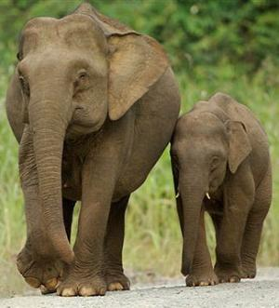
When comparison between two people or things we use the comparative form of the adjective & have to add “er” after word.
Small
Smaller
Taller
Larger
Tall
Large

Slide 11
When comparison between two people or things we use the comparative form of the adjective & have to use “er” after word.

Slide 12
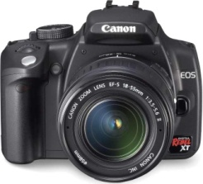
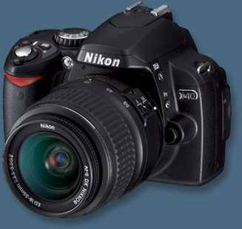
Comparative Degree: Example
A horse can run than a dog.
faster
Nikon
TK. 20,000/-
Canon
TK. 10,000/-
The canon camera is than Nikon camera.
cheaper

Slide 13
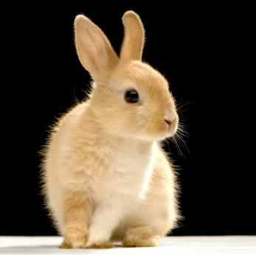
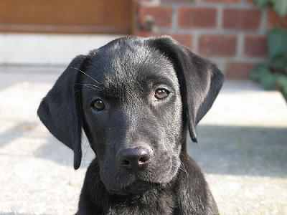
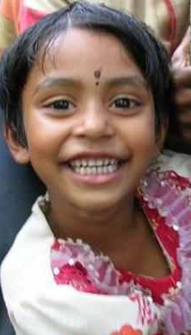
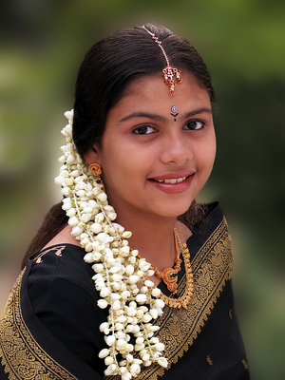
Example:-
A rabbit has ears.
large
A dog has ears than a rabbit.
larger
longer
I have hair than my sister.

Slide 14
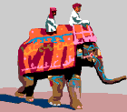
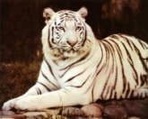
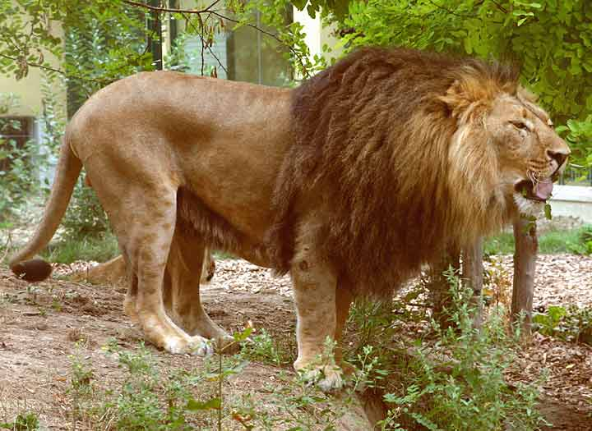
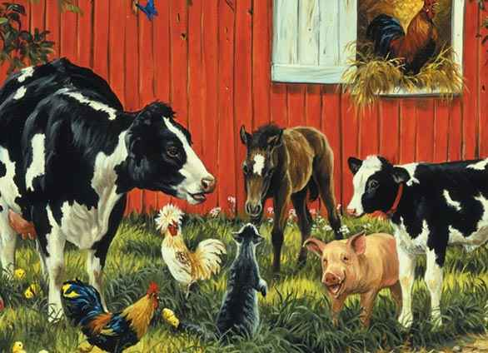
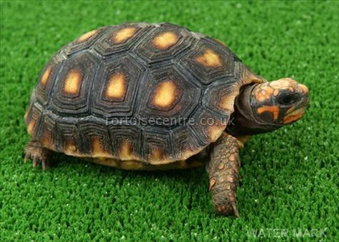
Superlative Degree
The elephant is the biggest of all land animals.
The tortoise is the slowest of all animals.

Slide 16
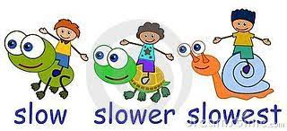

Slide 18
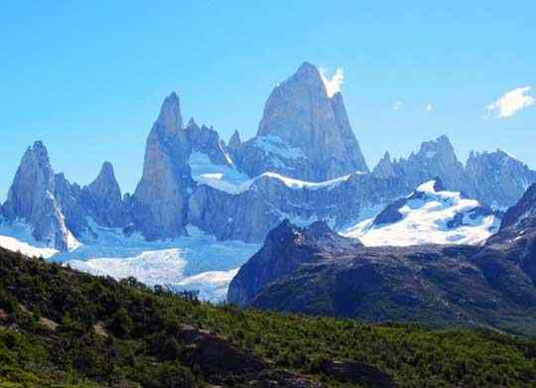
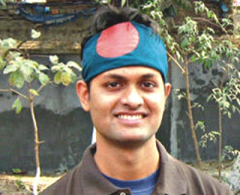
Superlative Degree:-
Mount Everest is the highest mountain in the world.

Slide 19
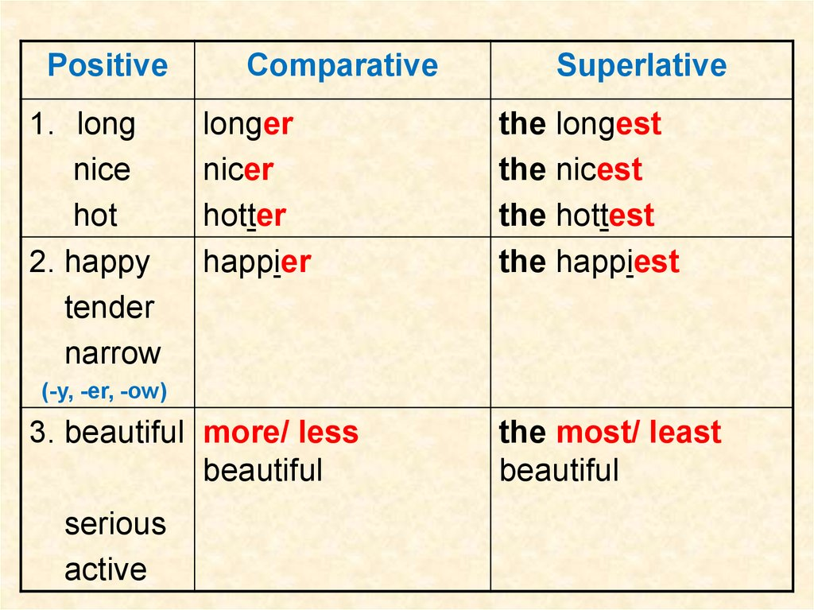

Slide 20
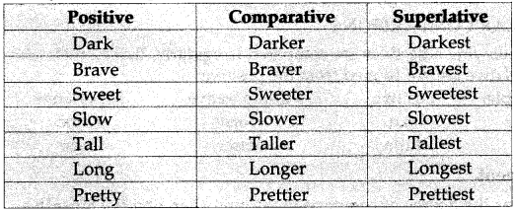

Slide 21
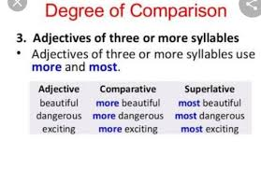

Slide 22
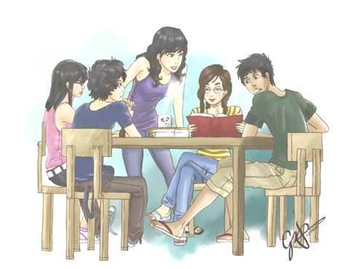
Group Work

Slide 23
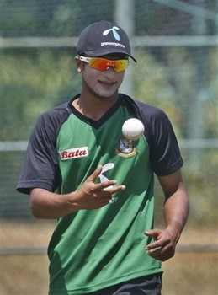
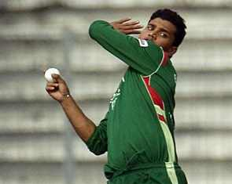
Evaluation
Tamim Iqbal is a bowler.
good
Sakib Al Hasan is a bowler than Tamim Iqbal.
better
Masrafe Mortaza is the bowler of all.
best

Slide 24
HOME WORK
Home work :- Make 5 sentences by using the following words.
POSITIVE | COMPARATIVE | SUPERLATIVE
Wise | Wiser | Wisest
Good | Better | Best
Bad | Worse | Worst
Cold | Colder | Coldest

Slide 25
Thank You

