Slide 1
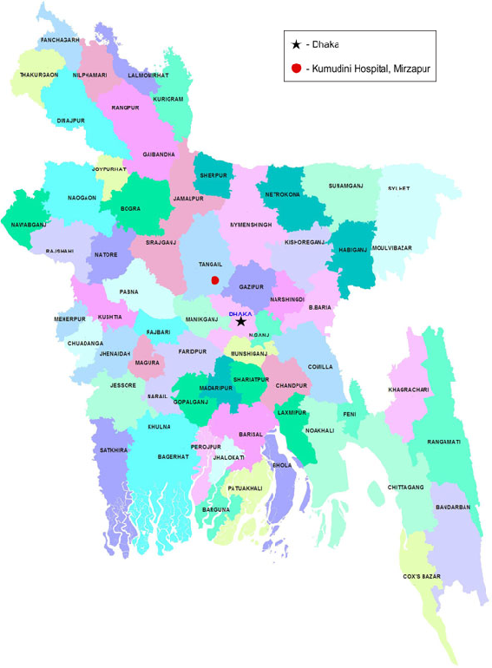
my
dear
students

Slide 2
Introduction
Md. Sultan-ul Arefin
Assistant Teacher
Gurudaspur Model Govt. Primary School
Gurudaspur, Natore.
Class: Five Unit: 10 Lesson: 1 Lesson Title: My home district. Today’s lesson: A (Read)
Part of the lesson:
My home…through the town.

Slide 3
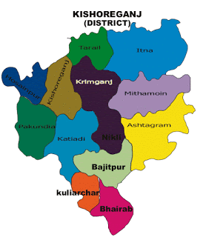
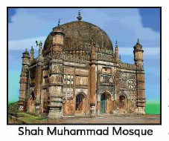
What district do you see in the picture-1?
Where is in the mosque?
What is the name of this mosque?
What do you see in the picture-2?
Map of Kishoregonj District

Slide 4
Declaration of Topic
Well, To day we are going to read-
My home district
A. Read about Mamun’s home district. Page: 38

Slide 5
Learning outcomes
Students will be able to-
Speaking
1.3.1 recognize which words in a sentence are stressed.
3.3.1 understand questions about objects around them.
3.4.1 understand statements made by the teacher and students.
Listening
1.1.1 say words, phrases and sentences with proper sounds and stress.
1.1.2 say sentences with proper intonation.
Reading
1.5.1 read words, phrases and sentences in the text with proper pronunciation, stress and intonation.
1.6.1 recognize and read statements, commands, greetings, questions and answers.

Slide 6
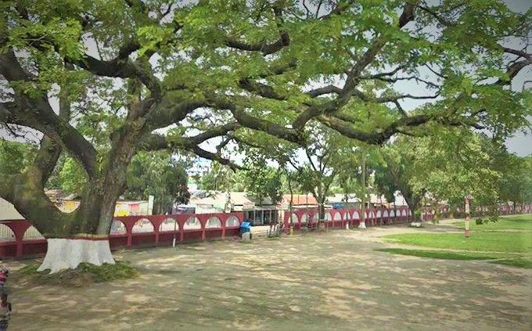
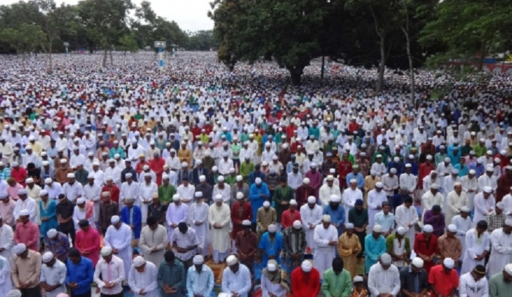
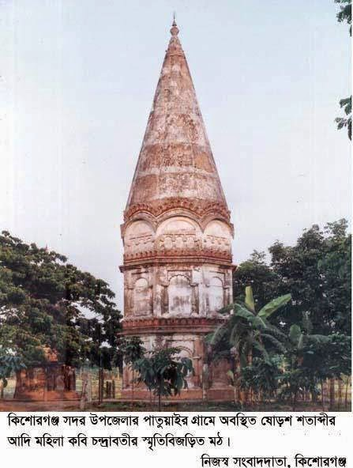
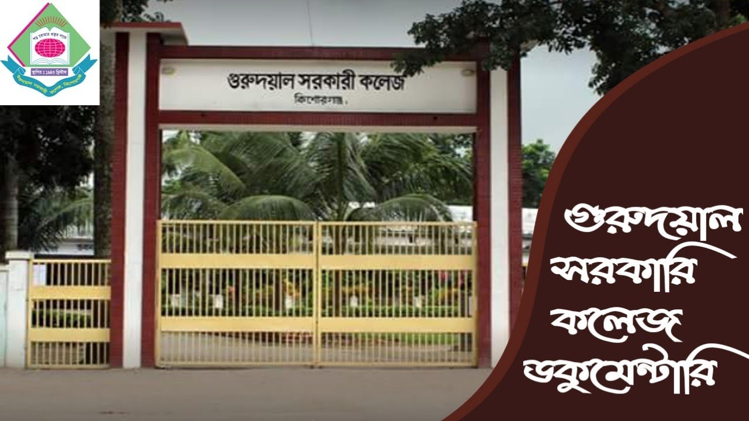
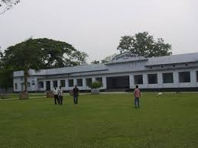

Slide 7
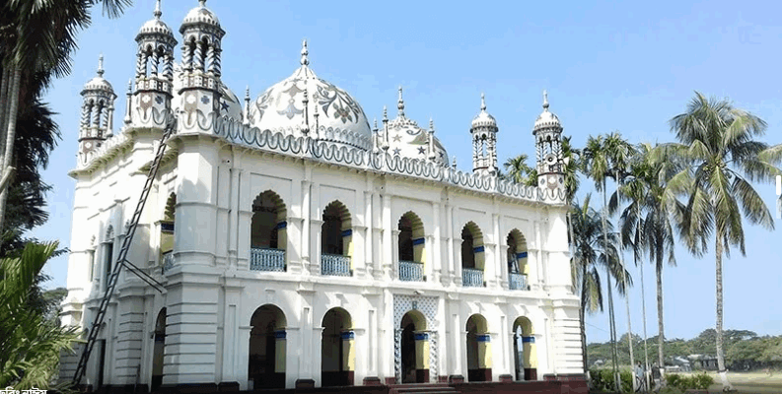
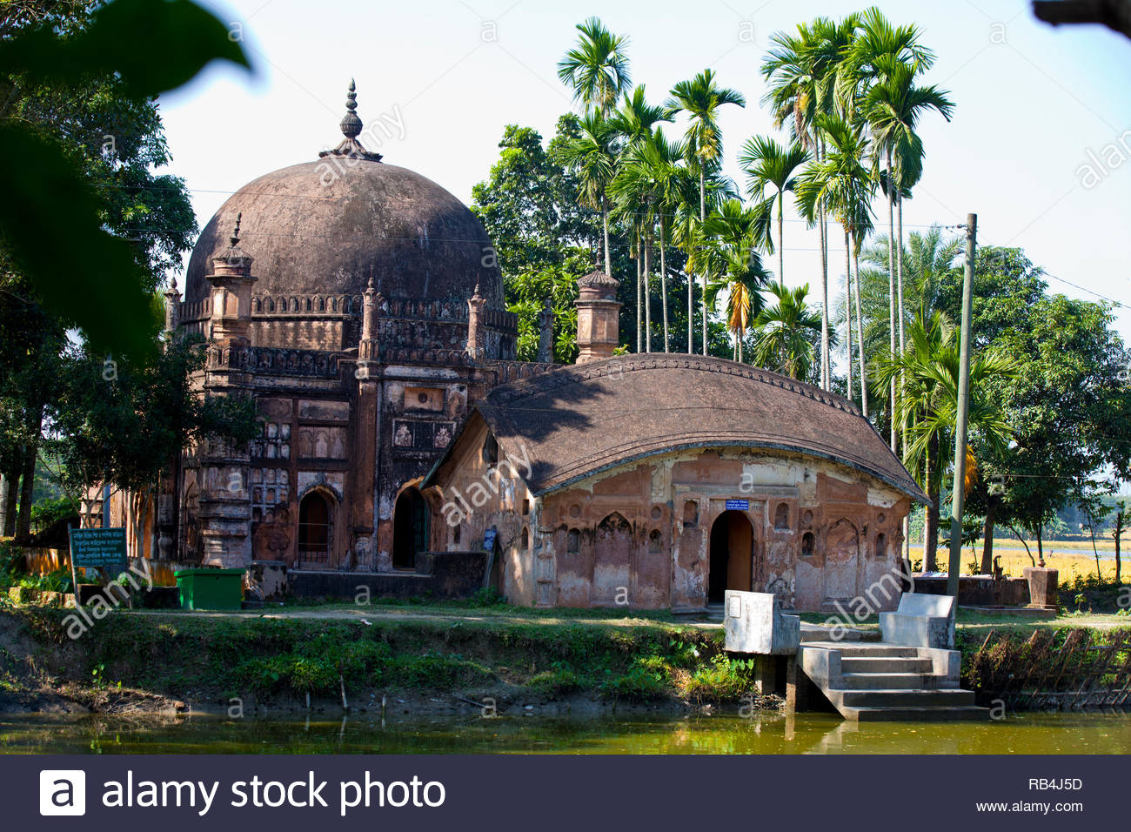
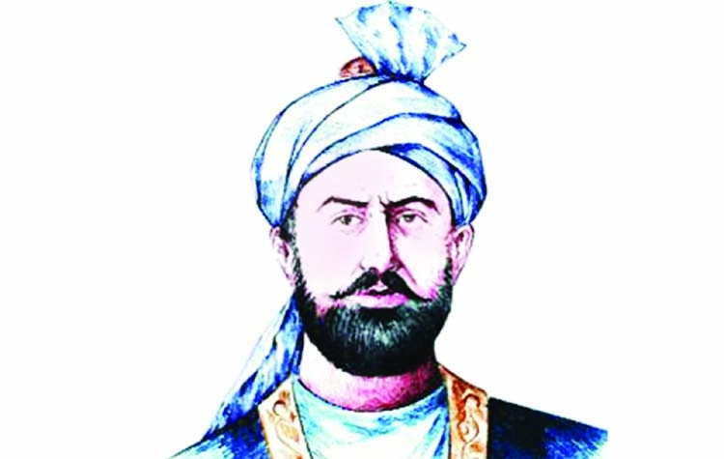
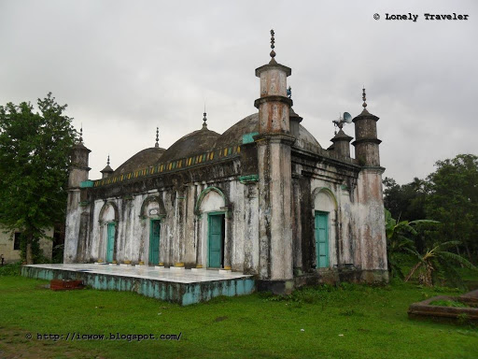

Slide 8
Kishoregonj
Solakia Eid Fairground
Gurudoyal Collegec
Pagla Mosque
Jungle Bari
Importanr places in
Kishoregonj district
Shah Muhammad Mosque
Shiva Temple

Slide 9
Small
Place
Vocabulary teaching
Aged
Celebrate
Important
Move
Across
Mosque
Well-known
Landower
Quadrangle
Many

Slide 10
A
B
a. Small
i. Look
b. Many
ii. Like
Match the words of the column A with their similar meaning in column B
c. Celebrate
iii. Much
d. see
iv. Close
v. Little
e. Near
vi. distance
vii. observe

Slide 11
A
B
a. Small
i. Look
b. Many
ii.
Solution
c. Celebrate
iii. Much
d. see
iv. Close
v. Little
e. Near
vi.
vii. observe

Slide 12
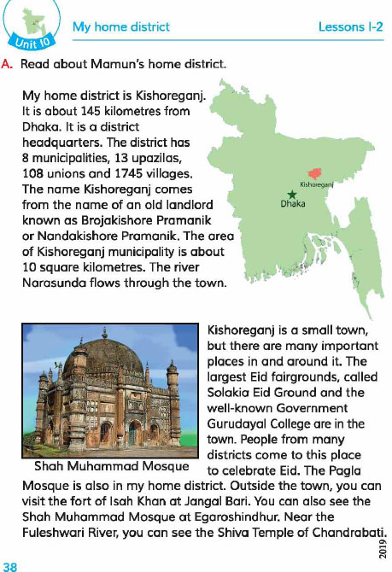
Teacher’s Model Reading
Dear students, open your English book at page 34. I am reading the text loudly, please put your fingers on the text.

Slide 13
Practice
Group Reading
In this stage the students will read the text in group.

Slide 14
Practice
Pair Reading
In this stage the students will read the text in pair.

Slide 15
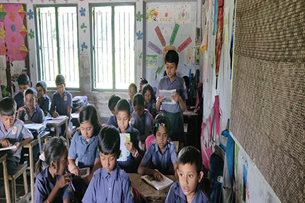
Practice
Individual Reading
In this stage one student reads the text and others listen.

Slide 16
Practice
Silent Reading
Students, please read the
text silently and try to understand.

Slide 17
Group work
Ask and answer the question orally
Upazila Group
Union Group
Village Group
Why do many people go to celebrate their Eid in Kishoregonj?
Which two places do you like to visit in Kishoregonj district?
Which temple is seen in Kishoregonj district?

Slide 18
Pair work
Ask and answer in pair.
1. Which famous mosque is seen in Kishoregonj district?
2. Which is the famous college in Kishoregonj district
3. Who was Isa Khan?
4. What is Shiva Temple?

Slide 19
Evaluation
Fill in the gaps with correct word from your text book.
Kishoregonj is (a)----- town. (b)-----s the largest Eid Fairground in Bangladesh. Gurudayel is a (c)----- college. (d)-----river flows near the town. There is (e)----- of Isa Khan at Jangle Bari.

Slide 20
Answer
Kishoregonj is a (a) town. (b) is the largest Eid Fairground in Bangladesh. Gurudayel is a (c) college. (d) river flows near the town. There is a (e) of Isa Khan at Jangle Bari.
small
Solakia
government
Fuleshwari
fort

Slide 21
Checking the learner’s learning
I will check the each and every student’s works properly. I will also directly help the weak student’s if they needed.

Slide 22
Task
Home work
Read the text attentively at your home.

Slide 23
Dear student, please stay safe and use musk.
See you later, bye………

