Slide 1
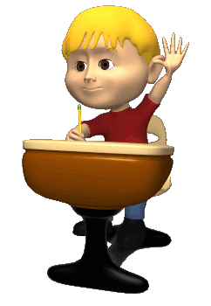
Welcome to my class

Slide 2
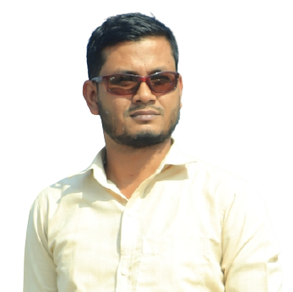
Introducing
Md Sazzadur Rahman
Assistant Teacher
Jaliarpar govt . Primary School
Companigonj,Sylhet.

Slide 3
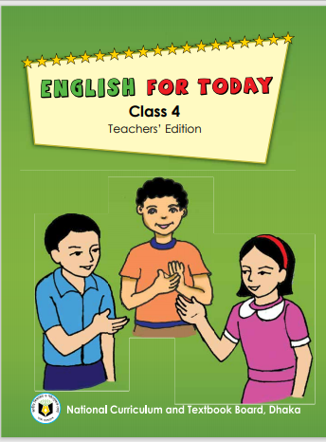
Subject Identity
Class:Four
Sub:English
Unite – 4
Lesson Title- Family tree.

Slide 4
Making safe Environment
Let us we sing a song.We shall over come----------we are not alone today.

Slide 5
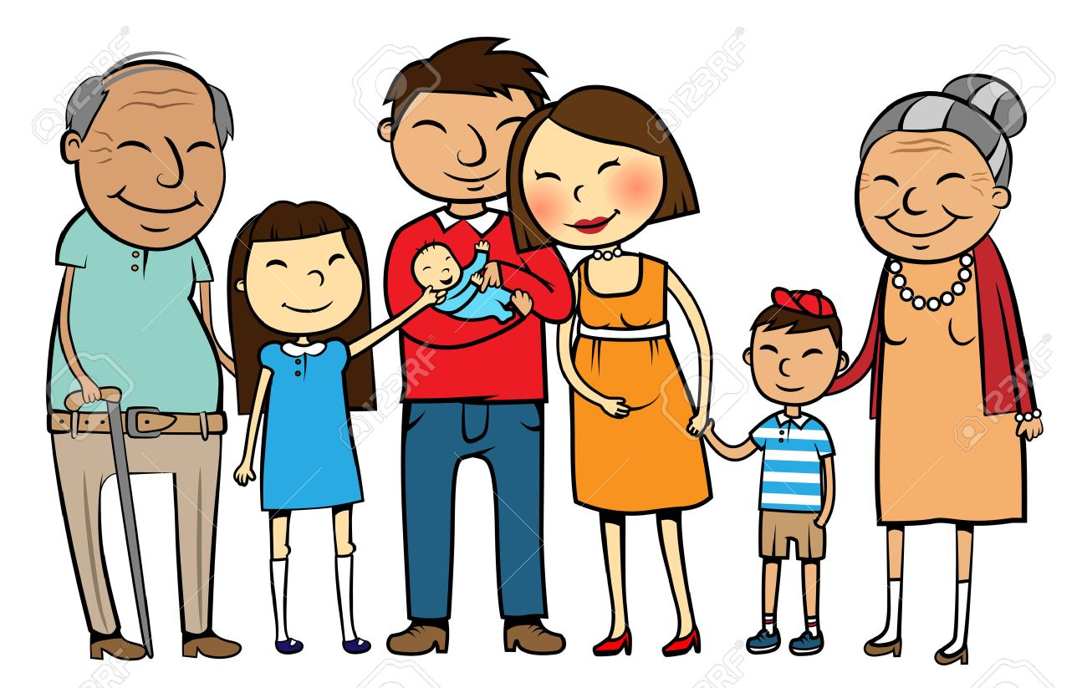
Look at the picture
What can you see in this picture ?
This is Family picture.

Slide 6
Lesson dicleration
Today we will know about ‘‘A Family Tree”.

Slide 7
Learning Outcomes:
Students will be able to-
3.2.1Understand questions about family and friends.(family)
1.1.1repet after the teacher and say words, phrases and sentences with
Proper sounds, stress and intonation.
8.1.1make sentences using words.

Slide 8
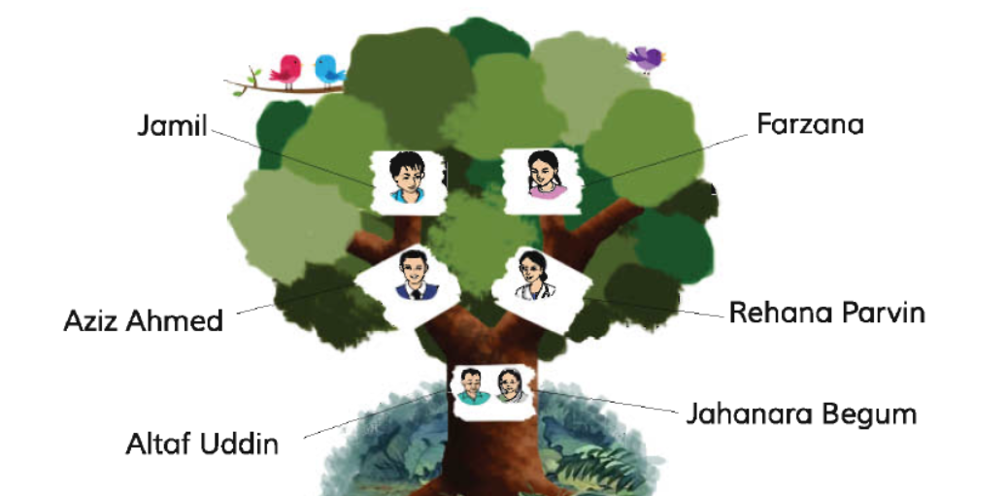
A Family Tree

Slide 9
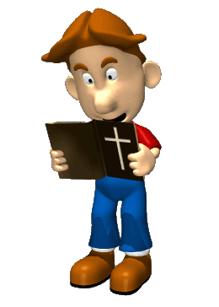
Teacher’s Model Reading

Slide 10
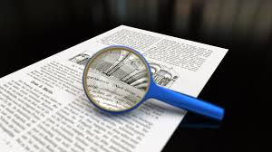
Identify New Word

Slide 11
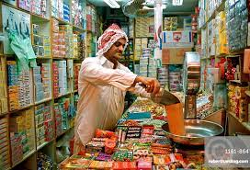
busi
ness
Businessman
ব্যবসায়ী
man

Slide 12
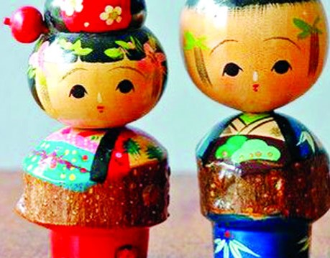
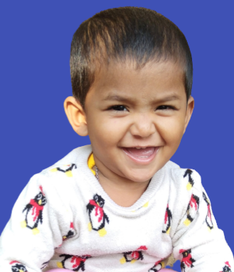
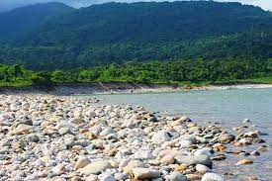
pic
picture
ছবি
ture

Slide 13
ban
banker
ব্যাংকার
ker

Slide 14
Grand
দাদা
দাদি
Grandparents
pa
rents

Slide 15
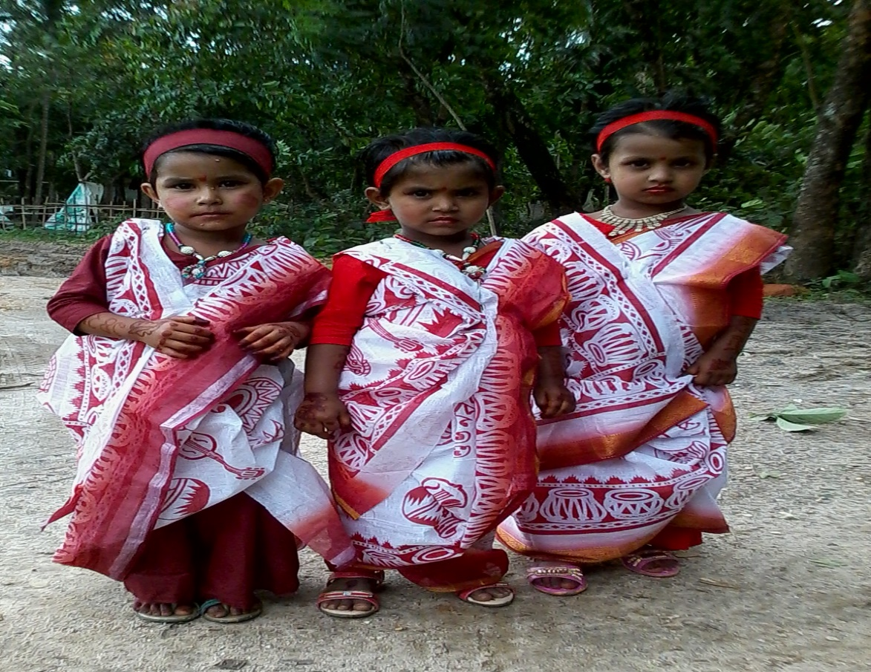
daugh
কন্যা/মেয়ে
Daughter
ter

Slide 16
Family
Daughter
Parents
Businessman
Bankers

Slide 17
Jahanara Begum
Altaf Uddin
Grandparents
Jamil Ahmed
Parents
Parvin Ahmed
Abeer and Farzana

Slide 18
Group Reading
Now read your text in group

Slide 19
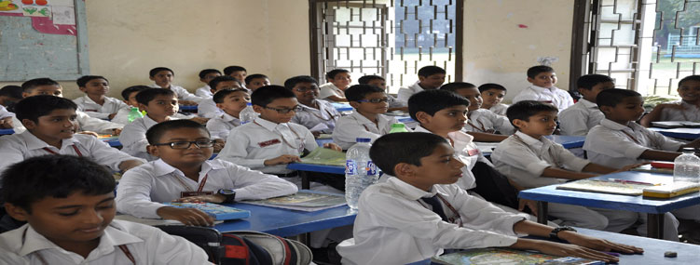
Individual Reading

Slide 20
Group work
Make sentence with the following words
Banker
Mr Shaker is a banker
Picture
Draw a picture
Nice
I have nice pen
Family
I live with my family
Housewife
My mother is a housewife

Slide 21
Pair work
Now Fill up your own family tree.

Slide 22
Evaluations
Answer the following questions:
(a)How many member’s are Abeer’s family?
(b)What’s Abeer’s father?
(c)What’s Abeer’s mother?

Slide 23
Home work
Now write five sentences about your own family.

Slide 24
Goodbye

