Slide 1
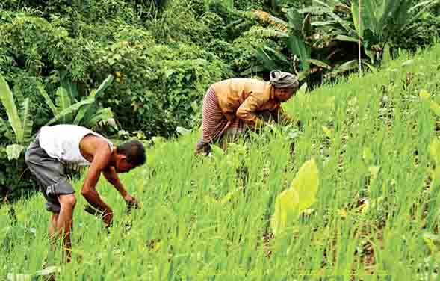
Welcome

Slide 2
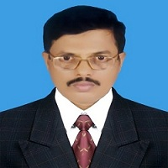
Md. Saiful Islam Chowdhury
Senior Teacher
C. J. M High School,
Mohara , Chandgaon , Chattogram.
saifulcjm@gmail.com Mob: 01991945882
ENGLISH FOR TODAY
Class - Eight
Unit - One , Lesson – Four
Time: 40 minute

Slide 3
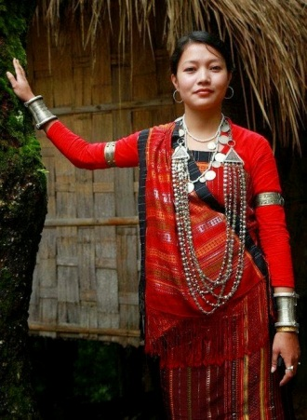
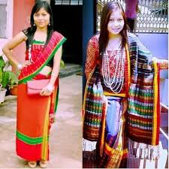
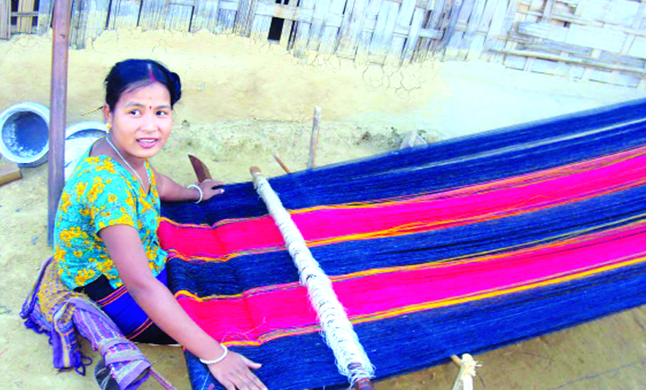
Look at the pictures
Try to guess what our today’s lesson may be ---

Slide 4
Today our Lesson is
Our Ethnic Friend ( 2 )
Unit-One ; Lesson – Four

Slide 5
Learning outcomes
After completing the Lesson students will be able to-
Read and understand texts through silent reading;
Infer meaning from the context ;
Ask and answer questions ;
Fill in the blanks ;
Write a short dialogue .

Slide 6
Listen the text attentively.
Teacher’s Model reading.
Most of these ethnic people living in Bangladesh have some common characteristics. They have their own lifestyles.
They build their houses on bamboo or wooden platforms called machang . Rice is their staple food. They eat vegetables, maize and fish, poultry and meat. Their kitchen utensils are bamboo, wooden and earthen pots which they make themselves. Men wear lungis and women wear thamis or sarongs and angis. Women weave their own clothes.
Hunting and fishing are their favourite pastimes. They are fond of songs, music, dances, theatre and fairs. Traditional musical instruments used are bugles made from buffalo horns, drums and bamboo flutes. Wrestling is a popular sport for them.

Slide 7
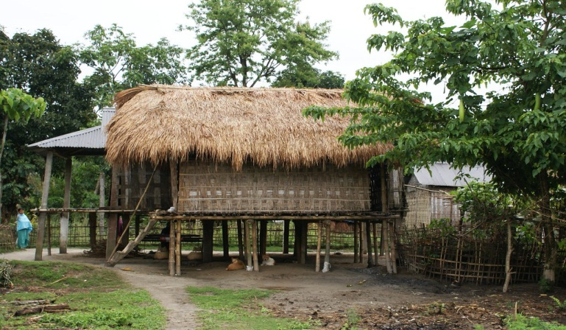
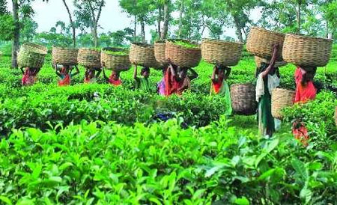
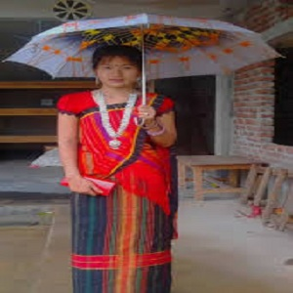
Read the following passage about
Our Ethnic Friend ( 2 )
Most of these ethnic people living in Bangladesh have some common characteristics. They have their own lifestyles.

Slide 8
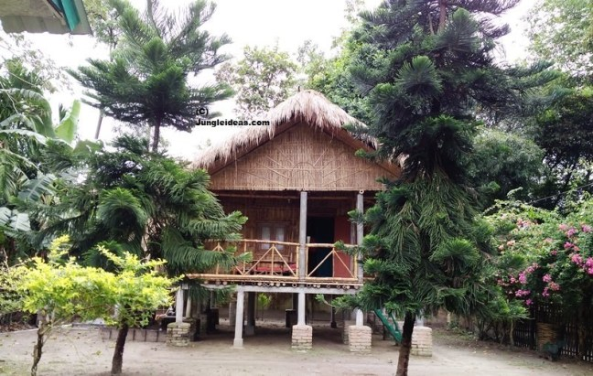
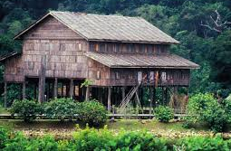
Home
They build their houses on bamboo or wooden platforms called ‘Machang’.

Slide 9
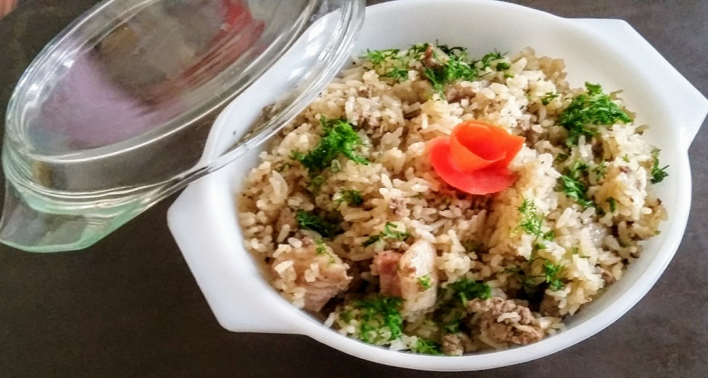
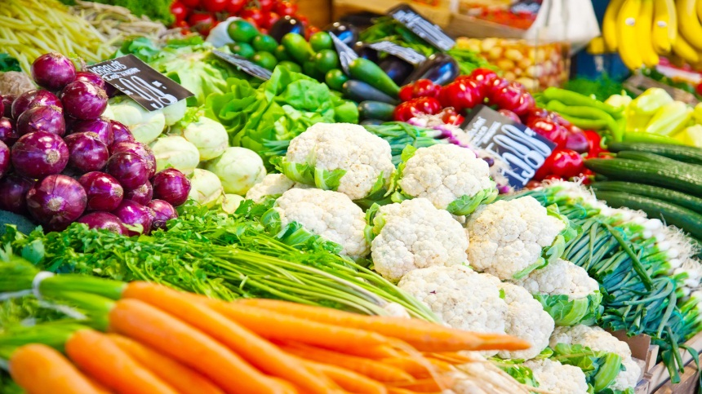
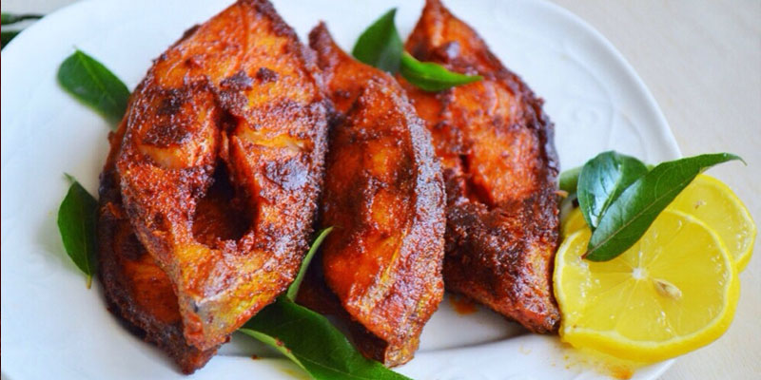
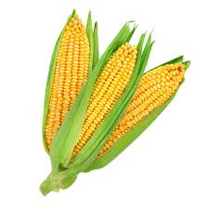
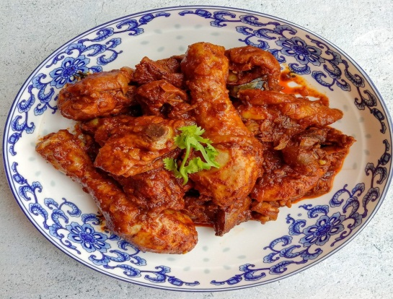
Food
Rice is their staple food. They eat vegetables, maize and fish, poultry and meat.

Slide 10
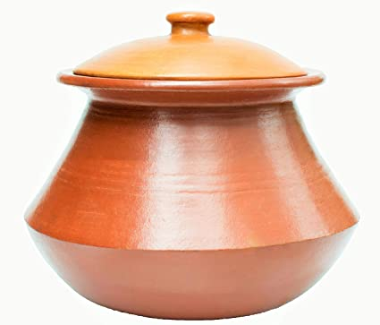
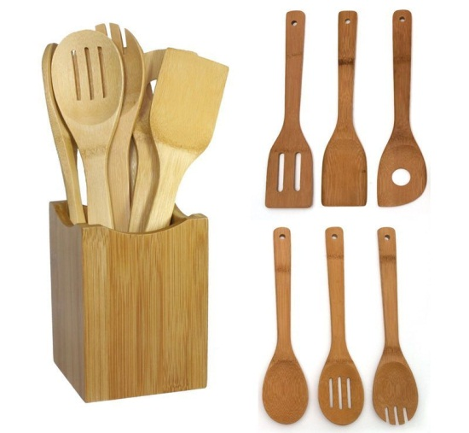
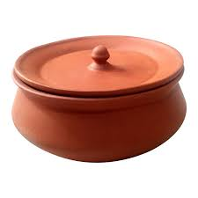
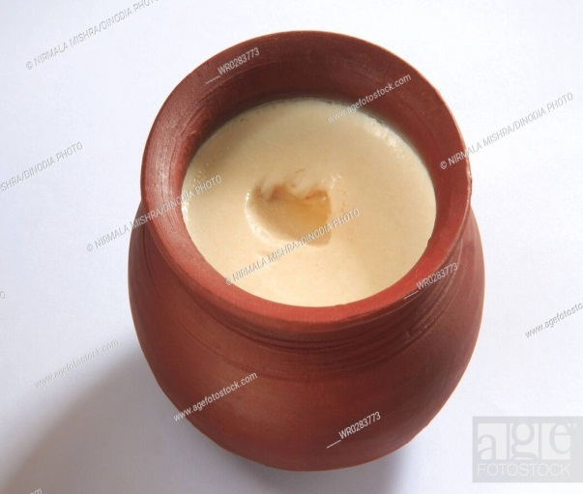
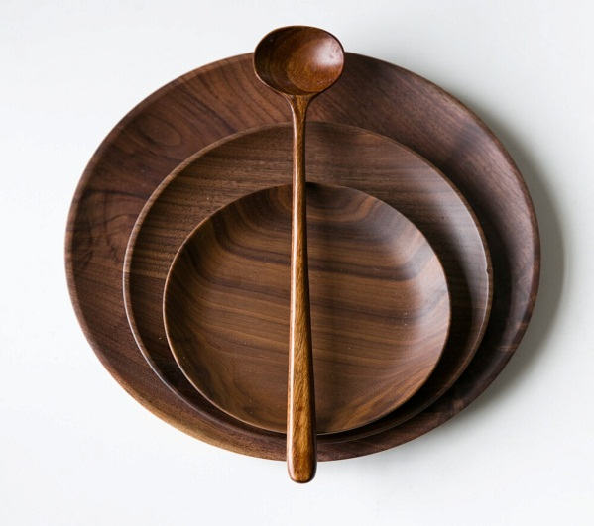
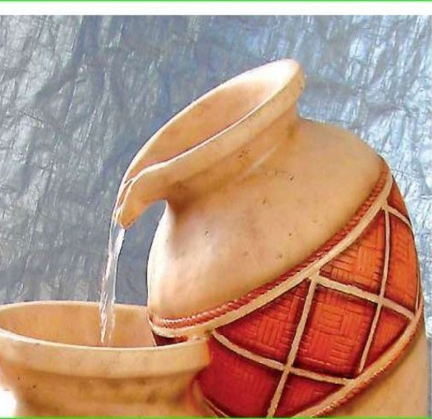
Kitchen
Their kitchen utensils are bamboo, wooden and earthen pots which they make themselves .

Slide 11
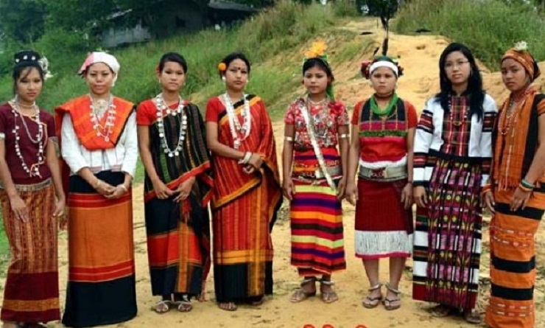
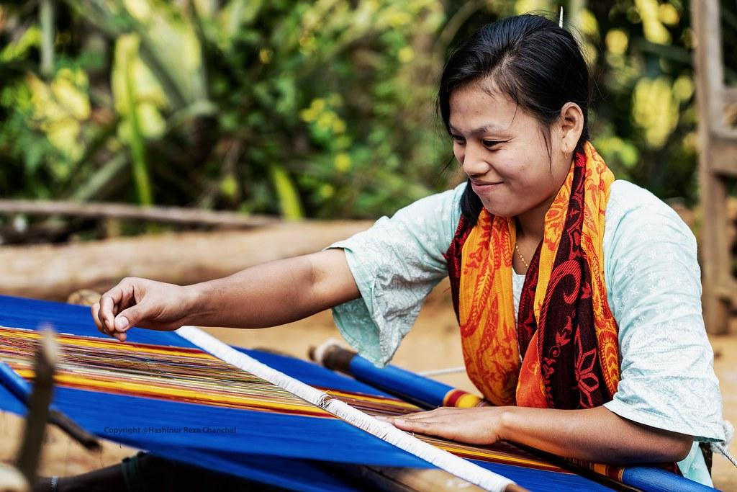
Dress
Men wear lungis and women wear thamis or sarongs and angis . Women wave their own clothes.

Slide 12
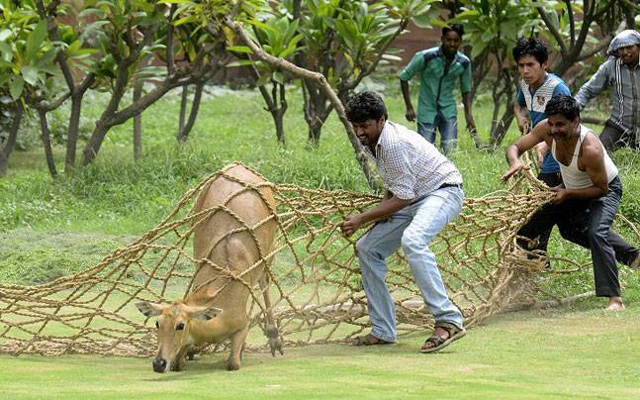
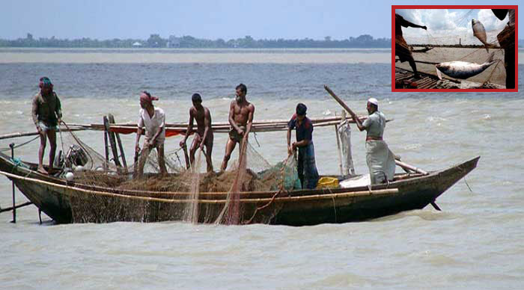
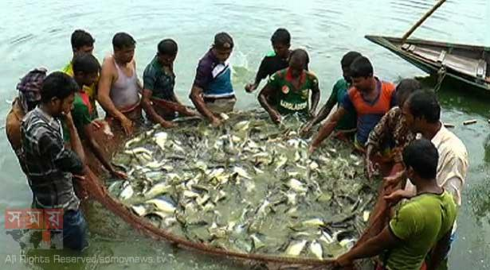
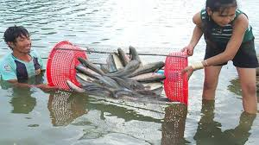
Pastimes
Hunting and fishing are their favorite pastimes.

Slide 13
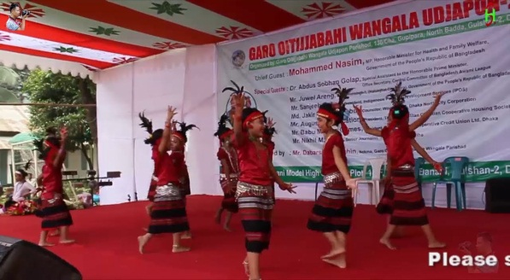
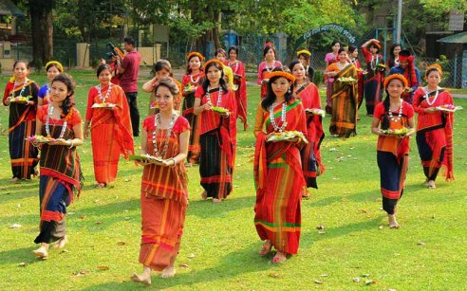
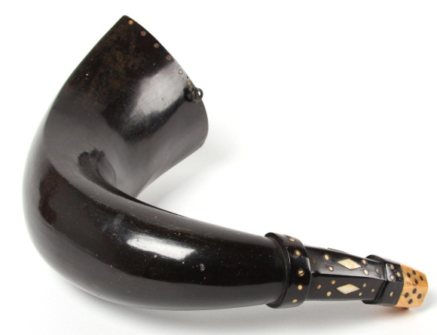
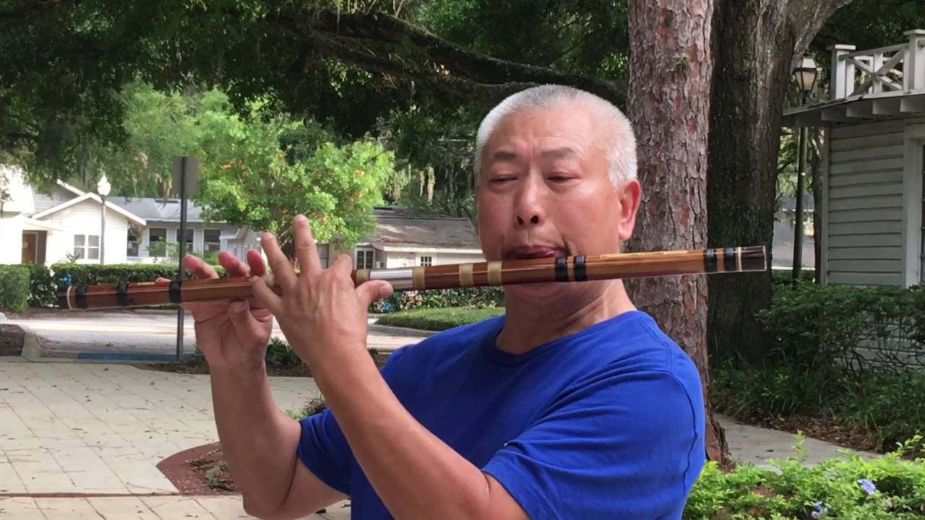
Music
They are fond of songs, music, dances, theatres and fairs. Traditional instruments used are bugles made from buffalo horns, drums and bamboo flutes.

Slide 14
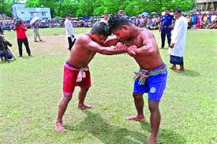
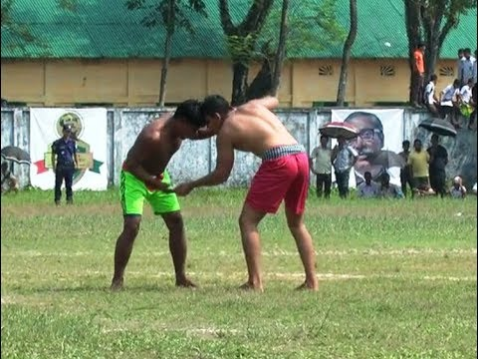
Sports
Wrestling is a popular sports for them.

Slide 15
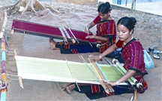
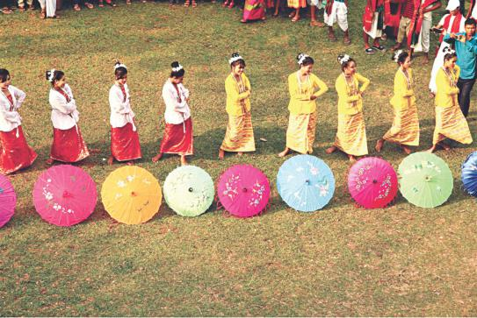
Key Word
Characteristics
Meaning
Features
These ethnic people have some common characteristics.

Slide 16
Key Word
Communities
Meaning
Societies
Ethnic communities have their own lifestyles.

Slide 17
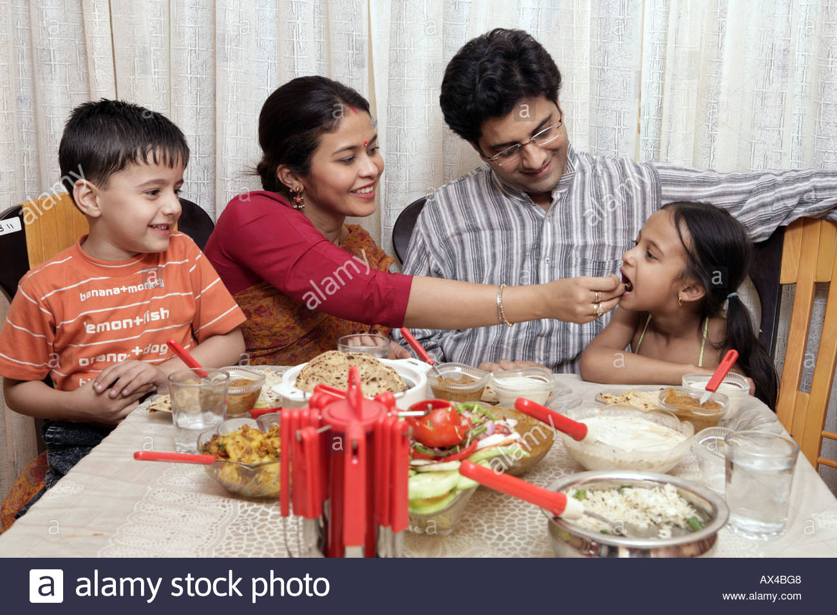
Key Word
Staple
Meaning
Prime
Rice is our staple food .

Slide 18
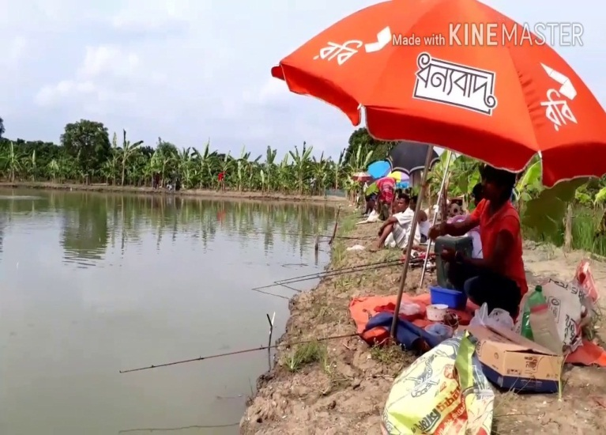
Key Word
Pastime
Meaning
Recreation / Relaxation
Hunting and fishing are their favorite pastime.

Slide 19
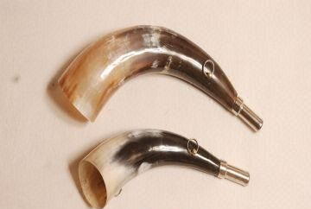
Key Word
Bugle
Meaning
Musical horn
Traditional instrument ‘Bugles’ made from buffalo horns.

Slide 20
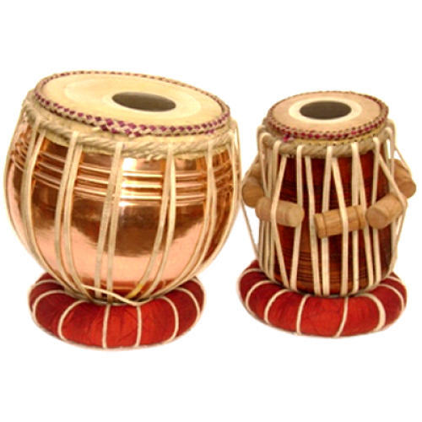
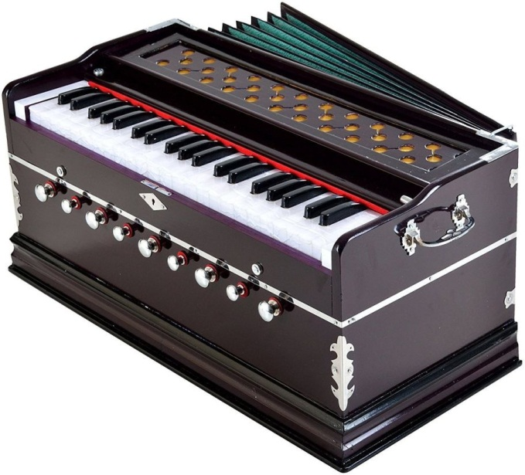
Key Word
Instrument
Meaning
Device / Equipment
Harmonium and Tabla are musical instruments.

Slide 21
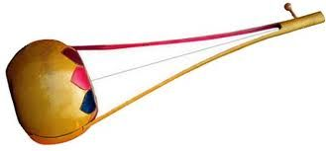
Key Word
Traditional
Meaning
Conventional
Ektara is our traditional musical instrument

Slide 22
Find the answers from column B to the questions in column A and write them in complete sentences.
A | B
1. Where do the ethnic people build their houses? | a) A traditional musical instrument made from a buffalo horn.
2. What are their favorite pastimes? | b) Clay, bamboo and wood
3. What is a bugle? | c) Rice
4. What do women wear? | d) On the wooden or bamboo platforms
5. What are their kitchen utensils made of? | e) Fishing and hunting
6. What is their staple food? | f) Thamis or sarongs and angis

Slide 23
Compare with your answers.
The ethnic people build their houses on the wooden or bamboo platforms.
2. Their favorite pastimes are fishing and hunting.
3. A bugle is traditional musical instrument made from a buffalo horn.
4. Women wear thamis or sarongs and angis .
5. Their kitchen utensils are made of clay, bamboo and wood.
6. Their staple food is rice.

Slide 24
Evaluation
Read the following text and fill in the gaps with appropriate words.
Hunting and fishing are their (a) pastimes . They are (b) of songs, music,dances, theatre and fairs.(c) musical instruments used are bugles (d) from buffalo horns, drums and bamboo flutes. Wrestling is a (e) sport for them.
favourite
fond
Traditional
made
popular

Slide 25
Home Work
Imagine you are Sajeed and you have a Marma friend called Masing.
Now write a dialogue asking and answering questions about dress, food, songs , sports and pastimes of both of you.

Slide 26
The World is my country, all mankind are my brethren, and to do good is my religion . Thomas Paine
Thank you all

