Slide 1
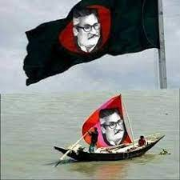
Welcome to my class

Slide 2
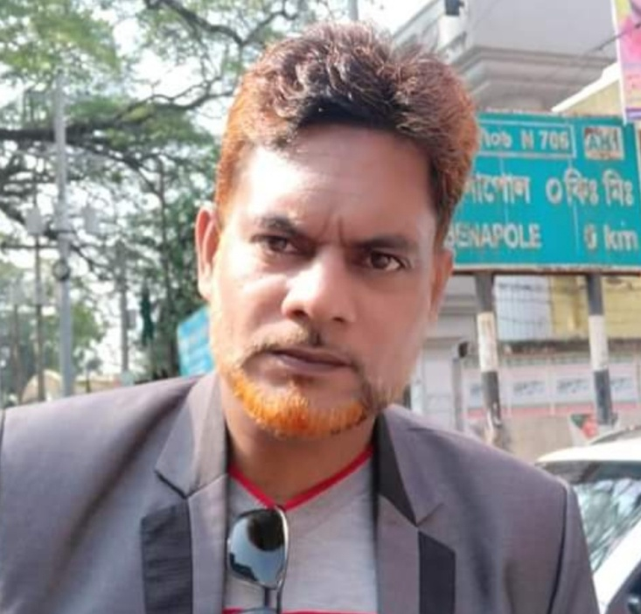
Introduction
Md. Shahneoaz
Assistant Teacher (English)
Jalalabad B/L High School
shahneoazmd@yahoo.com
Cell: 01631712091
English 1st Paper
Class: Nine
Unit: 01, Lesson: 01

Slide 3
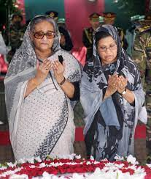
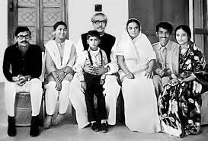
Look at the pictures bellow
Picture 1
Picture 2
Who can you see in the pictures?
What do you know about them?
Where were those people during the liberation war?

Slide 4
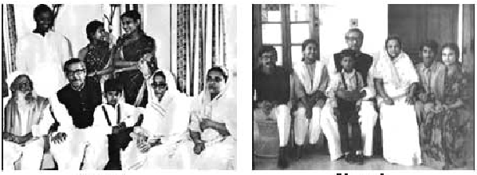
Today’s Topic
Bangabandhu’s Family in 1971
Unit 1, Lesson 1

Slide 5
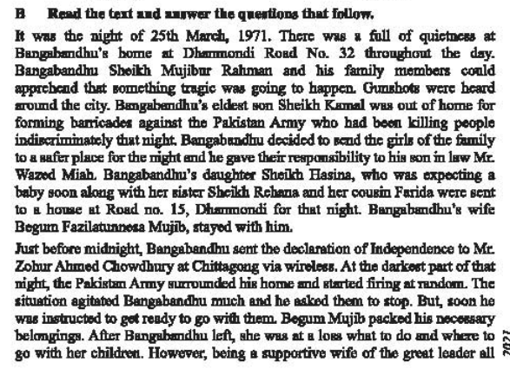
Silent Reading

Slide 6
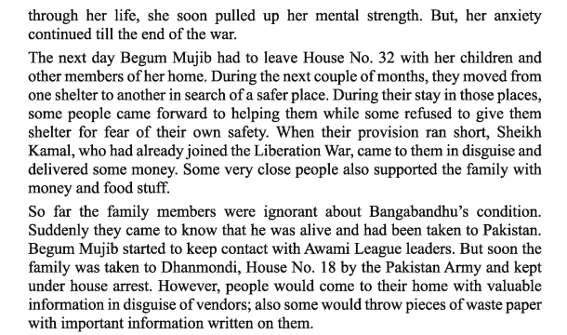
Silent Reading

Slide 7
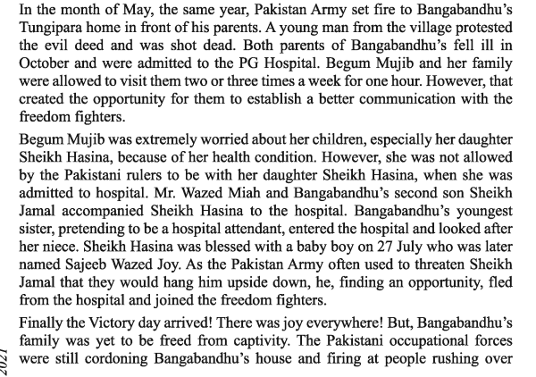
Silent Reading

Slide 8
Silent Reading

Slide 9
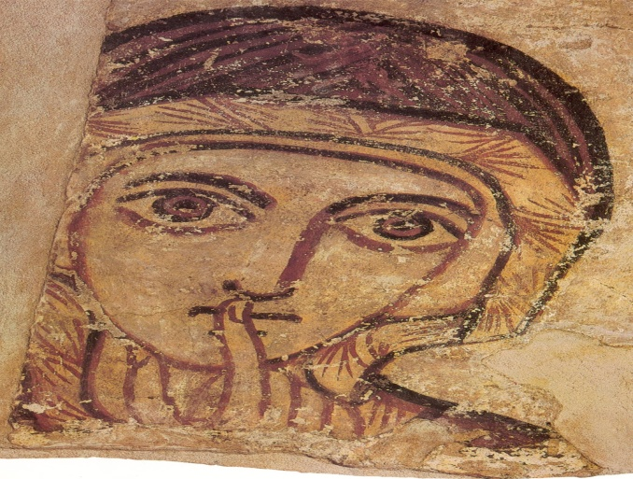
Let’s be introduced with some new words
Peace/Restfulness/
Calm/Calmness/
Tranquility/Serenity/
Silence/ stillness/still/quiet/
quietude/hush
Quietness
Understand /comprehend /realize /recognize /appreciate /discern /perceive
Apprehend

Slide 10
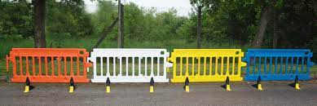
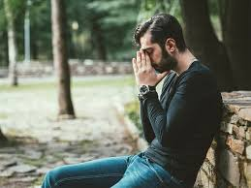
Let’s be introduced with some new words
Barrier/ obstacle/ blockade/ bar/ fence/ obstruction/ roadblock
Barricade
Upset/ Unnerved/ Disquieted/ Disturbed/ Distressed/ Unsettled/ Concerned/ Troubled/ Anxious
Agitated

Slide 11
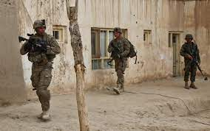
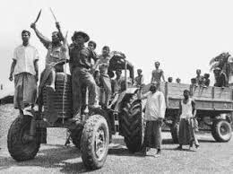
Let’s be introduced with some new words
Shut off/ partition off/ separate off/ Isolate/ Segregate/ Quarantine/ Seal/ Close/ Shut/ Blockade/ Enclose/ Encircle/ surround
Cordon
Making one feel strong, healthy, and full of energy
Invigorating

Slide 12
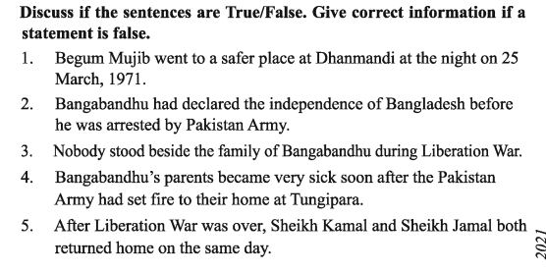
Pair Work
False
C/A: Begum Mujib stayed with Bangabandhu at Dhanmondi Road No 32.
True
False
C/A: Some people came forward to helping them while some refused to help them for fear of their own safety.
True
False
C/A: Sheikh Jamal returned home in the afternoon while Sheikh Kamal returned home the next day.

Slide 13
Group Work
Write the answer of the following question:
Why was the family anxious on the 25 March night in 1971?
Ans. The family was anxious on the 25 March night in 1971 because they could apprehend that something tragic was going to happen.
Where did Bangabandhu send the girls on that night?
Ans. Bangabandhu sent the girls to the safer place on that night.
How would the family communicate with people of freedom fighters while they were under house arrest?
Ans. While they were under house arrest, people would come to them with valuable information in disguise of vendors; also some would throw pieces of waste papers with important information written on them. Thus they communicate with freedom fighters.

Slide 14
Evaluation
Tell me the answer of the questions:
What was the invigorating slogan of Bangalees during the liberation war?
What was the consequence of the protest by a young man in Tungipara?
When was Sheikh Hasina blessed with a baby boy?
Who were admitted to PG Hospital?
How was Bangabandhu’s family kept in House No 18?

Slide 15
Answer of the questions:
How did Pakistani Army scare Sheikh Jamal?
How did Sheikh Jamal manage to flee from captivity?
How do you explain Bangabandhu’s family’s contribution to Liberation War?

