Slide 1
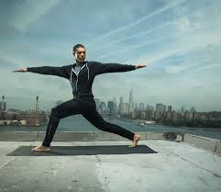
Welcome to my class

Slide 2
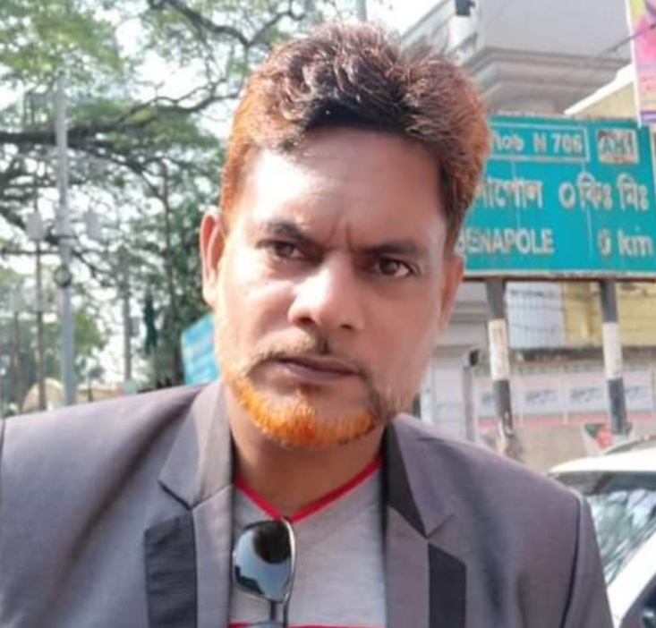
Introduction
Md. Shahneoaz
Assistant Teacher (English)
Jalalabad B/L High School
shahneoazmd@yahoo.com
Cell: 01631712091
English 1st Paper
Class: Nine
Unit: 02, Lesson: 01 (C)

Slide 3
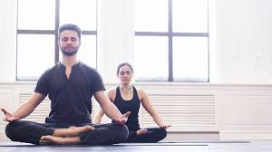
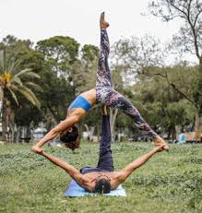
Look at the pictures bellow
Picture 1
Picture 2
What can you see in the pictures?
What do you know about it?
Is it beneficial for health?

Slide 4
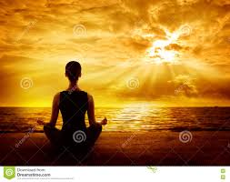
Today’s Topic
Yoga: Tap Into the Many Health Benefits
Unit 2, Lesson 1 (C)

Slide 5
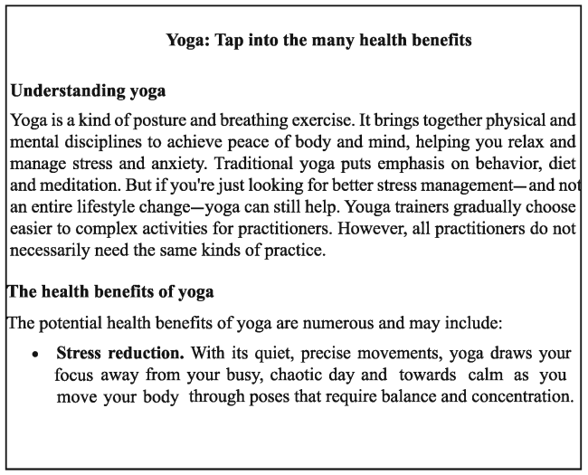
Silent Reading

Slide 6
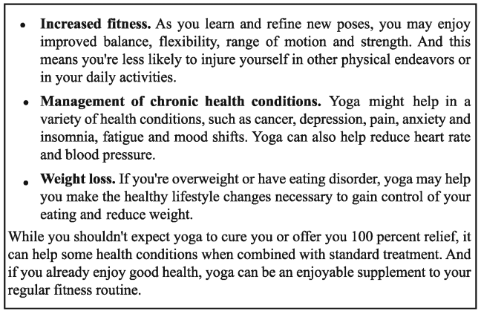
Silent Reading

Slide 7
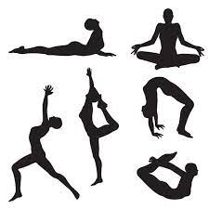
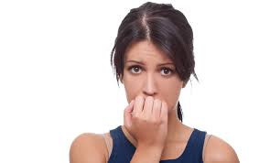
Let’s be introduced with some new words
A Hindu spiritual and ascetic discipline, a part of which, including breath control, simple meditation, and the adoption of specific bodily postures, is widely practiced for health and relaxation.
Yoga
Pressure/ tension/ strain/ tightness/ tautness/ tensely
Stress

Slide 8
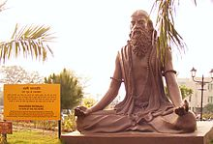
Let’s be introduced with some new words
Contemplation/ thought/ thinking/ musing/ pondering/ consideration
Meditation
A person actively engaged in an art, discipline, or profession, especially medicine.
Practitioner

Slide 9
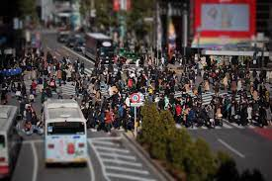
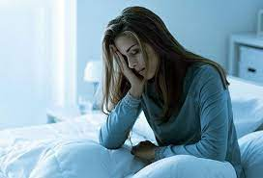
Let’s be introduced with some new words
In a state of complete confusion and disorder.
Chaotic
Sleeplessness/ wakefulness/ restlessness/ inability to sleep/ watchfulness
Insomnia

Slide 10
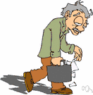
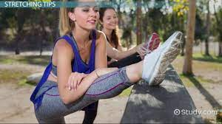
Let’s be introduced with some new words
Tiredness/ weariness/ exhaustion/ overtiredness/ drowsiness
Fatigue
The quality of bending easily without breaking
Flexibility

Slide 11
Pair Work
Ans. Exercise works on our memory by helping to be relaxed and managing stress and anxiety.
Ans. Exercise benefits us by reducing stress, increasing fitness, managing chronic health condition and lessening weight.
Ans. According to me, the most important benefit of exercise is to manage anxiety because it keeps me fit to continue my study smoothly.

Slide 12
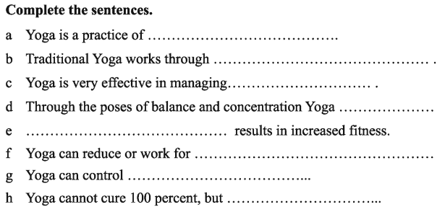
Group Work
posture and breathing.
behaviour, diet and meditation.
stress and anxiety.
draws your focus away from your busy chaotic day towards calm.
Yoga
heart rate and blood pressure.
eating and weight.
can be a supplement to standard treatment.

Slide 13
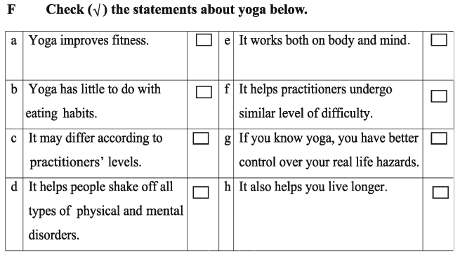
Evaluation

Slide 14
Write the summary with the one third number of the words of the passage.

