Slide 1
Welcome to
our multimedia education.
Notes:
Welcome slide.

Slide 2
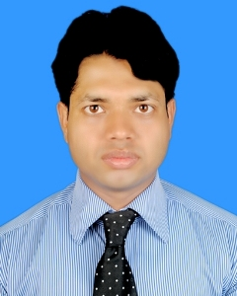
IDENTITY
Faiz Ahmed
Lecturer in English
Bakila Fazil Degree Madrasha
Hajiganj, Chandpur.
Class : 11-12
Sub : English 2nd
Topic : Punctuation
part 1

Slide 3
How are you my friend said Rebaka to Rabeya I am fine and you
I am also fine I sent you an email last night Did you find it
What are the problems with the sentences?
Punctuation
Notes:
Suspension to the lesson.

Slide 4
Our today’s lesson is-
Punctuation
Notes:
Lesson declaration

Slide 5
Learning outcomes
At the end of the lesson, we will be able to—
identify the definition of punctuation
identify the names of the punctuation
use punctuation where necessary
Notes:
Students will be able to learn the above items.

Slide 6
What is punctuation?
Follow the passage
Fahim said to me have you finished reading the book I gave you yesterday yes I have finished reading the book I replied What an interesting book it is I said Will you return the book to me today he asked
The passage does not express a clear meaning as
there is no punctuation mark in this passage.
Notes:
Advancing to definition of punctuation.

Slide 7
Follow this passage
Fahim said to me, “Have you finished reading the book I gave you yesterday?”
“ Yes, I have finished reading the book.” I replied. “What an interesting
book it is!” I said. “Will you return the book to me today?” he asked.
The passage expresses a clear meaning as there are
proper punctuation marks in this passage.
So, the symbols which are used in the sentences to make their
meaning clear are called punctuations.
Notes:
Definition of punctuation/Learning outcomes No-1 will be achieved from this slide.

Slide 8
What are the punctuations?
The punctuations are as follows.
Full stop (.)
Comma ( ,)
Semi-colon (;)
Colon (:)
Note of Interrogation (?)
Note of exclamation (!)
Inverted comma (“ ” )
Apostrophe (‘)
Hyphen (-)
Dash (−)
Brackets ({[ )}]
Notes:
Punctuation marks will be achieved from this slide.

Slide 9
1. Use of full stop (.)
He is a good student He reads his lessons regularly After
his Fazar prayer He reads the Quran with his mother
What are the mistakes with the sentences?
Full stop
He is a good student. He reads his lessons regularly. After
his Fazar prayer he reads the Quran.
Note: Full stop is used to stop fully.
Notes:
Where full stop used shown here.

Slide 10
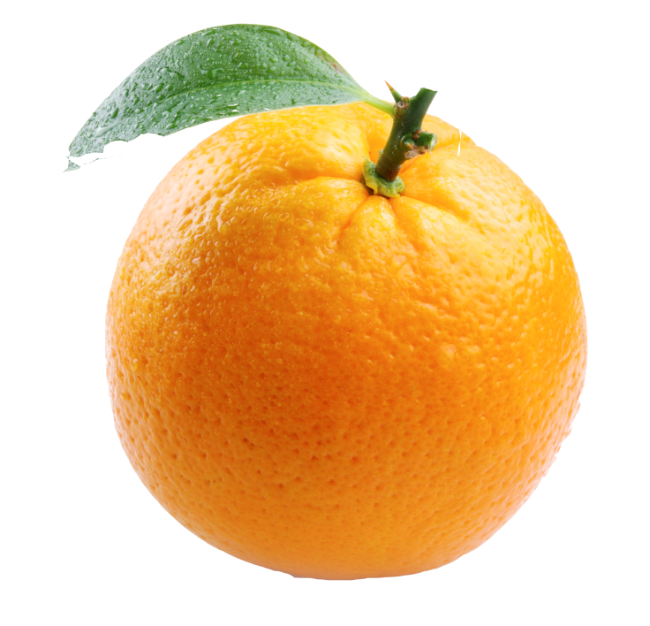
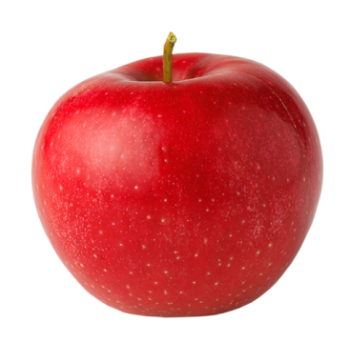
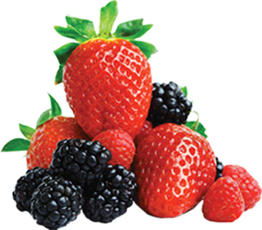
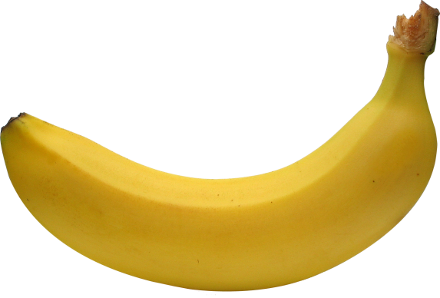
2. Use of comma-1(,)
Comma is used for multi-purpose.
He eats orange, apple, mango, banana and berry.
If there is more than two same kind of parts of speech in a sentence,
comma is used after each noun and the last two nouns are added with ‘and’.
Note: Comma is used to stop shortly.
Notes:
First use of comma shown here.

Slide 11
2. Use of comma-2(,)
Mr. Hasan, lecturer of English, conducts
his class very spontaneously.
Comma is used before
and after ‘Case in apposition’.
Notes:
2nd use of comma shown here.

Slide 12
2. Use of comma-3(,)
Tell me, my dear friend, how can I help you?
If there is vocative case at the beginning of the sentence, at the middle
of the sentence, comma is used after first vocative and second vocative.
Notes:
Comma is used after vocative case shown here.

Slide 13
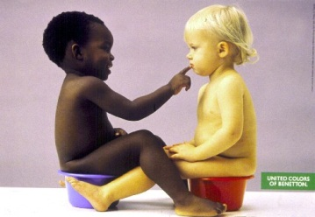
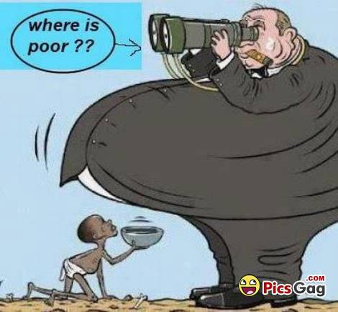
2. Use of comma- 4(,)
Black and white, rich and poor, all are equal to Allah.
Comma is used after more than one pair of words.
Notes:
Comma is used after pair of words shown here.

Slide 14
2. Use of comma- 5(,)
He said, ”Never tell a lie.”
Comma is used after reporting verb in direct speech.
Notes:
Using comma after reporting verb shown here.

Slide 15
2. Use of comma- 6 (,)
Running away, the criminals escaped themselves.
Comma is used after adjective or adverb phrase if it is at the beginning or at the middle.
Notes:
Comma is used after adverb phrase’

Slide 16
Activities
Use full stop and comma where necessary.
Rubina is a student She went to visit a museum with Sabrina Sumaia Rokeya and Rayhana They took bag books and foods They all are well and good cordial and intimate friendly and jolly They were happy to visit the zoo.
Notes:
Feed back/Evaluation of the lesson.

Slide 17
May Allah bless you.
Will be continued.
Notes:
Ending slide.

Slide 18
Thank
you
all

