Slide 2
Introduction
Lipi Sharma
Assistant teacher
Madhobpur GPS
Chhatak,Sunamganj

Slide 3
LEASON IDENTITY
Class: Five
Subject: English
Unit:8 Lesson:1-2, Write to me soon!
Lesson whole :(Sima is at ----well soon).

Slide 4
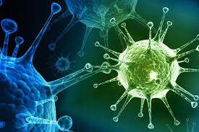
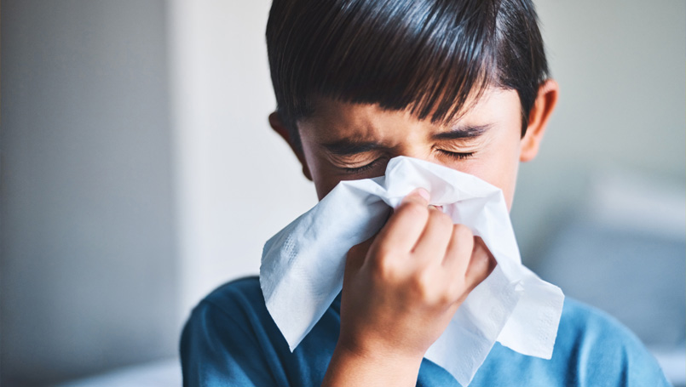
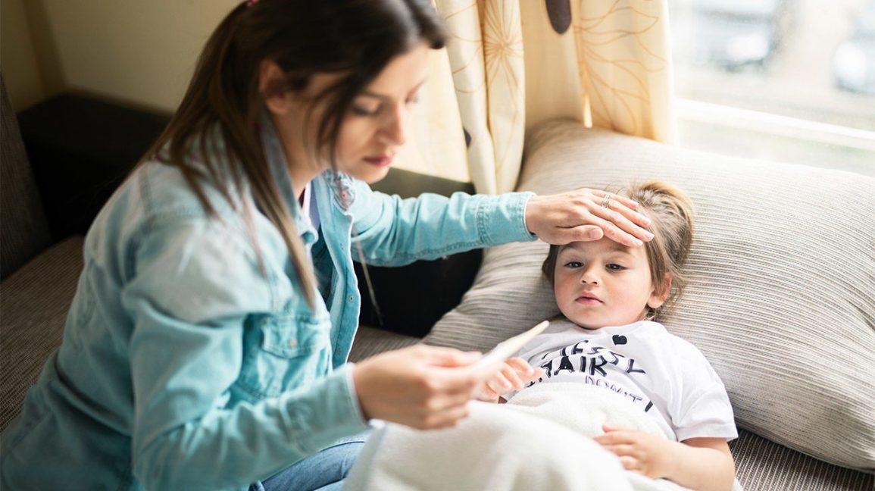
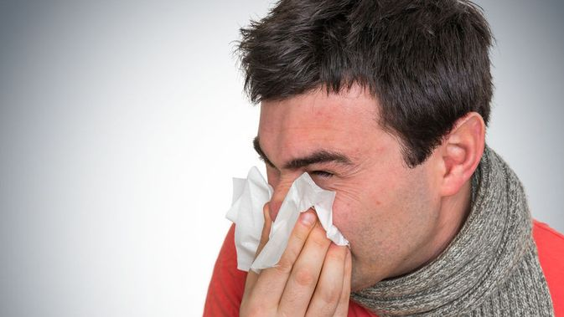
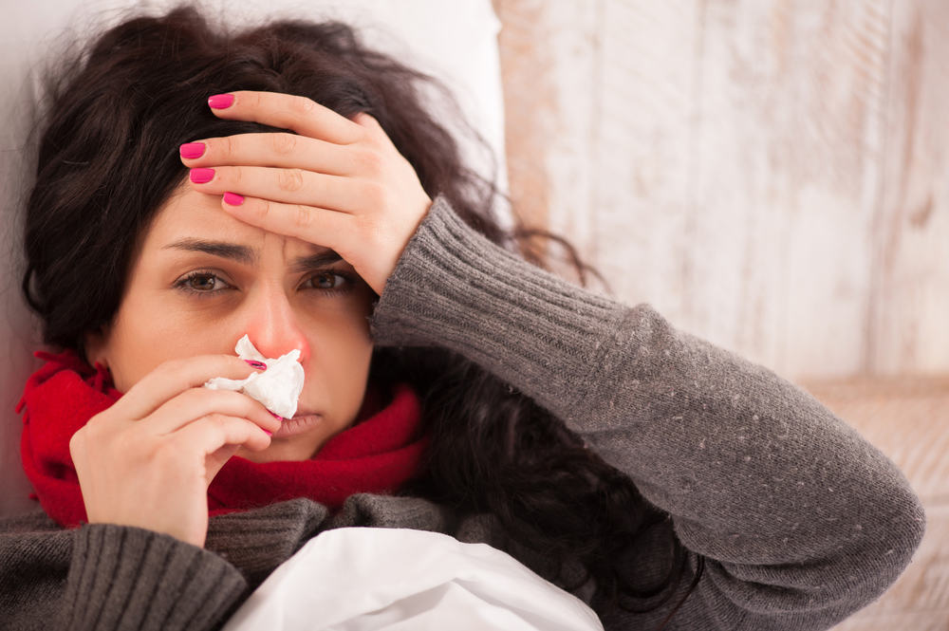
Let’s we see some pictures
Can you guess what’s our today’s topic

Slide 5
Lesson declaration
Write to me soon!

Slide 6
Learning outcomes
Students will be able to-
Listening: 1.2.1 recognize which syllable in a word is stressed.
Speaking: 6.2.1 talk about people, object, events etc.
Reading: 5.1.1 read silently with understanding paragraphs.
Writing: 8.1.1 make sentences using words and phrases given in the text.

Slide 7
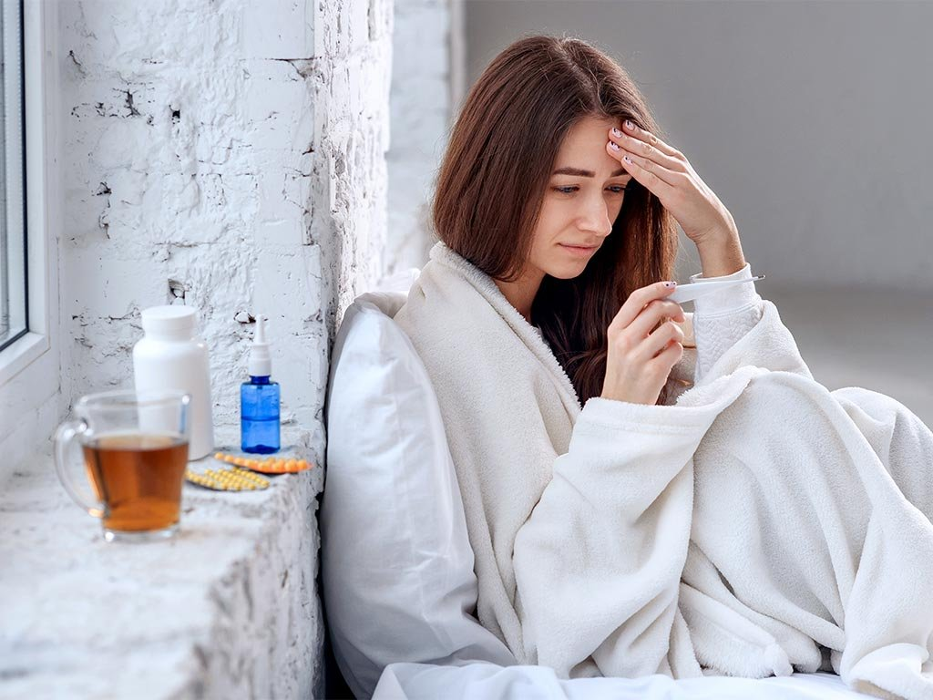
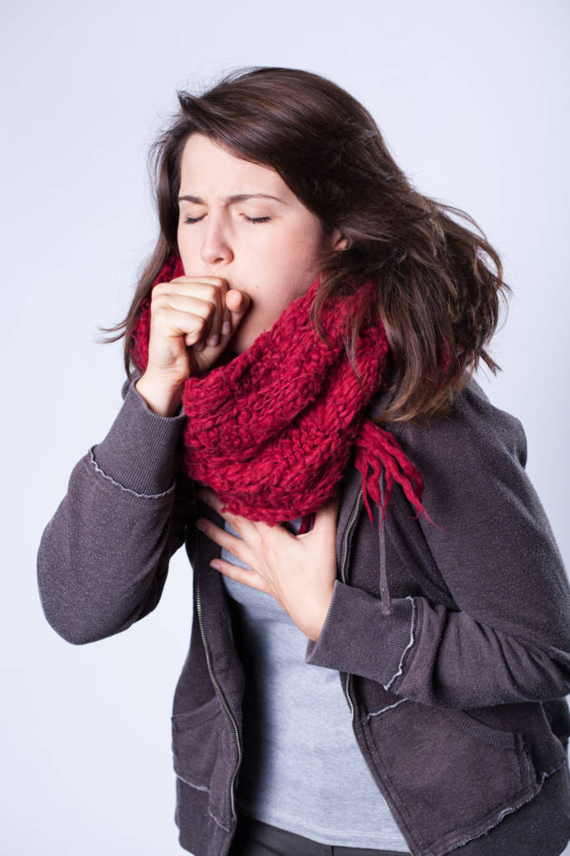
Let’s know the lesson with the pictures
Sima is at home today. She didn’t go to school because she is ill.
She has a cough and a sore throat.

Slide 8
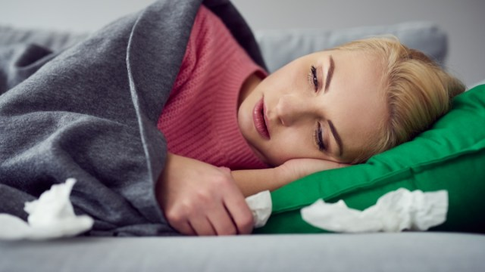
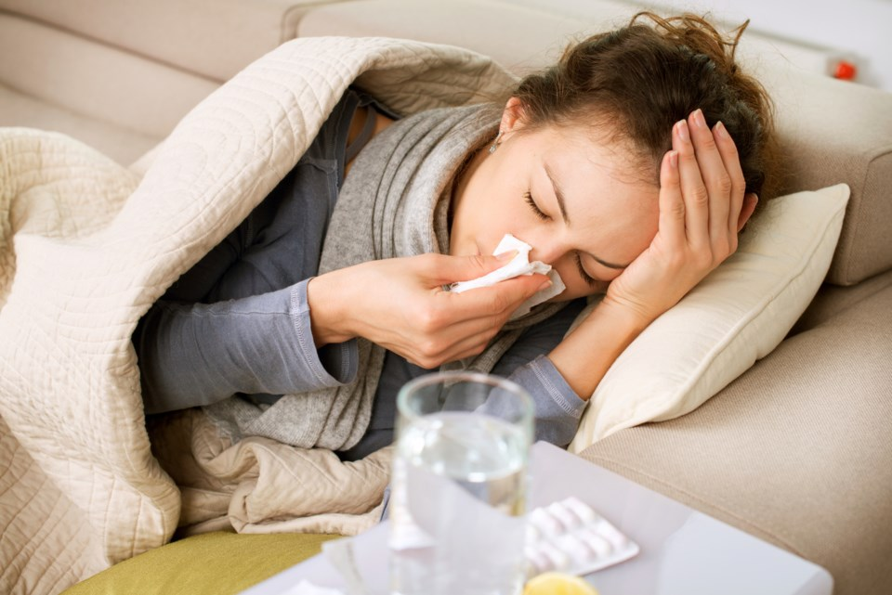
Let’s know the lesson with the pictures
She also fells very warm because she has a fever.
She has the flu.

Slide 9
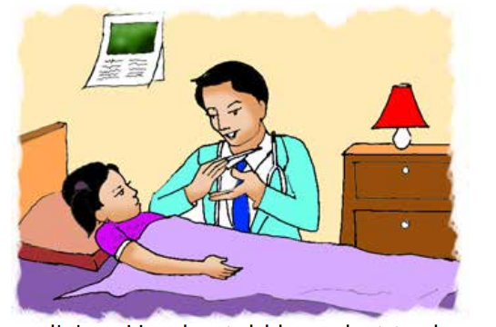
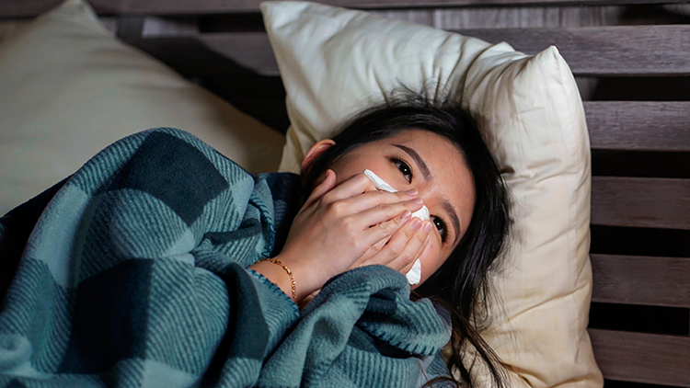
Let’s know the lesson with the pictures
The doctor visited sima last night.
She needs some medicine.He also told her what to do in order to get well soon.

Slide 10
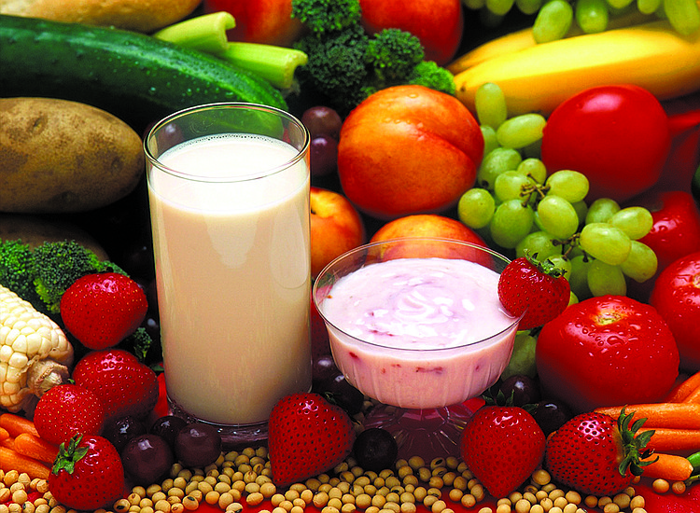
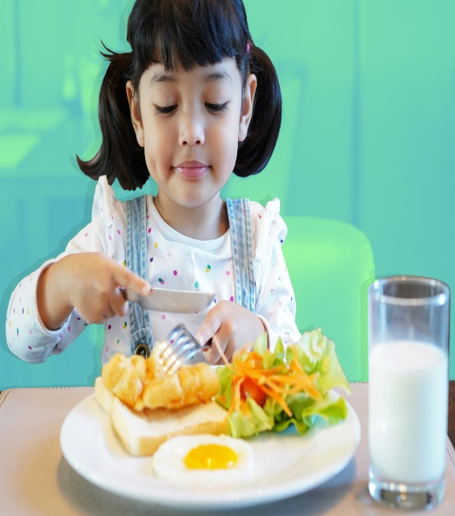
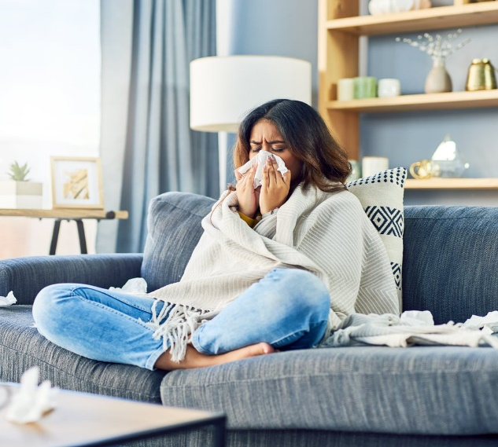
The doctor’s advice
Eat food that gives your body energy.Try to eat, even if you aren’t hungry You need to be strong.
Rest ! Stay at home . Don’t go to school or work.

Slide 11
Drink a lot of water or juice. They are better than soft drinks.

Slide 12
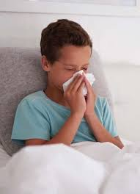
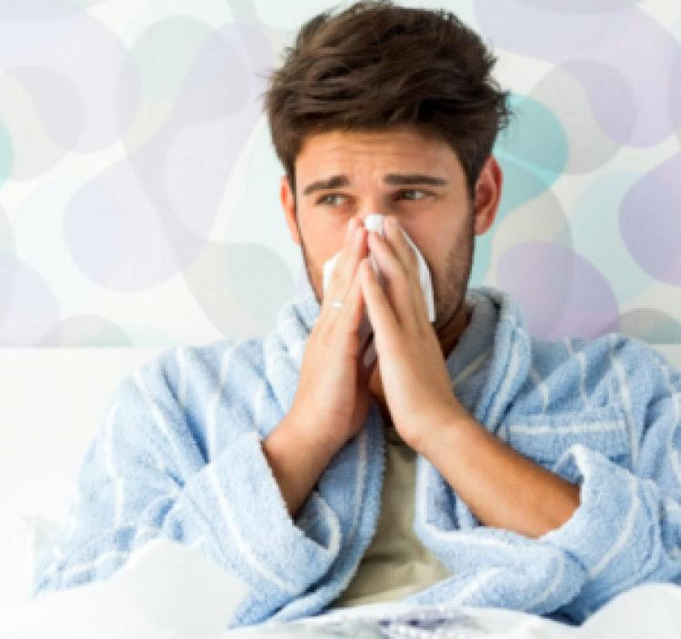
Are you coughing or sneezing? Cover your mouth and nose! Use a tissue, not your hand!

Slide 13
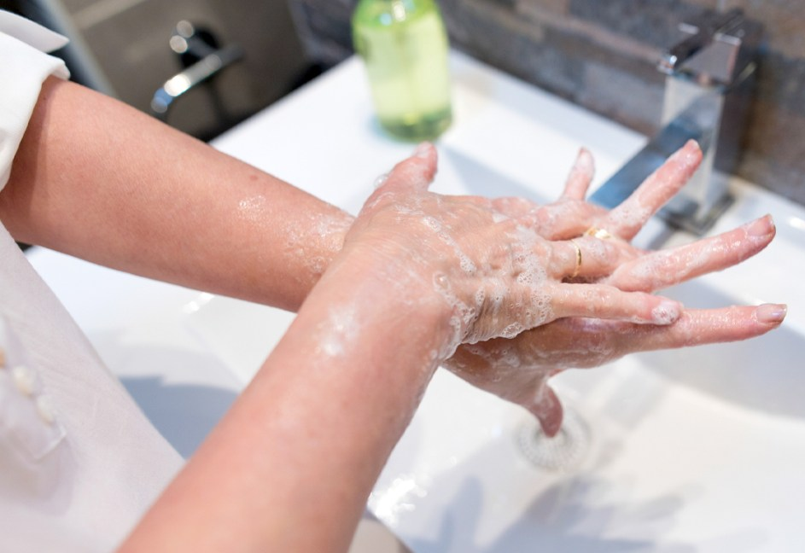
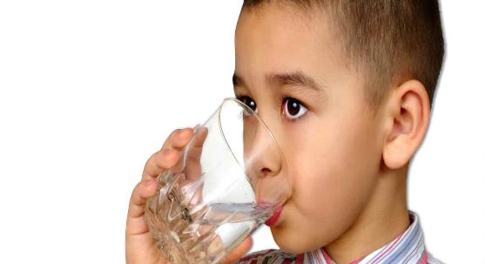
Wash your hand regularly.
Use your own plate, glass and cup. Other people can catch your illness from these things.

Slide 14
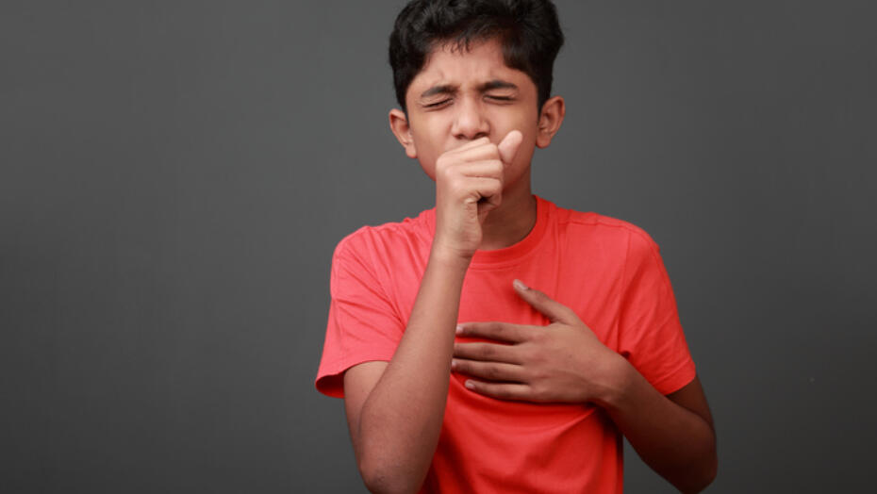
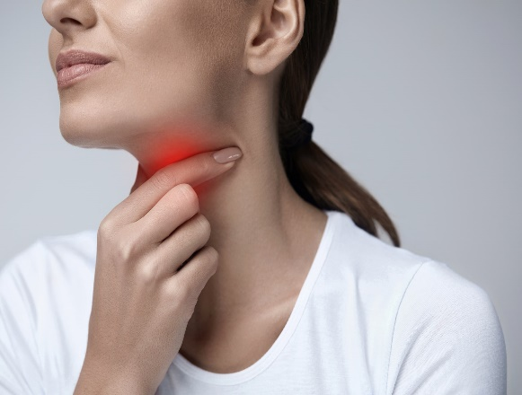
Teaching Vocabularies
Let’s find out new or difficult words:
Cough
Cough stored in the throat
শক্তিশালী
Sore throat
Pain in one’s throat
গলাব্যাথা

Slide 15
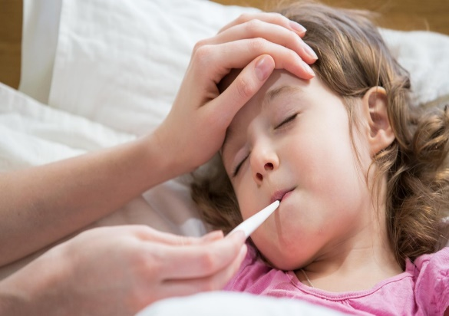
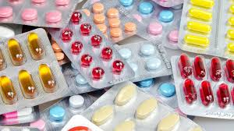
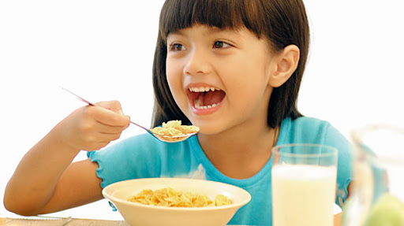
Let’s find out new or difficult words
Fever
A disease of high temperature
জ্বর
Medicine
A drug for the treatment of disease
ঔষধ
Hungry
ক্ষুধার্ত
One who has hunger

Slide 16
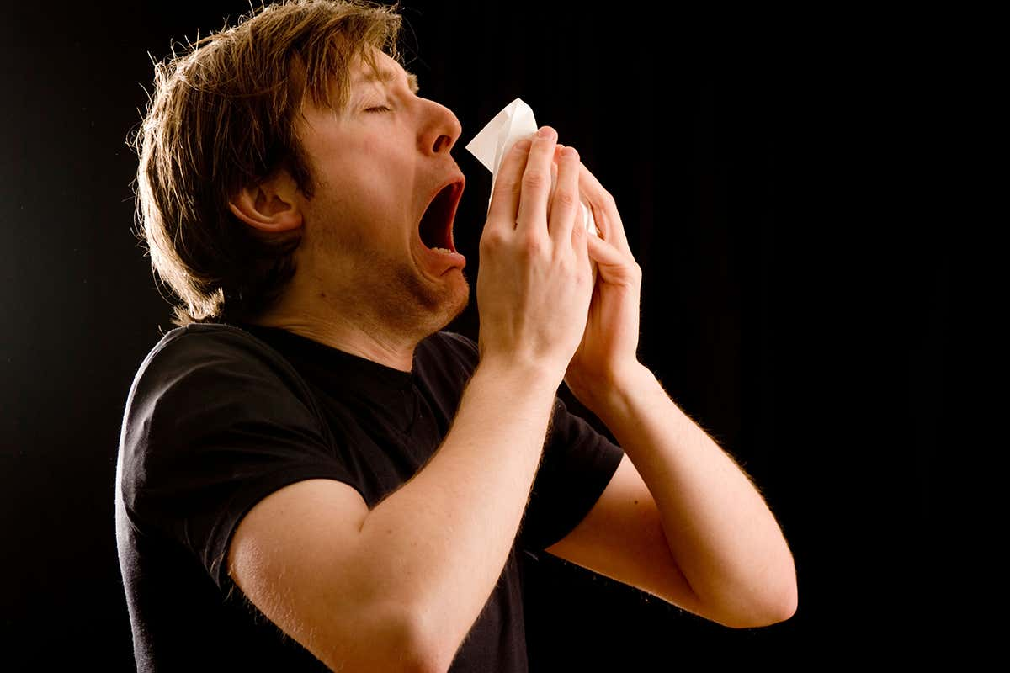
Let’s find out new or difficult words
Strong
Mighty or powerful
শক্তিশালী
To make a sudden expulsion of air from the nose
Sneeze
হাঁচি দেওয়া
Flu
One kind of fever
ইনফ্লুয়েঞ্জা

Slide 17
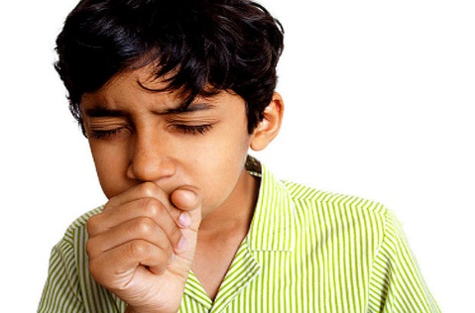
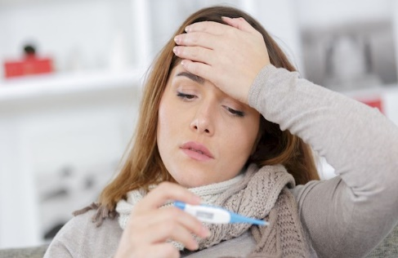
Make sentences
IW
Cough
I have a cough.
Visit
I have visited Dhaka.
Juice is better than soft drinks.
Juice
Flu
Sima has the flu.

Slide 18
Lets play a game (kims game).
WCW
Close your eyes
Which word have I covered
Cough
Energy
Hungry
Medicine
Sneeze
Regularly

Slide 19
Teacher’s loud reading
Have a look at page 30 of your book
Listen to me attentively
Put your finger under the line.
Write to me soon

Slide 20
Student’s Silent Reading

Slide 21
Group work
Group-A
Where is Sima today ?
Write the name of two drinks that Sima can drink.
Group-B
Group-C
Write 3 pieces of doctors advice for Sima?

Slide 22
Pair work
Write True for correct statement and False for incorrect statement
Let’s click on the sentences to know the right answer
a) Sima feels very warm for her coughing
True
b) We get energy from foods.
True
c) Sima should not drink juice.
False
d) Coughing or sneezing doesn’t spread diseases.
False
e) Patients should eat only when they feel hungry.
False

Slide 23
Match the words of column A with the similar meaning of Column B. Two extra meaning are given in column B.
IW
Column A
Column B
a) Flu
i) vigorous.
ii) Who advises medicine for the patients.
b) Medicine
iii) Respective.
c) Doctor
iv) One kind of disease.
d) Strong
v) Drug.
e) Own
vi) Painful.

Slide 24
Evaluation
a) What happened to Sima?
Ans: Sima has flu. She has a cough and sore throat. She has fever too.
b) Why didn’t Sima go to school?
Ans: Sima didn’t go to school because she was ill.
c) What should we drink when we get influenza?
Ans: We should drink a lot of water or juice when we get influenza.
d) What should sima do when she is sneezing?
Ans: Sima should cover her mouth and nose when she is sneezing.
e) How do you give your body energy when you are sick?
Ans: When I am sick, I give my body energy by eating routinely,Even I am not hungry.

Slide 25
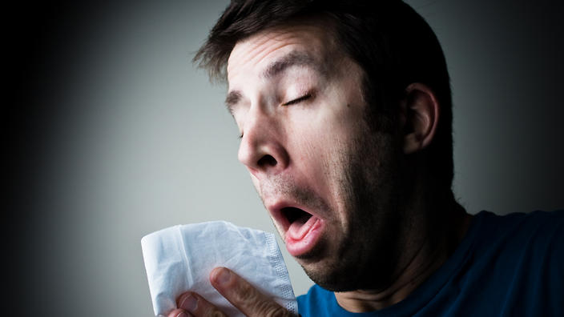
One day one word
Sneeze
হাঁচি দেওয়া
Today I am sneezing

Slide 26
Home work
Write a short composition about Flu.

