Slide 1
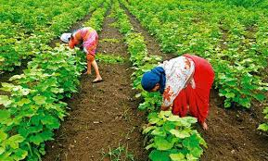
welcome

Slide 2
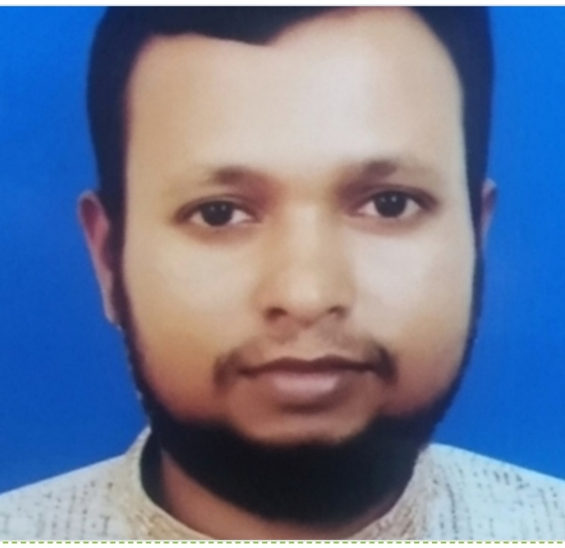
INTRODUCTION
MD. Habibur Rahman
Assistant teacher
Tilsindur dakhil madrasah
Barhatta-Netrakona
Class: Eight
SubJect:English

Slide 3
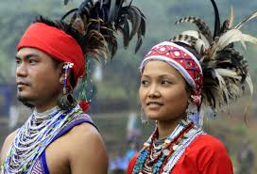
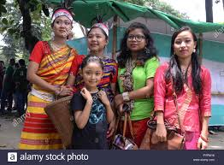
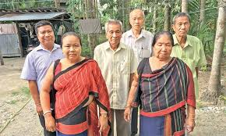
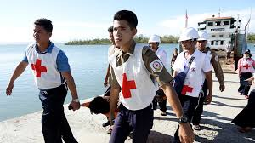
LOOK AT THE PICTURES
RAKHAIN

Slide 4
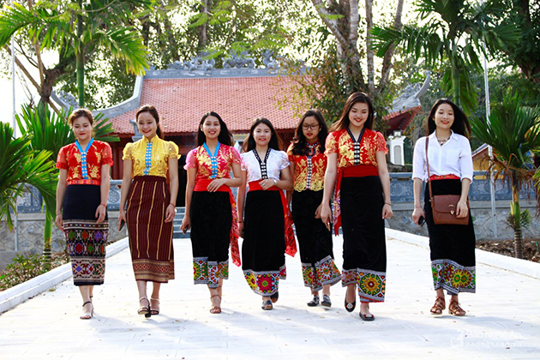
Today’s topic is
our ethnic friends

Slide 5
LEARNING OUTCOMES
By the end of the lesson the learners will be able to--
describe the ethnic people
guess meaning of the words close to the text
answer the questions about ethnic people
write the activities of the ethnic people

Slide 6
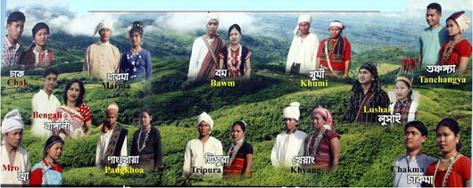
TEXT READING
I will ask the learners to read the text for 10 minutes. After they have finished reading the text, I will give them further tasks on the basis of the given text.

Slide 7
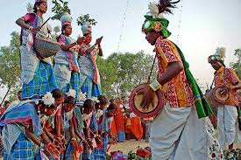
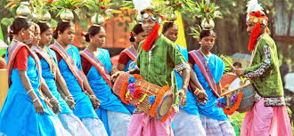
ETHNIC
pertaining to or characteristic of a group of people, especially a group sharing a common and distinctive culture, religion, language, or the like
Ethnic people practise a common and distinctive colourful culture

Slide 8
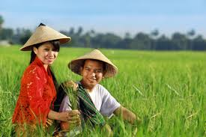
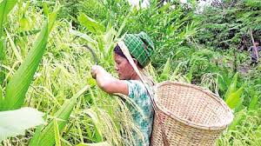
Jhum
Clearing the hill –slopes and the lands in the forests, ethnic people practise cultivation and its called ‘jhum’.

Slide 9
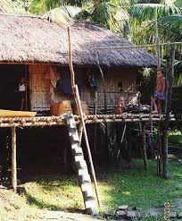
PLATFORM
A place raised high from the ground
Ethnic people build their houses on the high platform to protect them from wild animals.

Slide 10
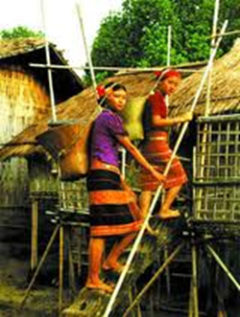
MACHANG
A house built on a high platform
Ethnic people build their houses on the high platform that is called the ‘machang.’

Slide 11
QUESTION ITEMS
1.Guess the meaning of the following words close to the text:
i) ethnic-
iii) platform-
a) people living in the forest areas,
distinct in culture, religious and language-tribes
a) station
b) track
c) stage
b) root people’s subordinate
c)rural people
d) raised surface to build houses
d)People living in the low lying areas
ii) tongue-
iv) characteristic-
a)language
c)utterance
a)feature
c) look
b)speech
b)type
d)quality
d)word

Slide 12
QUESTION ITEM
2. Answer the following questions in your own words
a. Who are our ethnic friends? Why are they considered so?
b. Are their features the same to us ? What do you think?
c. How do they pass their leisure
d. How do they do the JHUM CULTIVATION ?
e. How do they lead their lives?

Slide 13
EVALUATION
I will sum up the text . After that I will ask the learners some questions
1. What does the term ‘ethnic’ mean?
2. What is ‘MACHANG’?
3. Why do they build their houses on the high platform?
4. What are their occupations?
5. What do the most people do?

Slide 14
HOME WORK
Write a paragraph on Ethnic people.

Slide 15
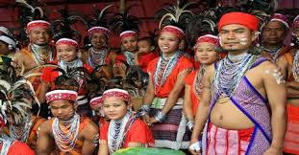
Thanks to all

