Slide 1
Welcome

Slide 2
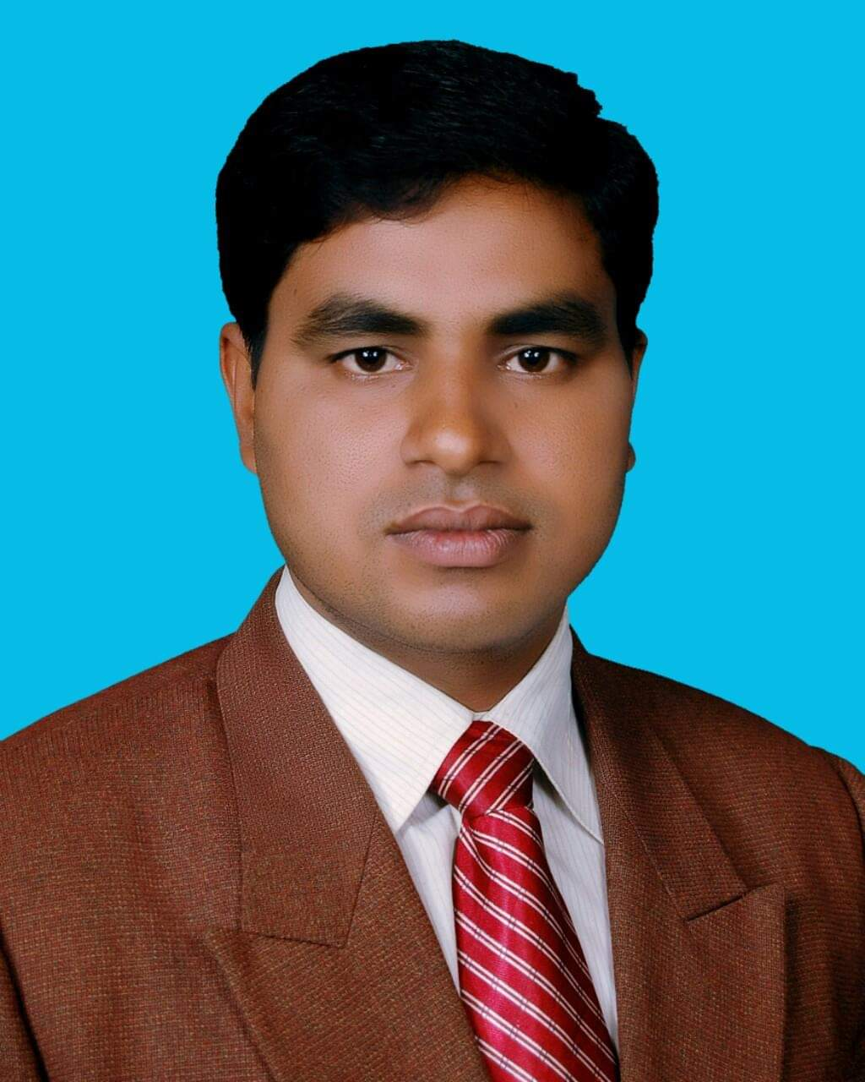
Introduction
Md. Noor –E- Alam Siddiki
Asstt. Teacher
Nageswari Keramatia M.L High School.
Mobile- 01716962418
Email- nooralam.na35@gmail.com
Unit -3, Lesson 6

Slide 3
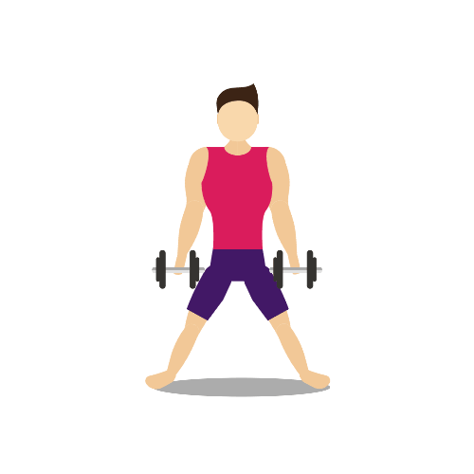
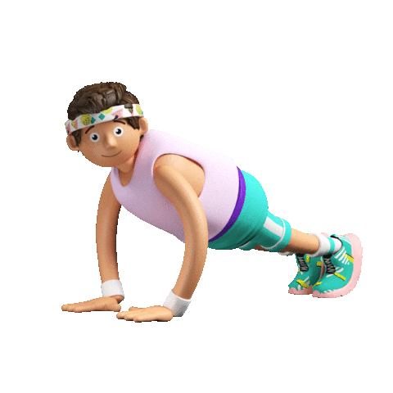
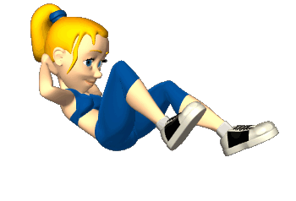
What are they doing in the picture?
They are taking physical exercise.

Slide 4
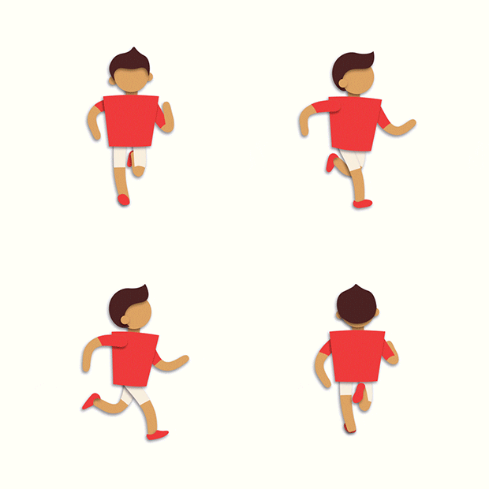
Today’s lesson title is…
Physical exercise
Unit 3, Lesson 5

Slide 5
Learning outcome
After studied the lesson , we will be able to …
tell about need of healthy food.
tell how many physical exercise are.
tell the benefit of physical exercise
ask and answer questions.

Slide 6
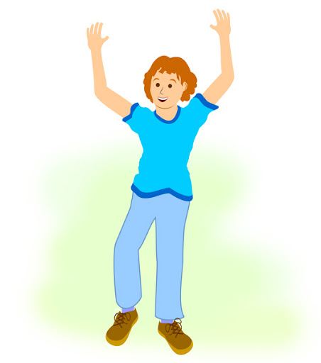
Let’s know some new words.
stretching
Noun /adjective
straighten or extend one's body or a part of one's body to its full length, typically so as to tighten one's muscles or in order to reach something.
Stretching is an indoor exercise.

Slide 7
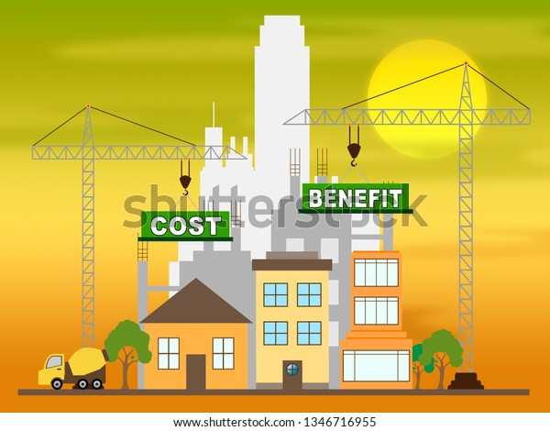
benefit
Noun
an advantage or profit gained from something.
receive an advantage; profit.
The benefits of physical exercise are many.

Slide 8
regularity
Noun
the fact that the same thing happens again and again, and usually with the same length of time between each time it happens.
the state or quality of being regular.
Physical exercise teaches us regularity.

Slide 9
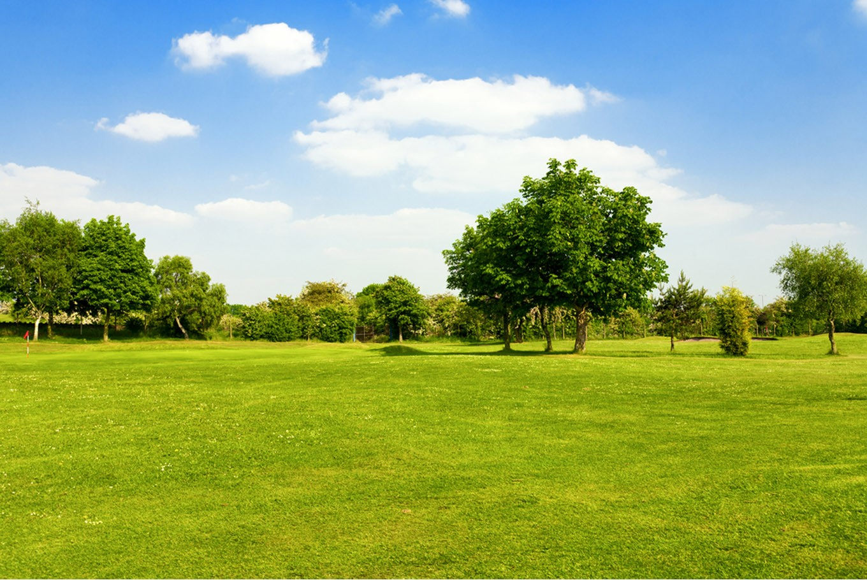
Let’s watch a video

Slide 10
Read the text carefully

Slide 11
Individual work
What are the benefits of physical exercise?

Slide 12
Match your answer
What are the benefits of physical exercise?
The benefits of physical exercise are many. It keeps us fit for work, gives energy, makes us strong and cheerful and teaches us regularity and discipline.

Slide 13
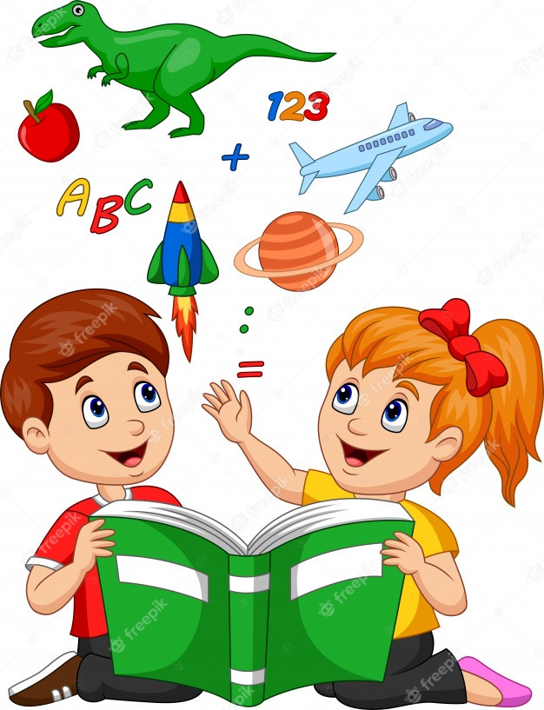
Pair work
Answer the questions in pair.
1. What things are necessary for good health?
2. How many physical exercise are there?
3. Why do we need physical exercise?
4. What physical exercise do you do?
5. Do you have physical education teacher in your school? How does he/she help you to physical exercise?

Slide 14
Match your answer
1. What things are necessary for good health?
4. What physical exercise do you do?
Ans- Taking balanced diet, rest and sleep and physical exercise are necessary for good health.
Ans- I walk in the morning.
5. Do you have physical education teacher in your school? How does he/she help you to physical exercise?
2. How many physical exercise are there?
There are two types of physical exercise. One is indoor and other is outdoor.
Ans- Yes . We have physical education teacher. He dictates us about physical exercise. When we take part in assembly he informs us update information of physical exercise.
3. Why do we need physical exercise?
Ans- We need physical exercise to keep us fit for work.

Slide 15
Find out indoor and outdoor exercise from the chart below
List of exercise
1. Playing sports
2. Swimming
3. Skipping
4. Jogging
5. Walking
6. Stretching

Slide 16
Match your answer
1. Playing sports
2. Swimming
3. Skipping
4. Jogging
5. Walking
6. Stretching
Indoor
3. Skipping
6. Stretching
outdoor
1.Playing sports
2.Swimming
4. Jogging
5. Walking

Slide 17
Group work
Ask and answer the questions in group
1. Do you do physical exercise everyday? What sorts of exercise do you do?
2. Why do we need regular physical exercise?
3. What does physical exercise teach you?
4. What’s your favorite sport? Do you take part in it? If so, where do you play it and who with?

Slide 18
Match your answer
1. Yes I do. I play football in the field.
2. I need regular physical exercise to keep me fit for work.
3. Physical exercise teach me maintaining regularity and discipline .
4. I like football very much. Yes , I take part in everyday in our school field with my friends.

Slide 19
Who is Pronoy Larma?

Slide 20
Thank you for nice co-operation.

