Slide 2
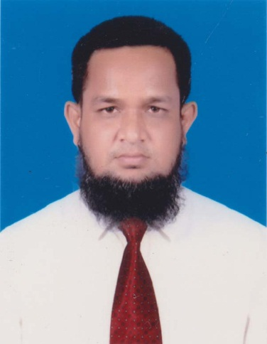
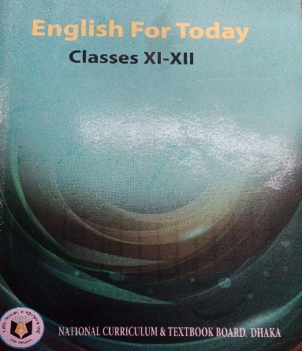
Teacher’s Identity
Md. Abdur Rouf
Lecturer in English
Khalna Islamia Fazil(Degree) Madrasah,Patnitala,Naogaon
Cell: 01767650169
E-mail: rouf301285@gmail.com
Class: XI
Subj: English 1st Paper
Unit: One
Lesson: Three
Time: 45 minutes
Date:12/09/2019

Slide 3
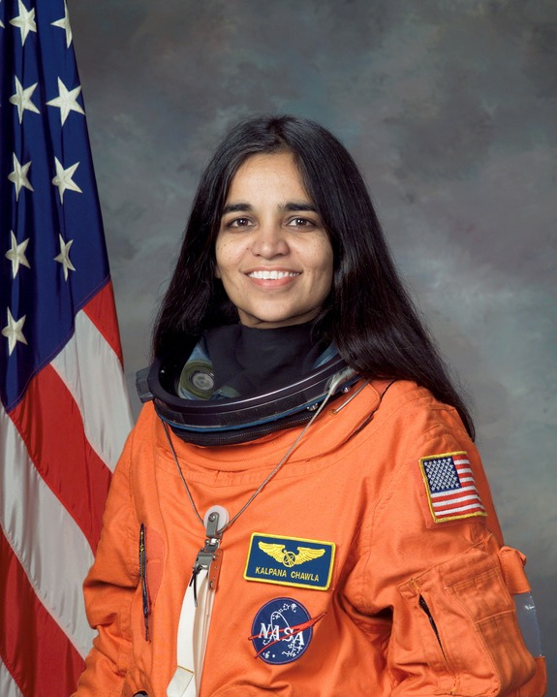
Look at the pictures
Valentina Tereshkova
Kalpana Chawla

Slide 4
Two Women

Slide 5
Lesson Introduction
Topic: People Making History
Unit: one
Lesson: 3
Subject: English
Class: xi
Time: 45 minutes.
Date:12/09/2019

Slide 6
Learning outcomes:
By the end of the lesson students will be able to -
define some new words.
tell about the early space mission.
tell about Kalpana Chawla who had gone to space.

Slide 7
Time: 5 minutes
Read the text silently
Kalpana Chawla (17 March 1962 - 1 February 2003)
Chawla was born in Karnal, India. She completed her earlier schooling at Tagore Baal Niketan Senior Secondary School, Karnal. She is the first Indian-born woman and the second person in space from this sub-continent. After graduating in Aeronautical Engineering from Punjab Engineering College, India, in 1982, Chawla moved to the United States the same year. She obtained her Masters degree in Aerospace Engineering from the University
of Texas in 1984. Later she did her Ph.D. in Aerospace Engineering in 1988 from the University of Colorado.
Determined to become an astronaut even in the face of the Challenger disaster 1986 that broke apart 73 seconds into its flight, leading to the deaths of its seven crew members, Chawla joined NASA in 1988. She began working as a Vice President where she did Computational Fluid Dynamics (CFD) research on vertical take-off and landing. In
1991 she got U.S. citizenship and started her career as a NASA astronaut in 1995. She was selected for her first flight in 1996. She spoke the following words while travelling in the weightlessness of space, ÔÔ You are just your intelligence”. She had travelled 10.67 million miles, as many as 252 times around the Earth.

Slide 8
Time: 5 minutes
Single Work
Write down the meaning of the following words
Centrifuge
Spacecraft
Cosmonaut
Launch
NASA

Slide 9
Let’s check our answers
Centrifuge
a machine with a part that spins around to separate substances

Slide 10
Let’s check our answers
Spacecraft
a vehicle that travels in space

Slide 11
Let’s check our answers
Launch
to start an activity

Slide 12
Let’s check our answers
Cosmonaut
an ASTRONAUT from the former Soviet Union

Slide 13
Let’s check our answers
NASA
National Aeronautics And Space Administration of U.S.A.

Slide 14
Kalpana Chawla

Slide 15
Time: 7 minutes
Pair Work
Make a flow chart finding out the historical importance of the mentioned years in the text. First one has been done.
17 March, 1962, birth of Kalpana Chawla
2
3
4
5
6

Slide 16
Evaluation
Who was the first women in the space?
How did Kalpana Chawla died?
What is spacecraft?

Slide 17
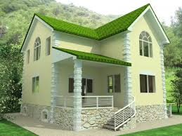
Home Work
Write a paragraph in 150 words about Chawla based on the information provided in the text.

Slide 18
Thank you

