Slide 1
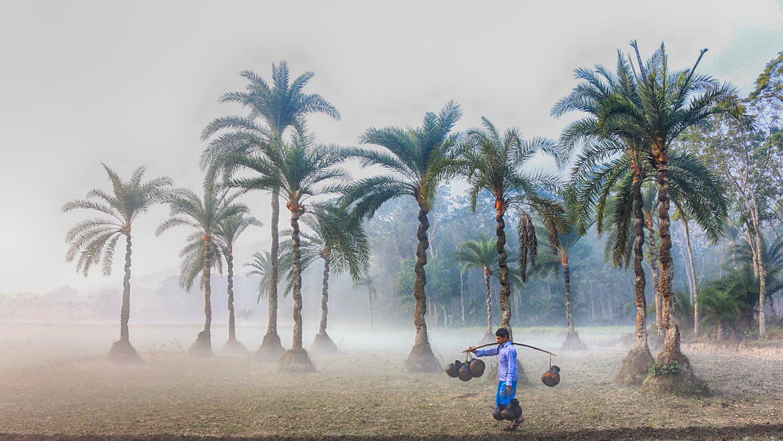

Slide 2
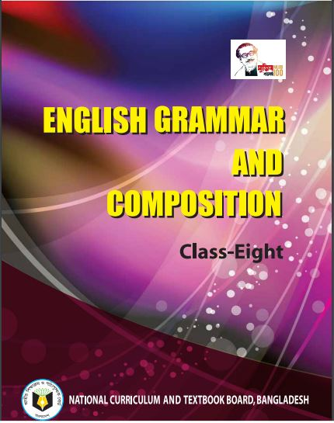

Slide 3
About what the video is ?
The video is about “ Winter Morning.”

Slide 4
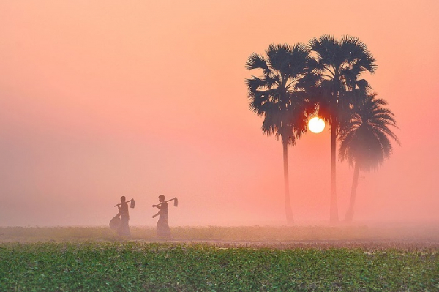
Today’s lesson is on
Paragraph Writing
“ Winter Morning ”

Slide 5
We will be able to know
what winter morning is.
how the things around are .
what children and people do in the winter morning.
what the special foods of a winter morning are.
what happens to the poor people.

Slide 6
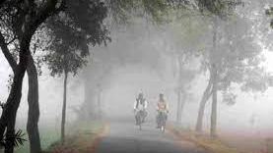
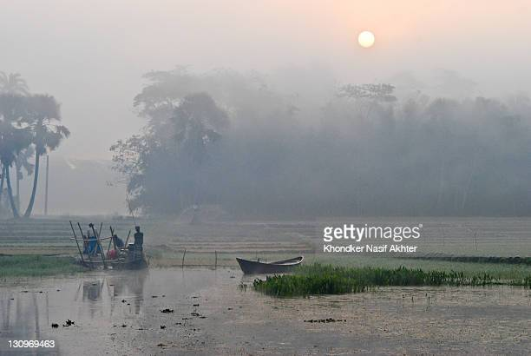
There are six seasons in Bangladesh. The winter is one of them. A cold and foggy morning in the winter season is called as a winter morning. There is dense fog every where. Everything looks hazy.
Cold
Misty

Slide 7
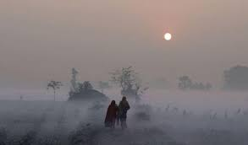
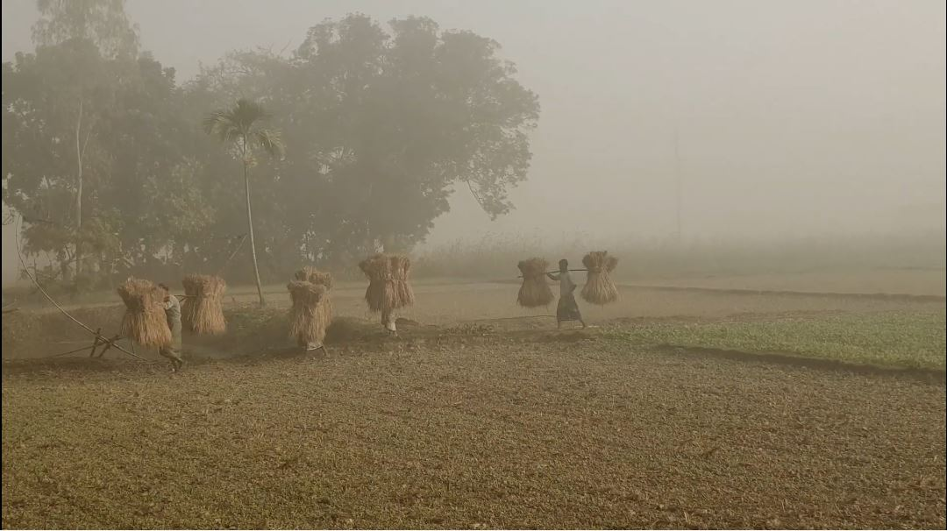
Sometimes the fog is so dense that the sun rays can not get through it. Even things at a little distance can hardly be seen. Bird’s chirping is not heard.
Fog

Slide 8
1.What is winter morning ?
Ans - A cold and foggy morning in the winter season is called as a winter morning.
Check the answer.
2.bHow are the things around ?
Ans- There is dense fog every where. Everything looks hazy. Sometimes the fog is so dense that the sun rays can not get through it.

Slide 9
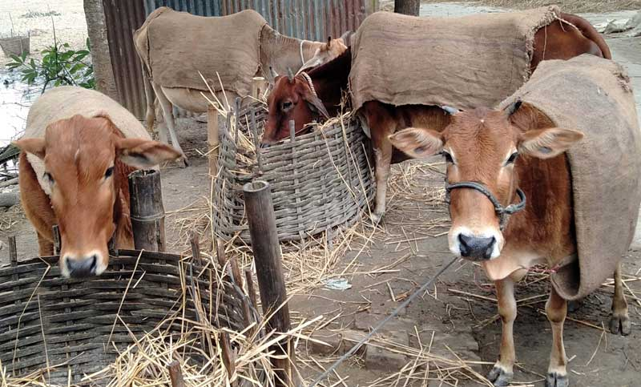
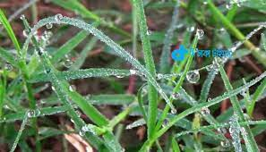
The cow and other animals can not come out. Dew drops fall on leaves and blades of grass at night. They look like glittering pearls when the rays of the morning sun fall on them.
Cows
Dews

Slide 10
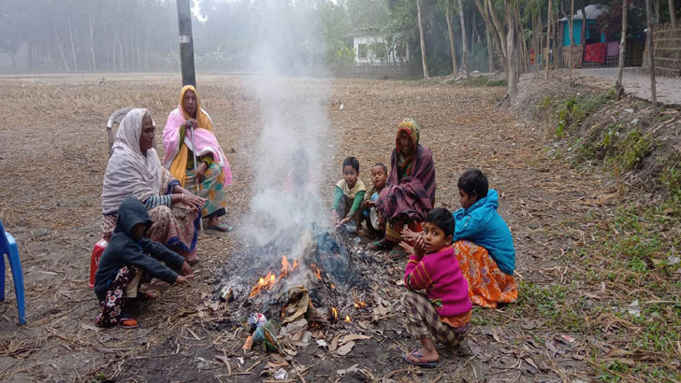
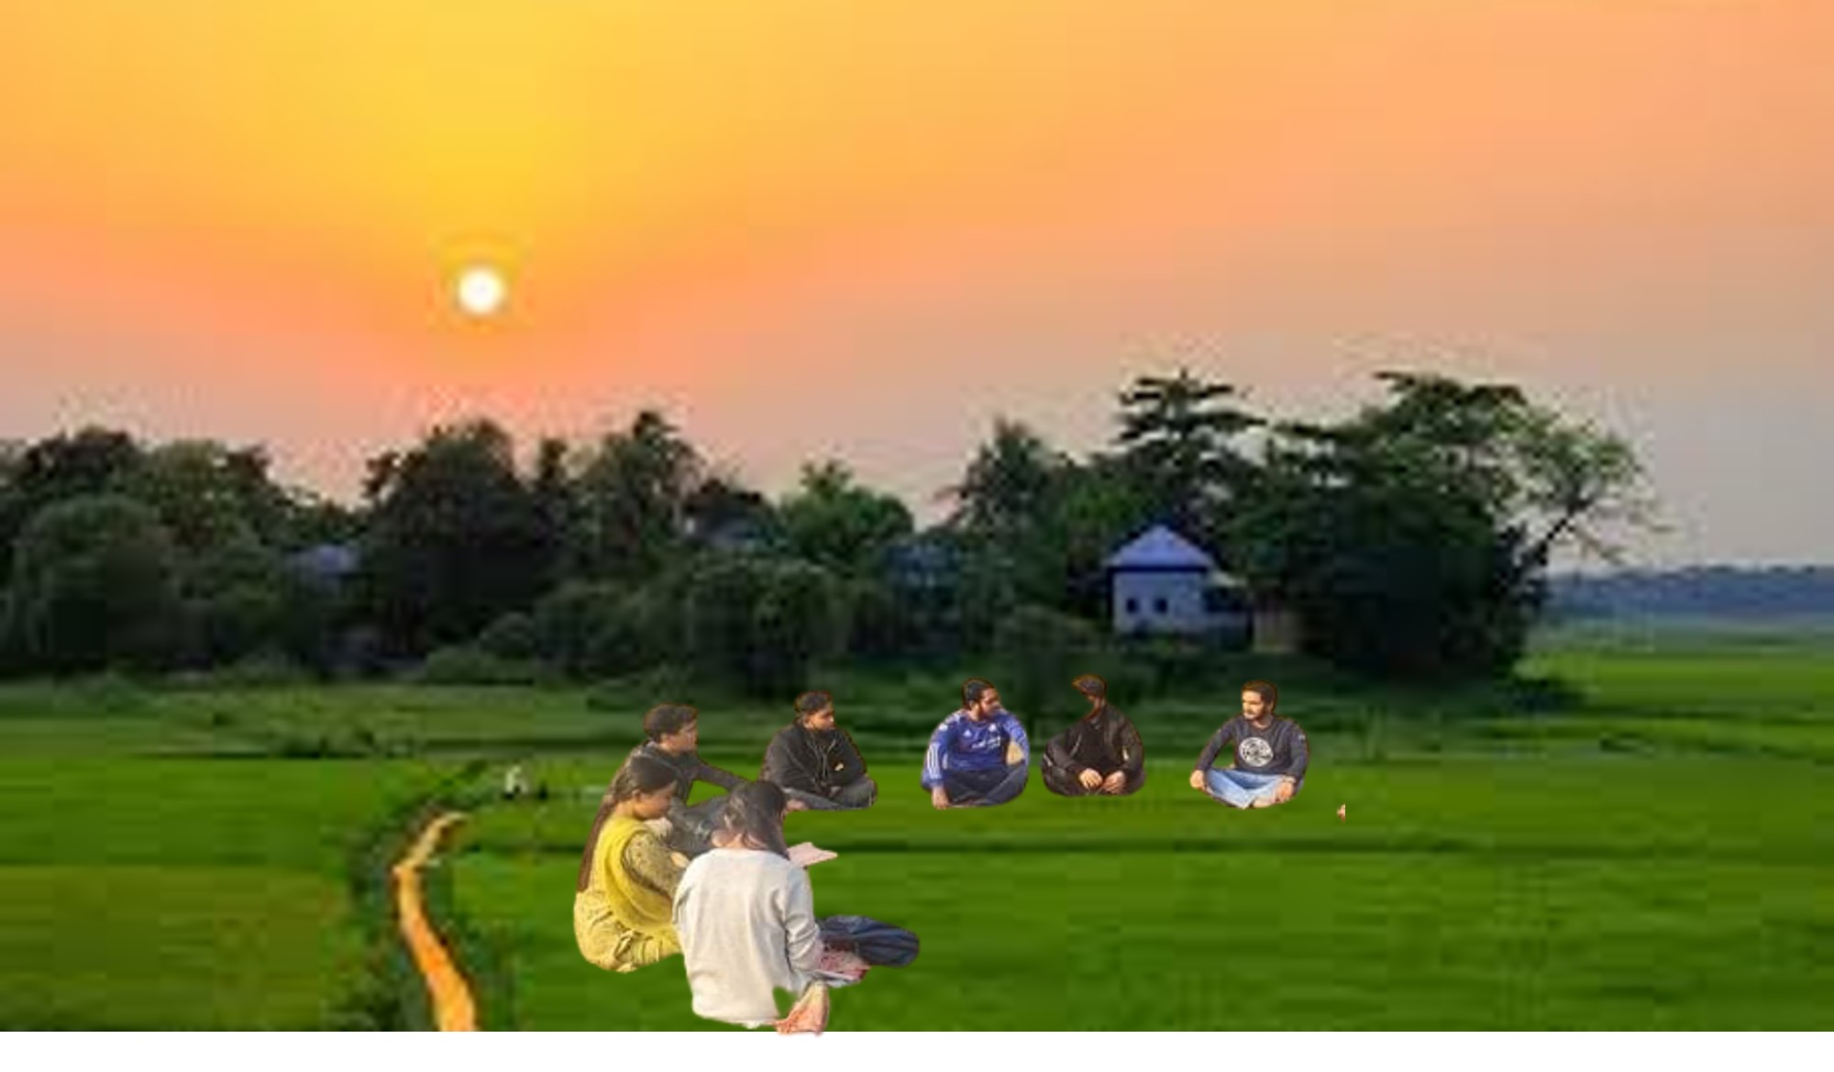
Village children and people have hardly warm cloths. They gather straw and dry leaves to make fire to warm themselves. The old and the poor bask in the sun in order to warm themselves. Generally people and children get up late.
Bask

Slide 11
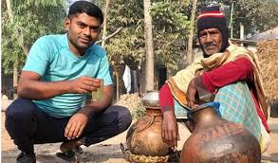
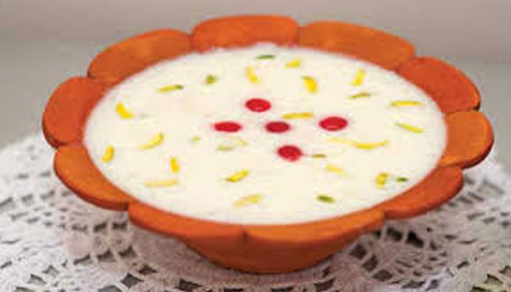
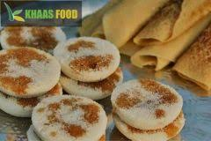
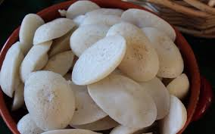
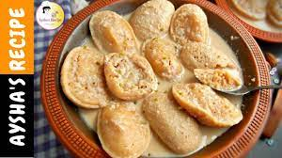
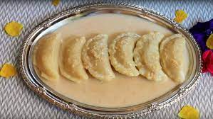
Some people make delicious and sweet cakes like juicy chitoy pitha, dry chitoy pitha, vapa pitha, vapa puli, pias with date juice and many other things. Some likes to drink date juice.
Pias
Date Juice
Vapa puli pitha
Dry Chitoy pitha
Vapa pitha
Juicy Chitoy pitha

Slide 12
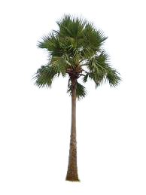
The foggy scene of winter morning vanishes as the day advances. The sun goes up and the nature returns to a normal day.

Slide 13
Check the answers
What do the children and people do in the winter morning ?
They gather straw and dry leaves to make fire to warm themselves. The old and the poor bask in the sun in order to warm themselves. Generally, People and children get up late.
What are the special foods in the winter morning?
Delicious and sweet cakes, pias with date juice and many other things are the special foods in the winter morning.

Slide 14
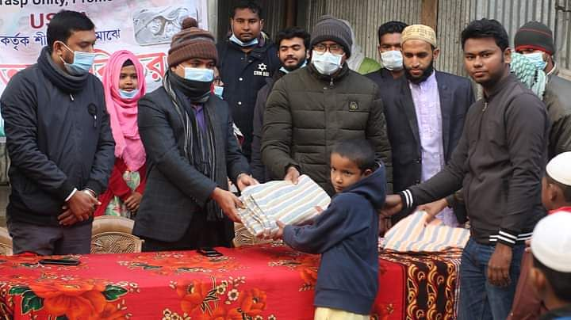
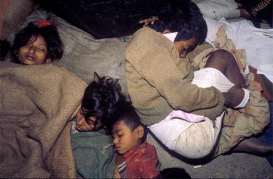
Though a winter morning is enjoyable to the rich, it brings distress to the poor for want of warm cloth. But, A winter morning is enjoyable in many respects.

Slide 15
Evaluation
√
Put ( ) mark to the correct answer.
1. There are ---- seasons in Bangladesh--
2.They use straw and leaves to --
(a) four
(b) ten
(a) Cook rice
(b) boil water
(c ) five
√
(c ) make fire
√
(d ) six
(d ) make hut
4. Generally, people get up ___in winter morning.
3. Date juice is found in---
(a) summer
(b) june
(b) at dawn
(a) at 8am
√
√
(c ) winter
(d ) march
(c ) early
(d ) late

Slide 16
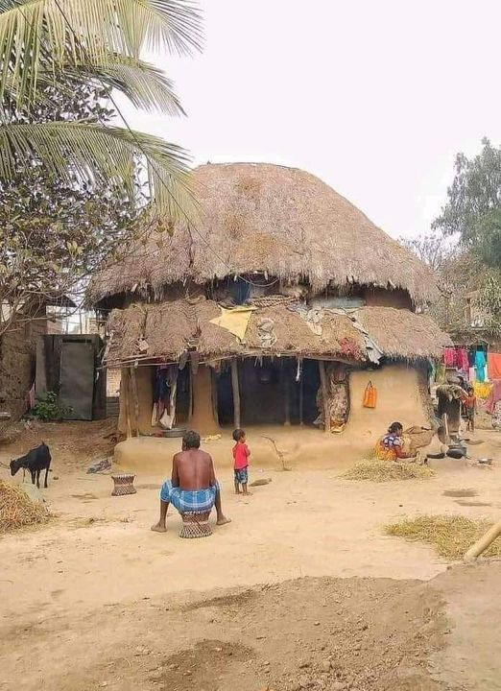
Winter morning

Slide 17
