Slide 1
Welcome to my class!

Slide 2
Teacher’s
Introduction
Tasnim Aktar Chowdhury Assistant Teacher
Chilahati Girls’ School & College

Slide 3
Lesson Introduction
Class: Seven
Sub: English Grammer

Slide 4
Lesson Title
Use of Articles

Slide 5
Learning Outcomes:
At the end of the lesson students will be able to-
know what is article.
know the classification.
use of a & an.

Slide 6
What is article?
A letter or letters used in a sentence before a noun to modify it is called article. In a word a, an & the are called articles.

Slide 7
Classification of article
Indefinite
Definite

Slide 8
Indefinite article:
A & An are known as indefinite articles.

Slide 9
Use of “A”
“A” is used before a noun that starts with a consonant .
Example:
I need a pen.
Use of “An”
“An” is used before a noun that starts with a vowel.
Example:
I need an egg.

Slide 10
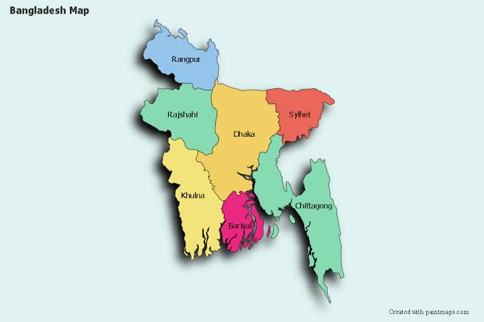
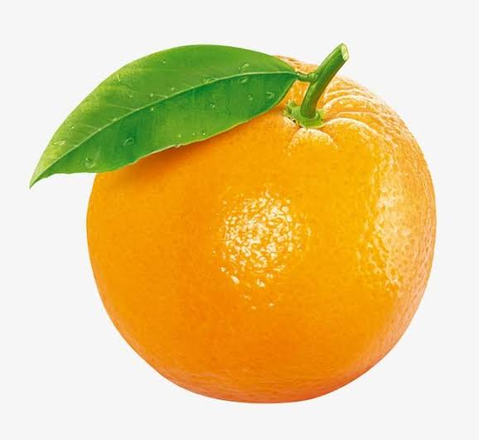
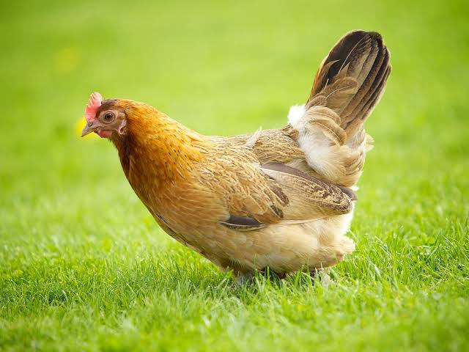
Look at the following examples:
This is a map.
This is an elephant.
There is a blackboard.
I eat an orange.
We see a hen.
Bring me an ice-cream.

Slide 11
Fill up the gaps with a & an
I have_______ parrot.
The passerby sits under _______banyan tree.
My uncle is ______English teacher.
Mr. Jamil bought _______ox.
Draw ________ aeroplane.

Slide 12
Now match the solution
I have a parrot.
The passerby sits under a banyan tree.
My uncle is an English teacher.
Mr. Jamil bought an ox.
Draw an aeroplane.

Slide 13
Exceptions:
Exception 1: If the noun starts with a consonant but sounds as a vowel then you have to use “an” in place of “a”.
Example: Mr Aslam is an honest man.
Exception 2: If the noun starts with a vowel but sounds as a consonant then you have to use “a” in place of “an”.
Example: Lucy is a European.

Slide 14
Good Bye

