Slide 2
Welcome
to English class

Slide 3
Md.Abdur Razzak
Assistant Teacher (English)
Shatgram Akota High School
Baniachang,Habigang
ICT District Ambassader,Habiganj
Class:Nine
Subject:English grammar and composition
Unit:Four
Lesson:1,6,11
Email:marazzak55555@gmail.com
Mobile Number:01731181479

Slide 4
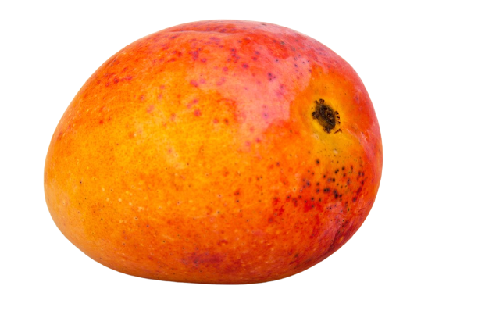
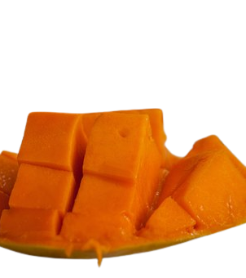
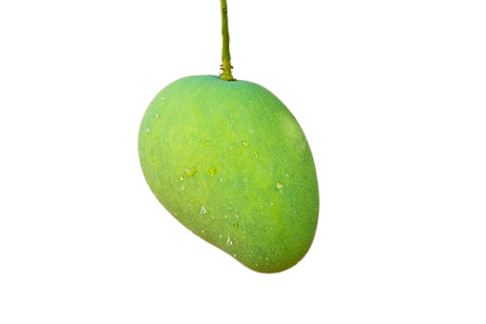
What do you mean?
Present condition
Past condition
Future condition
What are these related to?

Slide 5
Tense

Slide 6
1
define tense.
2
classify tense.
3
explain the structure of indefinite tense.
4
write sentences using indefinite tense.

Slide 7
He will be an officer in future.
Now he is going to university.
The baby played at his early age.
What is tense?

Slide 8
Follow
All the three verbs are functioning
on
Indicates past
played
Indicates present
is going
Indicates future
times.
will be
So, tense is called the time of verbs.

Slide 9
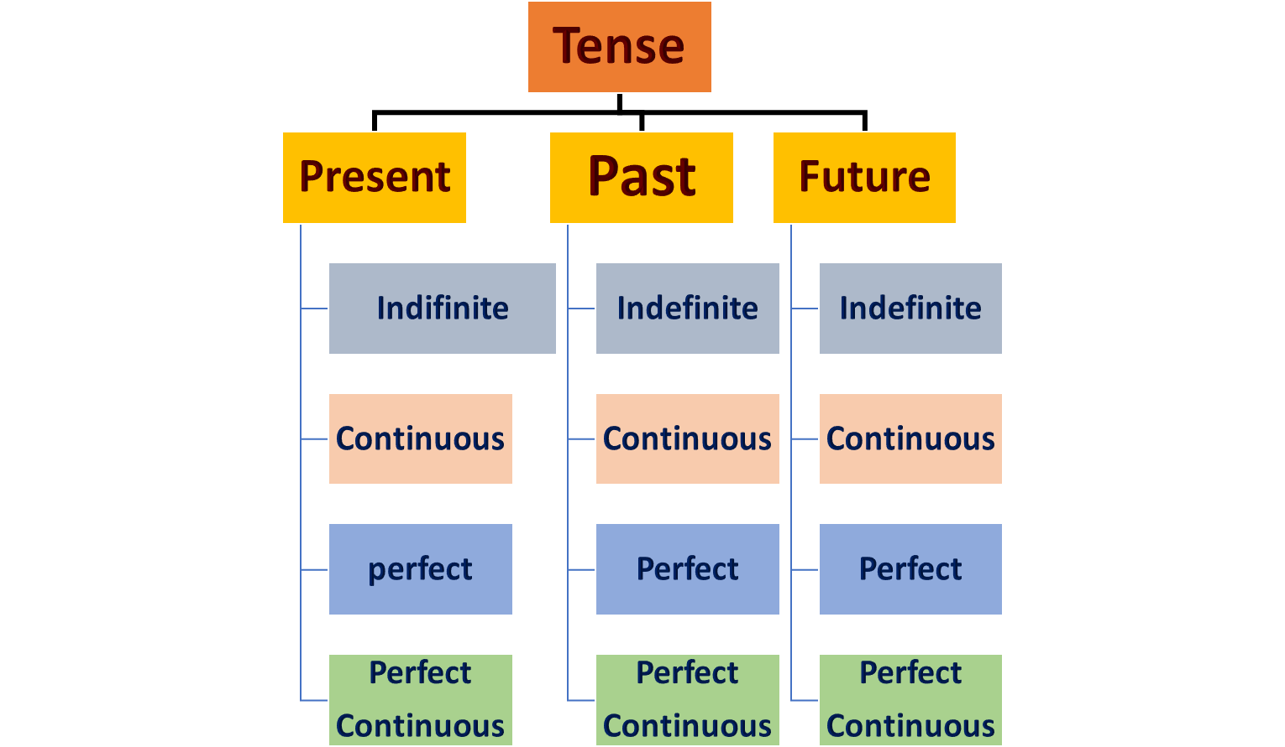
Kinds of Tense

Slide 10
Notice the following sentences.
1.Trees are our best friend.
2.They provide us many things.
3.We planted 100 trees last year.
4.We shall also plant trees in the coming year.
Here we find that each verb describes simply the time of the verb.So, they are simple tense/indefinite tense.

Slide 11
Notice the following sentences.
1.Monir is a student.
2.He reads in class seven.
3.He goes to school everyday.
4.So,every teacher loves him very much.
5.As a result ,he makes brilliant result.
Notice the structure:
Subject+present form of Verb+extension.
In every sentence we get the present form of verb.They describe the present condition of Monir.So, these are present simple /Present Indefinite Tense.

Slide 12
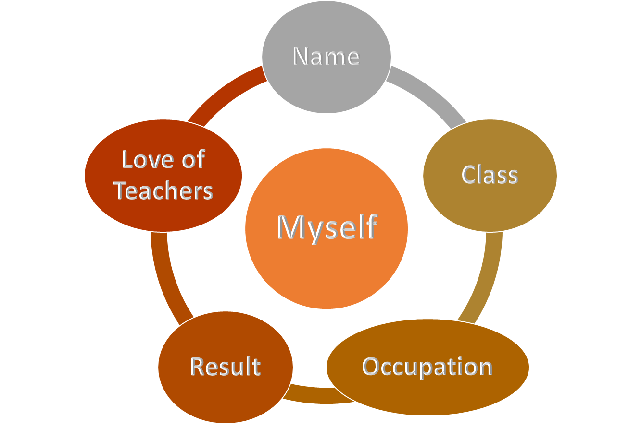
Write five sentences using the structure of present indefinite tense about you.You can take help from the chart below.
Individual work
1
6
3
4
5
8
10
7
2
9
00
Time:10 minutes

Slide 13
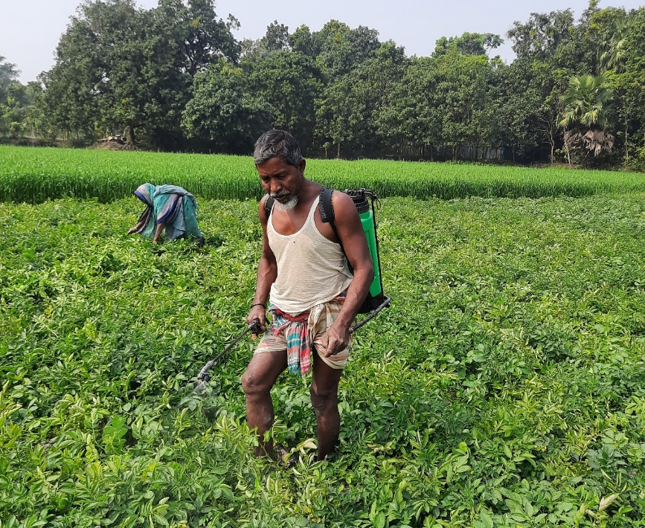
Notice the following sentences.
1.Mr. Rahman was a farmer.
2.He had two cows.
3.He grew all types of crops in his land.
4.So,he sold them in the local market.
5.But he did not get fair price of his crops.
Notice the structure:
Subject+past form of Verb+extension.
In every sentence we get the past form of verb.They describe the past condition of Mr. Rahman.So, these are past simple /Past Indefinite Tense.

Slide 14
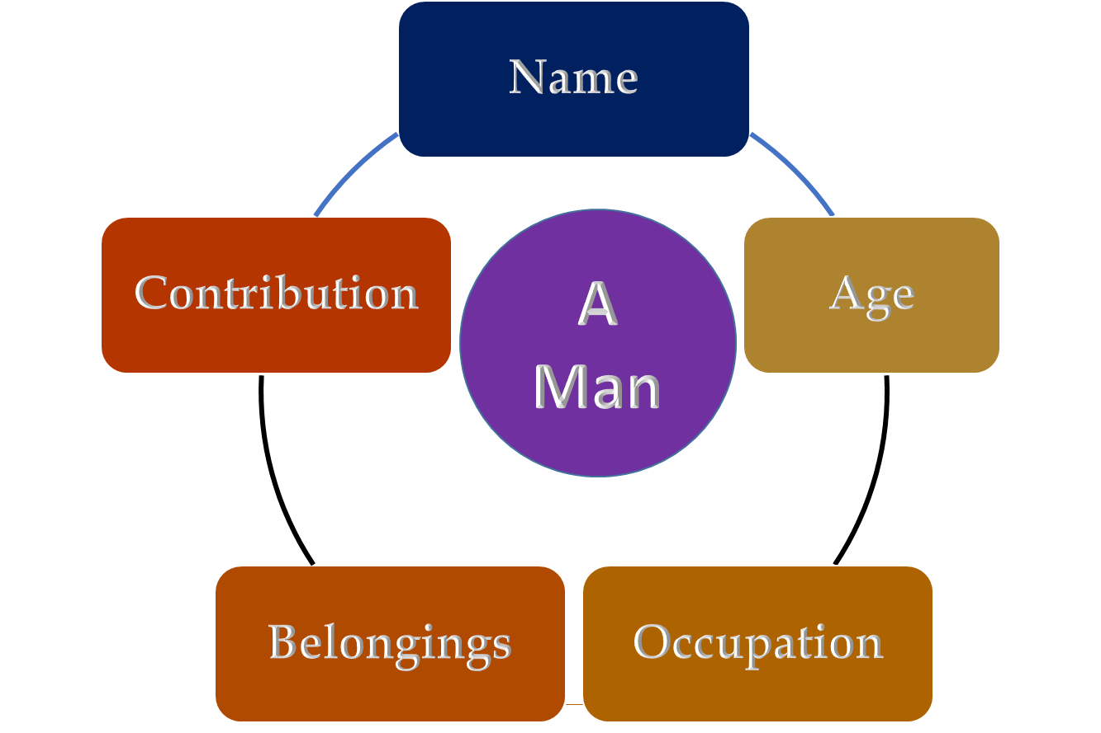
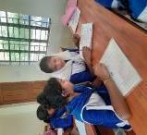
Write five sentences using the structure of past indefinite Tense about a man of your locality.You can take help from the chart below.
Pair work
1
6
3
4
14
11
5
8
12
10
7
2
15
13
9
00
Time:10 minutes

Slide 15
1.Human beings will cut trees indiscriminately.
2.so, the amount of carbon di-oxide will increase in the atmosphere.
3.On the other hand,Oxygen will decrease.
4.Ice in the pole will melt.
5.As a result,human beings will be helpless.
Notice the structure:
Subject+Shall/will+present form of Verb+extension.
In every sentence ,we get Shall/will+present form of verb.They describe the future of human beings for defoestration.So, these are Future Indefinite Tense.

Slide 16
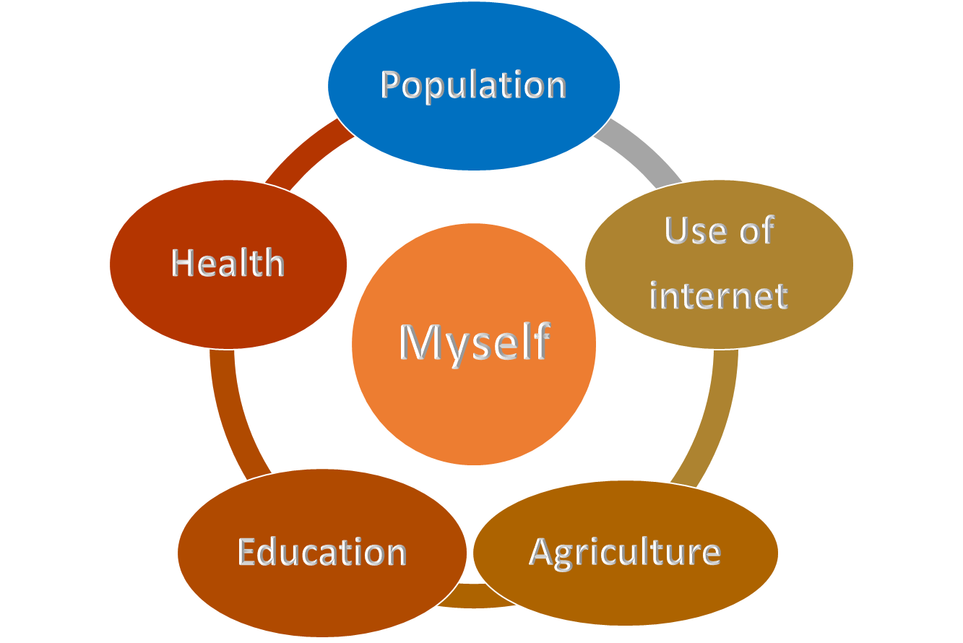
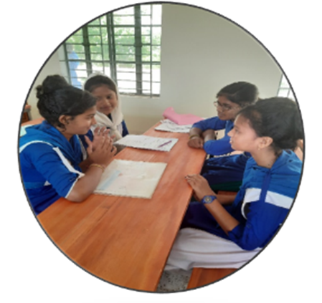
Write five sentences using the structure of future indefinite tense about Bangladesh.You can take help from the chart below.
Group work
1
6
3
4
14
11
5
8
12
10
7
2
15
13
9
00
Time:15 minutes

Slide 17
Change the following sentences into past simple tense.
1.Mr. Johurul Islam is an English teacher.
Mr. Johurul Islam was an English teacher.
2.He goes to his village every friday.
He went to his village every friday.
1
6
3
4
5
8
10
7
3.He can take care of his parents.
2
9
00
For this ,his parents loves her very much.
4.In the village everybody respects him.
Time:10 minutes
In the village everybody respected him.
5.As a result,he stands beside the villagers in time of danger.
As a result,he stood beside the villagers in time of danger.

Slide 18
Homework
Write ten sentences about “A Village Doctor” using indefinite tense of present,past and future.

Slide 19
Thanks and best wishes for all of you.
See you again.

