Slide 2
Identity
Sabina Yeasmin
Lecturer in English
Baridhara Nazmul Ulum Alim Madrasah
Badda, Dhaka

Slide 3
Class : Alim /HSC
Subject : English 1st Paper

Slide 4
Let’s enjoy the video
Fetching...
https://www.youtube.com/watch?v=ZsQfqlkayJ4

Slide 5
Let’s watch some images attentively

Slide 6
Can you guess what’s the today’s topic by watching the video & these images?
Part-2
Exactly today’s topic is-
Unit:1, Lesson: 2 Nelson Mandela, from Apartheid Fighter to President

Slide 7
Learning outcome
At the end of the lesson, students will be able to-
Increase vocabulary
1
2
Achieve the reading skill.
Answer the questions easily.
3
Fill in the blanks without clues spontaneously.
4

Slide 8
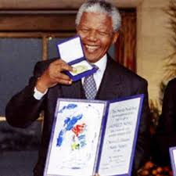
Vocabulary
awarded
Mean: Order the giving of as an prize to someone
Syn: given, bestowed
Ant: Taken
Ex: Nelson Mandela was awarded The Nobel Peace Prize in 19993.

Slide 9
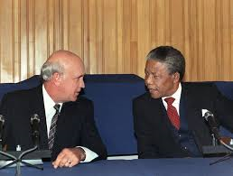
Vocabulary
Mean: Try to reach an agreement by discussion with others
Negotiated
Syn: discussed, mediated
Ant: warned
Nelson Mandela negotiated with F.W. de Klerk the end of apartheid.

Slide 10
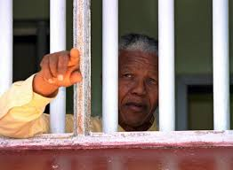
Vocabulary
Prisoner
Mean: A person who is in prison as a punishment
Syn: captive, convict
Ant: free
Ex: Nelson Mandela was a prisoner nearly 27 years.

Slide 11
Now read the text.
In 1993, Mandela was awarded the Noble Peace Prize, an honor he shared with F. W. de Klerk, the white African leader who had freed him from prison three years earlier and negotiated the end of apartheid.

Slide 12
He formally left public life in June 2004 before his 86th birthday, telling his adoring countrymen: “don’t call me. I’ll call you”. But he remained one of the world’s most revered public figures, combining celebrity sparkle with an unwavering message of freedom, respect and human rights.

Slide 13
“He is at the epicenter of our time, ours in South Africa, and yours, wherever you are,” Nadine Gordimer, the South African writer and Nobel Laureate for Literature, once remarked.

Slide 14
The years Mandela spent behind bars made him the world’s most celebrated political prisoner and a leader of mythic stature for millions of black South Africans and other oppressed people far beyond his country’s borders.

Slide 15
Charged with capital offences in the 1963 Rivonia trial, his statement from the dock was his political testimony.
“During my lifetime I have dedicated myself to this struggle of the African people. I have fought against white domination, I have fought against black domination.”

Slide 16
“I have cherished the ideal of a democratic and free society in which all persons live together in harmony and with equal opportunities,” he told the court.
“It is an ideal I hope to live for and to achieve. But If needs be, it is an ideal for which I am prepared to die.”

Slide 17
Friends adored Mandela and fondly called him “Madiba,” the clan name by which he was known. People lauded his humanity, kindness and dignity.

Slide 18
Individual work
F/B without clues
Nelson Mandela is the world’s most (a) public figure who (b) struggle against injustice and (c) oppression. His views as (d) in all his speeches can be accepted as an (e) for human right that leads the world to the path of (f) and equality.
revered
inspires
racial
expressed
epitome
harmony

Slide 19
Individual work
Fill in the blanks
Mandela fought for South Africa to make her free from the (g) of white (h) and ultimately reached his goal leaving an example for the world people. What he did and how he led the fight against white (i)
will remain as an inspiring (j) for the people to come.
bondage
domination
minority
instance

Slide 20
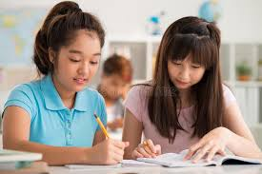
Pair work
Discuss about Nelson Mandela’s Political life.

Slide 21
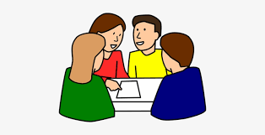
Choose the correct answer from the alternatives
Group work
1. What is the meaning of the word ‘negotiate’?
(a) equal (b) cure (c) discuss (d) sit
2. What does the word ‘revered’ mean?
(a) truthful (b) meticulous (c) admired (d) good
3. What is the synonym of the word ‘celebrity’ ?
(a) liberal (b) simple (c) star (d) conservation
4. What does the word ‘fondly’ mean?
(a) affectionately (b) wholly (c) widely (d) knowingly
5.The word ‘laud’ refers to-
(a) defame (b) put down (c) praise (d) rebuke
√
√
√
√
√

Slide 22
evaluation
Answer the questions
1.Who helped him to set free from prison three years earlier and negotiated the end of apartheid?
2. Mandela’s imprisonment boon to him. How?
3.What is Nadine Gordimer’s assessment regarding Mandela?
4. What is the ideal of Mandela? Do you support his ideal? Why/Why not?
5. Why had he cherished the ideal of a democratic and free society?

Slide 23
Home work
Write a short summary of this passage.

Slide 24
Thank you so much
For watching

