Slide 1
Welcome

Slide 2
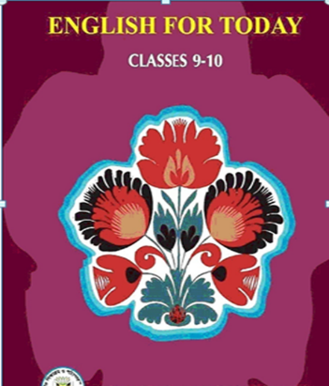
Introduc
Md. Saiful Islam
Assistant Teacher
Shahjalal High School
Habiganj sadar, Habiganj.
SUBJECT
Unit- 3 Lesson-3
International Mother Language Day

Slide 3
Look at the picture and say what about it.

Slide 4
1. What is the picture about?
2. Where do you think it is?
3. Why was it built?

Slide 5
1. The picture is about “Shahid Minar.”
2. I think it is in near Dhaka Medical College.
3. It was build to honour and commemorate the sacrifices of the language martyrs

Slide 6
Yes, Your answer is correct.
Today's lesson is—
International Mother language Day

Slide 7
After finishing the lesson the students will be able to know that-
What is International Mother Language Day?
2. What happened on 21 February in 1952?
3. What is the importance of the day?

Slide 8
Read the passage loudly.

Slide 9
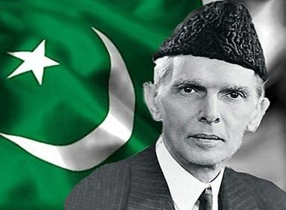
21 February is a memorable day in our national history. We observe the day every year as International Mother Language Day. The day is a national holiday. On this day, we pay tribute to the martyrs who laid down their lives to establish Bangla as a state language in undivided Pakistan in 1952.This is known as the Language Movement.

Slide 10
The seed of the Language Movement was sown on 21 March 1948 when Mohammad Ali Zinnah, the then Governor General of Pakistan, at a public meeting in Dhaka declared that Urdu would be the only official language of Pakistan. The declaration raised a storm protest in the eastern part of the country. The protest continued nonstop, gathering momentum day by day. It turned into a movement and reached its climax in 1952.

Slide 11
The government outlaw all sorts of public meetings and ralies to prevent it. The student of Dhaka University defied the law and they brought out a peaceful protest procession on 21 February 1952. When the procession reached near Dhaka Medical College, the police opened fire on the students, killing Salam, Rafiq, Barkat and Jabbar. So we should respect to the Martyrs. This enkindled the sparks of independent movement of Bangldesh.

Slide 12
Word | Meaning/synonym
Memorable (স্মরণীয়) | Notable, famous, eminent, leading.
Observe (উৎযাপন করা) | Bring up, execute, accomplish.
Establish (প্রতিষ্ঠা করা) | Set up, found, embed. To make stable base.
Movement (আন্দোলন) | Commotion, oscillation.
Protest (প্রতিবাদ করা) | Clamor against, raise an objection.
Prevent (প্রতিরোধ করা) | Rein, avert, clog.
Enkindle(উত্তেজিত করা) | Inflame, stimulate, excite, incite.
Undivided (অবিভক্ত) | Whole, entire, united.

Slide 13
Read the text in B aloud and choose the best answer.
a) The police opened fire on the students of---
i) Dhaka Medical College ii) Dhaka University
iii) Dhaka Dental College iv) Dhaka College
b) Mr. Zinnah was the---
Presedent of India ii) Prime Minister of Pakistan
iii) President of Bangladesh iv) Governor General of Pakistan
c) The----outlawed all shorts of public meetings.
i) President ii) Government
iii) Prime Minister iv) Member of Parliament
The student of Dhaka University defied the law and they brought out a peaceful protest procession on 21 February 1952. When the procession reached near Dhaka Medical College, the police opened fire on the students, killing Salam, Rafiq, Barkat and Jabbar. So we should respect to the Martyrs.

Slide 14
Complete the chart
Time | What happened
1947
1948
1952

Slide 15
Answer
Time | What happened
1947 | Pakistan and India became independent.
1948 | Mohammad Ali Zinnah declared that Urdu would be the only official language of Pakistan.
1952 | The student of Dhaka University broght out a peaceful protest procession on 21 February.

Slide 16
Discuss with your partner and match the words with their meaning
Words | Meanings
Tribute | ● to have a particular effect.
Climax | ● to refuse to obey.
Outlaw | ● to give in.
Defy | ● the ability to keep increasing or developing.
Provoke | ● an act to show respect or admiration.
Relent | ● the most exciting point in time.
Momentum | ● to ban.

Slide 17
Answer
Words | Meanings
Tribute | ● an act to show respect or admiration.
Climax | ● the most exciting point in time.
Outlaw | ● to ban.
Defy | ● to refuse to obey.
Provoke | ● the ability to keep increasing or developing.
Relent | ● to give in.
Momentum | ● to have a particular effect.

Slide 18
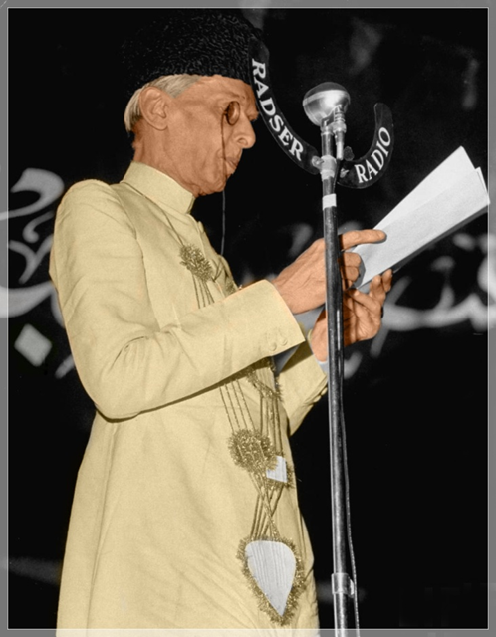
Discuss in a group and answer the following questions.
Why do we observe 21 February as the International Mother language Day?
(b) What happen when Urdu was declared as the only official
language of Pakistan.
“The seed of independence was sown in 21 February 1952”. Do you agree with the comment? Why? .

Slide 19
Answer
The UNESCO has proclaimed February 21 as the International Mother Language Day in 1999. So we observe 21 February as International Mother Language Day.
2. The declaration raised a storm of protest in East Pakistan. It continued non-stop. The government banned all types of public meetings.
3. Yes, I agree. On this day, by protesting the one sided decision of the then Government of Pakistan, the people of East Pakistan understood how to struggle against illegal decision and oppression. So the people of East Pakistan dreamt to be free from West Pakistan.

Slide 20
Evaluation
Fill in the blanks
February 21 is a glorious (a)……………..for Bangalee nation. We are always (b)…………..against the (c)……………and untruth. Let us (d)……………..our pledge on (e)……………….day and (f)…………….our motherland a “Sonar Bangla” so (g)……………our next (h)……………….can hold their (i)…………………high in the (j)………………… .

Slide 21
Answer
a) milestone b) vocal
c) injustice d) renew
e)this f) build
g) that h) generation
i) heads j) world

Slide 22
Home work
Write a paragraph about International Mother language Day.

Slide 23
Thanks a lot

