Slide 1
Welcome to English Class
Notes:
Welcome slide. This picture is related to the topic. So I have chosen it. Teacher may change it if he wants.

Slide 2
Identity
Class: Nine
Subject: English For Today
Unit:One
Lesson: One
Md. Saiful Islam
Assistant teacher
Shahjalal High School
Habiganj sadar, Habiganj.

Slide 3
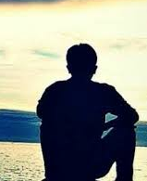
Living alone
Living with family

Slide 4
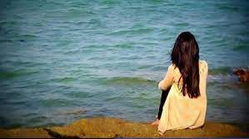
Today’s topics is
Living alone.

Slide 5
After we have studied this lesson, we will be able to-
ask and answer questions
read and understand the text through silent reading
write incidents
participate in discussions

Slide 6
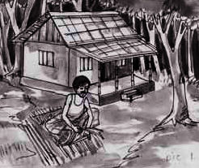
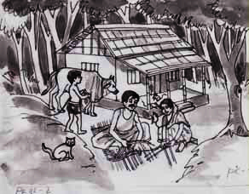
A Look at the pictures and discuss in pairs the following questions.
1 Can you live alone in a house?
2 Make a list of the problems you think you will have if you live alone in a
house, e.g. having accidents, cooking, etc.

Slide 7
jungle

Slide 8
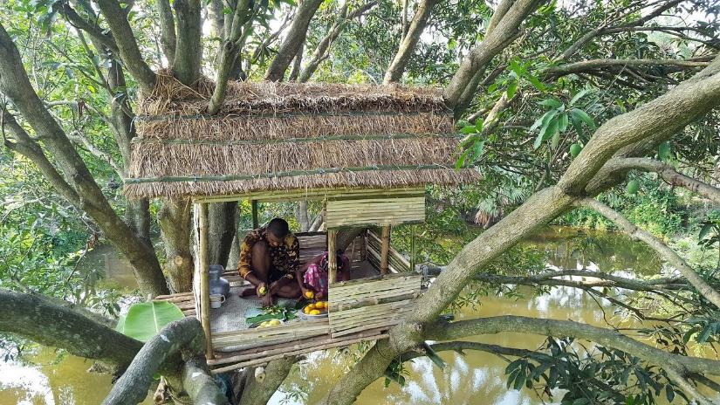
So he left his house and went to a jungle to live by himself. There he made a nice little hut with wood, bamboo and reeds. "Ah, how happy I am here!" said the man to himself.

Slide 9
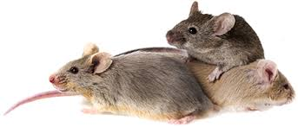
But one day-
he found some mice in his hut. The little creatures soon made holes in his blanket.

Slide 10
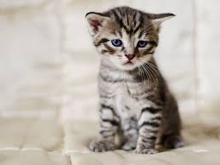
So he brought a-
Cat

Slide 11
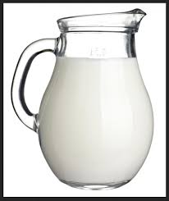
But the cat
needed –
milk

Slide 12
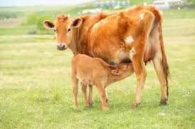
In order to supply milk
he had to bring a-
Cow

Slide 13
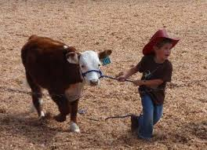
To take care of the cow he
had to bring a -
cowboy

Slide 14
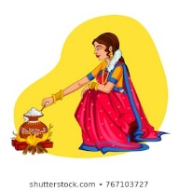
The cowboy needed food. So he had to bring a--
Wife.

Slide 15
At last he found himself in
a family.

Slide 16
B Read the story and answer the questions that follow.
Long ago, a young man found life in the family in his village full of problems and sufferings. Quarrels, ill-feelings, jealously, enmity - all were part of everyday life there. So he left his house and went to a jungle to live by himself. There he made a nice little hut with wood, bamboo and reeds. “Ah, how happy I am here!” said the man to himself. But one day he found some mice in his hut. The little creatures soon made holes in his blanket. So he brought a cat to kill the mice. The cat needed milk. So he brought a cow. The cow needed grass and hay. So he brought a cowboy. The cowboy needed food. So he took a wife to cook meals. Then children were born to them, and the man found himself again in a family. So nobody can live alone, unless they are either angels or devils. People need food, shelter, companions and cooperation. They need to help each other. And if they live in a family or community, their need can be fulfilled. Hence living in society can make people good and happy citizens.
Notes:
Teacher may use it at any purpose he likes. It may be helpful to the students those have not brought books with them.

Slide 17
C (Books shut) What five things did the young man do in the jungle? Now
divide into groups of five. Tell the story to the groups sequentially.
D Answer these questions. First discuss in pairs, then write the answers
individually.
1 Why did the young man leave his house?
2 Where did he make a hut? What did he make the hut with?
3 Was the man happy in his hut?
4 How did he find himself again in a family?
5 Where and how can a person be happy?
6 What is the moral of the story?

Slide 18
Home Work
Write a paragraph on
“ The problems and comforts
of living in a society,”

Slide 19
Thanks to all

