Slide 2
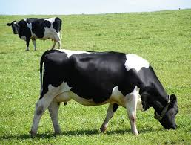
WELCOME

Slide 3
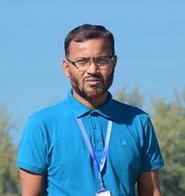
INTRODUCTION
Md. Mizanur Rahman
Assis. Teacher ,
Hafizpur Mohila Dakhil Madrasa
Bahubal , Hobigonj
Mobile : $01767156658$
Email : mizanur $1371984$@gmail.com
CLASS: SEVEN
SUBJECT: ENGLISH SECOND PAPER
TOPIC: RIGHT FORMS OF VERBS (SUBJECT VERB AGREEMENT)

Slide 4
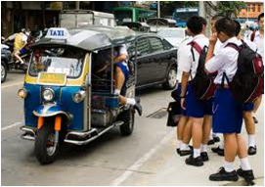
Mind set up : Can you speak in English about the following pictures ?
The cow lives on grass
The sun rises in the east.
They go to school everyday.
T. You are right. Thank a lot. Everybody claps for him

Slide 5
Lesson Declaration
So today we shall discuss about
Present Indefinite Tense

Slide 6
LEARNING OUTCONES
After completing this lesson students will be able to
say how many kinds of Tense.
Write the structure of Present Indefinite Tense
Make correct sentence according to Present Indefinite Tense.
Re-write in Present Indefinite Tense.

Slide 7
Present Indefinite Tense
Can anyone say the definition of Present Indefinite Tense.
Definition:
Present Indefinite Tense denotes an action in the present time of habitual event, universal truth, historical events and near future.

Slide 8
Present Indefinite Tense
Can anyone say the structure of Present Indefinite Tense
Aff : Sub + V $1$+ obj.
Neg : Sub + do not/ does not + V $1$ + obj.
Intre : Do/ Does + Sub + V $1$ + obj ?
If subject is third person singular number then s/es will be add with principle verb.

Slide 9
Present Indefinite Tense
If in the sentence there is everyday//always/regularly/
occasionally/usually/often/sometimes/ generally , the sentence will be Present Indefinite tense.
Example : Mother reads the Quran everyday.
Regularly I pay my tuition fees. etc.

Slide 10
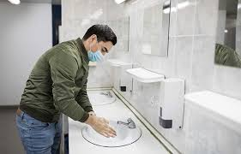
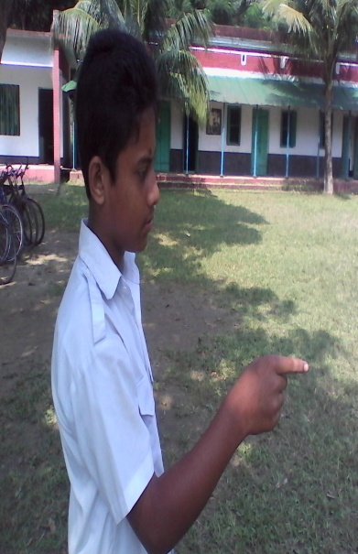
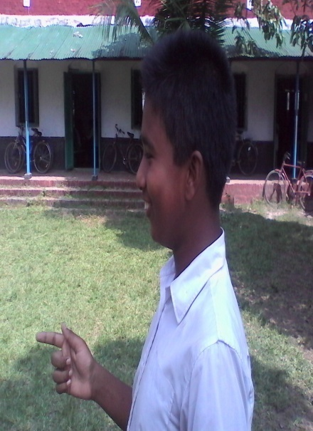
Pair work: Ask and answer - Follow the conversation
Does he wash his hands before eating?
Now any two boys come to near my desk and make a dialogue using do/does or don`t/doesn`t.

Slide 11
Evaluation
Fill in the gaps with the right form of verbs that given in the box.
We (a) ---------- to school everyday but Rana (b) ------- not to go school everyday. He (c) --------- football with his friends. (d) ---------- you go to school everyday ? What class does he (e) ---------- in ? Sama (f) --------- in Dhaka with his family. Do you (g) ---------- your school ? Sabiya (h) -------- a song.
Play | Rise | Live | Do | Read
Sing | Dig | Make | Eat | go
(a) go (b) does (c) plays (d) Do (e) read (f) lives (g) go (h) sings

Slide 12
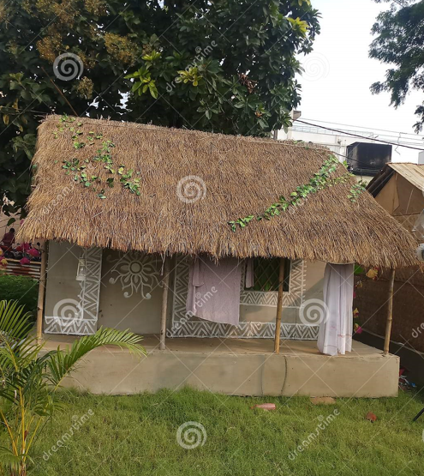
HOME WORK
Write down five sentences that you and your sister do at your house. Using Present Indefinite Tense.

Slide 13
Thank You All

