Slide 1
Welcome

Slide 2
Introduction
Md. Saiful Islam
Assistant Teacher
Shahjalal High School
Habiganj sadar, Habiganj.
Subject: English 1st Paper
Unit: 6, Lesson: 3
Class: IX

Slide 3
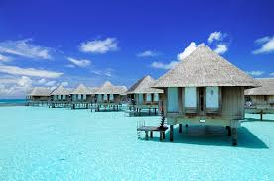
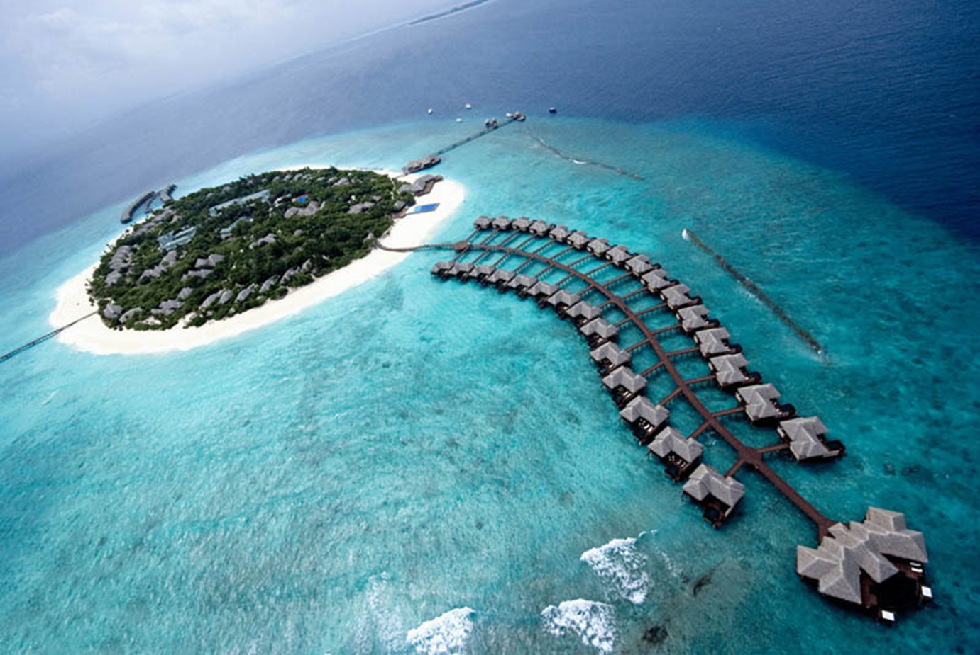
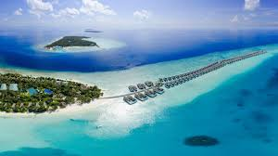
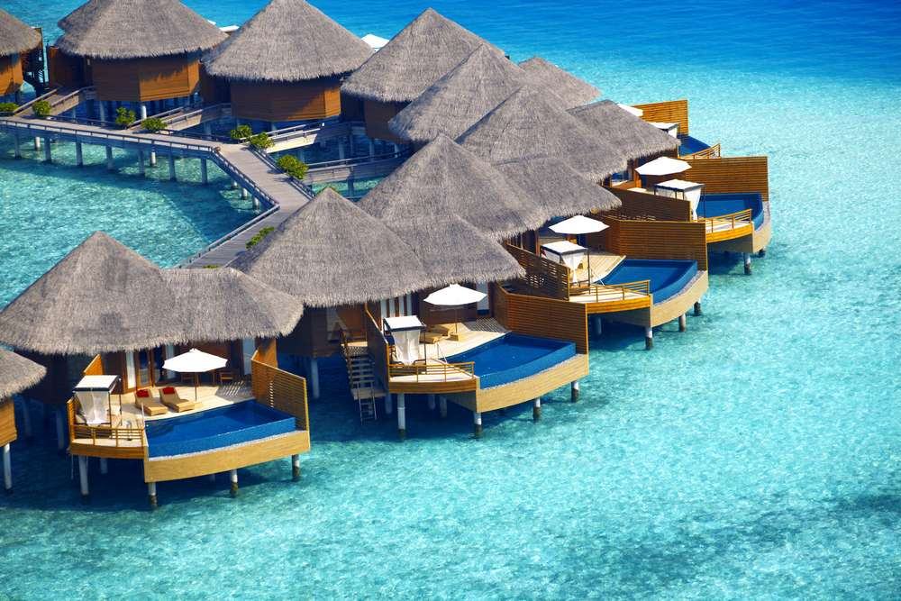
Look at some pictures

Slide 4
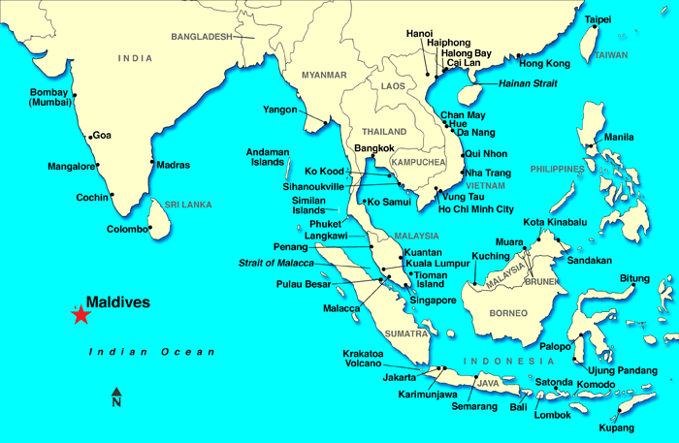
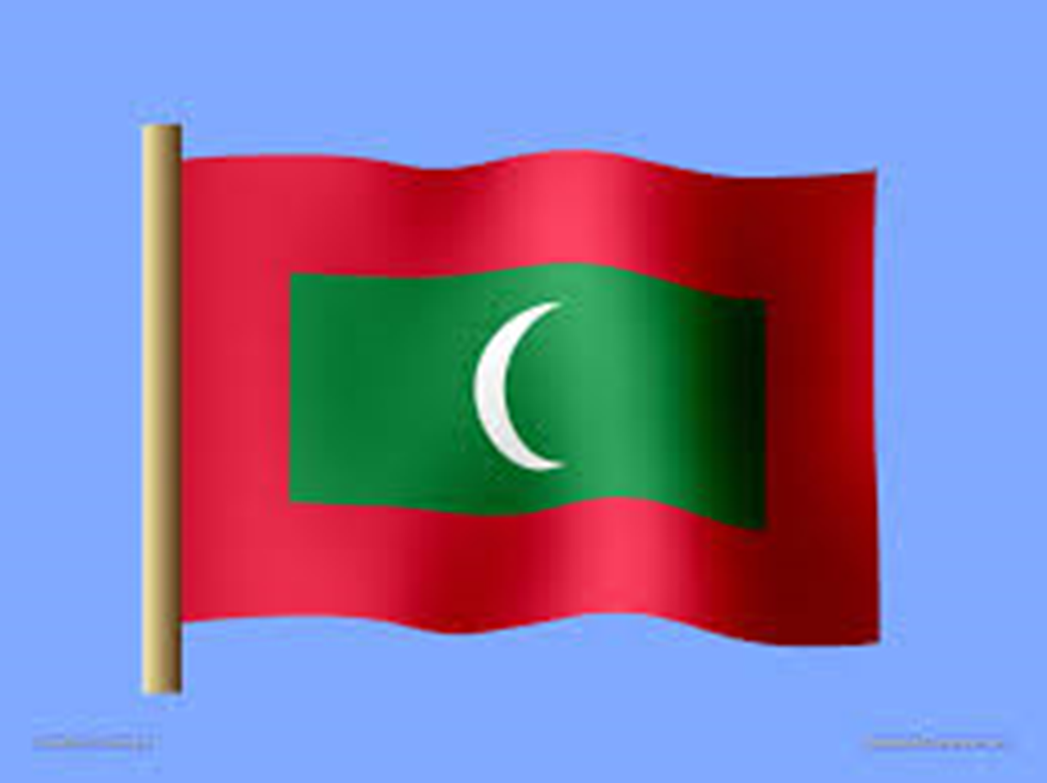

Slide 5
The Maldives

Slide 6
After completing the lesson students will be able to…
read and comprehend the text.
infer the meaning of the words.
ask and answers the questions.
complete the table.

Slide 7
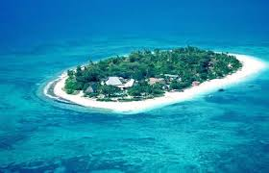
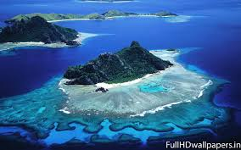
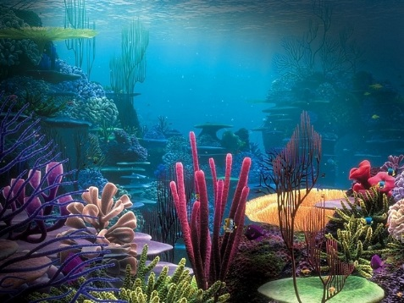
Now discuses the picture in pairs
1. Have you ever visited any island or seen any island on TV ?
2. Have you ever heard of a coral island? Is there any coral in Bangladesh?
3. What do you know about Maldives ?

Slide 8
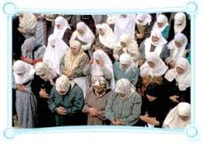
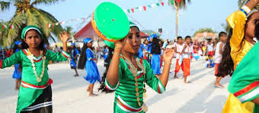
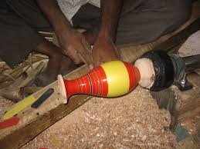
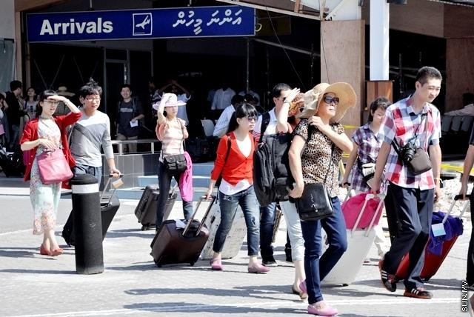
Religion
Culture
Tradition
Tourism

Slide 9
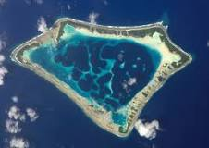
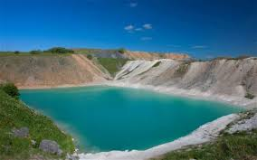
Vocabulary
Coral Reef
Coral reefs are underwater structures made from calcium carbonate secreted by coral.
Atoll
An atoll is a ring shaped coral reef, island, or series of islets. An atoll surrounds a body of water called a lagoon.
Lagoon
A Lagoon is shallow body of water separated from a large body of water by barrier islands or reefs.

Slide 10
Read the text individually & answer the question given below. Then share the answer with your partner
a. Why is the Maldives famous for ?
b. How many countries in world are smaller than the Maldives in size ?
c. What dangers of climate change might affect the Maldives ?
The suggested answers are…
a. The Maldives is famous as tourist destination.
b. Seven countries in the world are smaller than the Maldives in size.
c. The dangers of climate change which might affect the Maldives are the rising
sea levels due to global warming, its flooding and sweeping the islands
in the Indian Ocean.

Slide 11
Read the text in B again and complete the table with no more than two words and/or numbers
Time | Facts
4th and 5th centuries BC | The early inhabitants of the Maldives arrived and settled form southern India and Sri Lanka.
12th | The sailors from African and Arab countries started to settled in the islands. Buddhism was ……………… .by Islam.
……………………………………….. | A famous scholar and historian named Ibn Batuta visited the islands of the Maldives.
16th century | The Portuguese occupied the Maldives and they became the…………………of the country for 15 years.
1887 | Beginning of the British………………………era.
……………………………………….. | Maldives became independent from the British.
1968 | End of Islamic sultanate and ………………… of the Republic of Maldives.
converted
In 1344
rulers
colonial
In 1965
beginning

Slide 12
Evaluation
a. Who conquered the Maldives ?
b. When was the Maldives ranked as the best countries ?
c. When was Islam introduced in the Maldives ?

Slide 13
Homework
Imagine that you have visited the Maldives. Now write an email to your friend about your visit.

Slide 14
Thanks a lot.

