Slide 1
Welcome to my Online School

Slide 2
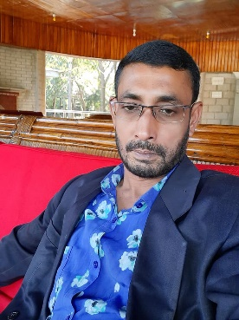
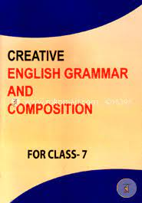
Identification
Lotiful Kabir
Assistant Teacher
SHYAMPUR ALIM MADRASAH
lktonic1978@gmail.com
Sadar,Sirajgonj.
Class: Seven
Subject: English Grammar and composition
Topic: Kinds Of Tense

Slide 3
Learning Outcomes:
After completing the topic students wiil be able to:
# Definition Of Tense.
# Kinds Of Tense
# know about different kinds of Tense

Slide 4
Tense:
The time of accomplishing any action of a verb is called Tense

Slide 5
Kinds Of Tense
3 types Of Tense
Present Tense
Past Tense
Future Tense

Slide 6
Let’s go discuss about Tense
Present Tense
Present Continuous tense
Present perfect tense
Present Perfect continuous Tense

Slide 7
Past Tense
Indefinite tense
Perfect Continuous tense
Continuous tense
Perfect Tense

Slide 8
Future Tense
Indefinite Tense
Continuous Tense
Perfect Tense
Perfect continuous

