Slide 1
My dear students
Welcome to my class

Slide 2
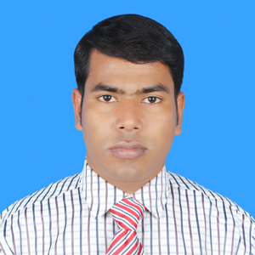
Teacher’s Identity
Abdul Awyal
BA Honours in English and MA in English
Assistant Teacher
Poyratila Govt. Primary School
Bahubal, Habiganj
E-mail: abdulawyal2012@gmail.com

Slide 3
Lesson Introduction
Class : One Subject : English
Unit : 1 Lesson : 1-3
Lesson title : Greetings
Activity : C

Slide 4
Learning Outcomes
Students will be able to
Listening :
1.1.1 become familiar with English sounds by listening to common English words.
3.1.1 understand simple question about students.
3.2.1 understand simple statements.
Speaking:
2.1.1 greet each other.
3.1.1 answer question asked by the teacher about students.

Slide 5
Let’s listen and sing a song

Slide 6
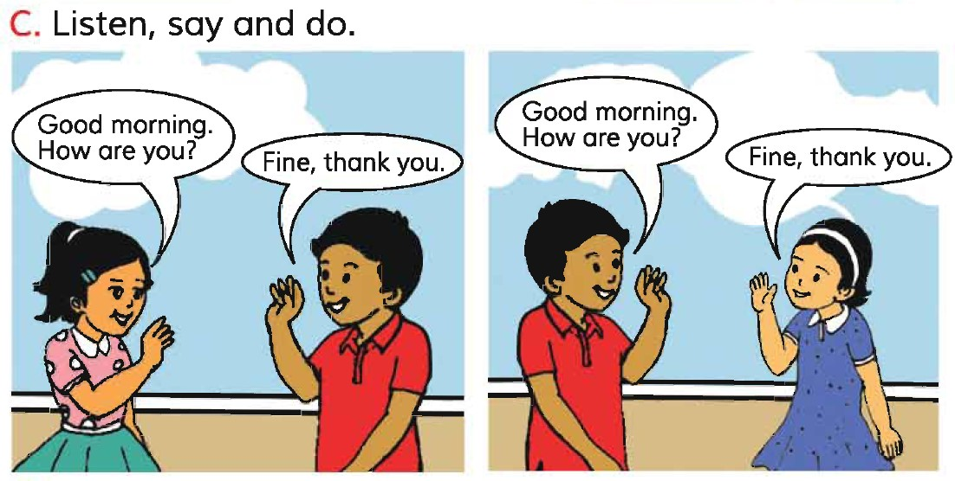
PAIRWORK

Slide 7
Open your English book

Slide 8
Open at page 2

Slide 10
GROUP WORK
Play a game with the ball
One will throw the ball and another one will catch.
The student who catch the ball will say ‘How are you?’
In reply ‘Fine, thank you.’

Slide 11
Thank you

