Slide 1
WELCOME

Slide 2
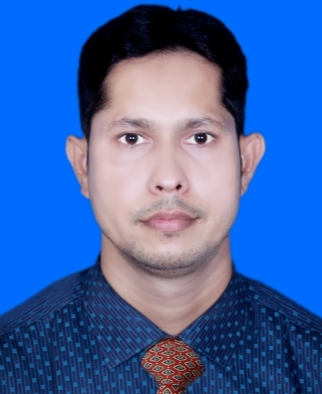
Md. Inam Ulla Khan
Assistant Teacher
Sharergoj Govt. Primary School
Sreemangal, Moulvibazar.

Slide 3
Lesson introduce
Class: Five
Subject: English
Part of lesson : Tania is from …….in summer.

Slide 4
Learning Outcome
Students will be able to
(1) take part in conversations
on appropriate topics (sports).
(2) ask and answer with Wh questions.

Slide 5
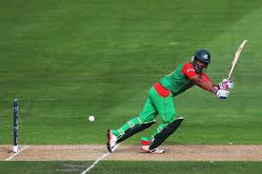
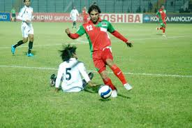
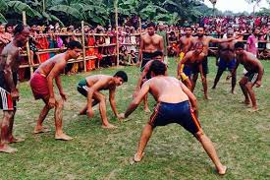
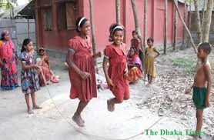

Slide 6
Cricet
Rope
jump
Football
Hadudu
Like
Dislike
Rubel
Football
Hadudu
Cricket
Rope jump
Dislike
Like
Ruman

Slide 7
Today’s Lesson
What sports do you like ?

Slide 8
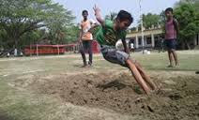
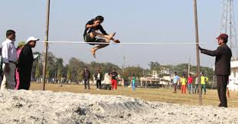
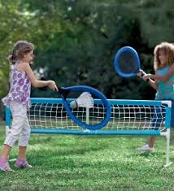
Long jump
High jump
Foot ball
Batminton

Slide 9
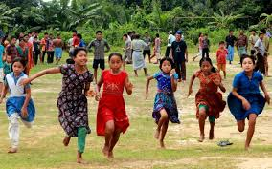
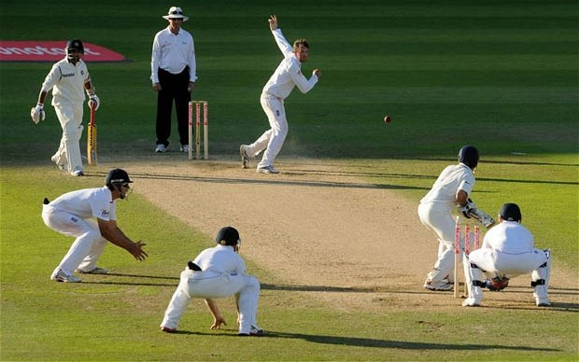
Walking
Cricket

Slide 10
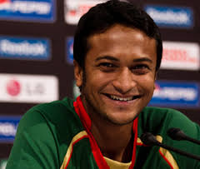
Sakib Al Hasan
A famous cricketer of the world.
He is proud of Bangladesh.

Slide 11
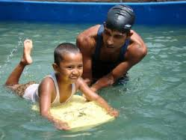
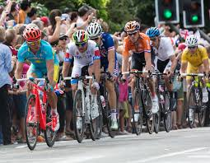
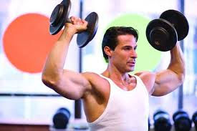
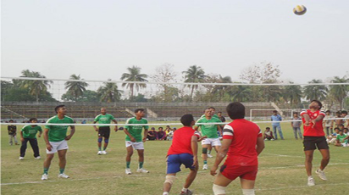
Swimming
Bicycling
Weight lifting
Volleyball

Slide 12
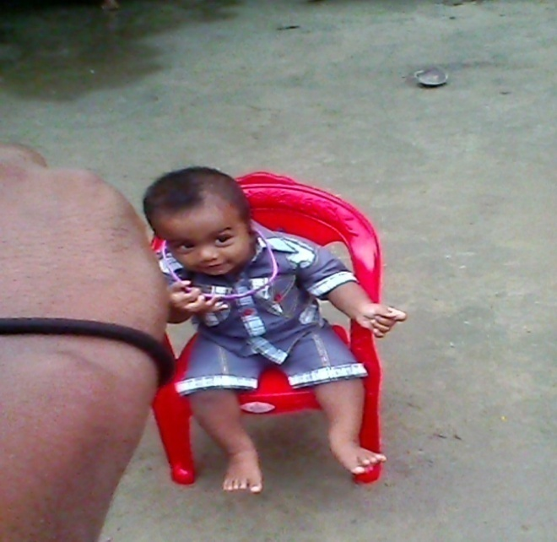
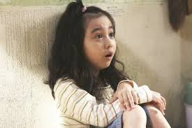
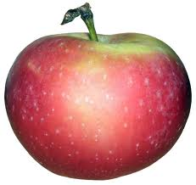
New words
Don’t choice
Dislike
Like
Dislike

Slide 13
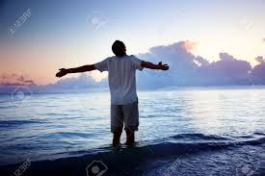
Wonderful!
Fantastic
Attractive

Slide 14
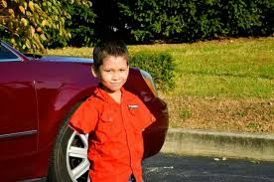
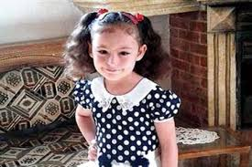
Baichong
Tania
Two or three times a week. Going cycling with friend’s is very fantastik!
Yes, I love swimming! I go swimming regulerly in summer.
I’m a football player. I like to cycling, too.
Well, I do both.I also play batminton.What about you?
How often do you go cycling?
Tania, do you like any game’s and sports ?
Do you play or simply watch ?
Oh , yes. I like football.

Slide 15
Open your text book at page no. 77 and match the information.

Slide 16
Evaluation
1.Answer the short Question’s.
What sport’s do you like?
when do you do it ?
Who do you play with you?

Slide 17
Task
Write five sentences about your favorite game’s.

Slide 18
Thank You

